Slide 1
Imagine that you won $1,000 playing a scratch-off lottery ticket. Congratulations!
And now you want to invest this $1,000 to work towards achieving your personal goals.
Which of the following are you going to invest in?
Please select up to 3 of these options and discuss your selection with a neighbor.
Stock of Amazon.
Stock of Tesla.
Stock of Bank of America.
Stock of Bed, Bath & Beyond
Bitcoin.
2 pairs of vintage Air Jordan shoes.
U.S. Treasury bills.
Stock of Gazprom, Russia’s largest energy company.
A fractional share of a time-share condo in Barbados.
A fractional share of your cousin’s friend’s new technology start-up venture.
Oil. Several barrels of crude oil.
Cash. Just put it in an envelope under your mattress.

Slide 2
Opening Quiz – Question #1
The U.S. stock markets had a terrible 2022. But that was just 1 year.
If you had invested $1,000 in the S&P 500 at the beginning of 2021
(2 years years ago), how much would that $1,000 be worth today?
A. $557
B. $755
C. $1,058
D. $3,149

Slide 3
Opening Quiz – Question #1
The U.S. stock markets had a terrible 2022. But that was just 1 year.
If you had invested $1,000 in the S&P 500 at the beginning of 2021
(2 years years ago), how much would that $1,000 be worth today?
A. $557
B. $755
C. $1,058
D. $3,149

Slide 4
Opening Quiz – Question #2
The U.S. stock markets had a terrible 2022. But that was just 1 year.
If you had invested $1,000 in the S&P 500 at the beginning of 2013
(10 years ago), how much would that $1,000 be worth today?
A. $557
B. $755
C. $1,058
D. $3,149

Slide 5
Opening Quiz – Question #2
The U.S. stock markets had a terrible 2022. But that was just 1 year.
If you had invested $1,000 in the S&P 500 at the beginning of 2013
(10 years ago), how much would that $1,000 be worth today?
A. $557
B. $755
C. $1,058
D. $3,149
That’s an average annual return of 12% of over 10 years.

Slide 6
Opening Quiz – Question #3
Which of these 4 countries currently
has the highest inflation rate?
United States
England
Germany
Mexico

Slide 7
Opening Quiz – Question #3
Which of these 4 countries currently
has the highest inflation rate?
United States
England
Germany
Mexico

Slide 8
Opening Quiz – Question #4
Which of these 4 countries
currently has the LOWEST inflation rate?
United States
England
Germany
Mexico

Slide 9
Opening Quiz – Question #4
Which of these 4 countries
currently has the LOWEST inflation rate?
United States (6.5%)
England (10.2%)
Germany (8.6%)
Mexico (7.8%)

Slide 10
Opening Quiz – Question #5
Which of these 4 stocks had
the HIGHEST RETURN during 2022?
Amazon
Tesla
Bank of America
Bed, Bath & Beyond

Slide 11
Opening Quiz – Question #5
Which of these 4 stocks had
the HIGHEST RETURN during 2022?
Amazon
Tesla
Bank of America
Bed, Bath & Beyond

Slide 12
Opening Quiz – Question #6
Which of these 4 stocks had
the LOWEST RETURN during 2022?
Amazon
Tesla
Bank of America
Bed, Bath & Beyond

Slide 13
Opening Quiz – Question #6
Which of these 4 stocks had
the LOWEST RETURN during 2022?
Amazon -50%
Tesla -65%
Bank of America
-24%
Bed, Bath & Beyond
-86%

Slide 14
Opening Quiz – Question #7
Which of these 4 securities has high had
the highest return over the past 5 years?
Amazon
Tesla
Bank of America
Bitcoin

Slide 15
Opening Quiz – Question #7
Which of these 4 securities has high had
the highest return over the past 5 years?
Amazon +22%
Tesla +433%
Bank of America
+22%
Bitcoin
+152%

Slide 16
Opening Quiz – Question #8 – Last One
If I had invested $1,000 into the S&P 500, the overall U.S. stock market, on the day that I was born, how much would that be worth today?
A. $1,000
B. $12,257
C. $43,656
C. $85,035

Slide 17
Opening Quiz – Question #8 – Last One
If I had invested $1,000 into the S&P 500, the overall U.S. stock market, on the day that I was born, how much would that be worth today?
A. $1,000
B. $12,257
$43,656
That’s an annual return of just over 10% per year.
C. $85,035

Slide 18

STUDENT SUPPORT SERVICES
FINANCIAL WELLNESS SERIES 2023
Session #3
Creating and Investment Strategy
March 15, 2023

Slide 19
Brian Bolton
Professor of Finance brian.bolton@louisiana.edu http://business.louisiana.edu/financeispersonal

Slide 20
Owning Your Financial Future
INVESTING GOALS, HABITS & STRATEGIES
Today, January 23
CREDIT SCORES & DEBT MANAGEMENT
Wednesday, March 8
CREATING AN INVESTMENT STRATEGY
Wednesday, March 15

Slide 21
Owning Your Financial Future
OPENING AN INDIVIDUAL RETIREMENT ACCOUNT
Wednesday, March 22
TAX STRATEGIES
Wednesday, April 5
CAREER PLANNING: YOUR MONEY & YOUR FUTURE
Wednesday, April 26

Slide 22
Owning Your Financial Future
Structure of each session:
  Open question & answer session
  Brian presents general update on investing and any relevant current events
  Brian presents specific guidance and ideas for the session’s topic
  Open question & answer session…about any topics you wish to discuss

Slide 23
Happiness
Long-Term Goals
Short-Term Goals
Financial Needs
Family Needs

Slide 24
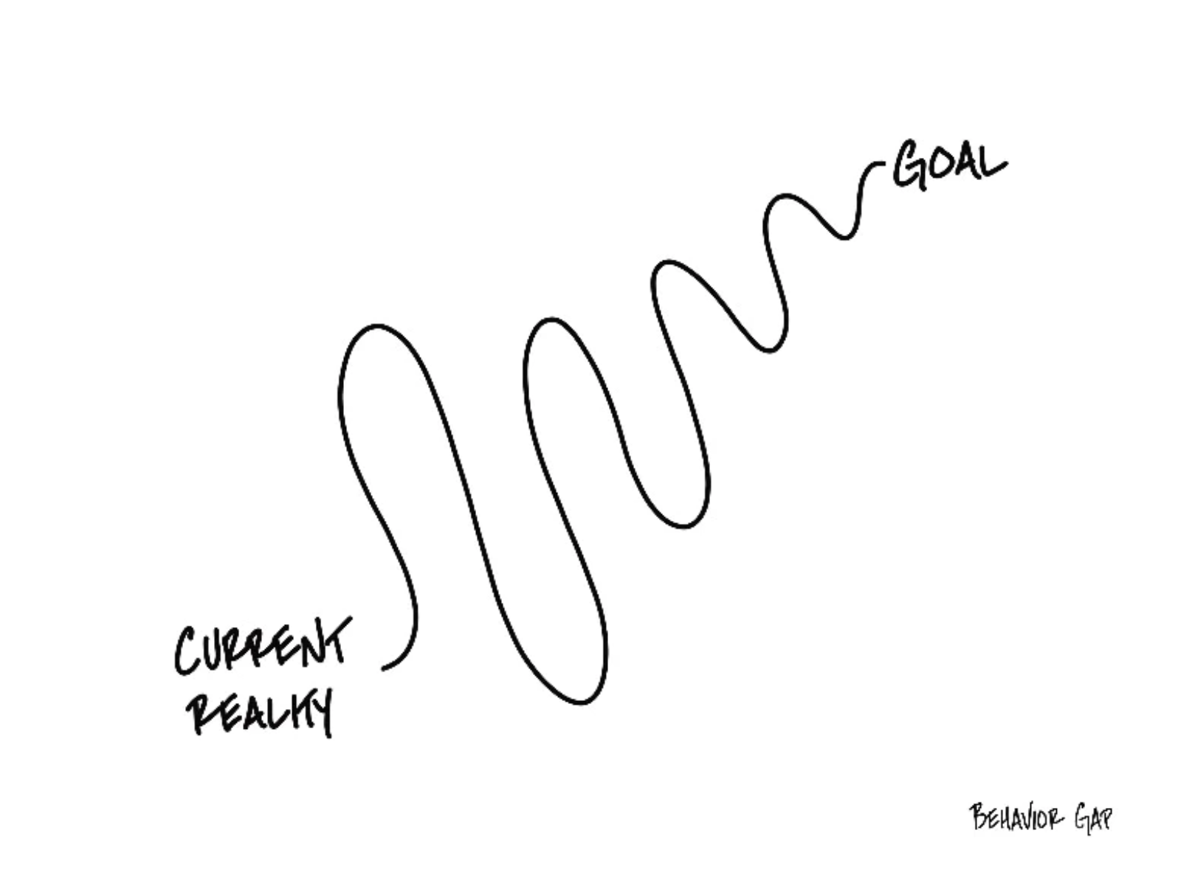

Slide 25
Financial Wellness
A goal without a plan is just a dream.
Wealth is largely the result of habit.
The most difficult thing is the decision to act; the rest is mere tenacity.
It takes as much energy to plan as it does to wish.
You cannot escape the responsibility of tomorrow by avoiding it today.

Slide 26
This is exactly how most of us think about other priorities in our lives: family, career, education.
Let’s try to have the same thinking for our financial lives.
A goal without a plan is just a dream.
Wealth is largely the result of habit.
The most difficult thing is the decision to act; the rest is mere tenacity.
It takes as much energy to plan as it does to wish.
You cannot escape the responsibility of tomorrow by avoiding it today.

Slide 27
Owning Your Financial Future
What Are Your Values, Dreams & Goals?
Education
Career
Family
What Is Your Current Situation?
Education
Career
Family
Financial
Create a Personal Financial Plan for You:
Investing
Budgeting
Debt Management
Taxes
Insurance
Retirement
Education
Family
Business Planning
Estate Planning
Philanthropy

Slide 28

Isn’t this a lot like what you do with your education planning?

Slide 29
Financial Wellness
If you don’t know where you’ve come from, you can’t know where you’re going.
- Maya Angelou

Slide 30
TODAY THE NEXT 6 MONTHS THE NEXT 12 MONTHS 2 YEARS AFTER GRADUATION 3 YEARS AFTER GRADUATION
ONCE EVERY SEMESTER:
TRACK EVERY PENNY THAT YOU SPEND & TRACK EVERY PENNY THAT YOU EARN
IN THE NEXT 3 MONTHS:
IDENTIFY WAYS TO DECREASE YOUR DISCRETIONARY SPENDING BY 25%
IN THE NEXT 6 MONTHS:
MAKE A PLAN TO MANAGE – AND PAY OFF – YOUR DEBT
IN THE NEXT 6-12 MONTHS:
OPEN MULTIPLE SAVINGS ACCOUNTS, 1 FOR EACH GOAL
IN THE NEXT 12 MONTHS, OPEN AN IRA OR ROTH IRA
WITHIN 2 YEARS OF GRADUATION:
HAVE AN “EMERGENCY FUND” ACCOUNT, WITH 3-6 MONTHS OF NON-DISCRETIONARY EXPENSES
WITHIN 3 YEARS OF GRADUATION:
ELIMINATE ALL OF YOUR BAD DEBT.

Slide 31
TODAY THE NEXT 6 MONTHS THE NEXT 12 MONTHS 2 YEARS AFTER GRADUATION 3 YEARS AFTER GRADUATION
ONCE EVERY SEMESTER:
TRACK EVERY PENNY THAT YOU SPEND & TRACK EVERY PENNY THAT YOU EARN
IN THE NEXT 3 MONTHS:
IDENTIFY WAYS TO DECREASE YOUR DISCRETIONARY SPENDING BY 25%
IN THE NEXT 6 MONTHS:
MAKE A PLAN TO MANAGE – AND PAY OFF – YOUR DEBT
IN THE NEXT 6-12 MONTHS:
OPEN MULTIPLE SAVINGS ACCOUNTS, 1 FOR EACH GOAL
IN THE NEXT 12 MONTHS, OPEN AN IRA OR ROTH IRA
WITHIN 2 YEARS OF GRADUATION:
HAVE AN “EMERGENCY FUND” ACCOUNT, WITH 3-6 MONTHS OF NON-DISCRETIONARY EXPENSES
WITHIN 3 YEARS OF GRADUATION:
ELIMINATE ALL OF YOUR BAD DEBT.

Slide 32
I DO NOT GIVE INVESTMENT ADVICE
But here are some investment issues to think about:
Do you want to pick individual stocks (or other securities) and monitor them regularly?
  This can help you feel more control, more connection and more personal interest in your investments.
  Advantages: Potential for big gains, maybe a personal connection to the companies, you feel more engaged with the process.
  Disadvantages: Potential for big losses, requires more time and energy, transaction costs (trading, taxes) can add up, there are 1000s to choose from, potential loss of sleep and hair.

Slide 33
I DO NOT GIVE INVESTMENT ADVICE
But here are some investment issues to think about:
Or, would you be content investing in mutual funds and/or market indexes that pool dozens or hundreds of stocks?
  Advantages: Potential for moderate gains, lower risk (through diversification), lower trading and tax costs, you can narrow down the selection pretty quickly, less loss of sleep and hair
  Disadvantages: Lots of singles and doubles but no home runs, no emotional connection to your investments, susceptible to big market downturns (but not necessarily more than individual stocks)

Slide 34
I DO NOT GIVE INVESTMENT ADVICE
If you want to invest in individual stocks, I cannot help you.
But if you are interested in market indexes, here are some ideas:
  SPY – The S&P 500 index. 500 of the largest U.S. firms, from all industries.
  SPYD – The same as above, with a focus on those companies that pay regular dividends out to investors from their earnings. You will get more income, but possibly lower long-term capital gains.
  IWM – The Russell 2000. 2000 smaller U.S. firms (the 2000 firms after the 1000 largest firms). More volatility, possibly higher returns.
  EFA – Index of non-US firms (Europe, Far East, Australasia). Big firms.
  EEM – Index of non-US, emerging market stocks. Bigger firms in developing countries. More risk than any of the above.
  GBTC – A Bitcoin index. Invest in Bitcoin without mining or owning. Big Risk.

Slide 35
Investing – How Do You Do It?
When you’re just getting started with investing, there are a few approaches you can take:
  Start with a small amount of money – whether that’s $20 or $2,000 – and just go for it. Pick a few investments, track them regularly and be prepared to buy more or sell more should you feel comfortable doing either.

Slide 36
Investing – How Do You Do It?
When you’re just getting started with investing, there are a few approaches you can take:
  Start with a small amount of money – whether that’s $20 or $2,000 – and just go for it. Pick a few investments, track them regularly and be prepared to buy more or sell more should you feel comfortable doing either.
  Determine how much you have to invest.
    Put ½ of that into an index fund or a specific mutual fund. This will provide some security, generally with less or moderate risk.
    Put the other ½ into individual stocks or securities that intrigue you. If you’re interested in the companies, you might be more likely to follow them as investments.
    This half-half approach will help you figure out what kind of investor you are. In 1-2 years, you might gravitate more to either of the approaches that interest you more.

Slide 37
Investing – How Do You Do It?
When you’re just getting started with investing, there are a few approaches you can take:
  Start with a small amount of money – whether that’s $20 or $2,000 – and just go for it. Pick a few investments, track them regularly and be prepared to buy more or sell more should you feel comfortable doing either.
  Determine how much you have to invest.
    Put ½ of that into an index fund or a specific mutual fund. This will provide some security, generally with less or moderate risk.
    Put the other ½ into individual stocks or securities that intrigue you. If you’re interested in the companies, you might be more likely to follow them as investments.
    This half-half approach will help you figure out what kind of investor you are. In 1-2 years, you might gravitate more to either of the approaches that interest you more.
  Talk to a financial advisor. Note that they generally do not (initially) tell you which specific investments to make, but they will work talk through your options with you and help you better understand what you’re getting into.
    They will ask you 2 questions – what are your goals and what is your risk tolerance – and then work with you to find the investments that best align with your answers to these questions.

Slide 38
Long-Term Investment Planning
YOUR VALUES
YOUR GOALS
FINANCIAL STRATEGIES
INVESTMENT STRATEGIES
Identify Your Risk Tolerance
Identify Your Time Horizons
Select Investments
Monitor & Modify Investments

Slide 39
Long-Term Investment Planning
FINANCIAL STRATEGIES
EDUCATION STRATEGIES
INVESTMENT STRATEGIES
GRAD SCHOOL STRATEGIES
Identify Your Risk Tolerance
Identify Your Risk Tolerance
Identify Your Time Horizons
Identify Your Time Horizons
Select Investments
Select Your Field, Program, Specialization, Thesis
Monitor & Modify Investments
Monitor & Modify Your Progress & Plan

Slide 40
Your INVESTMENT POLICY STATEMENT
An Investment Policy Statement is your personal investing roadmap and strategy.
It includes a holistic perspective on what your investing goals are and what your investing preferences are.
  It does not include specific details, like your income or stocks you own or want to buy. It’s focused on big-picture strategy, not on execution.
It is about you, your family and your preferences.
We want you to be able to use this today and after you graduate and your income (hopefully) increases.
We want you to be able to share this with your family or with a financial advisor who might be able to help you execute your strategy.
Even if you do not have the excess money to invest today, thinking about these issues today can help you be prepared for making such decisions when you are capable.

Slide 41
Your INVESTMENT POLICY STATEMENT
An Investment Policy Statement is your personal investing roadmap and strategy.
It includes the following information:
  Some brief personal information, about you and your situation
  Your risk tolerance
  Your investing goals
  Your tax, liquidity and income preferences
  How you want to handle your investments
  How you want to allocate your investments across different asset classes (stocks vs. bonds)
  Any other personal or situational issues that may impact your ability to invest or your investment strategy

Slide 42
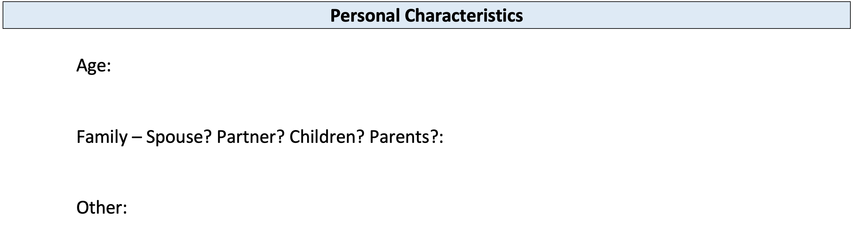
Your INVESTMENT POLICY STATEMENT

Slide 43
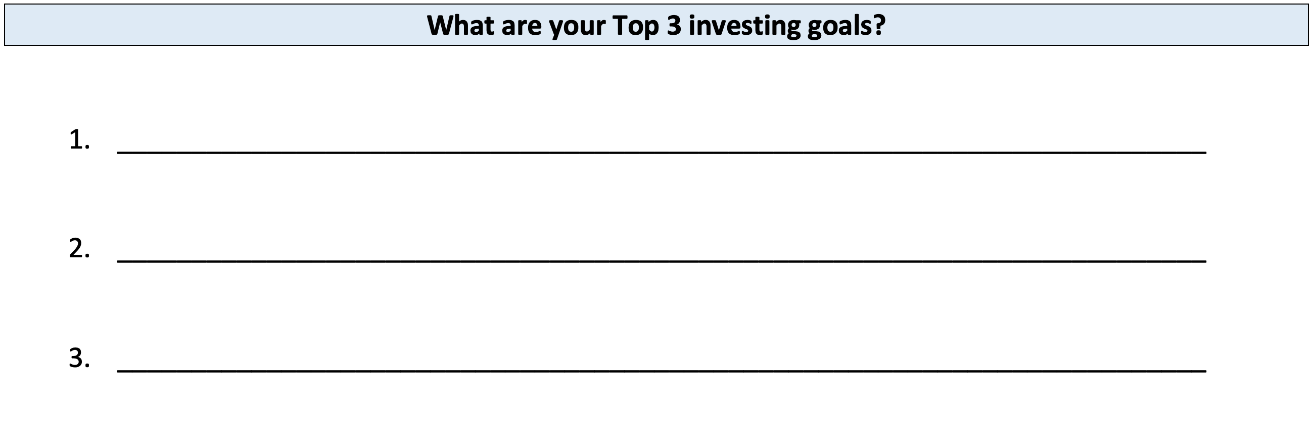
Your INVESTMENT POLICY STATEMENT

Slide 44
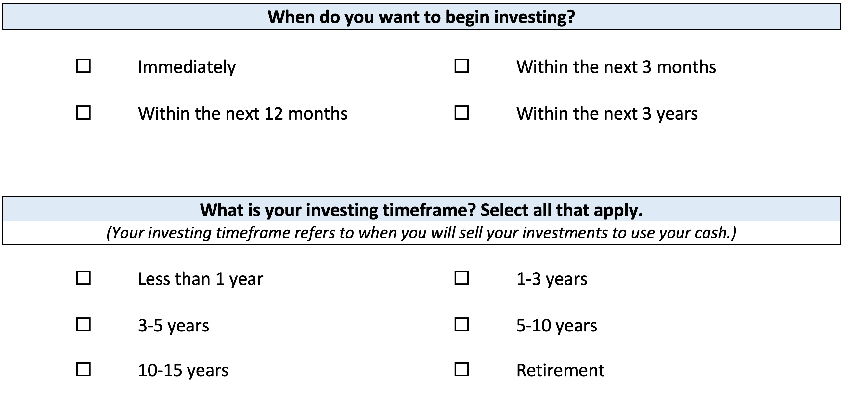
Your INVESTMENT POLICY STATEMENT

Slide 45
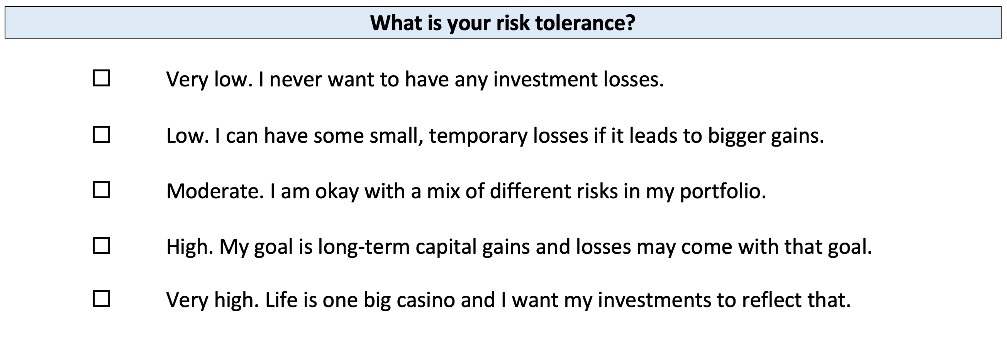
Your INVESTMENT POLICY STATEMENT

Slide 46
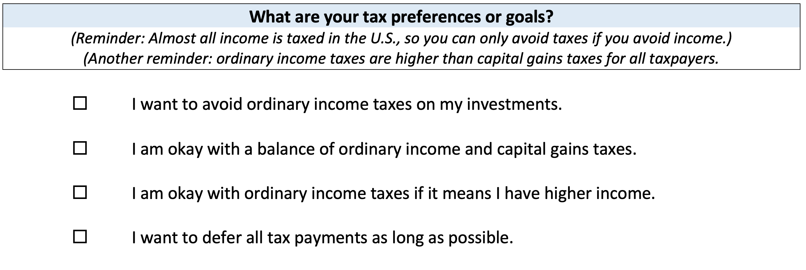
Your INVESTMENT POLICY STATEMENT

Slide 47
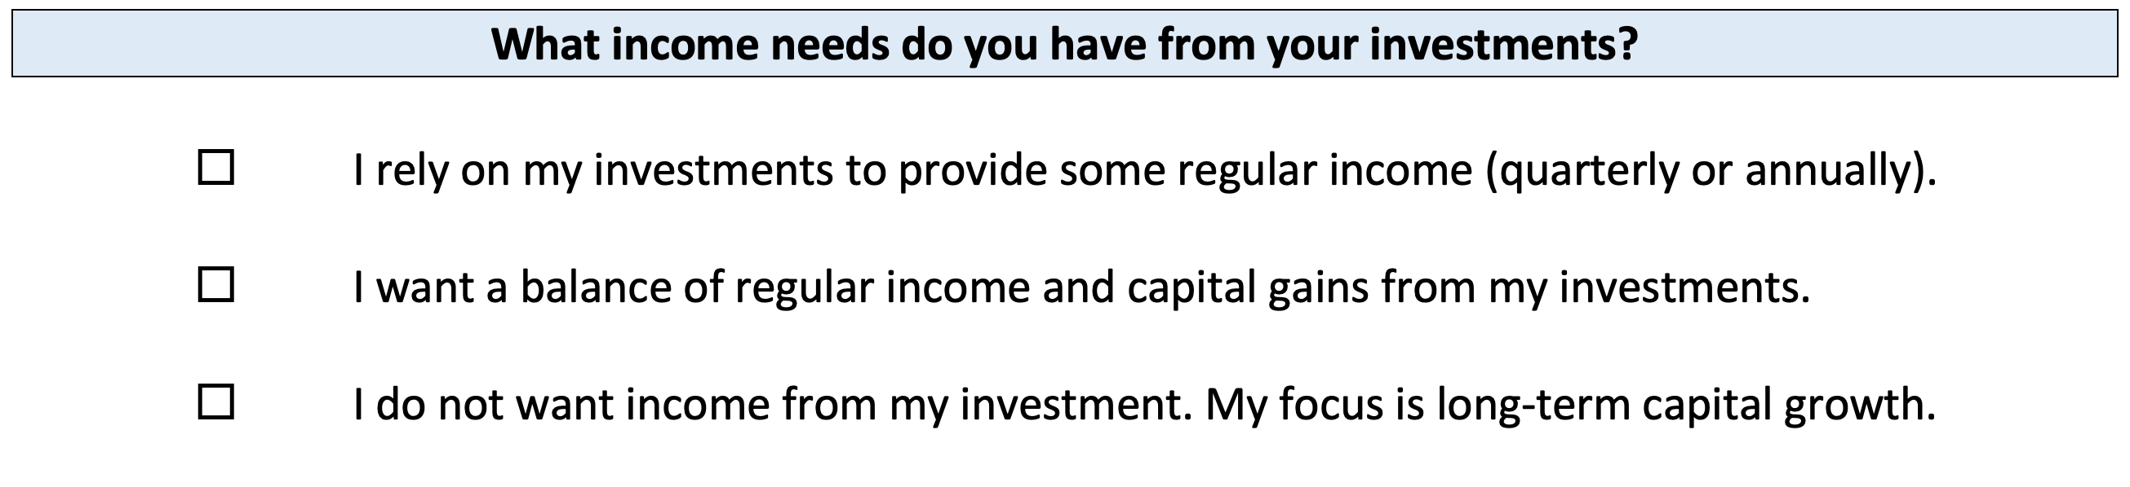
Your INVESTMENT POLICY STATEMENT

Slide 48
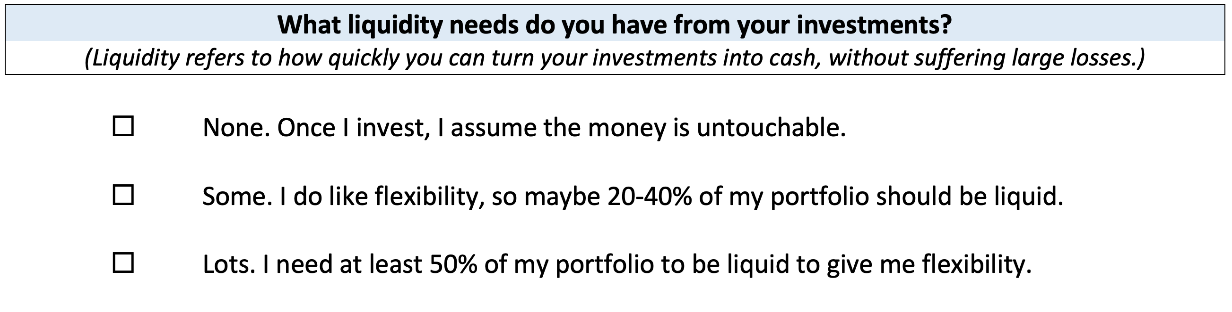
Your INVESTMENT POLICY STATEMENT

Slide 49
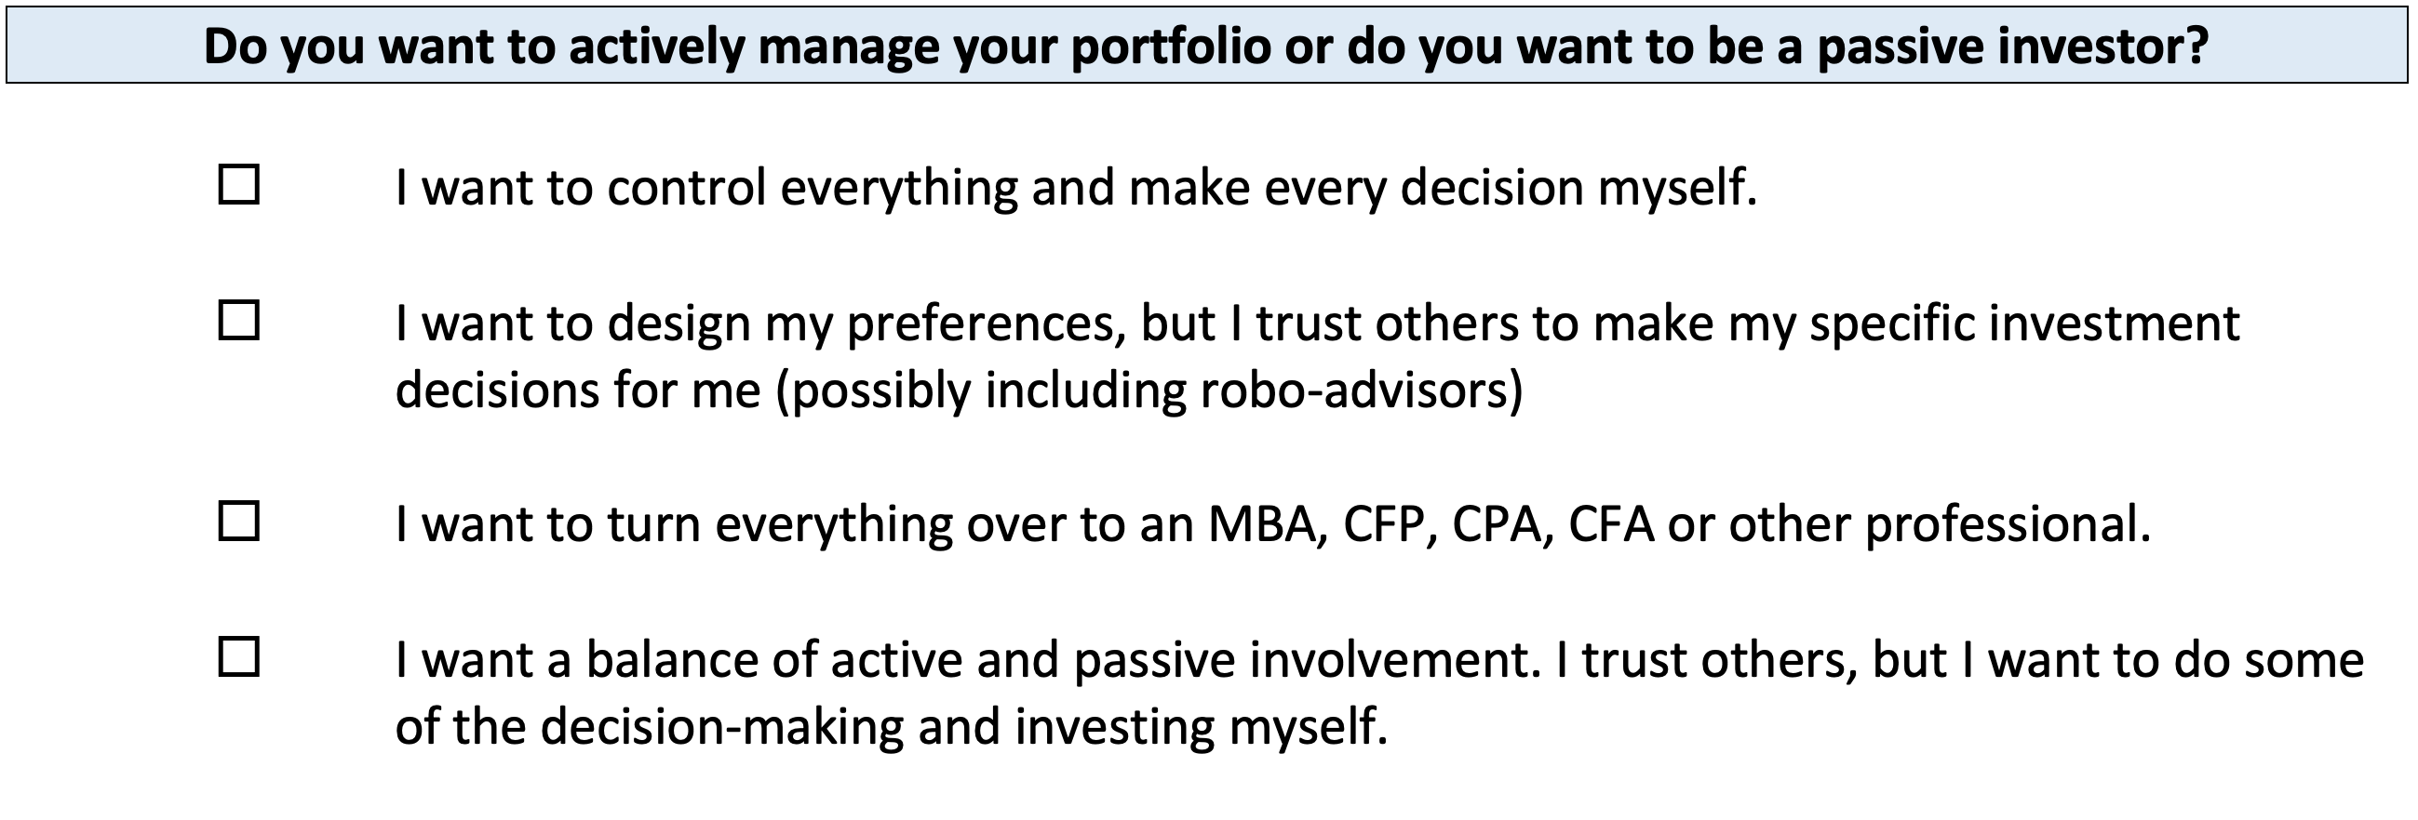
Your INVESTMENT POLICY STATEMENT

Slide 50
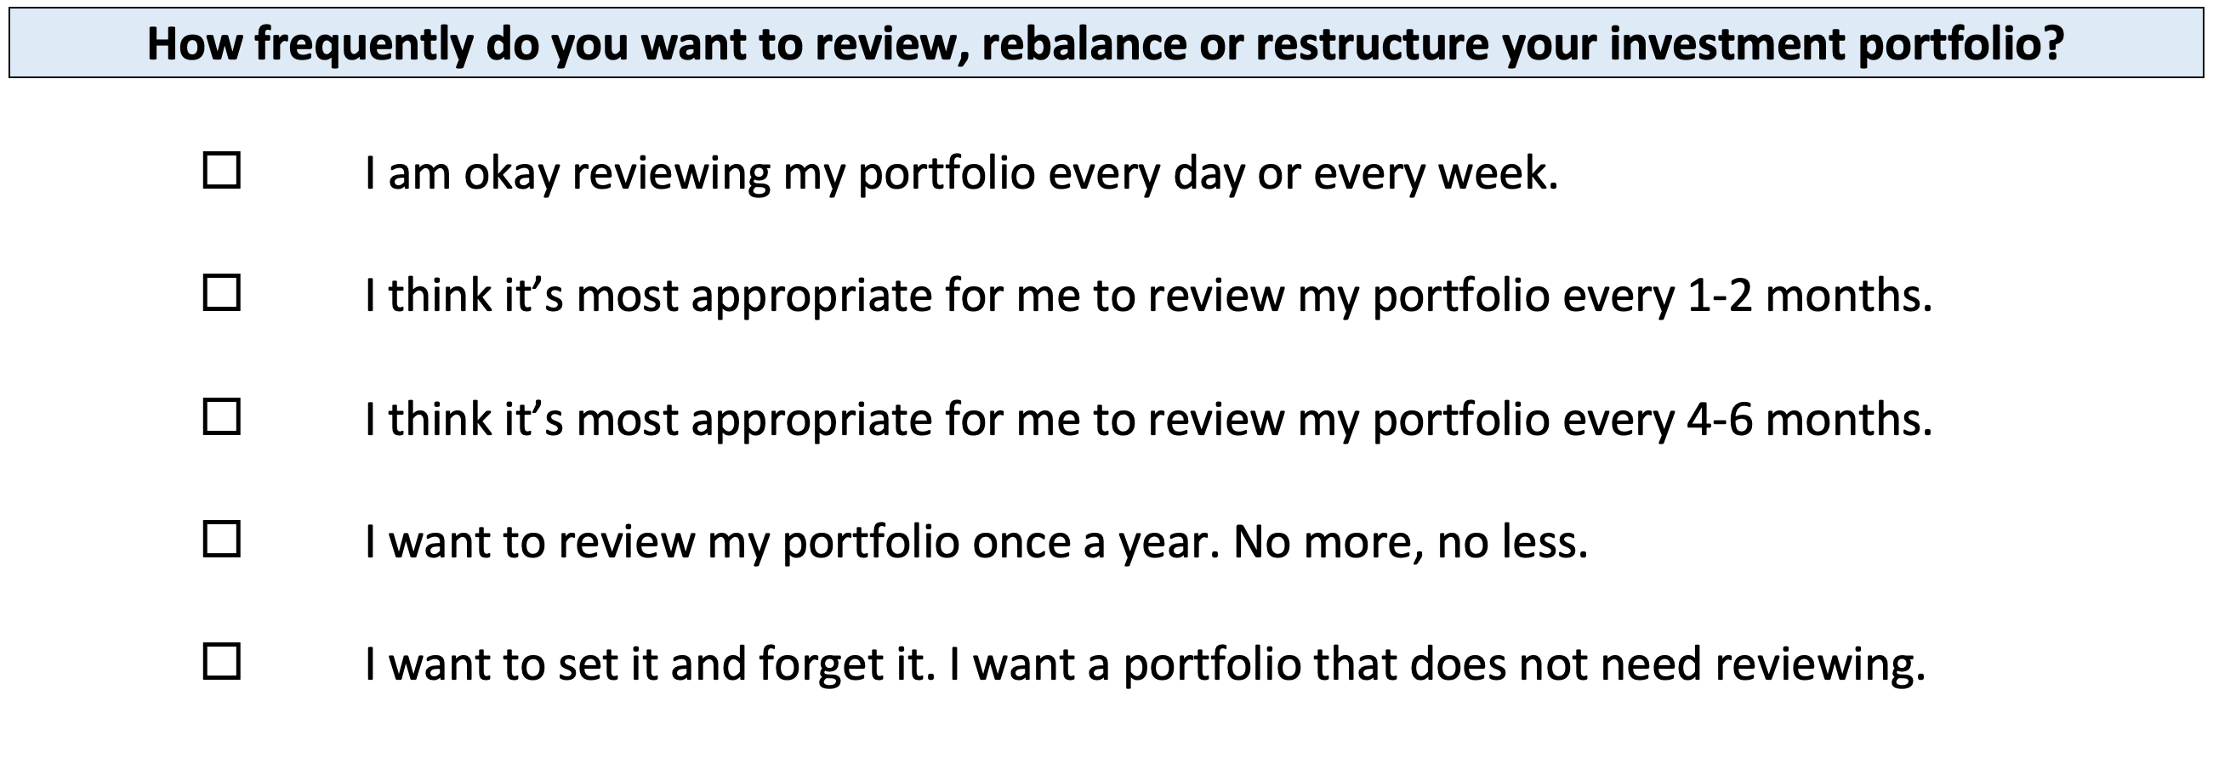
Your INVESTMENT POLICY STATEMENT

Slide 51
Your INVESTMENT POLICY STATEMENT
ASSET ALLOCATION
We know that the asset classes or categories you choose are responsible for 90% of portfolio returns, while specific security selection within classes is responsible for 10% of returns.
This means that how you decide to allocate your investments is the primary driver of your investment returns.
  Think about which geographic regions you want to invest in.
  Think about how to distribute your investment across asset categories.
    Stocks, bonds, currency, real estate, crypto, value stocks, growth stocks,
    large companies, small companies, oil, gold…

Slide 52
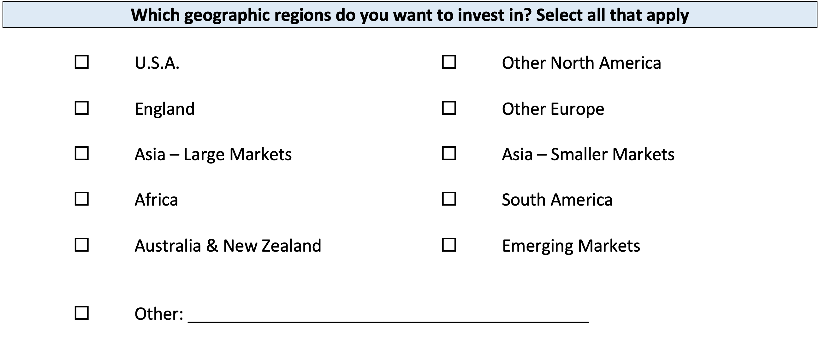
Your INVESTMENT POLICY STATEMENT

Slide 53
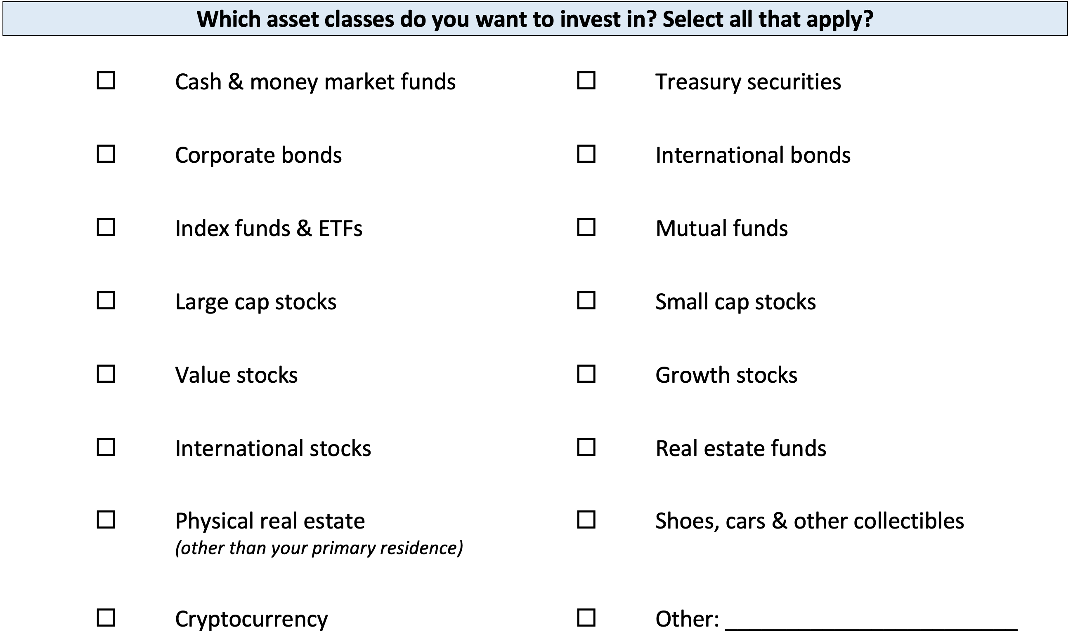
Your INVESTMENT POLICY STATEMENT

Slide 54
Your INVESTMENT POLICY STATEMENT

Slide 55
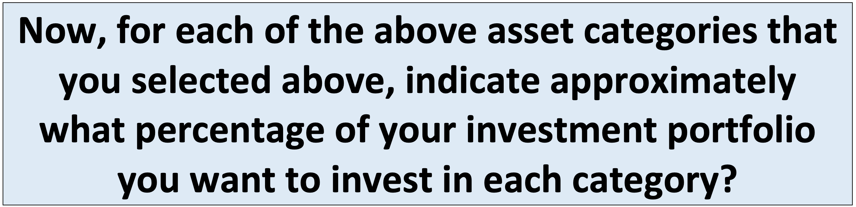
Your INVESTMENT POLICY STATEMENT

Slide 56
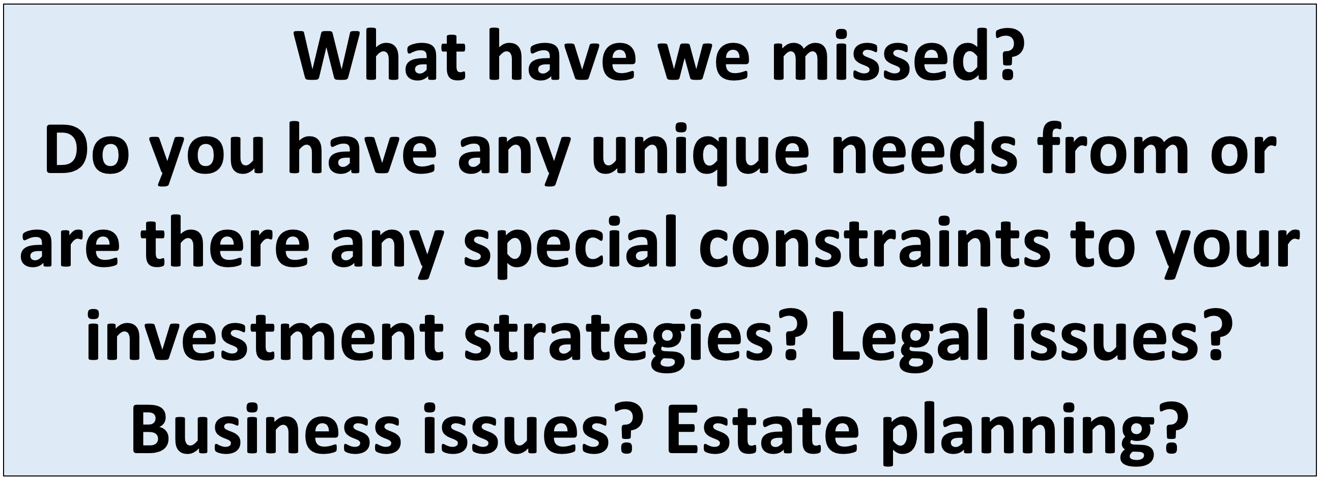
Your INVESTMENT POLICY STATEMENT

Slide 57
Your INVESTMENT POLICY STATEMENT
Complete this worksheet today.
Work on this with your friends or family.
Revise and update it after you graduate.
Continue refining it throughout your investing life…make it about you and your goals.

Slide 58
Isn’t this a lot like what you do with your education planning?

Slide 59
Owning Your Financial Future
INVESTING GOALS, HABITS & STRATEGIES
Today, January 23
CREDIT SCORES & DEBT MANAGEMENT
Wednesday, March 8
CREATING AN INVESTMENT STRATEGY
Wednesday, March 15

Slide 60
Owning Your Financial Future
OPENING AN INDIVIDUAL RETIREMENT ACCOUNT
Wednesday, March 22
TAX STRATEGIES
Wednesday, April 5
CAREER PLANNING: YOUR MONEY & YOUR FUTURE
Wednesday, April 26

Slide 61
Don’t wait around for other people to be happy for you.
Any happiness you get,
You’ve got to make yourself.
~ Alice Walker, poet & novelist
A goal without a plan is just a dream.
Wealth is largely the result of habit.
The most difficult thing is the decision to act; the rest is mere tenacity.
It takes as much energy to plan as it does to wish.
You cannot escape the responsibility of tomorrow by avoiding it today.

Slide 62
Brian Bolton
Professor of Finance brian.bolton@louisiana.edu http://business.louisiana.edu/financeispersonal

