Slide 1
Opening Quiz – Question #1
If you borrow $10,000 for a student loan, at an interest rate of 5%, and you repay the loan with monthly payments over 10 years, how much total interest will you pay over the life of the loan?
A. $500
B. $1,723
C. $2,723
D. $12,393

Slide 2
Opening Quiz – Question #1
If you borrow $10,000 for a student loan, at an interest rate of 5%, and you repay the loan with monthly payments over 10 years, how much total interest will you pay over the life of the loan?
A. $500
B. $1,723
C. $2,723
D. $12,393

Slide 3
Opening Quiz – Question #2
If you borrow $10,000 for a fun vacation using your credit card, at an interest rate of 18.99%, and you repay the loan with monthly payments over 10 years, how much total interest will you pay over the life of the loan?
A. $500
B. $1,723
C. $2,723
D. $12,393

Slide 4
Opening Quiz – Question #2
If you borrow $10,000 for a fun vacation using your credit card, at an interest rate of 18.99%, and you repay the loan with monthly payments over 10 years, how much total interest will you pay over the life of the loan?
A. $500
B. $1,723
C. $2,723
D. $12,393

Slide 5
Opening Quiz – Question #3
Which of the following is the best kind of debt…the kind of debt that usually gives you the most benefits and has the least costs.
A. Car Loans
B. Credit Cards
C. Student Loans
D. Home Loans

Slide 6
Opening Quiz – Question #3
Which of the following is the best kind of debt…the kind of debt that usually gives you the most benefits and has the least costs.
A. Car Loans
B. Credit Cards
C. Student Loans
D. Home Loans

Slide 7
Opening Quiz – Question #4
Which of the following is the WORST kind of debt…the kind of debt that usually gives you the FEWEST benefits and has the MOST costs.
A. Car Loans
B. Credit Cards
C. Student Loans
D. Home Loans

Slide 8
Opening Quiz – Question #4
Which of the following is the WORST kind of debt…the kind of debt that usually gives you the FEWEST benefits and has the MOST costs.
A. Car Loans
B. Credit Cards
C. Student Loans
D. Home Loans

Slide 9
Opening Quiz – Question #5
Your credit score is a number between 300-850. It is composed of 5 categories.
Which of the following is NOT one of these 5 categories?
Payment History
Amounts Owed
Credit Mix
Your Age

Slide 10
Opening Quiz – Question #5
Your credit score is a number between 300-850. It is composed of 5 categories.
Which of the following is NOT one of these 5 categories?
Payment History
Amounts Owed
Credit Mix
Your Age

Slide 11
Opening Quiz – Question #6
Your credit score is a number between 300-850. It is composed of 5 categories. The average score in the USA is around 700.
Which state has the lowest average credit score?
Louisiana
Mississippi
Texas
California

Slide 12
Opening Quiz – Question #6
Your credit score is a number between 300-850. It is composed of 5 categories. The average score in the USA is around 700.
Which state has the lowest average credit score?
Louisiana
Mississippi
Texas
California

Slide 13
Opening Quiz – Question #6
Your credit score is a number between 300-850. It is composed of 5 categories. The average score in the USA is around 700.
Which state has the lowest average credit score?
Louisiana
(We have the 2nd lowest)
Mississippi
Texas
California

Slide 14

STUDENT SUPPORT SERVICES
FINANCIAL WELLNESS SERIES 2023
Session #2
Credit Scores & Debt Management
March 8, 2023

Slide 15
Brian Bolton
Professor of Finance brian.bolton@louisiana.edu http://business.louisiana.edu/financeispersonal

Slide 16
Owning Your Financial Future
INVESTING GOALS, HABITS & STRATEGIES
Today, January 23
CREDIT SCORES & DEBT MANAGEMENT
Wednesday, March 8
CREATING AN INVESTMENT STRATEGY
Wednesday, March 15

Slide 17
Owning Your Financial Future
OPENING AN INDIVIDUAL RETIREMENT ACCOUNT
Wednesday, March 22
TAX STRATEGIES
Wednesday, April 5
CAREER PLANNING: YOUR MONEY & YOUR FUTURE
Wednesday, April 26

Slide 18
Owning Your Financial Future
Structure of each session:
  Open question & answer session
  Brian presents general update on investing and any relevant current events
  Brian presents specific guidance and ideas for the session’s topic
  Open question & answer session…about any topics you wish to discuss

Slide 19
Happiness
Long-Term Goals
Short-Term Goals
Financial Needs
Family Needs

Slide 20
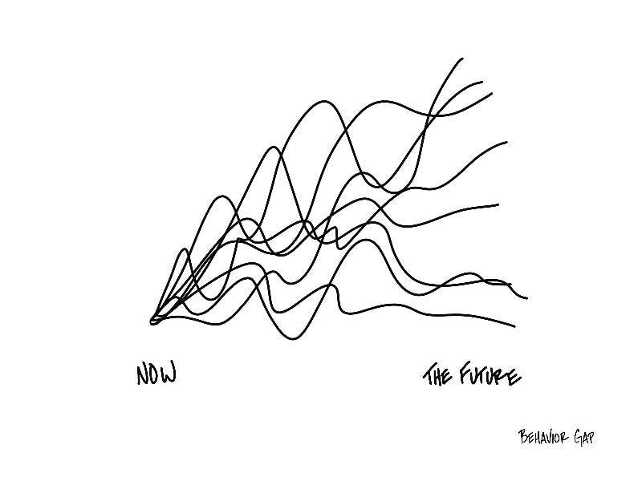

Slide 21
Financial Wellness
A goal without a plan is just a dream.
Wealth is largely the result of habit.
The most difficult thing is the decision to act; the rest is mere tenacity.
It takes as much energy to plan as it does to wish.
You cannot escape the responsibility of tomorrow by avoiding it today.

Slide 22
This is exactly how most of us think about other priorities in our lives: family, career, education.
Let’s try to have the same thinking for our financial lives.
A goal without a plan is just a dream.
Wealth is largely the result of habit.
The most difficult thing is the decision to act; the rest is mere tenacity.
It takes as much energy to plan as it does to wish.
You cannot escape the responsibility of tomorrow by avoiding it today.

Slide 23
Owning Your Financial Future
What Are Your Values, Dreams & Goals?
Education
Career
Family
What Is Your Current Situation?
Education
Career
Family
Financial
Create a Personal Financial Plan for You:
Investing
Budgeting
Debt Management
Taxes
Insurance
Retirement
Education
Family
Business Planning
Estate Planning
Philanthropy

Slide 24

Isn’t this a lot like what you do with your education planning?

Slide 25
Financial Wellness
If you don’t know where you’ve come from, you can’t know where you’re going.
- Maya Angelou

Slide 26
TODAY THE NEXT 6 MONTHS THE NEXT 12 MONTHS 2 YEARS AFTER GRADUATION 3 YEARS AFTER GRADUATION
ONCE EVERY SEMESTER:
TRACK EVERY PENNY THAT YOU SPEND & TRACK EVERY PENNY THAT YOU EARN
IN THE NEXT 3 MONTHS:
IDENTIFY WAYS TO DECREASE YOUR DISCRETIONARY SPENDING BY 25%
IN THE NEXT 6 MONTHS:
MAKE A PLAN TO MANAGE – AND PAY OFF – YOUR DEBT
IN THE NEXT 6-12 MONTHS:
OPEN MULTIPLE SAVINGS ACCOUNTS, 1 FOR EACH GOAL
IN THE NEXT 12 MONTHS, OPEN AN IRA OR ROTH IRA
WITHIN 2 YEARS OF GRADUATION:
HAVE AN “EMERGENCY FUND” ACCOUNT, WITH 3-6 MONTHS OF NON-DISCRETIONARY EXPENSES
WITHIN 3 YEARS OF GRADUATION:
ELIMINATE ALL OF YOUR BAD DEBT.

Slide 27
TODAY THE NEXT 6 MONTHS THE NEXT 12 MONTHS 2 YEARS AFTER GRADUATION 3 YEARS AFTER GRADUATION
ONCE EVERY SEMESTER:
TRACK EVERY PENNY THAT YOU SPEND & TRACK EVERY PENNY THAT YOU EARN
IN THE NEXT 3 MONTHS:
IDENTIFY WAYS TO DECREASE YOUR DISCRETIONARY SPENDING BY 25%
IN THE NEXT 6 MONTHS:
MAKE A PLAN TO MANAGE – AND PAY OFF – YOUR DEBT
IN THE NEXT 6-12 MONTHS:
OPEN MULTIPLE SAVINGS ACCOUNTS, 1 FOR EACH GOAL
IN THE NEXT 12 MONTHS, OPEN AN IRA OR ROTH IRA
WITHIN 2 YEARS OF GRADUATION:
HAVE AN “EMERGENCY FUND” ACCOUNT, WITH 3-6 MONTHS OF NON-DISCRETIONARY EXPENSES
WITHIN 3 YEARS OF GRADUATION:
ELIMINATE ALL OF YOUR BAD DEBT.

Slide 28
WHAT IS DEBT
Debt is borrowing from YOUR future.
We borrow because we want something today that we cannot afford today.
We make a promise to pay for that something in the future.
The entity we borrow from wants to make money. They are not our friends.
We have to pay them helping us get what we want today.
  At a minimum, we pay them interest on our debt.
  Depending on the type of debt, we may have to pay them much more (fees, collateral, earnings, control, etc.)

Slide 29
WHAT IS DEBT
Debt is borrowing from YOUR future.
If your debt is keeping you up at night…
If your debt is preventing you from achieving your goals…
If your debt is damaging your relationships…
…Then you may have too much debt.
(we will return to this issue later)

Slide 30
One Truism About DEBT
If you borrow $10,000,
You will have to repay $10,000.
Whatever you borrow, you will have to repay – in full, with interest – 99% of the time. Lenders do not exist to give you money.
One good exception: Student loan forgiveness.
Lots of bad exceptions: Default, bankruptcy, short sale…

Slide 31
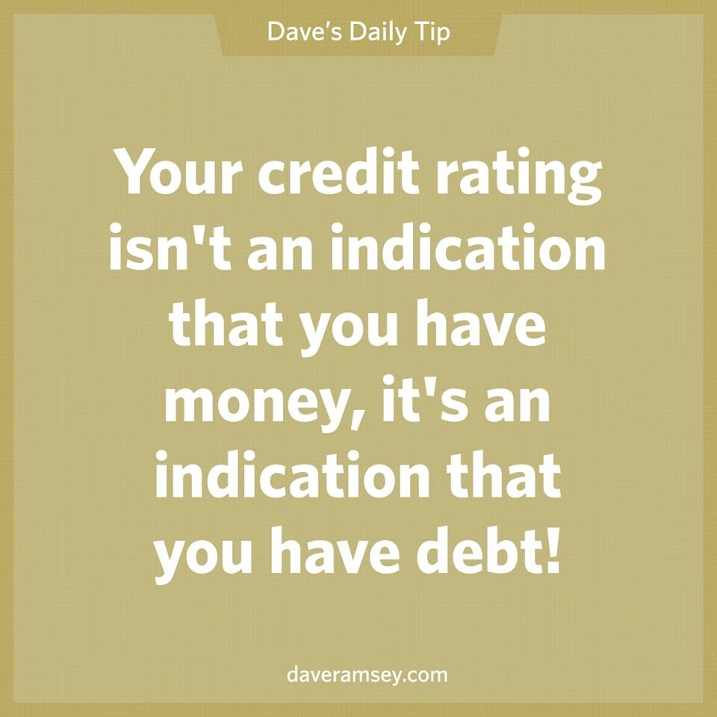
Daily Inspiration

Slide 32
LET’S MAKE THIS PERSONAL…
WHAT IMPACTS YOUR CREDIT RATING AS A CONSUMER?

Slide 33
LET’S MAKE THIS PERSONAL…
WHAT IMPACTS YOUR CREDIT RATING AS A CONSUMER?
35% Payment History – This is perhaps this simplest category, as it looks at how well you repay all borrowed amounts on credit cards, retail accounts, auto loans, utilities and phone bills, other installment loans and other debts. The better you are at repaying, the better your Payment History. Pay your bills on time.

Slide 34
LET’S MAKE THIS PERSONAL…
WHAT IMPACTS YOUR CREDIT RATING AS A CONSUMER?
30% Amounts Owed –The amount you owe is not simply about how much money you owe, but it’s also about how much of your available credit you use. If you have a credit card limit of $5,000 and your balance is $4,000, that’s worse than having a limit of $20,000 and a balance of $10,000. There are many trade-offs within this category and it can be confusing.
Pro-tip if you are using more than 30% of your available balance: Pay it off or down before the end of your reporting cycle and the credit agencies will never know it existed.

Slide 35
LET’S MAKE THIS PERSONAL…
WHAT IMPACTS YOUR CREDIT RATING AS A CONSUMER?
15% Length of Credit History – This is also pretty simple – the longer your history of paying bills and loans, the better off you’ll be. Yes, this does bias against younger borrowers – but if your behavior in the other categories is strong, you should be okay. Be patient – you’ll build your history.

Slide 36
LET’S MAKE THIS PERSONAL…
WHAT IMPACTS YOUR CREDIT RATING AS A CONSUMER?
10% Credit Mix – Perhaps ironically, it can be better to have 5 different accounts that you repay regularly than it is to have just 2 different accounts. The greater the variety of accounts you have, the more opportunity you have to indicate that you are a low credit risk. Of course, if you have 5 accounts and you miss your payments, that will be doubly bad. Pay your bills on time and the Credit Mix will take care of itself.

Slide 37
LET’S MAKE THIS PERSONAL…
WHAT IMPACTS YOUR CREDIT RATING AS A CONSUMER?
10% New Credit – Opening a large number of new accounts in a short period of time may indicate that you are a higher risk. So, is the moral to never open new accounts? No – because then you can never indicate that you are a low risk. Be mindful of opening too many accounts in a short period of time, pay all your bills on time, and the New Credit category will not be a big issue.

Slide 38
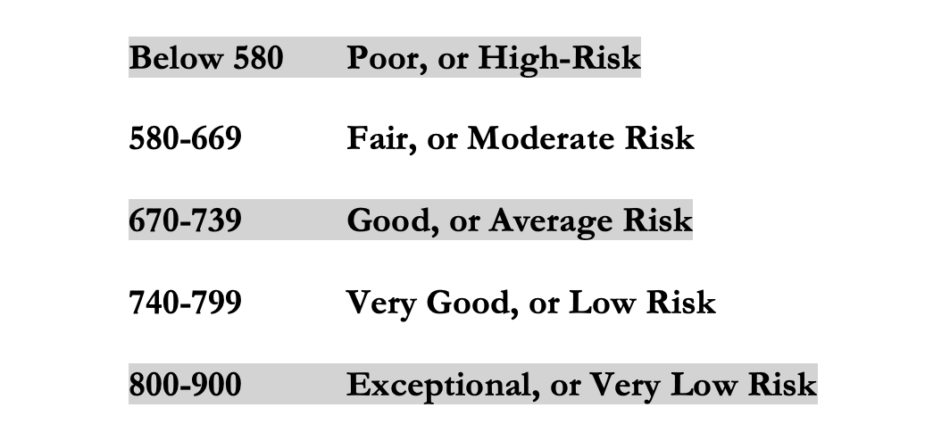
LET’S MAKE THIS PERSONAL…
WHAT IMPACTS YOUR CREDIT RATING AS A CONSUMER?
Your FICO Score will become an actual number: between 250 and 900.
The higher your Score, the lower interest rates you will pay on most loans.
The average FICO Score for Americans is just over 700.
The average in Louisiana is 677, the second lowest in the 50 U.S. states; only Mississippi has a lower average FICO Score.

Slide 39
LET’S MAKE THIS PERSONAL…
WHAT SHOULD YOU BE FOCUSED ON WITH RESPECT TO YOUR CREDIT SCORE?
If your FICO Score is below 600, there are probably 1 or 2 areas where you have significant weaknesses in your history.
Commit to correcting these weaknesses and not creating any new weaknesses.
If your FICO Score is between 600-700, there are probably 1 or 2 areas that can be improved – or where you used to have significant weaknesses.
Keep doing what you’re doing – and commit to not creating any new concerns.
If your FICO Score is over 700, keep doing what you’re doing and time will eventually get you the best score possible.

Slide 40
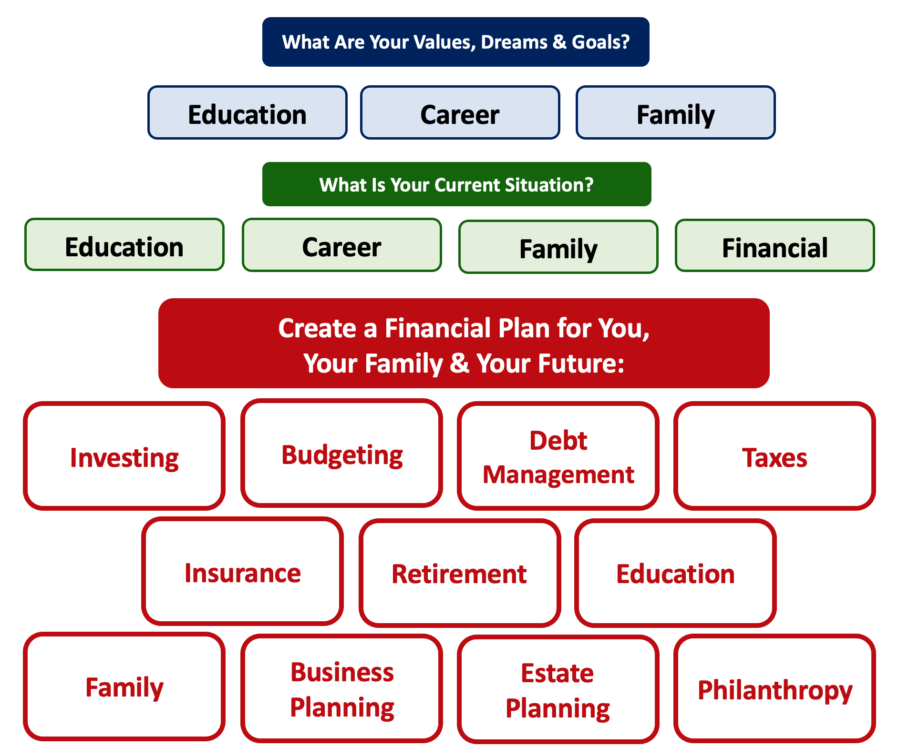
Debt is NOT a bad thing.
Debt can help us achieve our goals, depending on our current situations and what those goals are.
Debt is also called “leverage” – because it gives us the ability do things we might not be able to do otherwise.

Slide 41
Debt is NOT a bad thing.
My one primary piece of advice:
Whenever borrow money – whether it’s $20 for a Friday night pizza on your credit card or a $10,000 student loan – have a plan for paying it back.
Know why you are borrowing and where you will get the money to repay it.

Slide 42
A Little Math: Good Debt vs. Bad Debt

Slide 43
A Little Math: Good Debt vs. Bad Debt
Yes, I’ve simplified this a little. You will be making debt payments on your mortgage over those 3 years, so that would count against your equity growth. But this also means you would repay less in 3 years, which would increase your equity growth. And I have ignored taxes: both the benefits from using a mortgage and any costs due to the gains you may earn on the sale. But the idea here is to show how debt can create – or leverage – opportunities today to create value in the future.

Slide 44
A Little Math: Good Debt vs. Bad Debt
Isn’t this a lot like what you’re doing with your education?
You’re investing today – time, energy, money – in order
to create bigger and better opportunities for your future.
These opportunities may or may not be financial.
These opportunities are what will help you live your values and achieve your goals & dreams.
Yes, you do have to repay the money you borrowed. But if you are borrowing the money to achieve your dreams – dreams that you would not otherwise be able to achieve – then it’s probably a wonderful investment for you.

Slide 45




Good Debt vs. Bad Debt
High cost, both in $$$ and opportunity
Lots of uncertainty
Potential for enormous return
Perfectly aligned with values, goals & dreams
High cost, both in $ and opportunity
Lots of uncertainty
Potential for some return
Usually aligned with values, goals & dreams
Very high cost
Short-term fulfillment
No future return
Unrelated to values, goals & dreams

Slide 46
Good Debt vs. Bad Debt
$100,000 of principal
$45,435 of interest
Repaid over 20 years @ 4% interest

Slide 47
Good Debt vs. Bad Debt
$100,000 of principal
$58,389 of interest
Repaid over 20 years @ 5% interest

Slide 48
Good Debt vs. Bad Debt
$100,000 of principal
$216,030 of interest
Repaid over 20 years @ 15% interest

Slide 49
Good Debt vs. Bad Debt
Is this debt aligned with my values, goals & dreams?
How am I going to repay this debt?

Slide 50
Free Money…for you or for your bank.
Borrowing $100,000
At 15% Interest
Repaying over 20 years.
You Borrow $100,000
You Repay $316,030

Slide 51
Free Money…for you or for your bank.
Borrowing $100,000
At 15% Interest
Repaying over 20 years.
You Borrow $100,000
You Repay $316,030
Investing $50 a month
At 10% interest
For 20 years
You Invest $12,000
You Have $38,285

Slide 52
Good Debt vs. Bad Debt
NOTE:
Using a credit card is not necessarily a bad idea.
Only racking up loads of credit card debt is a bad idea.
I regularly use 3 credit cards.
Here’s how and here’s why…

Slide 53
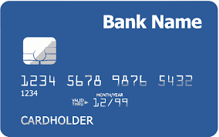
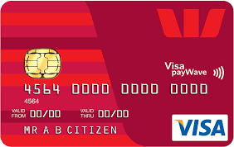
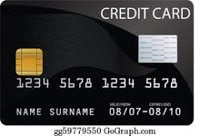
Credits Cards as Tools for Financial Planning
Card #1: Automatic bill payment of recurring monthly expenses (phone, insurance, cable, utilities)
Card #2: Living and discretionary expenses (gas, groceries, coffee, pizza, new shoes)
Card #3: Non-recurring big expenses (vacation, holidays, charity, new refrigerator)
Card #3 frequently has a $0.00 balance

Slide 54
Credits Cards as Tools for Financial Planning
WHY DO I DO THIS?
#1 Mental Budgeting: This helps me mentally be aware of what I’m spending and why I’m spending.
  Instead of just knowing that I’m putting $1,000 on my credit cards in a month, separating the expenses across cards forces me to be aware of what I’m spending money on.
  When I review my statements and budgets at the end of each month, this gives me an easy opportunity to judge myself and to analyze my own behavior.
Card #1: Automatic bill payment of recurring monthly expenses (phone, insurance, cable, utilities)
Card #2: Living and discretionary expenses (gas, groceries, coffee, pizza, new shoes)
Card #3: Non-recurring big expenses (vacation, holidays, charity, new refrigerator)

Slide 55
Credits Cards as Tools for Financial Planning
WHY DO I DO THIS?
#2 FREE MONEY!
  I pay off the full balance of each card each month. If I make a purchase on October 5, the cash does not leave my bank account until December 1.
    It might only be a penny or two, but earning interest during those 57 days feels kind of nice.
  Miles, cash-back and other rewards.
    Choose a card with benefits that you would be paying for anyway. And then cash in the rewards instead of paying cash in the future.
Card #1: Automatic bill payment of recurring monthly expenses (phone, insurance, cable, utilities)
Card #2: Living and discretionary expenses (gas, groceries, coffee, pizza, new shoes)
Card #3: Non-recurring big expenses (vacation, holidays, charity, new refrigerator)

Slide 56
PRIORITIZING YOUR DEBT
The first step to taking control of your debt is to identify all of your debt and understand you’re your responsibilities are with respect to each loan or debt.
Today, tomorrow or anytime in the near future, take the time to complete the information below, paying specific attention to the interest rates and any special features related to the debt (e.g. variable rates, prepayment penalties, restructuring fees, ability to negotiate or refinance).
Taking control of your financial situation begins with looking in the mirror and knowing you’re your situation is. This is not always fun, but it is the key to you being in control of your financial situation, instead of your money financial situation being in control of you.

Slide 57
PRIORITIZING YOUR DEBT

Slide 58
PRIORITIZING YOUR DEBT
Which debt is most costly?
  Maybe this is due to the interest rate being very high.
  Maybe this is due to certain restrictions – you cannot prepay or there are fees.
  Or maybe this is due to the repayment term being very long.
Which debt is most flexible?
  Which debt can you prepay anytime?
  Which debt can you renegotiate to different terms without cost?
Which debt helps your credit score?
Which debt hurts your credit score?

Slide 59
PRIORITIZING YOUR DEBT
Which debt is essential to you achieving your goals?
Which debt keeps you up at night?
Can you retire any debt – even if it’s good debt, low interest and flexible – to create a psychological victory to see it gone?
Do you want to keep any debt – even if it’s bad debt – to act as a psychological constraint so you do not build even more debt?
  For example, maybe you keep a $500 balance on a credit card because you are worried that you might use it more if you actually retired the full balance.

Slide 60
PRIORITIZING YOUR DEBT
Making a plan to pay off your debt:
  Which debt can be retired?
  Which debt is most costly?
  Which debt is most flexible?
  What income or savings will you use?
  Make plans for different points in time:
  This year – The Next 2 Years – The Next 5 Years
Paying off all of your bad debt:
  Maybe it takes 5 years, maybe it takes 10 years.
  But begin thinking about how and when you will get rid of the debt that is the biggest burden to you.
IN THE NEXT 6 MONTHS:
MAKE A PLAN TO MANAGE – AND PAY OFF – YOUR DEBT
WITHIN 3 YEARS OF GRADUATION:
ELIMINATE ALL OF YOUR BAD DEBT.

Slide 61
Opening Quiz – The Morals
Nothing is free in finance. You have to sacrifice something to receive something good. Every benefit has a cost.
Be mindful of short-term vs. long-term tradeoffs. Is a short-term indulgence worth a long-term sacrifice? Top Ramen costs $0.25 per meal. Gourmet ramen can cost $20 per meal. (Or $50+ for truffle ramen.)
Interest is your friend – if you are receiving it.
Interest is your enemy – if you are paying it.
Save and invest as early as you can. Small savings today can create enormous opportunities in the future.
Debt can change your life – both for the better and for the worse. Don’t let debt destroy your life and determine your future.
Be thoughtful, be strategic, be patient and have a plan.

Slide 62
Owning Your Financial Future
INVESTING GOALS, HABITS & STRATEGIES
Today, January 23
CREDIT SCORES & DEBT MANAGEMENT
Wednesday, March 8
CREATING AN INVESTMENT STRATEGY
Wednesday, March 15

Slide 63
Owning Your Financial Future
OPENING AN INDIVIDUAL RETIREMENT ACCOUNT
Wednesday, March 22
TAX STRATEGIES
Wednesday, April 5
CAREER PLANNING: YOUR MONEY & YOUR FUTURE
Wednesday, April 26

Slide 64
Don’t wait around for other people to be happy for you.
Any happiness you get,
You’ve got to make yourself.
~ Alice Walker, poet & novelist
A goal without a plan is just a dream.
Wealth is largely the result of habit.
The most difficult thing is the decision to act; the rest is mere tenacity.
It takes as much energy to plan as it does to wish.
You cannot escape the responsibility of tomorrow by avoiding it today.

Slide 65
Brian Bolton
Professor of Finance brian.bolton@louisiana.edu http://business.louisiana.edu/financeispersonal

