Slide 1
MONEY MATTERS
Spring 2024 SESSION #5
March 20, 2024
SIDE HUSTLES & ENTREPRENEURSHIP
(What Does It Mean to Be An Entrepreneur & How Can You Succeed At It)
Let’s get started investing towards your long-term goals.
Manage Your Money Today
Maximize Your Money in the Future

Slide 2
Happiness
Long-Term Goals
Short-Term Goals
Financial Needs
Family Needs

Slide 3
MONEY MATTERS SERIES: SPRING 2024
JANUARY 31
INTERNATIONAL STUDENTS: JOBS, TAXES, MONEY
FEBRUARY 8
INVESTING: OPENING YOUR OWN ROTH IRA
FEBRUARY 22
DEBT MANGEMENT, INCOME MANAGEMENT & YOUR FAMILY
MARCH 6
TAX STRATEGIES & TAX PLANNING
MARCH 20
CREATING & BUILDING A SIDE-HUSTLE: MAKING IT A BUSINESS
APRIL 18
CAREER PLANNING: YOUR FUTURE & YOUR MONEY

Slide 4
Happiness
Long-Term Goals
Short-Term Goals
Financial Needs
Family Needs

Slide 5
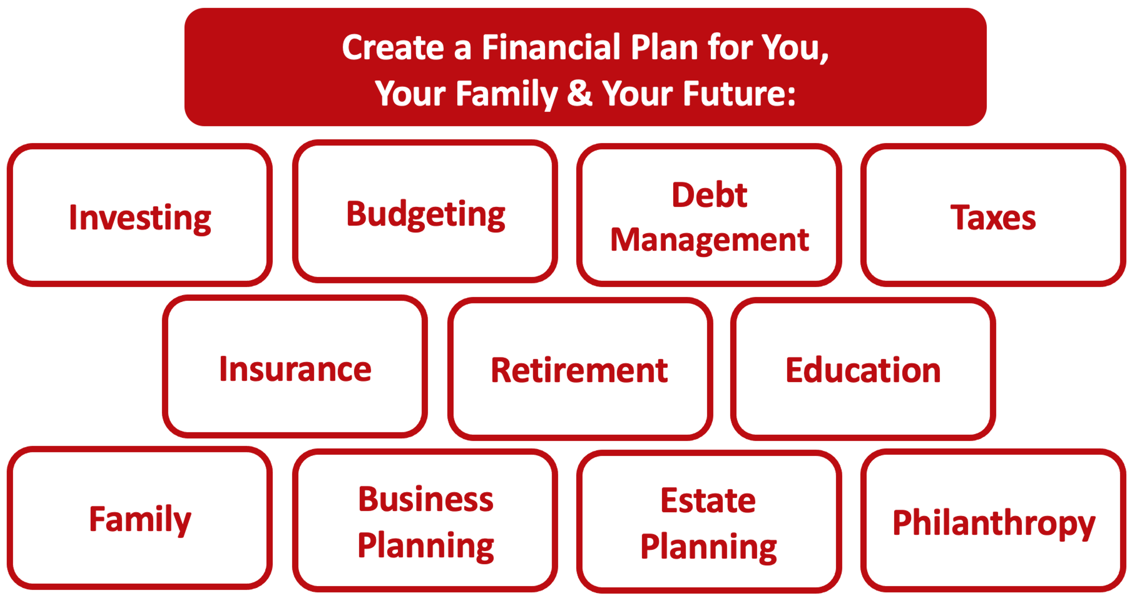

Slide 6
Owning Your Financial Future
YOUR VALUES
YOUR GOALS
Education
Career
Family
FINANCIAL STRATEGIES
Investing
Income & Expense Management
Debt Management
Taxes, Insurance & Other

Slide 7
Owning Your Financial Future
YOUR VALUES
YOUR GOALS
Education
Career
Family
FINANCIAL STRATEGIES
Investing
Income & Expense Management
Debt Management
Taxes, Insurance & Other

Slide 8
School & Education
Money
Family

Slide 9
School & Education
Money
Family
A new business, a new job, your new future…

Slide 10
Financial Wellness
Don’t wait around for other people to be happy for you.
Any happiness you get, You’ve got to make yourself.
~ Alice Walker American novelist, poet, activist

Slide 11
Note to INTERNATIONAL STUDENTS
Whether or not you can turn your side hustle into a legitimate business in the U.S. is tricky.
First and foremost, your visa requires you to be a full-time student. That has to be your first priority. Finishing your degree has to be your purpose and your goal.
You are limited in what income your can earn while on your visa…because your visa expects you to focus on your degree.

Slide 12
Note to INTERNATIONAL STUDENTS
So, can you start your own business while you are a student?
Officially….YES.
You can start a business, you can own a business, you can do business stuff. But, that cannot become your full-time job. That cannot become a significant source of your income. You have to continue to be a full-time student and comply with all visa requirements.
What else can you do while in school or after graduation?
Maybe you start a business but do not pay yourself a salary.
Maybe you begin building your business and then make it bigger & better after graduation.
Maybe you employ these entrepreneurship & side-hustle ideas in your lab, your degree program, or your full-time post-graduation job (“intrapreneurship”).
Maybe your side-hustle always stays a side-hustle….and that’s just fine.

Slide 13
Money Matters Survey
What questions do you have?
What else do you want to know about creativity, innovation, business, and entrepreneurship?
What do you think of this event – the food, the location, the topic, the people?
What events do you want to have in the future?

Slide 14
What is ENTREPRENEURSHIP?
Entrepreneurship is about solving problems.

Slide 15
What is ENTREPRENEURSHIP?
Every business has to solve a problem or make someone’s life better.
Socks
Sky’s Bites – Baklava desserts
Spoon
Balloon Decorator

Slide 17
Simply Chic Balloons

Slide 18
What is ENTREPRENEURSHIP?
The process of creating value by bringing together a unique combination of resources to exploit an opportunity

Slide 19
THE ENTREPRENEURIAL MINDSET
Attitude
I can affect change
There is a better way
Opportunities are
everywhere
Embrace innovation,
change & growth
Failure is learning
Optimism
Passion for what you do
In One’s Life
In my family
In my church activities
In my community
involvement
In my personal relationships
In managing my personal finances
In dealing with personal change
Professionally
Applying entrepreneurship in different ways over one’s career
Behavior
Pursuing opportunity
Innovating
Perseverance
Leveraging resources
Guerrilla actions
Risk management
Adaptation

Slide 20
Why talk mindset??
Time (talent development)
Born with it, genetics
Luck

Slide 21
Why talk mindset
Mindset 66%

Slide 22
THE ENTREPRENEURIAL MINDSET
Attitude
I can affect change
There is a better way
Opportunities are
everywhere
Embrace innovation,
change & growth
Failure is learning
Optimism
Passion for what you do

Slide 23
ARE YOU PROVIDING VALUE?
Profit Revenue
Revenue Customers
Customers VALUE
So what value are you providing?
What pain or problem are you solving?
Are you making people’s lives better?

Slide 25
Let’s create
Groups, come up with a company that solves a problem of your choosing.
You will have 2 minutes to pitch your idea
Must use the words (nouns and adjectives) that are assigned to you

Slide 26
Nouns and Adjectives
Group 1 – noodle, cat, fuzzy, purple
Group 2 – table, llama, smelly, cold
Group 3 – banana, car, beautiful, gluten-free

Slide 27
WHAT PROBLEM DO YOU WANT TO SOLVE?
WHAT BUSINESS DO YOU WANT TO START?
WHAT ENTREPRENEURIAL ACTIVITIES WILL YOU BE LEADING?

Slide 28
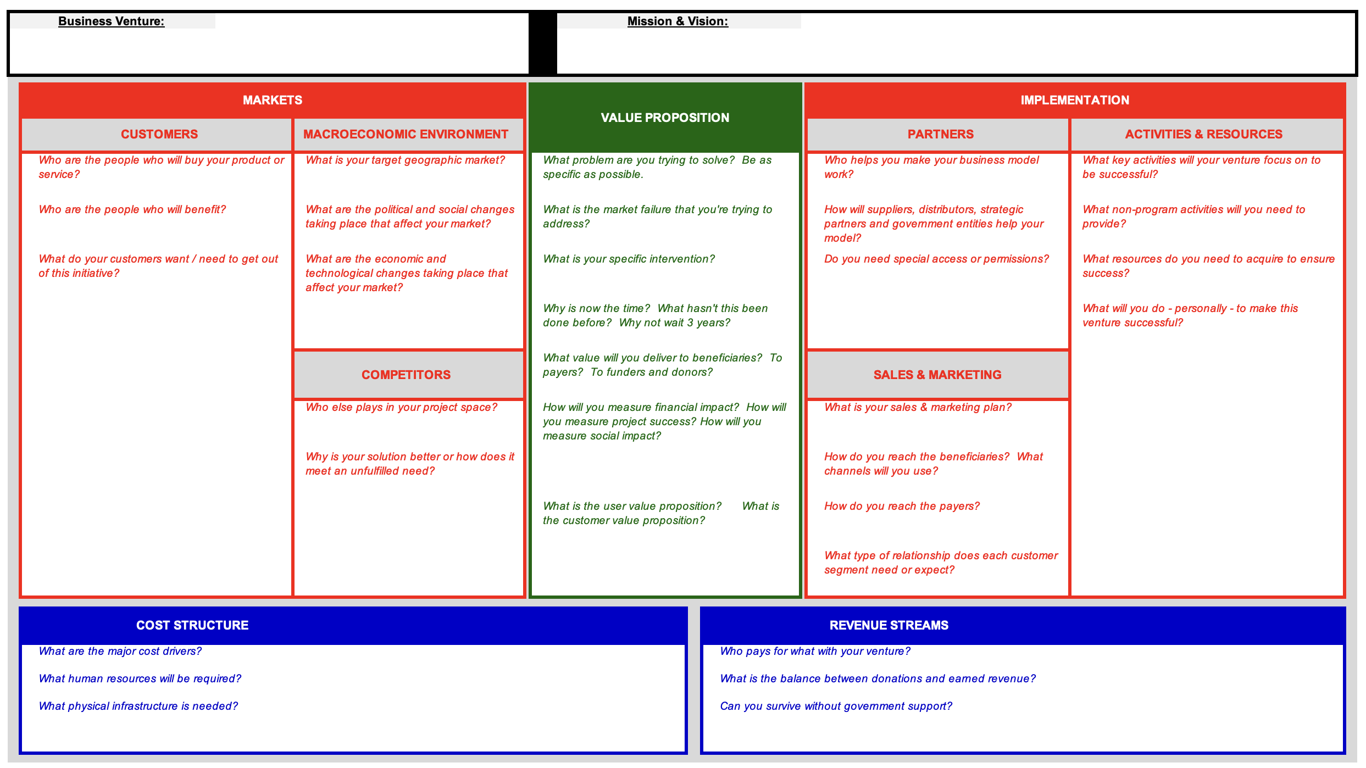

Slide 29
As you think about your businesses, your mission, your dreams, your visions for starting a new business, and what you want to do with what you get out of this program, try to answer one key question:
WHO CARES?
For your businesses, make a list of 3-5 groups of people or entities who care about that project.
Make a list of 3-5 people or entities who will contribute their human or financial resources to make that project successful.

Slide 30
Stakeholders & Entrepreneurs
Family
Investors
Employees
Business Entity
The Community
Customers
Suppliers
The Government
Others: future generations, trade associations, unions, activists, competitors, the media, business partners, the public, society

Slide 31
Stakeholders & Entrepreneurs
We care about making money because we want to (or have to) give money to people who make our business happen…who contribute to our business striving to serve its mission:
Employees, suppliers, partners, the government, investors…
The money we give to these people comes from our Revenues
Every dollar of Revenue that your business will ever make comes from your CUSTOMERS.
If you run a non-profit, it’s a little different…you have to make both your donors and your beneficiaries’ lives better with your mission.

Slide 32
Stakeholders & Entrepreneurs
Revenues
– Cost of Goods Sold
= Gross Margin
– Operating Expenses
= Operating Income
– Other Expenses
= Taxable Income
– Income Taxes
= Net Income

Slide 33
Some Side-Hustle Homework
Identify your financial goals:
What financial goals do you want to achieve in the next 3 months?
These could involve building your team, getting business bank accounts, or achieving revenue milestones. Anything related to your business.
These could also involve personal finance issues – because those will impact your business, too.
What financial goals do you want to achieve in the next 12 months?
What financial goals do you want to achieve in the next 3 years?

Slide 34
Personal Finance for Entrepreneurs
PERSONAL FINANCE
Your life as an entrepreneur will regularly overlap with your life as an individual.
Knowing where to take advantage of the overlaps (such as in tax planning) and where to create a necessary divide (such as with relationships) can be critical to both your success in business and your happiness as a human. Be intentional with your choices.

Slide 35
Personal Finance for Entrepreneurs
FINANCIAL MANAGEMENT
AS AN ENTREPRENEUR, ALL OF THESE PERSONAL FINANCE DIMENSIONS ARE GOING TO BE CONNECTED TO YOUR BUSINESS.
INVESTMENTS
INSURANCE
TAXES
FAMILY
ESTATE PLANNING

Slide 36
Personal Finance for Entrepreneurs
FINANCIAL MANAGEMENT
How much of your savings is necessary to start the business?
Maybe you are using your home as your office.
Maybe you are using your personal computer to run the business.
Maybe your personal car is integral to the business.
INVESTMENTS
INSURANCE
TAXES
FAMILY
ESTATE PLANNING

Slide 37
Personal Finance for Entrepreneurs
FINANCIAL MANAGEMENT
How are you going to hire employees and grow the business?
Are you able to make any investments outside of the business?
Can you succeed if you don’t commit everything to the business?
Can you have a retirement account?
What physical investments – office, factory, equipment – will you need to make?
INVESTMENTS
INSURANCE
TAXES
FAMILY
ESTATE PLANNING

Slide 38
Personal Finance for Entrepreneurs
FINANCIAL MANAGEMENT
What insurance do you need for the business?
What insurance do you need for YOU, to ensure that the business can succeed?
What liability do YOU have personally for what the business does?
What legal structure will you choose for the business?
INVESTMENTS
INSURANCE
TAXES
FAMILY
ESTATE PLANNING

Slide 39
Personal Finance for Entrepreneurs
FINANCIAL MANAGEMENT
What legal structure will you choose for the business?
Will you file taxes as an individual or as a corporation?
What are the tax benefits available to entrepreneurs?
How will the business tax issues impact your family and your long-term personal goals?
INVESTMENTS
INSURANCE
TAXES
FAMILY
ESTATE PLANNING

Slide 40
Personal Finance for Entrepreneurs
FINANCIAL MANAGEMENT
How will the business tax issues impact your family and your long-term personal goals?
What are the pros and cons of making your venture a family affair?
How do you manage family relationships AND commit yourself to the business?
What happens to the business when you retire?
INVESTMENTS
INSURANCE
TAXES
FAMILY
ESTATE PLANNING

Slide 41
What Can You Do Tomorrow?
Build your team. Don’t try to do everything on your own.
You probably want to have an attorney and a tax accountant on your team. You may want to connect with other advisors, but having an attorney and accountant on your team is essential.
Separate your personal and business lives as much as possible.
Get separate bank accounts for the business.
Establish a credit history for the business.
Find an accounting system you like. Quicken, Quickbooks, TaxBot, Zero, Sage, FreshBooks are all decent options. Learn it, live it, love it.
Build your business plan. Tell the narrative of your business.
Banks will want to see this. Investors will want to see this.
View this as your roadmap or to-do list. Use it to guide both strategy and decision-making.

Slide 42
A Few Finance Rules for Entrepreneurs
Nothing is free in finance & entrepreneurship. Every benefit has a cost. Understand what the benefits are.
Financial institutions and advisors do not exist to be your friends. They exist to take your money. Protect your money.
Debt can change your life – for better and for worse. Be careful with how you use debt.
Interest is your friend – when you’re receiving it. Interest is your enemy – when you’re paying it.
Finance is about trading money across time: short-term vs. long-term. Know the trade-offs you are making.
In entrepreneurship…Cash is Queen (or King). Focus on cash inflows & cash outflows.

Slide 43
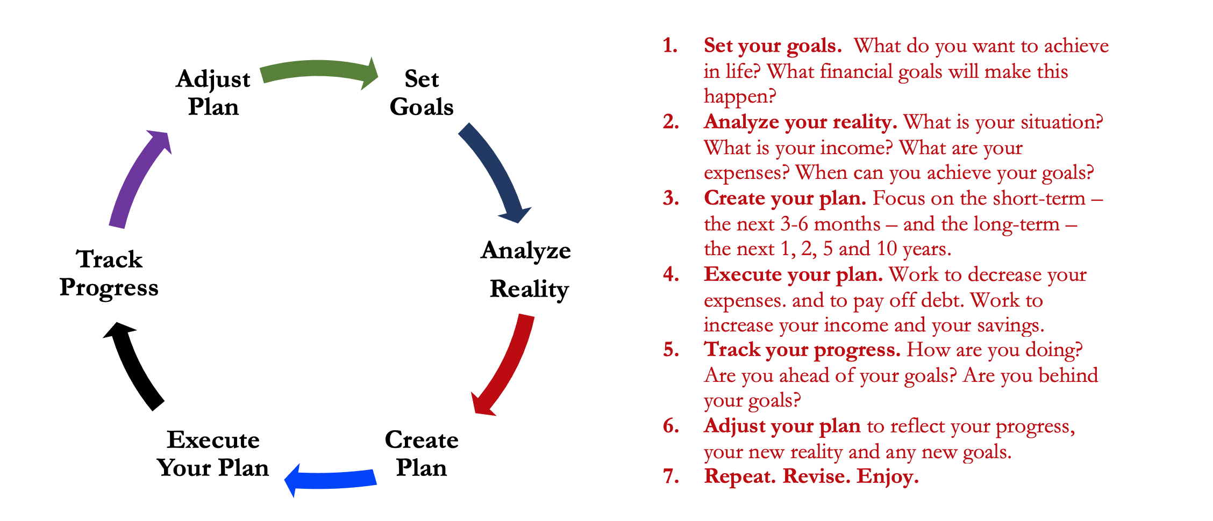
Isn’t this a lot like what you do with your education planning?

Slide 44
You’ve been doing this with your education for years.
You’re about to begin doing this with your career…and you will continue working through this process for the next 30 or 40 years.
Whether it’s education planning or career planning, by now we know that all of our personal decisions with have financial implications.
The more we plan ahead and integrate our decision-making process, the more control we will have over our futures…and the less money will be a source of stress and the more money will be a source of empowerment.
Isn’t this a lot like what you do with your education planning?

Slide 45
MONEY MATTERS SERIES: SPRING 2024
JANUARY 31
INTERNATIONAL STUDENTS: JOBS, TAXES, MONEY
FEBRUARY 8
INVESTING: OPENING YOUR OWN ROTH IRA
FEBRUARY 22
DEBT MANGEMENT, INCOME MANAGEMENT & YOUR FAMILY
MARCH 6
TAX STRATEGIES & TAX PLANNING
MARCH 20
CREATING & BUILDING A SIDE-HUSTLE: MAKING IT A BUSINESS
APRIL 18
CAREER PLANNING: YOUR FUTURE & YOUR MONEY

Slide 46
Financial Wellness
A goal without a plan is just a dream.
Wealth is largely the result of habit.
The most difficult thing is the decision to act; the rest is mere tenacity.
It takes as much energy to plan as it does to wish.
You cannot escape the responsibility of tomorrow by avoiding it today.

Slide 47
Becoming an owner allows you to be the architect of your own future.
- Leigha Porter
Entrepreneur, Dancer, Choreographer, Founder of the Creole Nutcracker, PARC Village and FIRE Expressions Conservatory, UL Lafayette grad, Northside High School grad
A goal without a plan is just a dream.
Wealth is largely the result of habit.
The most difficult thing is the decision to act; the rest is mere tenacity.
It takes as much energy to plan as it does to wish.
You cannot escape the responsibility of tomorrow by avoiding it today.

Slide 48
Louisiana Entrepreneurship & Economic Development Center jonathan.shirley@louisiana.edu https://business.louisiana.edu/leed

Slide 49
brian.bolton@louisiana.edu http//:business.louisiana.edu/financeispersonal

Slide 50
gradschool@louisiana.edu

