Slide 1
Opening Quiz – Question #1
If you sold cookies out of your apartment during 2022 and made $500 from those sales, you owe taxes on that $500 of income.
TRUE
FALSE

Slide 2
Opening Quiz – Question #1
If you sold cookies out of your apartment during 2022 and made $500 from those sales, you owe taxes on that $500 of income.
TRUE
FALSE
Maybe

Slide 3
Opening Quiz – Question #2
If you sold cookies out of your apartment during 2022 and made $500 from those sales, and spent $200 making those cookies, what do you owe taxes on?
$500
$300
$200
$0

Slide 4
Opening Quiz – Question #2
If you sold cookies out of your apartment during 2022 and made $500 from those sales, and spent $200 making those cookies, what do you owe taxes on?
$500
$300
$200
$0

Slide 5
Opening Quiz – Question #3
If you sold cookies out of your apartment during 2022 and made $500 from those sales, and spent $700 making those cookies, what do you owe taxes on?
$500
$700
$0
You get a refund for the $200 loss

Slide 6
Opening Quiz – Question #3
If you sold cookies out of your apartment during 2022 and made $500 from those sales, and spent $700 making those cookies, what do you owe taxes on?
$500
$700
$0
You get a refund for the $200 loss

Slide 7
Opening Quiz – Question #4
If you earned $13,500 of income in 2022, which of the following applies to you:
You owe taxes on the entire $13,500.
It depends on whether someone else claims you as a dependent.
You do not owe any taxes and you do not have to file a tax return.
You do not owe any taxes but you have to file a tax return.

Slide 8
Opening Quiz – Question #4
If you earned $13,500 of income in 2022, which of the following applies to you:
You owe taxes on the entire $13,500.
It depends on whether someone else claims you as a dependent.
You do not owe any taxes and you do not have to file a tax return.
You do not owe any taxes but you have to file a tax return.

Slide 9
Opening Quiz – Question #5
Imagine you put $1,000 into a Roth IRA today.
Imagine this grows to become $25,000 over the next 35 years.
When you withdraw that $25,000 at age 60, what income will be taxed?
NONE
$25,000
$24,000
$1,000

Slide 10
Opening Quiz – Question #5
Imagine you put $1,000 into a Roth IRA today.
Imagine this grows to become $25,000 over the next 35 years.
When you withdraw that $25,000 at age 60, what income will be taxed?
NONE
$25,000
$24,000
$1,000

Slide 11
Opening Quiz – Question #6
If you spend $2,500 (or more) on education expenses that are required for your degree – including tuition, books, supplies, maybe a computer – you might be able to receive a $2,500 credit on your tax return.
TRUE
FALSE

Slide 12
Opening Quiz – Question #6
If you spend $2,500 (or more) on education expenses that are required for your degree – including tuition, books, supplies, maybe a computer – you might be able to receive a $2,500 credit on your tax return.
Check out the American Opportunity Tax Credit (up to $2,500) and the Lifetime Learning Credit (up to $2,000) to see if you are eligible for either credit.
Credits directly reduce the taxes you owe…which is really nice.
TRUE
FALSE

Slide 13
Opening Quiz – Question #7
If you are an international student but do not earn any income during a given year, you do NOT need to file a tax return or any return with the IRS.
TRUE
FALSE

Slide 14
Opening Quiz – Question #7
If you are an international student but do not earn any income during a given year, you do NOT need to file a tax return or any return with the IRS.
If you received any income, you have to file a tax return (Form 1040).
But, if you did not receive any income, you still need to file Form 8843 to tell the IRS that you were in the US but did not earn any income.
TRUE
FALSE

Slide 15
MONEY MATTERS
2022-2023 SESSION #8
March 7, 2023
INCOME TAX PLANNING
Designing strategies to keep as much of your income as possible.
Manage Your Money Today
Maximize Your Money in the Future

Slide 16
Happiness
Long-Term Goals
Short-Term Goals
Financial Needs
Family Needs

Slide 17
MONEY MATTERS SESSION #4
INCOME TAXES:
FINANCIAL PLANNING & STRATEGIES
Focusing on financial planning opportunities, challenges and situations that might be unique to international graduate students.
Manage Your Money Today
Maximize Your Money in the Future
March 6, 2024

Slide 18
MONEY MATTERS SERIES: SPRING 2024
JANUARY 31
INTERNATIONAL STUDENTS: JOBS, TAXES, MONEY
FEBRUARY 8
INVESTING: OPENING YOUR OWN ROTH IRA
FEBRUARY 22
DEBT MANGEMENT, INCOME MANAGEMENT & YOUR FAMILY
MARCH 6
TAX STRATEGIES & TAX PLANNING
MARCH 20
CREATING & BUILDING A SIDE-HUSTLE: MAKING IT A BUSINESS
APRIL 18
CAREER PLANNING: YOUR FUTURE & YOUR MONEY

Slide 19
School & Education
Money
Family

Slide 20
You cannot escape the responsibility
of tomorrow by avoiding it today.

Slide 21
5 Things You Can Do To Reduce Your Taxes
Open an Individual Retirement Account or Roth IRA
You can defer income tax and avoid capital gains tax altogether
Talk to HR and reduce your tax withholding
If you get a refund, you are loaning your income to the government
Cluster your income so you make less than $13,850 in a year
If possible, shift income between years to get the maximum deduction
Scan tax code and identify 3-5 deductions & credits you qualify for
Child tax credit, education expenses (tuition, books…), student loan interest, charitable deductions, small business or hobby-related expenses
Get rid of your income

Slide 22
4 Frequently Asked Questions
When should we begin talking to our children about money & finances?
As soon or early as you are comfortable.
Young children observe and think about everything. They notice all of your financial behavior.
Children under 10-12 might earn an allowance for doing chores → This instills habits and the link between work and money.
Children 10-12 are going to begin having goals and dreams.
The sooner you talk to them about your financial situation – not necessarily with numbers – the more they will think of these goals and dreams as a partnership, and not just your job.
They can begin mentally budgeting for their goals and dreams. They can begin thinking about what THEY need to do to make these goals and dreams a reality.
Children 14+ should have their own budgets…either as a function of the family budget or on their own. Help them have as much agency over their lives as possible.

Slide 23
4 Frequently Asked Questions
When should we open bank and other accounts for our children?
As soon as they have a social security number.
This creates options, independence and agency.
You do not have to put a lot of money into any account, but having it open allows you – or them – to work towards their dreams and goals when appropriate.
When they become independent, they will want their own borrowing potential. This starts with them having a credit score…which you can help with by co-signing for debt when they are young.
A co-signed credit card with a $300 limit that they only use for gas and groceries, for example.
Opening an Individual Retirement Account for them or a 529 education savings account – even if you do not put any money into these accounts – also gives them options.
Trusts are not just for the super-wealthy. They can be creative tools to transfer assets from you to your children…while you still retaining some control (and having unique legal protection for any assets in the trust).

Slide 24
4 Frequently Asked Questions
One side benefit of being proactive in establishing your children’s financial habits and financial planning…
It may help you realize where you can improve your own financial habits and financial planning.

Slide 25
4 Frequently Asked Questions
Should we file taxes as Married Filing Jointly or Separately?
It depends. It will be different for each family…and it may be different for each year.
Both spouses are NOT allowed to take the same deductions & credits on their own returns.
You want to be strategic and do the math to see where your combined tax liability is lowest.
Perhaps you file separately and the higher-income spouse claims all of the deductions & credits to reduce their income the most.
If there is a big difference in your incomes, you may be able to strategically lower your tax liability by filing individually (in theory). Look at both options and choose the better one (this year).
A couple examples:
The IRS allows us to have professional tax preparation if our income is less than $73,000, regardless of how you file.
If you are working but your spouse is not, you can open an IRA for them since they cannot…but only if you file MFJ.
“Head of Household” filing status is generally the most favorable status…but it is a legal status, it is not a description. It is generally reserved for single parents who provide >50% of dependent care.

Slide 26
4 Frequently Asked Questions
Speaking of taxes, what are some tax benefits for families?
There are lots – each family can probably identify 3-10 benefits for them.
The 2017 tax cuts eliminated the ability to claim a deduction for each dependent…but there are still credits and deductions available.
The child tax credit – possibly $2,000 credit for each child.
The dependent care credit – not exclusive to children.
The adoption credit – can receive up to $14,000+ credit for all adoption-related expenses.
The earned-income tax credit – available for low-income taxpayers.
Medical expenses for having a baby may be an above-the-line deduction.
Education credits & deductions…including the American Opportunity Tax Credit, the Lifetime Learning Credit, and deductions for student loan interest.
As your family grows, your benefits grow…so talk to Human Resources an reduce your tax withholding.
With all of the above, there are limitations and rules. Read the fine print.

Slide 27
4 Frequently Asked Questions – TAXES
Gross Salary & Wages
Less: Medical Expenses
Less: Student Loan Interest paid
Less: Contributions to Retirement Accounts
Adjusted Gross Income
Less: Standard Deduction or Itemized Deduction
Taxable Income
x Tax Rate .
Gross Taxes Owed
Less: Tax Credits .
Taxes Owed
“Above-the-Line” Deductions.
We like these because they reduce “Adjusted Gross Income” and you also get another deduction “below-the-line”
Standard Deduction = $13,850 for 2023
(or $27,700 for married-filing-jointly)
Everyone gets this deduction / subtraction, at least. Some will “itemize” certain deductions to get an even larger subtraction
Credits are wonderful → The reduce the taxes owed, dollar-for-dollar
But not everyone will have credits. They are for specific situations (see previous slide), but do a little homework to see if any apply to you.

Slide 28
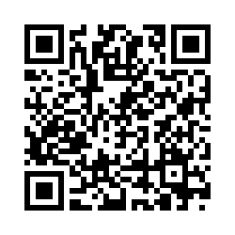
Money Matters Survey
What questions do you have?
What else do you want to know about taxes?
What do you think of this event – the food, the location, the topic, the people?
What events do you want to have in the future?

Slide 29
Tax Strategies for International Students, Faculty & Staff
Tax Planning as an Entrepreneur
Tax Overview & Tax Refunds
Tax Benefits of Being a Student
Tax Planning for Education & Retirement

Slide 30
Overview on Income Tax Planning
For tax year 2023, you need to file your tax return – and pay any taxes – by April 15, 2024. You need to file both your federal & state returns by this date.
If you are expecting a refund, file as soon as possible. If you still owe some in taxes, file as late as possible.
If you do not file and pay what you owe, there may be penalties.
We only owe income taxes on income (and cash)
If you invest $1,000 and it grows to $1,500, you owe taxes on $500 only…when you sell.
There may be years when your taxable income – your income less deductible expenses – is negative. You may be able to apply these losses to the income you make in other years.

Slide 31
Overview on Income Tax Planning
Taxes are based on cash. If cash changes hands, there are likely taxes owed. (You do not owe taxes when your $1,000 rises to $1,500; you owes taxes if you sell at $1,500 and recognize that $500 profit.)
You may need to file personal and business taxes as an entrepreneur.
Tips, gambling gains, and other non-salary income will appear on your W2 or a 1099.
Most of us owe U.S. federal income taxes and state income taxes. That means we have to file a federal and state returns.
You must file a state return for every state in which you earn income.
Get in the habit of keeping all records and tracking all income and expenses. You never know when and old textbook or child-care receipt can be used to lower your tax bill.

Slide 32
Do You Really Want a Tax Refund?
January $1,200
February $1,200
March $1,200
April $1,200
May $1,200
June $1,200
July $1,200
August $1,200
September $1,200
October $1,200
November $1,200
December $1,200
January $0
February $0
March $3,600
January $1,500
February $1,500
March $1,500
April $1,500
May $1,500
June $1,500
July $1,500
August $1,500
September $1,500
October $1,500
November $1,500
December $1,500
January $0
February $0
March $0
Total Income
$18,000

Slide 33
Do You Really Want a Tax Refund?
January $1,200
February $1,200
March $1,200
April $1,200
May $1,200
June $1,200
July $1,200
August $1,200
September $1,200
October $1,200
November $1,200
December $1,200
January $0
February $0
March $3,600
January $1,500
February $1,500
March $1,500
April $1,500
May $1,500
June $1,500
July $1,500
August $1,500
September $1,500
October $1,500
November $1,500
December $1,500
January $0
February $0
March $0
NO…I do not want a tax refund.
A tax refund is not a gift and it is not found money. It’s MY money.
I get the same amount of money either way.
I would rather get MY money sooner and not make an interest-free loan to the government.
The sooner I get MY money, the sooner I can invest it or use it to pay down debt.
Talk to your HR office and think about reducing your withholding so you can decrease your refund and get YOUR money sooner.
If you do get a refund, use it to invest in your future…in a retirement account or use it to pay off debt. Your future self will thank you.
Total Income
$18,000

Slide 34
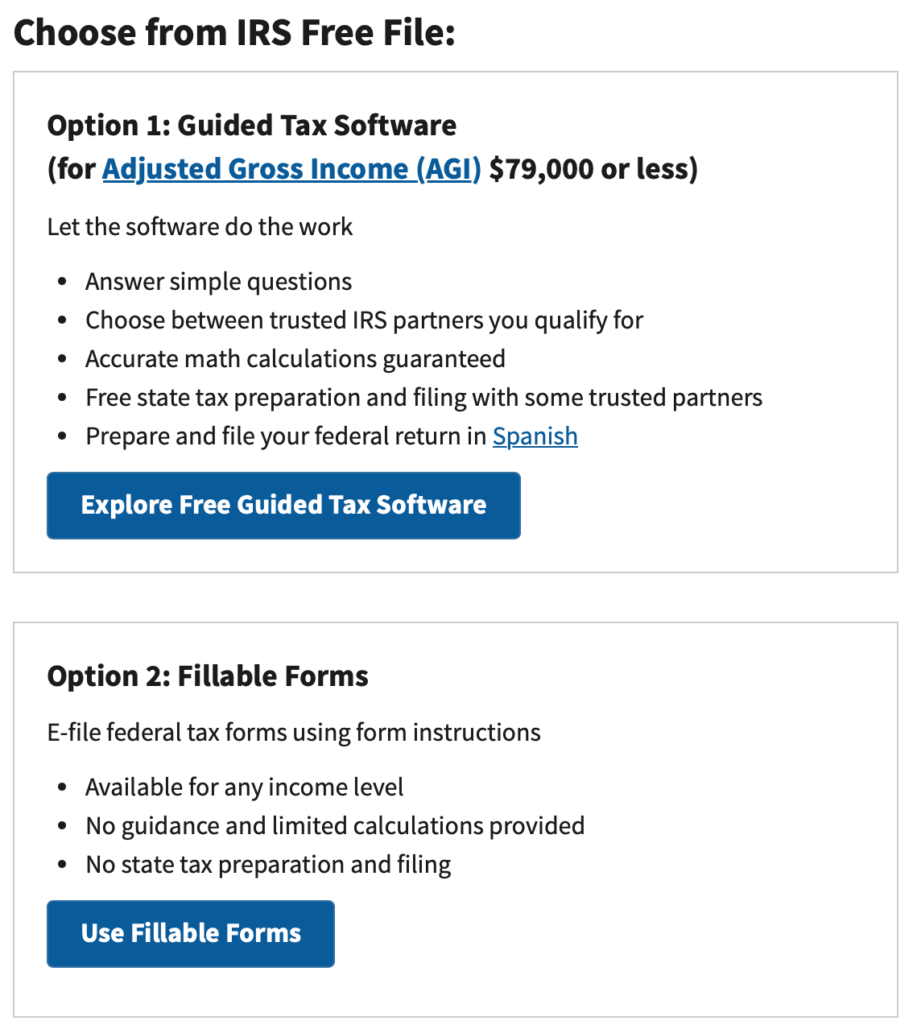
Filing Your Income Taxes for Free
This limit of $79,000 is the same regardless of whether you are filing individually or married-jointly. Sorry.
With Option 1, the IRS does not prepare your taxes, but will connect you with HR Block, Jackson Hewitt, TurboTax or some other professional provider.
Note – the “free file” probably only applies to your federal filing and to the most basic software available.
With Option 2, everything is done within the IRS website – but the IRS will not guide or advise you as the professional providers will. I would only recommend this option to the brave, more seasoned tax preparers.
https://www.irs.gov/filing/free-file-do-your-federal-taxes-for-free
Or just Google “irs free file”

Slide 35
U.S. Income Taxes for Non-US Citizens
Filing for income tax – FOR INTERNATIONAL STUDENTS & FACULTY:
It’s important to be aware that, as a nonresident in the US, you’re legally required to file a tax return if you received US income during 2023.
And even if you didn’t work or receive income in the US, you’re still obliged to file a Form 8843 with the IRS.
You may owe taxes on non-cash benefits you received, such as tuition forgiveness or any scholarships.
Talk to your University to see if it has a partnership to assist you.
The University of Louisiana at Lafayette has arranged discounted access to Sprintax Tax Preparation for international graduate students and faculty. Your university may have something similar.
Sprintax guides you through the tax preparation process, arrange the necessary documents and check if you’re due a tax refund.

Slide 36
U.S. Income Taxes for Non-US Citizens
Filing for income tax – FOR INTERNATIONAL STUDENTS & FACULTY:
Depending on any arrangements between the U.S. and your home country, the taxes that you owe in the U.S. and at home may be different.
For your tax return, you will probably end up filing Form 1040N, whereas most US citizens file Form 1040. They are similar enough and any software will guide you to that form.
Whereas married U.S. citizens have the choice of filing as “married filing jointly” or “married filing separately,” married non-US citizens are required to file separately.
This should not be a big deal. It means twice the work, but it is unlikely to change your tax bill much (it may increase or decrease your tax bill – it all depends on your situation)

Slide 37
U.S. Income Taxes for Non-US Citizens
Filing for income tax – FOR INTERNATIONAL STUDENTS & FACULTY:
Beyond that, most international Students, Faculty & Staff are able to engage in the same investment and financial planning opportunities that permanent residents can.
A Social Security Number is generally all that is required.
You can open a bank account or brokerage account.
You can open a 529 education savings account.
You can open a Traditional IRA or Roth IRA.
You can engage in the same business or hobby activities as an entrepreneur
I you are on a student visa, being a student is your primary purpose, not running a business.
There will be some filing and reporting requirements that may be unique for non-residents, depending on your financial activity, and most tax preparation software can guide you through this.

Slide 38
Income Taxes Are All About Income & Cash
Income taxes are generally based on when cash changes hands – if cash is exchanged for goods or services, there is a taxable transaction.
The exception is that exchanging goods for goods may be taxable, too.
When you get your paycheck, the day you get your cash is the day you owe taxes.
If you get paid on January 10 for work you performed in December, the taxable transaction occurs on January 10.
If you get $20 in tips after an evening of waiting tables, you owe taxes on that $20 as of that night.
If you get a $25 gift card for donating plasma, you owe taxes on that gift card as of the day you receive the card.
If I give you a car worth $5,000 in exchange for a computer worth $1,000, you owe taxes on the $4,000 difference on the day we trade.
Can you avoid taxes by not reporting some transactions? Assume that the other person is reporting the transaction as a business expense. If I report the $20 in tips that I give you in tips as an expense, the IRS now knows about it. And it’s going to wonder why you haven’t reported and paid your taxes.
Even if you do not have taxes withheld from your paycheck – perhaps like with tips – you are supposed to submit estimated tax payments throughout the year.
If you owe $10,000 in taxes for 2023, the IRS doesn’t want to wait until April 2024 to receive that $10,000 from you.
You owe taxes to the IRS at the time you received the income, and there may be penalties if you wait too long to pay what you owe.

Slide 39
Income Taxes: Deductions & Credits
What are income tax deductions & credits and why do we like them so much?
Tax Deductions
Qualifying reductions to your Taxable Income that will reduce how much Taxable Income you have…that may reduce the taxes you owe.
All filers are allowed the standard deduction ($13,850 for single, $27,700 for married) for 2023.
If your Taxable Income is less than this, you do not owe taxes.
Some deductions are “above-the-line,” reducing your Adjusted Gross Income.
We really like these because they lower the income we receive that may allow us to receive certain credits.
Examples: school tuition, fees, some student loan interest, some moving expenses, some health care expenses, contributions to retirement
Other deductions, like home mortgage interest and charitable donations, can reduce your taxable income…if they are larger than the standard deduction. This is called ‘itemizing deductions.’
Tax Credits
A dollar-for-dollar reduction in taxes owed.
If you owe $2,500 in taxes for the year and find a $1,000 credit, your taxes owed will be reduced to $1,500.
We really really like tax credits.
Dependent care credits, education credits, earned income credit for lower income households, foreign tax credit are some of the more common. There are not many.

Slide 40
Income Taxes: Deductions & Credits
What are some income tax deductions & credits for students?
In general, you may deduct up to $2,500 of student loan interest (or the amount of interest paid, whichever is less).
You cannot be a dependent on someone else’s return.
You cannot file “married filing separately.”

Slide 41
Income Taxes: Deductions & Credits
What are some income tax deductions & credits for students?
There are two tax credits that you may be able to use – but you cannot use both of these for the same child in the same year (although you can use different credits for different children).
The American Opportunity Tax Credit
100% of the first $2,000 of expenses + 25% of the second $2,000
Calculated per student
Based on the first 4 years of post-secondary education
Includes tuition and fees, paid directly to the university, or books and supplies
If you do not use the entire tax credit and your tax bill is $0, you can get a refundable credit of up to $1,000

Slide 42
Income Taxes: Deductions & Credits
What are some income tax deductions & credits for students?
There are two tax credits that you may be able to use – but you cannot use both of these for the same child in the same year (although you can use different credits for different children).
Lifetime Learning Credit
Tax credit of $2,000 per family (20% x first $10,000 in expenses)
Unlimited number of year of qualified education expenses
Not eligible if income > $90,000 (single) or $180,000 (MFJ)
Wait…Is a computer a “qualified higher education expense?” Can I claim the cost of my school computer?
Maybe. It’s kind of a gray or subjective area.
If the computer is a personal asset that you use as a student for convenience and to enhance your education, then it is probably NOT a qualified education expense.
If the computer is required by the institution, if it is essential to being a student, then you may claim it.

Slide 43
Tax Planning for Health Care
Many health care expenses are above-the-line deductions. That’s great.
If the 529 Education Savings Account is the gold standard of financial planning, a Health Savings Account (HSA) is either the platinum or silver standard.
An HSA allows you to contribute up to $3,850 for yourself or $7,750 for your family into an investment account dedicated to fund future health care costs.
All growth in the investment account is NOT taxable. That’s great.
Any money not spent in a year rolls over to the next year. That’s great, too.
If you employer also contributes to your HSA, the above contribution limits apply to the combined contribution. That’s not great.
You must be in an eligible ‘high deductible’ health care plan ($1,500 for you or $3,000 for the family) to be able to contribute to an HSA. That’s not great, either.
An alternative is the Flexible Savings Account (FSA). You DO NOT have to be in a high-deductible plan to contribute, but the money DOES NOT rollover at the end of the year.

Slide 44
Tax Planning for Education & Retirement
If you have children, there is one thing you can do to help fund their future education: Open a 529 savings account…the gold standard of financial planning.
Each account is in one child’s or individual’s name. Anyone with a SSN can have one.
Distributions – payments for school – are federal and state tax free…if used for qualified education expenses
You deposit $10,000, it grows to $25,000, you have $25,000 for tuition…and you don’t pay any taxes on the $15,000 of growth.
Qualified education expenses include tuitions, fees, books, technology, software…and, yes, room and board.
Can use $10,000 per year for non-college education…including elementary, secondary, private, religious, vocational or other education.
We do not get tax deductions for contributing.

Slide 45
Tax Planning for Education & Retirement
If you have children, there is one thing you can do to help fund their future education: Open a 529 savings account…the gold standard of financial planning.
There are no income limits – anyone can participate and contribute
A contributor can gift up to the annual gift tax exclusion amount ($17,000 in 2023) and not incur any gift/estate tax liability (but cannot give any other gifts).
And…that contributor can pre-gift up to 5 years of contributions into a 529 plan. So, in 2023, a grandparent might pre-fund $17,000 x 5 = $85,000 into a child’s 529 college savings plan.
Has virtually zero limitations on what institutions the child can go to.
If the child does not go to college, and you do not use the funds for other educational purposes, you can withdraw the cash…by paying taxes and a 10% penalty.
You can also change the beneficiary…so if your deadbeat son decides go on tour with his band and not use the 529 funds, you can change the name on the account so that your true academic rockstar daughter (or cousin or yourself) can use the funds for education.
And, as of 2024, any unused 529 funds can be transferred to an IRA. That’s really cool (but there is some fine print).

Slide 46
Tax Planning for Education & Retirement
Even if your employer offers you a retirement plan, you may be able to invest in additional retirement funding for yourself with an Individual Retirement Plan or a Roth IRA.
You can open a Traditional IRA or a Roth IRA with any traditional brokerage firm – like Fidelity or Robinhood.
You can contribute $7,000 per year ($8,000 if you’re over 50).
You can invest in just about anything you can with a normal (taxable) brokerage account….whereas your company retirement plan may only offer you 10-15 mutual fund options.
You receive big tax benefits, either today or in retirement.
However, if you take out the money before you turn 59 ½, you will (a) pay appropriate taxes on the distributions, and (b) pay a 10% penalty. And you cannot borrow from an IRA.

Slide 47
Tax Planning for Education & Retirement
Even if your employer offers you a retirement plan, you may be able to invest in additional retirement funding for yourself with an Individual Retirement Plan or a Roth IRA.
What is a Traditional IRA…
You get a tax deduction (above the line, at the top of your return) for all contributions today, but you do have to pay ordinary income taxes when you withdraw the money in retirement.
You can contribute $7,000 per year ($8,000 if you’re over 50).
Anyone with earned income can contribute (passive income does not count).
There are no income limits for who can contribute.
Best for people who think their income – and tax bracket – will be lower in the future.

Slide 48
Tax Planning for Education & Retirement
Even if your employer offers you a retirement plan, you may be able to invest in additional retirement funding for yourself with an Individual Retirement Plan or a Roth IRA.
What is a Roth IRA…
You do not get a tax deduction today. You invest after-tax money.
But, when you withdraw the money in retirement, you do not pay any taxes.
Many people like Roths for this reason: if your account balance is $50,000, you know you will have $50,000 available to you. No tax math to worry about.
There are income limits – if you are single and make over $153,000, you cannot contribute to a Roth ($228,000 if you are married filing jointly).
Best for people who think their income – and tax bracket – will be higher in the future. Students who can find a little money to put away can usually benefit from a Roth.

Slide 49
Tax Planning for Education & Retirement
Even if your employer offers you a retirement plan, you may be able to invest in additional retirement funding for yourself with an Individual Retirement Plan or a Roth IRA.
What else is there to know…
You will have to take mandatory distributions from an IRA at age 73….but you never have to take distributions from a Roth (because you’ve already paid your taxes)
If your spouse doesn’t work, and thus does not have earned income, they still may be able to open a spousal IRA.
Yes, you can open both a Traditional IRA and a Roth IRA.
But, the combined contribution cannot exceed the annual limit.
That is, you can contribute $3,000 to an IRA and $4,000 to a Roth, but you cannot contribute $7,000 to an IRA and $7,000 to a Roth.
You can name a beneficiary or multiple beneficiaries for either kind, so when you cross the rainbow bridge, your remaining investments automatically go to them.

Slide 50
Tax Planning as an Entrepreneur
You may be an entrepreneur and you don’t know it…
If you have a side-hustle, whether that’s selling cookies out of your kitchen, selling goods or accessories that you made yourself or if you’re offering consulting or other services – for some form of compensation – YOU ARE AN ENTREPRENEUR.
If you are a gambler, you are an entrepreneur.
If you receive any income – that some other party may claim as a loss or an expense – then you probably have hobby or business income that classifies you as an entrepreneur.

Slide 51
Tax Planning as an Entrepreneur
The general rule is simple: If you receive income, it is probably taxable.
There is a key distinction: Is your activity a business or a hobby?
You have a business if your activity or side-hustle generates profits in 3 out of the past 5 years.
Profits = Business Revenue minus Business Expenses are greater than $0.00
You can demonstrate that you have a business by registering with the state, by setting up specific financial accounts for the business and if you can prove that you are a legitimate business (e.g. with business plans, a strategic plan, a board of directors…)
You have a hobby if your activity does not meet the above standards.

Slide 52
Tax Planning as an Entrepreneur
Why does it matter?
Why do I want to have a business rather than a hobby?
If your business brings in $1,000 of Revenue for the year….
And your business has $1,200 of Expenses for the year….
A business will have a $200 loss. If you are a pass-through entity (like an LLC or sole proprietorship), you can use this $200 loss to offset other income that you have, like your salary from your main job.
A hobby will have $0.00 of taxable income. That is, you cannot apply the $200 loss to other income that you have (including your salary from your main job).

Slide 53
Tax Planning as an Entrepreneur
What are my legitimate business expenses?
Some expenses will be obvious – the ingredients you purchase to make cookies, the raw materials you use to make any accessories, and any direct business expenses specific to your business activity (like a website or SWAG)
You can only recognize salary or compensation for yourself if you (a) pay yourself cash, and (b) pay self-employment taxes, which are currently 15.30% of the compensation
You may be eligible for other business expenses that double as personal expenses:
You may claim mileage or direct expenses if you use a personal vehicle for business purposes
You may claim some of your home expenses if you have a home office
The rule that applies requires you to recognize the % of personal expenses that go towards your business activity…if your home is 2,000 square feet and your home office is a 400 square foot space, you can recognize up to 20% of your home expenses – like mortgage & utilities – for business purposes.

Slide 54
Tax Planning as an Entrepreneur
What are my legitimate business expenses?
Some expenses will be obvious – the ingredients you purchase to make cookies, the raw materials you use to make any accessories, and any direct business expenses specific to your business activity (like a website or SWAG)
You can only recognize salary or compensation for yourself if you (a) pay yourself cash, and (b) pay self-employment taxes, which are currently 15.30% of the compensation
You may be eligible for other business expenses that double as personal expenses:
You may claim mileage or direct expenses if you use a personal vehicle for business purposes
You may claim some of your home expenses if you have a home office
The rule that applies requires you to recognize the % of personal expenses that go towards your business activity…if your home is 2,000 square feet and your home office is a 400 square foot space, you can recognize up to 20% of your home expenses – like mortgage & utilities – for business purposes.
WARNING:
This is one of the areas of tax law that is most commonly abused by taxpayers.
And the IRS knows it.
Claiming personal items as business expenses – which can be perfectly legitimate – is one of the areas that the IRS investigates the most. If you do it, make sure it’s exactly correct and make sure you have a paper trail to justify your expenses and deductions.

Slide 55
Tax Strategies for International Students, Faculty & Staff
Tax Planning as an Entrepreneur
Tax Overview & Tax Refunds
Tax Benefits of Being a Student
Tax Planning for Education & Retirement

Slide 56
Happiness
Long-Term Goals
Short-Term Goals
Financial Needs
Family Needs

Slide 57
Financial Wellness
A goal without a plan is just a dream.
Wealth is largely the result of habit.
The most difficult thing is the decision to act; the rest is mere tenacity.
It takes as much energy to plan as it does to wish.
You cannot escape the responsibility of tomorrow by avoiding it today.

Slide 58
Making Financial Planning a Priority
FINANCIAL STRATEGIES
EDUCATION STRATEGIES
BUDGETING
STRATEGIES
GRAD SCHOOL STRATEGIES
Identify Your Income & Expenses
Identify Your Resources
Identify Your Priorities & Goals
Identify Your Priorities & Goals
Do Your Planning
Do Your Planning
Monitor & Modify Budgeting Activities
Monitor & Modify Your Progress & Plan

Slide 59
Making Financial Planning a Priority
FINANCIAL STRATEGIES
YOU,
are better wired and equipped to make long-term plans – education, career, financial & otherwise – than 99% of humanity.
Be confident. Be intentional.
Be diligent.
Be awesome.
EDUCATION STRATEGIES
BUDGETING
STRATEGIES
GRAD SCHOOL STRATEGIES
Identify Your Income & Expenses
Identify Your Resources
Identify Your Priorities & Goals
Identify Your Priorities & Goals
Do Your Planning
Do Your Planning
Monitor & Modify Budgeting Activities
Monitor & Modify Your Progress & Plan

Slide 60
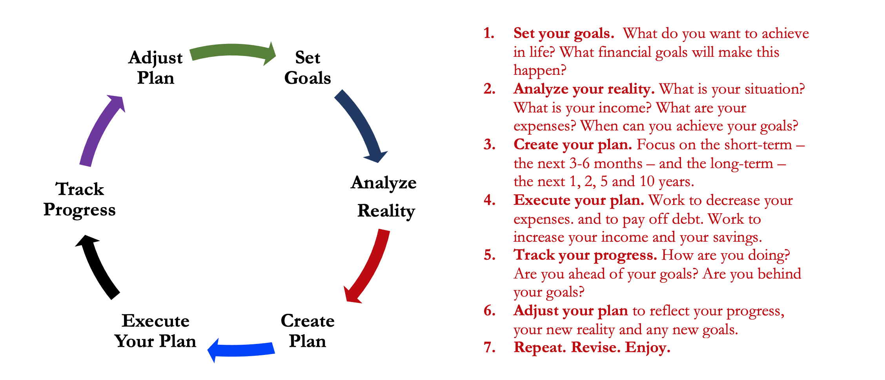
Isn’t this a lot like what you do with your education planning?

Slide 61
You’ve been doing this with your education for years.
You’re about to begin doing this with your career…and you will continue working through this process for the next 30 or 40 years.
Whether it’s education planning or career planning, by now we know that all of our personal decisions with have financial implications.
The more we plan ahead and integrate our decision-making process, the more control we will have over our futures…and the less money will be a source of stress and the more money will be a source of empowerment.
Isn’t this a lot like what you do with your education planning?

Slide 62
MONEY MATTERS SERIES: SPRING 2024
JANUARY 31
INTERNATIONAL STUDENTS: JOBS, TAXES, MONEY
FEBRUARY 8
INVESTING: OPENING YOUR OWN ROTH IRA
FEBRUARY 22
DEBT MANGEMENT, INCOME MANAGEMENT & YOUR FAMILY
MARCH 6
TAX STRATEGIES & TAX PLANNING
MARCH 20
CREATING & BUILDING A SIDE-HUSTLE: MAKING IT A BUSINESS
APRIL 18
CAREER PLANNING: YOUR FUTURE & YOUR MONEY

Slide 63
brian.bolton@louisiana.edu

Slide 64
gradschool@louisiana.edu

