Slide 1
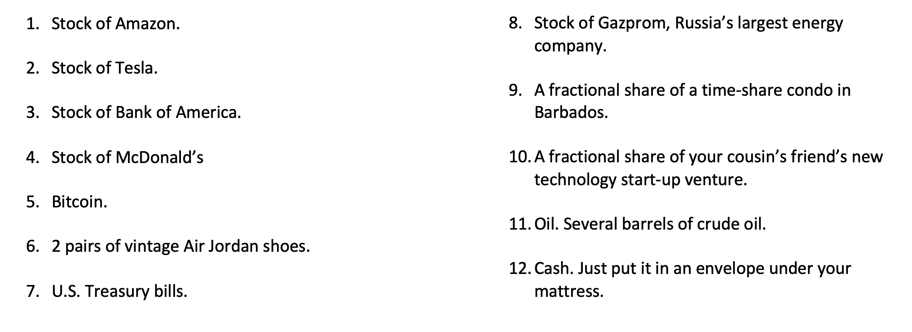
Imagine that you won $1,000 playing a scratch-off lottery ticket. Congratulations!
And now you want to invest this $1,000 to work towards achieving your personal goals.
Which of the following are you going to invest in?
Please select up to 3 of these options and discuss your selection with a neighbor.

Slide 2
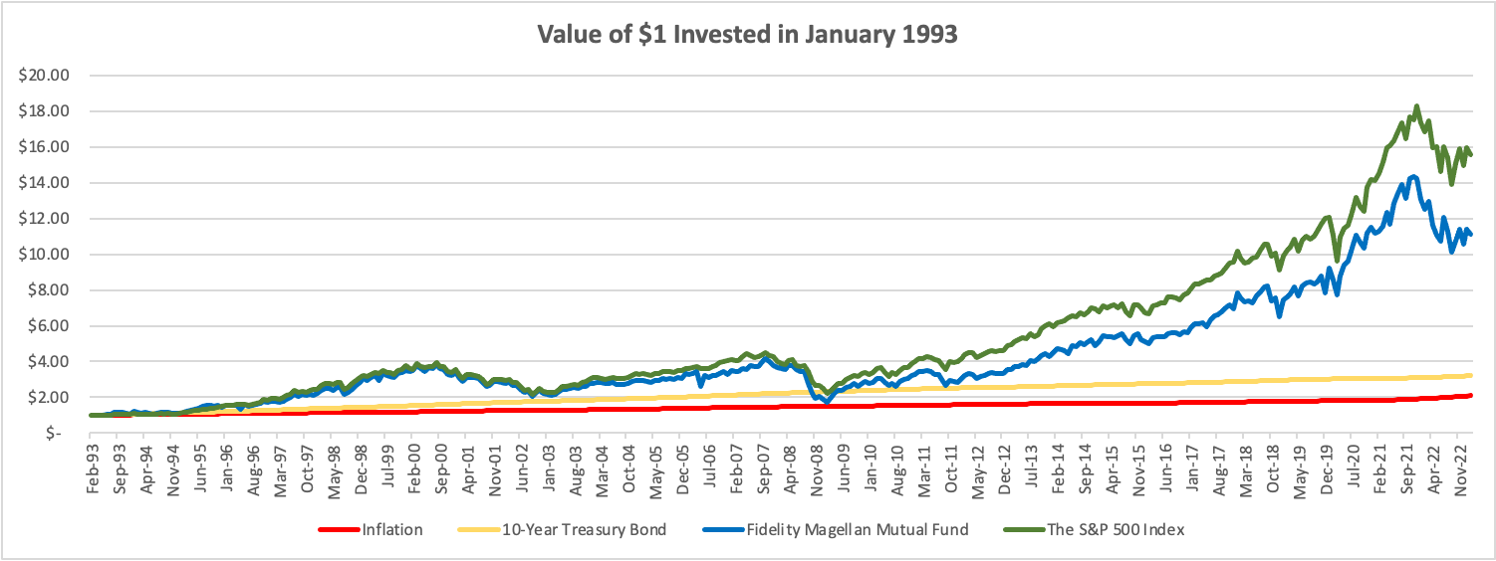
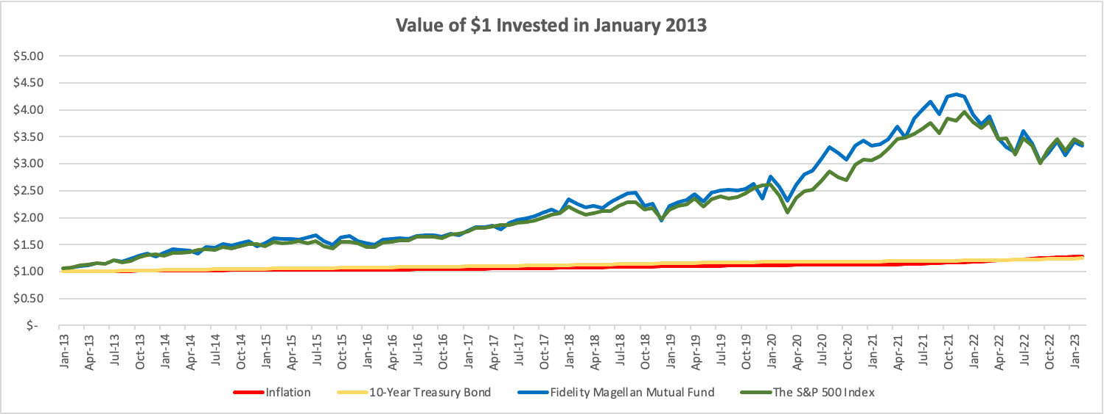

Slide 3


MONEY MATTERS
2024 Spring SESSION #2
February 8, 2024
INVESTING & OPENING A ROTH IRA
(An Individual Retirement Account with Special Features)
Let’s get started investing towards your long-term goals.
Manage Your Money Today
Maximize Your Money in the Future

Slide 4
MONEY MATTERS SERIES: SPRING 2024
JANUARY 31
INTERNATIONAL STUDENTS: JOBS, TAXES, MONEY
FEBRUARY 8
INVESTING:
OPENING YOUR OWN ROTH IRA
FEBRUARY 22
DEBT MANGEMENT, INCOME MANAGEMENT & YOUR FAMILY
MARCH 6
TAX STRATEGIES
& TAX PLANNING
MARCH 20
CREATING & BUILDING A SIDE-HUSTLE: MAKING IT A BUSINESS
APRIL 18
CAREER PLANNING: YOUR FUTURE & YOUR MONEY

Slide 5
School & Education
Money
Family

Slide 6
Happiness
Long-Term Goals
Short-Term Goals
Financial Needs
Family Needs

Slide 7
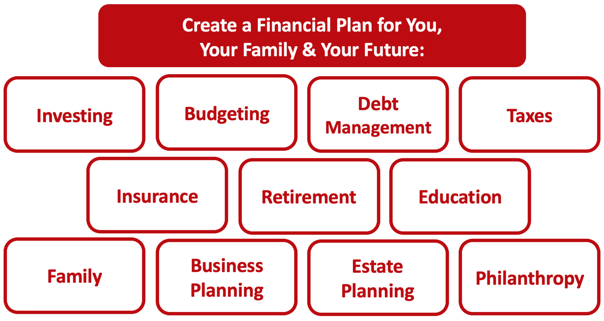

Slide 8
Owning Your Financial Future
YOUR VALUES
YOUR GOALS
Education
Career
Family
FINANCIAL STRATEGIES
Investing
Income & Expense Management
Debt Management
Taxes, Insurance & Other

Slide 9
Owning Your Financial Future
YOUR VALUES
YOUR GOALS
Education
Career
Family
FINANCIAL STRATEGIES
Investing
Income & Expense Management
Debt Management
Taxes, Insurance & Other

Slide 10
TODAY THE NEXT 6 MONTHS THE NEXT 12 MONTHS 2 YEARS AFTER GRADUATION 3 YEARS AFTER GRADUATION
ONCE EVERY SEMESTER:
TRACK EVERY PENNY THAT YOU SPEND & TRACK EVERY PENNY THAT YOU EARN
IN THE NEXT 3 MONTHS:
IDENTIFY WAYS TO DECREASE YOUR DISCRETIONARY SPENDING BY 25%
IN THE NEXT 6 MONTHS:
MAKE A PLAN TO MANAGE – AND PAY OFF – YOUR DEBT
IN THE NEXT 6-12 MONTHS:
OPEN MULTIPLE SAVINGS ACCOUNTS, 1 FOR EACH GOAL
IN THE NEXT 12 MONTHS, OPEN AN IRA OR ROTH IRA
WITHIN 2 YEARS OF GRADUATION:
HAVE AN “EMERGENCY FUND” ACCOUNT, WITH 3-6 MONTHS OF NON-DISCRETIONARY EXPENSES
WITHIN 3 YEARS OF GRADUATION:
ELIMINATE ALL OF YOUR BAD DEBT.

Slide 11
TODAY THE NEXT 6 MONTHS THE NEXT 12 MONTHS 2 YEARS AFTER GRADUATION 3 YEARS AFTER GRADUATION
ONCE EVERY SEMESTER:
TRACK EVERY PENNY THAT YOU SPEND & TRACK EVERY PENNY THAT YOU EARN
IN THE NEXT 3 MONTHS:
IDENTIFY WAYS TO DECREASE YOUR DISCRETIONARY SPENDING BY 25%
IN THE NEXT 6 MONTHS:
MAKE A PLAN TO MANAGE – AND PAY OFF – YOUR DEBT
IN THE NEXT 6-12 MONTHS:
OPEN MULTIPLE SAVINGS ACCOUNTS, 1 FOR EACH GOAL
IN THE NEXT 12 MONTHS, OPEN AN IRA OR ROTH IRA
WITHIN 2 YEARS OF GRADUATION:
HAVE AN “EMERGENCY FUND” ACCOUNT, WITH 3-6 MONTHS OF NON-DISCRETIONARY EXPENSES
WITHIN 3 YEARS OF GRADUATION:
ELIMINATE ALL OF YOUR BAD DEBT.

Slide 12
Financial Wellness
Don’t wait around for other people to be happy for you.
Any happiness you get,
You’ve got to make yourself.
~ Alice Walker
American novelist, poet, activist

Slide 13
Note to INTERNATIONAL STUDENTS
Most of you should be eligible to do everything that we will introduce today.
  The U.S. government may prohibit students from certain countries from investing in the U.S.
  Your visa status may prohibit you from opening an investment or bank account in the U.S.
  But, most of you can invest exactly as any U.S. citizen can
The fine print:
  If you return home following graduation, you do not have to close the account.
    The money still belongs to you and only you can access it.
    However, you are also still subject to the rules of the account. With a Roth IRA, you cannot access the funds until you turn 59 ½ years old or you will pay a 10% penalty.
    There are not any future tax implications with a Roth IRA in the U.S. Whether you pay taxes in your home country depends on that country’s policies.
  If you stay in the U.S. following graduation, then nothing changes – the account is yours and you can keep contributing to it and changing your investments just as anyone else can.
To me, the financial planning decision comes down to this: You may not want to lock-up some of your precious cash flow in a U.S. retirement account given that you may need that precious cash flow to navigate your future career and home uncertainty.

Slide 14
Planning for Retirement – Why do it NOW?
Conceptually, the earlier we begin saving for retirement, the more we will benefit from compound interest when we get to retirement age.
  If you invest $6,000 per year from age 25 to age 60, you would have $1,300,000 in your account at age 60 (assuming a 9% annual return).
  If you wait 10 years and invest $6,000 per year from age 35 to age 60, you would have $500,000 in your account at age 60 (assuming a 9% annual return).

Slide 15
Planning for Retirement – How to do it?
A taxable-brokerage account (with Robinhood, Fidelity or some other brokerage)
    You contribute/invest after-tax cash flow (what is leftover from your paycheck)
    Your investments should grow over time
    You pay income taxes today, before investing, and then capital gains when you withdraw the money in the future
    This is the most flexible…but has the fewest tax benefits
A company-sponsored retirement plan: 401(k) or 403(b), in most cases.
    Your employer may match some of your contributions (= “free money”)
    Your investments should grow over time
    You will pay income taxes when you withdraw the money in retirement, only
    You never pay capital gains taxes on the growth – that’s good

Slide 16
Planning for Retirement – How to do it?
An IRA – Individual Retirement Account, designed for people without a company sponsored retirement plan
    Available through Robinhood, Fidelity or most other brokerages
    You contribute/invest PRE-TAX cash flow today
    Your investments should grow over time
    You pay income taxes in retirement
A Roth IRA
    Available through Robinhood, Fidelity or most other brokerages
    You contribute/invest AFTER-TAX cash flow today
    Your investments should grow over time
    You pay income taxes today, but never again
    Roth IRAs are ideal for people with relatively low income today,
    who expect their income to increase in the future

Slide 17
Opening a Roth IRA – The Fine Print
But what is an IRA? Why the Roth IRA?
  An IRA is an Individual Retirement Account.
  You are allowed to contribute $6,500 per year
  An IRA has tax advantages to a regular brokerage account, in that it allows you avoid capital gains taxes
    With a Roth IRA, you use after-tax money to invest today. The money should grow over time, but then when you with withdraw the money in retirement, you do NOT pay income taxes
    With a traditional IRA, you get a tax-deduction today for the amount that you invest. So you do not pay taxes today on that amount of income. But then you will pay income taxes when you withdraw the money in retirement.
    The key decision is based on whether you think your tax rate will be higher today or in the future.
    This is why we recommend a Roth IRA to graduate students: Your income tax rate is probably lower today than it will be in the future, so you want to pay taxes today and avoid taxes in the future. The Roth lets you do this.
  The bad news is that the money you put into an IRA cannot be withdrawn, unless you pay a 10% penalty, until you turn 59 ½ years old
  There is more fine print that we are skipping over here and some minor exceptions to this overview, but this should cover most of you and most situations.

Slide 18
Opening a Roth IRA – A Checklist
  Research – and pick – a brokerage or financial institution to use.
      Functionally & legally, as far as managing your account and investments, they are going to be similar.
      However, the user interfaces will be different…including how you use the account and resources available. That’s the decision – which interface do you like best.
      And, some brokerages may not offer certain types of accounts.
      Robinhood, Fidelity, Charles Schwab, JP Morgan Chase, Bank of America, TD Ameritrade and many others are all good.
  Establish and open your Roth IRA account.
      This will require your Social Security number and other personal information, but not too much. It should take 5-10 minutes.
  Fund your Roth IRA account.
      Link a bank account to your Roth IRA to allow online transfers. It may take 1-2 weeks initially to get the money transferred as the Roth IRA account verifies your bank accounts.
      Your brokerage may allow wire transfers for a fee, but the initial transfer may still take 1-2 weeks
      You may be able to upload an electronic copy of a personal check to deposit funds into your Roth IRA account.
      You may be able to go old school and visit a branch of your brokerage to do everything in person.
  Begin investing and saving for your retirement.

Slide 19
Opening a Roth IRA – A Checklist
  Research – and pick – a brokerage or financial institution to use.
  Establish and open your Roth IRA account.
  Fund your Roth IRA account.
  Begin investing and saving for your retirement.
  This all begins with understanding who you are and what your investment goals are.
  And this all begins with your Investment Policy Statement.

Slide 20
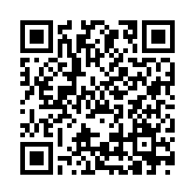
Money Matters Investing & Roth IRA Survey
What questions do you have?
What do you want to know from about investing or Retirement Accounts
What do you think of this event – the food, the location, the topic, the people?
What events do you want to have in the future?

Slide 21
Your INVESTMENT POLICY STATEMENT
An Investment Policy Statement is your personal investing roadmap and strategy.
It includes a holistic perspective on what your investing goals are and what your investing preferences are.
  It does not include specific details, like your income or stocks you own or want to buy. It’s focused on big-picture strategy, not on execution.
It is about you, your family and your preference.
We want you to be able to use this today and after you graduate and your income (hopefully) increases.
We want you to be able to share this with your family or with a financial advisor who might be able to help you execute your strategy.
Even if you do not have the excess money to invest today, thinking about these issues today can help you be prepared for making such decisions when you are capable.

Slide 22
Your INVESTMENT POLICY STATEMENT
An Investment Policy Statement is your personal investing roadmap and strategy.
It includes the following information:
  Some brief personal information, about you and your situation
  Your risk tolerance
  Your investing goals
  Your tax, liquidity and income preferences
  How you want to handle your investments
  How you want to allocate your investments across different asset classes (stocks vs. bonds)
  Any other personal or situational issues that may impact your ability to invest or your investment strategy

Slide 23
Your INVESTMENT POLICY STATEMENT
Let’s create your own, personal Investing Roadmap
It includes a holistic perspective on what your investing goals are and what your investing preferences are.
  It does not include specific details, like your income or stocks you own or want to buy. It’s focused on big-picture strategy, not on execution.
We want you to be able to use this today and after you graduate and your income (hopefully) increases.
We want you to be able to share this with your family or with a financial advisor who might be able to help you execute your strategy.
Even if you do not have the excess money to invest today, thinking about these issues today can help you be prepared for making such decisions when you are capable.

Slide 24
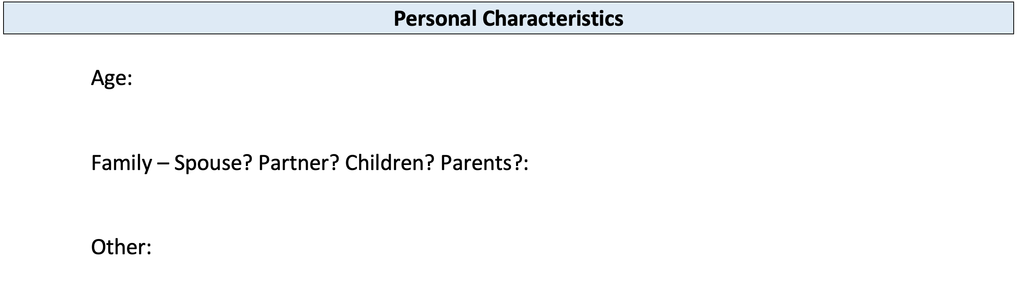
Your INVESTMENT POLICY STATEMENT

Slide 25
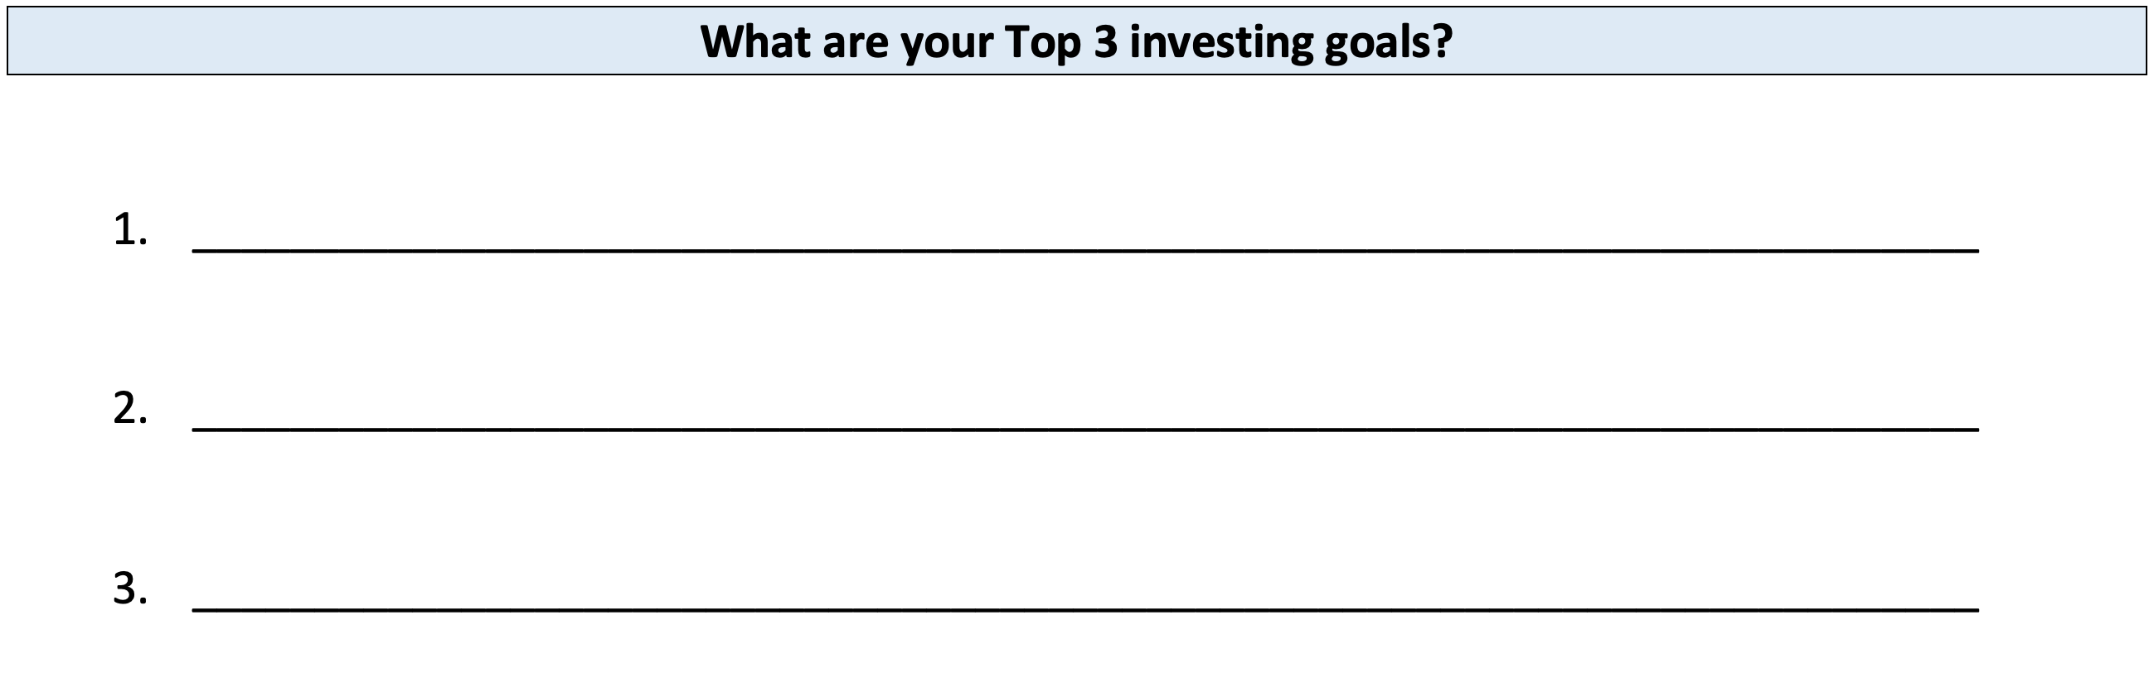
Your INVESTMENT POLICY STATEMENT

Slide 26
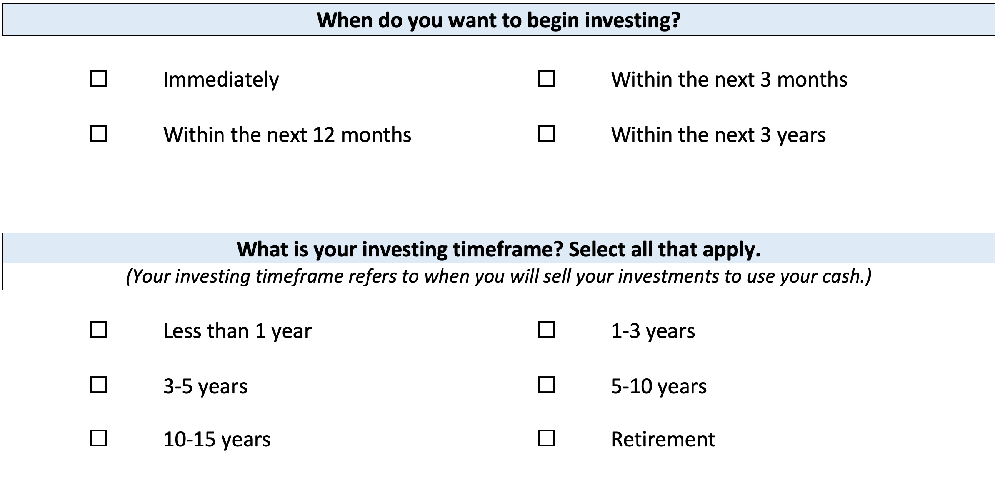
Your INVESTMENT POLICY STATEMENT

Slide 27
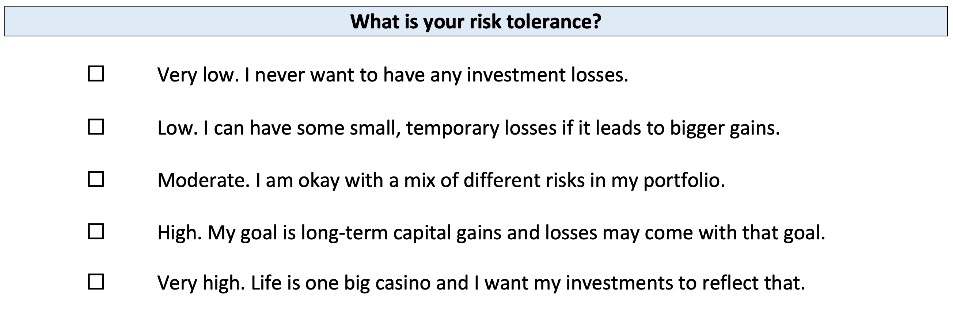
Your INVESTMENT POLICY STATEMENT

Slide 28
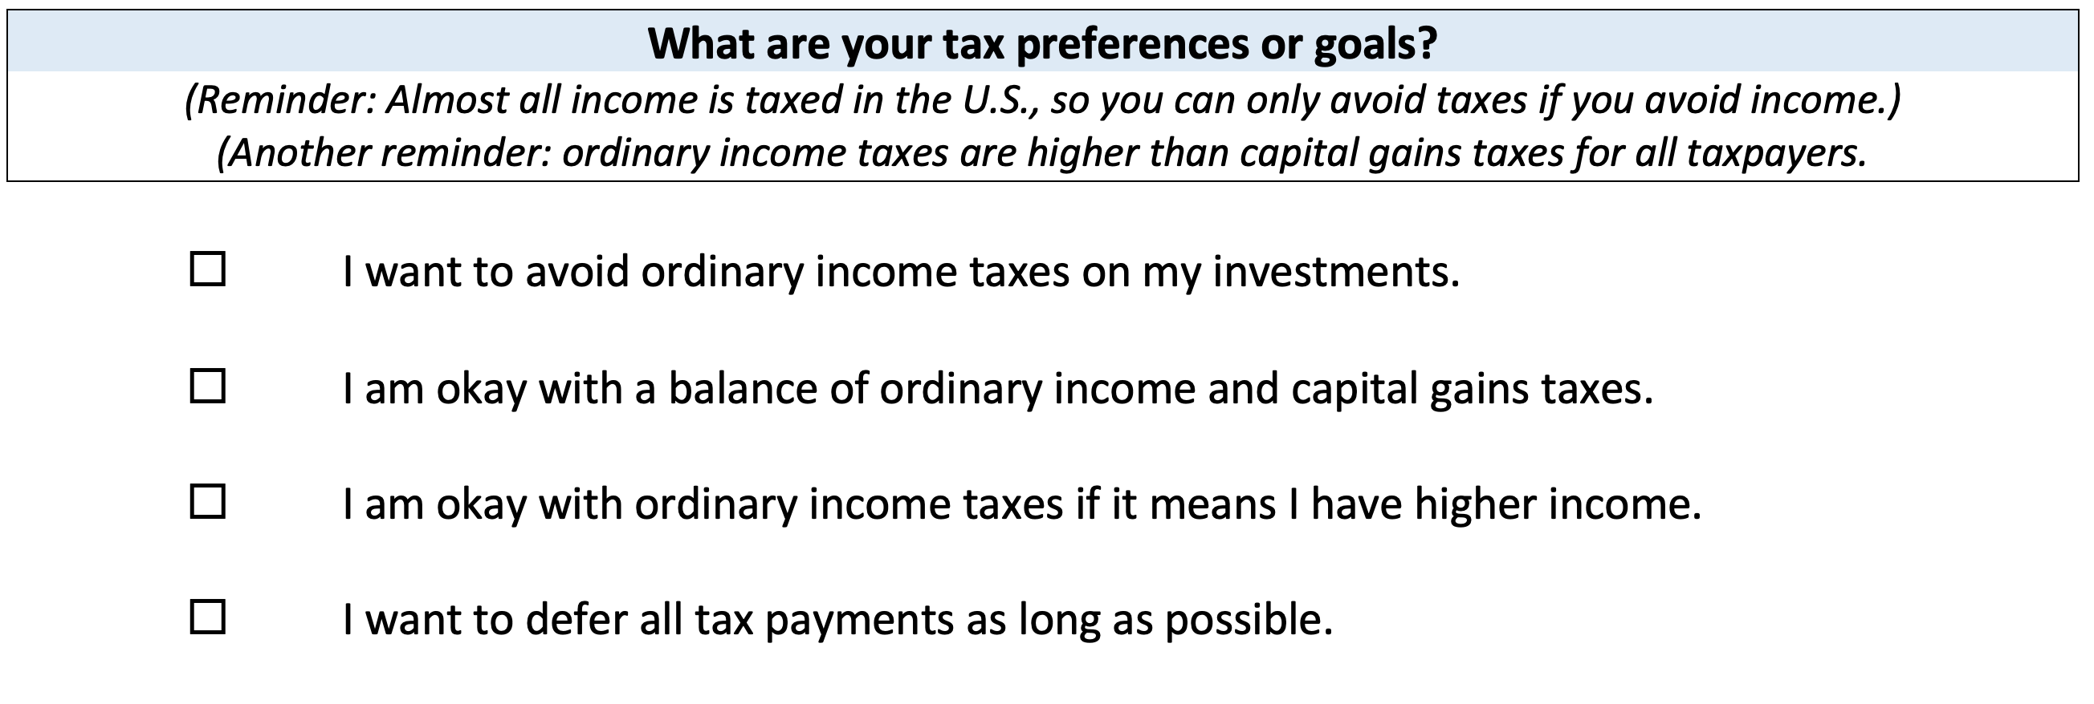
Your INVESTMENT POLICY STATEMENT

Slide 29
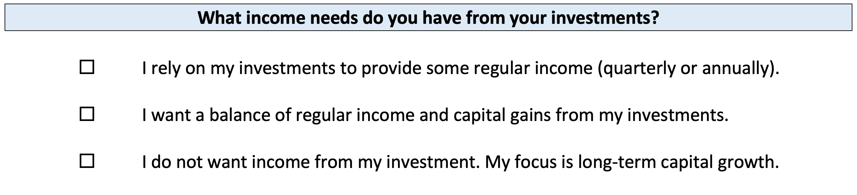
Your INVESTMENT POLICY STATEMENT

Slide 30
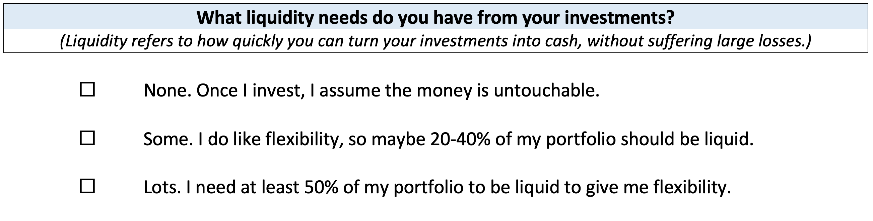
Your INVESTMENT POLICY STATEMENT

Slide 31
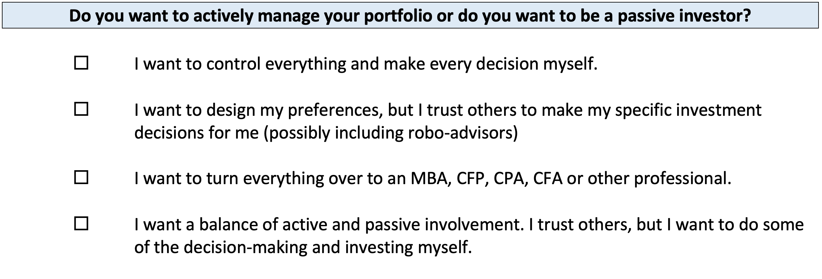
Your INVESTMENT POLICY STATEMENT

Slide 32
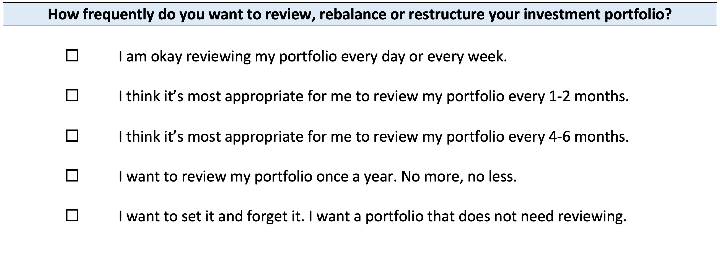
Your INVESTMENT POLICY STATEMENT

Slide 33
Your INVESTMENT POLICY STATEMENT
ASSET ALLOCATION
We know that the asset classes or categories you choose are responsible for 90% of portfolio returns, while specific security selection within classes is responsible for 10% of returns.
This means that how you decide to allocate your investments is the primary driver of your investment returns.
  Think about which geographic regions you want to invest in.
  Think about how to distribute your investment across asset categories.
    Stocks, bonds, currency, real estate, crypto, value stocks, growth stocks,
    large companies, small companies, oil, gold…

Slide 34
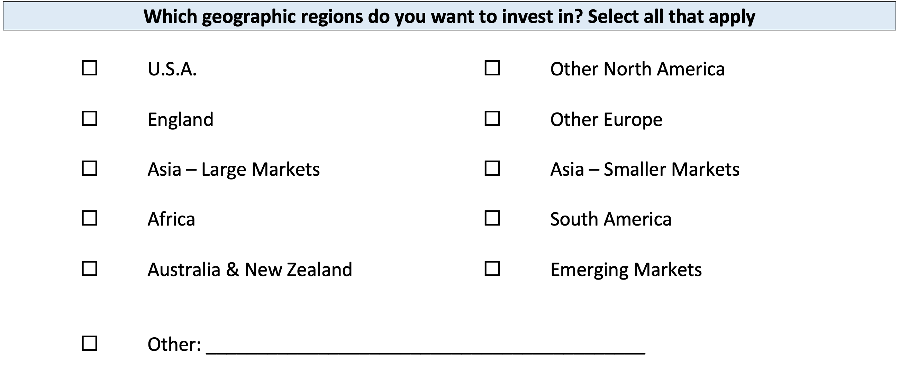
Your INVESTMENT POLICY STATEMENT

Slide 35
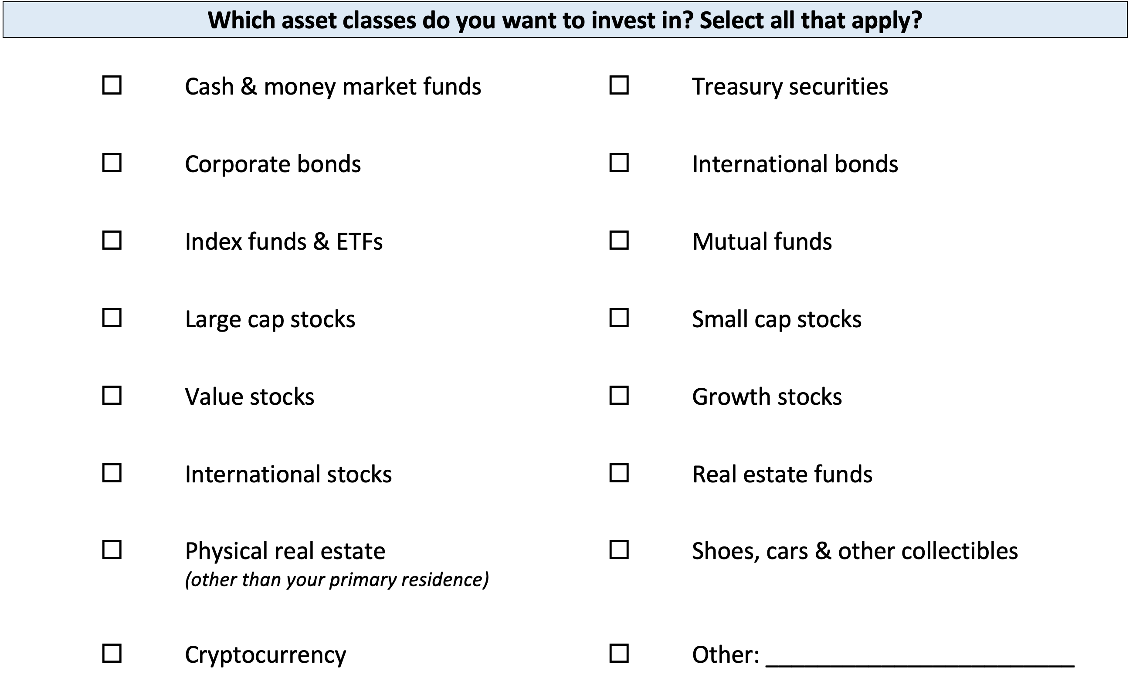
Your INVESTMENT POLICY STATEMENT

Slide 36
Your INVESTMENT POLICY STATEMENT

Slide 37
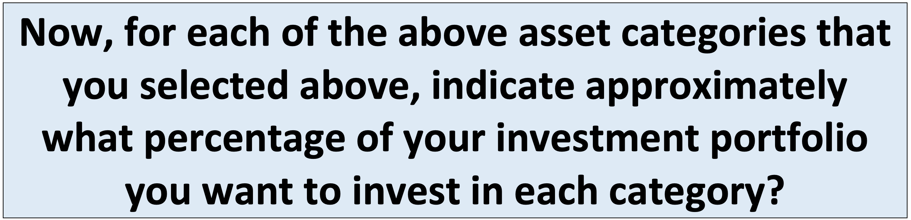
Your INVESTMENT POLICY STATEMENT

Slide 38
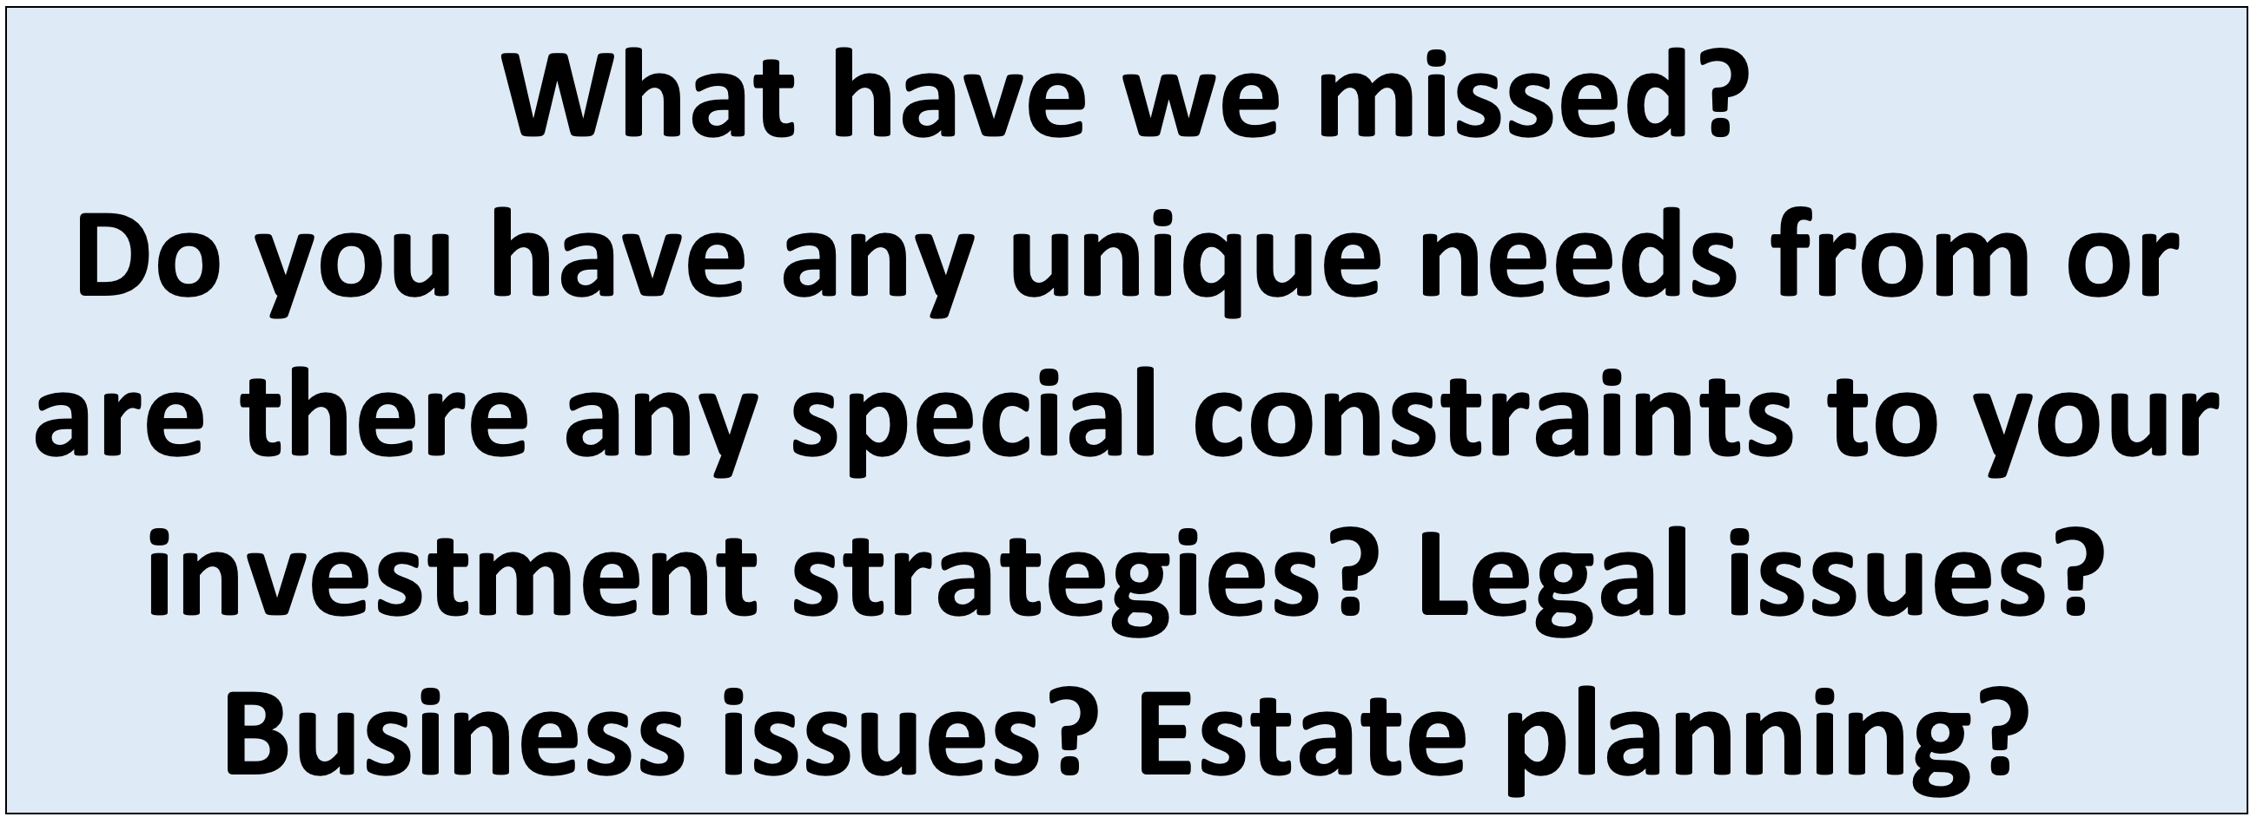
Your INVESTMENT POLICY STATEMENT

Slide 39
Your INVESTMENT POLICY STATEMENT
Once you complete this worksheet….
And once you open your Roth IRA account…
You are ready to begin investing. Now you just have to decide which of the 10,000+ securities to invest in.
Work on this with your spouse or family.
Revise and update it after you graduate.
Continue refining it throughout your investing life…make it about you and your goals.

Slide 40
I DO NOT GIVE INVESTMENT ADVICE
But here are some investment issues to think about:
Do you want to pick individual stocks (or other securities) and monitor them regularly?
  This can help you feel more control, more connection and more personal interest in your investments.
  Advantages: Potential for big gains, maybe a personal connection to the companies, you feel more engaged with the process.
  Disadvantages: Potential for big losses, requires more time and energy, transaction costs (trading, taxes) can add up, there are 1000s to choose from, potential loss of sleep and hair.

Slide 41
I DO NOT GIVE INVESTMENT ADVICE
But here are some investment issues to think about:
Or, would you be content investing in mutual funds and/or market indexes that pool dozens or hundreds of stocks?
  Advantages: Potential for moderate gains, lower risk (through diversification), lower trading and tax costs, you can narrow down the selection pretty quickly, less loss of sleep and hair
  Disadvantages: Lots of singles and doubles but no home runs, no emotional connection to your investments, susceptible to big market downturns (but not necessarily more than individual stocks)

Slide 42
I DO NOT GIVE INVESTMENT ADVICE
If you want to invest in individual stocks, I cannot help you.
But if you are interested in market indexes, here are some ideas:
  SPY – The S&P 500 index. 500 of the largest U.S. firms, from all industries.
  SPYD – The same as above, with a focus on those companies that pay regular dividends out to investors from their earnings. You will get more income, but possibly lower long-term capital gains.
  IWM – The Russell 2000. 2000 smaller U.S. firms (the 2000 firms after the 1000 largest firms). More volatility, possibly higher returns.
  EFA – Index of non-US firms (Europe, Far East, Australasia). Big firms.
  EEM – Index of non-US, emerging market stocks. Bigger firms in developing countries. More risk than any of the above.
  GBTC – A Bitcoin index. Invest in Bitcoin without mining or owning. Big Risk.

Slide 43
Investing – How Do You Do It?
When you’re just getting started with investing, there are a few approaches you can take:
  Start with a small amount of money – whether that’s $20 or $2,000 – and just go for it. Pick a few investments, track them regularly and be prepared to buy more or sell more should you feel comfortable doing either.

Slide 44
Investing – How Do You Do It?
When you’re just getting started with investing, there are a few approaches you can take:
  Start with a small amount of money – whether that’s $20 or $2,000 – and just go for it. Pick a few investments, track them regularly and be prepared to buy more or sell more should you feel comfortable doing either.
  Determine how much you have to invest.
    Put ½ of that into an index fund or a specific mutual fund. This will provide some security, generally with less or moderate risk.
    Put the other ½ into individual stocks or securities that intrigue you. If you’re interested in the companies, you might be more likely to follow them as investments.
    This half-half approach will help you figure out what kind of investor you are. In 1-2 years, you might gravitate more to either of the approaches that interest you more.

Slide 45
Investing – How Do You Do It?
When you’re just getting started with investing, there are a few approaches you can take:
  Start with a small amount of money – whether that’s $20 or $2,000 – and just go for it. Pick a few investments, track them regularly and be prepared to buy more or sell more should you feel comfortable doing either.
  Determine how much you have to invest.
    Put ½ of that into an index fund or a specific mutual fund. This will provide some security, generally with less or moderate risk.
    Put the other ½ into individual stocks or securities that intrigue you. If you’re interested in the companies, you might be more likely to follow them as investments.
    This half-half approach will help you figure out what kind of investor you are. In 1-2 years, you might gravitate more to either of the approaches that interest you more.
  Talk to a financial advisor. Note that they generally do not (initially) tell you which specific investments to make, but they will work talk through your options with you and help you better understand what you’re getting into.
    They will ask you 2 questions – what are your goals and what is your risk tolerance – and then work with you to find the investments that best align with your answers to these questions.

Slide 46
Long-Term Investment Planning
YOUR VALUES
YOUR GOALS
FINANCIAL STRATEGIES
INVESTMENT STRATEGIES
Identify Your Risk Tolerance
Identify Your Time Horizons
Select Investments
Monitor & Modify Investments

Slide 47
Long-Term Investment Planning
FINANCIAL STRATEGIES
EDUCATION STRATEGIES
INVESTMENT STRATEGIES
GRAD SCHOOL STRATEGIES
Identify Your Risk Tolerance
Identify Your Risk Tolerance
Identify Your Time Horizons
Identify Your Time Horizons
Select Investments
Select Your Field, Program, Specialization, Thesis
Monitor & Modify Investments
Monitor & Modify Your Progress & Plan

Slide 48

Isn’t this a lot like what you do with your education planning?

Slide 49
You’ve been doing this with your education for years.
You’re about to begin doing this with your career…and you will continue working through this process for the next 30 or 40 years.
Whether it’s education planning or career planning, by now we know that all of our personal decisions with have financial implications.
The more we plan ahead and integrate our decision-making process, the more control we will have over our futures…and the less money will be a source of stress and the more money will be a source of empowerment.
Isn’t this a lot like what you do with your education planning?

Slide 50
Question of the Day
Why are you in graduate school?
This is the biggest investment you’ve ever made. You are giving up several years, thousands of dollars and enormous effort & energy.
What return are you getting from this investment?

Slide 51
Financial Wellness
A goal without a plan is just a dream.
Wealth is largely the result of habit.
The most difficult thing is the decision to act; the rest is mere tenacity.
It takes as much energy to plan as it does to wish.
You cannot escape the responsibility of tomorrow by avoiding it today.

Slide 52
Don’t wait around for other people to be happy for you.
Any happiness you get,
You’ve got to make yourself.
A goal without a plan is just a dream.
Wealth is largely the result of habit.
The most difficult thing is the decision to act; the rest is mere tenacity.
It takes as much energy to plan as it does to wish.
You cannot escape the responsibility of tomorrow by avoiding it today.

Slide 53
MONEY MATTERS SERIES: SPRING 2024
JANUARY 31
INTERNATIONAL STUDENTS: JOBS, TAXES, MONEY
FEBRUARY 8
INVESTING:
OPENING YOUR OWN ROTH IRA
FEBRUARY 22
DEBT MANGEMENT, INCOME MANAGEMENT & YOUR FAMILY
MARCH 6
TAX STRATEGIES
& TAX PLANNING
MARCH 20
CREATING & BUILDING A SIDE-HUSTLE: MAKING IT A BUSINESS
APRIL 18
CAREER PLANNING: YOUR FUTURE & YOUR MONEY

Slide 54

brian.bolton@louisiana.edu http//:business.louisiana.edu/financeispersonal

Slide 55

gradschool@louisiana.edu

