Slide 1
Imagine that you won $1,000 playing a scratch-off lottery ticket. Congratulations!
And now you want to invest this $1,000 to work towards achieving your personal goals.
Which of the following are you going to invest in?
Please select up to 3 of these options and discuss your selection with a neighbor.
Stock of Amazon.
Stock of Tesla.
Stock of Bank of America.
Stock of Bed, Bath & Beyond
Bitcoin.
2 pairs of vintage Air Jordan shoes.
U.S. Treasury bills.
Stock of Gazprom, Russia’s largest energy company.
A fractional share of a time-share condo in Barbados.
A fractional share of your cousin’s friend’s new technology start-up venture.
Oil. Several barrels of crude oil.
Cash. Just put it in an envelope under your mattress.

Slide 2
Opening Quiz – Question #1
The U.S. stock markets had a terrible 2022. But that was just 1 year.
If you had invested $1,000 in the S&P 500 at the beginning of 2021
(2 years years ago), how much would that $1,000 be worth today?
A. $557
B. $755
C. $1,058
D. $3,149

Slide 3
Opening Quiz – Question #1
The U.S. stock markets had a terrible 2022. But that was just 1 year.
If you had invested $1,000 in the S&P 500 at the beginning of 2021
(2 years years ago), how much would that $1,000 be worth today?
A. $557
B. $755
C. $1,058
D. $3,149

Slide 4
Opening Quiz – Question #2
The U.S. stock markets had a terrible 2022. But that was just 1 year.
If you had invested $1,000 in the S&P 500 at the beginning of 2013
(10 years ago), how much would that $1,000 be worth today?
A. $557
B. $755
C. $1,058
D. $3,149

Slide 5
Opening Quiz – Question #2
The U.S. stock markets had a terrible 2022. But that was just 1 year.
If you had invested $1,000 in the S&P 500 at the beginning of 2013
(10 years ago), how much would that $1,000 be worth today?
A. $557
B. $755
C. $1,058
D. $3,149
That’s an average annual return of 12% of over 10 years.

Slide 6
Opening Quiz – Question #3
Which of these 4 countries currently
has the highest inflation rate?
United States
England
Germany
Mexico

Slide 7
Opening Quiz – Question #3
Which of these 4 countries currently
has the highest inflation rate?
United States
England
Germany
Mexico

Slide 8
Opening Quiz – Question #4
Which of these 4 countries
currently has the LOWEST inflation rate?
United States
England
Germany
Mexico

Slide 9
Opening Quiz – Question #4
Which of these 4 countries
currently has the LOWEST inflation rate?
United States (6.5%)
England (10.2%)
Germany (8.6%)
Mexico (7.8%)

Slide 10
Opening Quiz – Question #5
Which of these 4 stocks had
the HIGHEST RETURN during 2022?
Amazon
Tesla
Bank of America
Bed, Bath & Beyond

Slide 11
Opening Quiz – Question #5
Which of these 4 stocks had
the HIGHEST RETURN during 2022?
Amazon
Tesla
Bank of America
Bed, Bath & Beyond

Slide 12
Opening Quiz – Question #6
Which of these 4 stocks had
the LOWEST RETURN during 2022?
Amazon
Tesla
Bank of America
Bed, Bath & Beyond

Slide 13
Opening Quiz – Question #6
Which of these 4 stocks had
the LOWEST RETURN during 2022?
Amazon -50%
Tesla -65%
Bank of America
-24%
Bed, Bath & Beyond
-86%

Slide 14
Opening Quiz – Question #7
Which of these 4 securities has high had
the highest return over the past 5 years?
Amazon
Tesla
Bank of America
Bitcoin

Slide 15
Opening Quiz – Question #7
Which of these 4 securities has high had
the highest return over the past 5 years?
Amazon +22%
Tesla +433%
Bank of America
+22%
Bitcoin
+152%

Slide 16
Opening Quiz – Question #8 – Last One
If I had invested $1,000 into the S&P 500, the overall U.S. stock market, on the day that I was born, how much would that be worth today?
A. $1,000
B. $12,257
C. $43,656
C. $85,035

Slide 17
Opening Quiz – Question #8 – Last One
If I had invested $1,000 into the S&P 500, the overall U.S. stock market, on the day that I was born, how much would that be worth today?
A. $1,000
B. $12,257
$43,656
That’s an annual return of just over 10% per year.
C. $85,035

Slide 18


MONEY MATTERS
2022-2023 SESSION #8
February 1, 2023
DESIGNING AN INVESTING ROADMAP
Let’s create your own personal Investment Policy Statement for your goals.
Manage Your Money Today
Maximize Your Money in the Future

Slide 19
Happiness
Long-Term Goals
Short-Term Goals
Financial Needs
Family Needs

Slide 20
Owning Your Financial Future: Spring 2023
FINANCIAL PLANNING FOR INTERNATIONAL STUDENTS
Thursday, January 19
INVESTING, PART 1
TODAY – Wednesday, February 1
TAX PLANNING STRATEGIES
Tuesday, February 28
INVESTING, PART 2
Tuesday, March 21
CAREER PLANNING & FINANCIAL PLANNING
Thursday, April 20

Slide 21
Owning Your Financial Future: Spring 2023
FINANCIAL PLANNING FOR INTERNATIONAL STUDENTS
Thursday, January 19
INVESTING, PART 1
TODAY – Wednesday, February 1
TAX PLANNING STRATEGIES
Tuesday, February 28
INVESTING, PART 2
Tuesday, March 21
CAREER PLANNING & FINANCIAL PLANNING
Thursday, April 20

Slide 22
Owning Your Financial Future: Spring 2023
FINANCIAL PLANNING FOR INTERNATIONAL STUDENTS
Thursday, January 19
INVESTING, PART 1
TODAY – Wednesday, February 1
TAX PLANNING STRATEGIES
Tuesday, February 28
INVESTING, PART 2
Tuesday, March 21
CAREER PLANNING & FINANCIAL PLANNING
Thursday, April 20

Slide 23
Owning Your Financial Future: Spring 2023
FINANCIAL PLANNING FOR INTERNATIONAL STUDENTS
Thursday, January 19
INVESTING, PART 1
TODAY – Wednesday, February 1
TAX PLANNING STRATEGIES
Tuesday, February 28
INVESTING, PART 2
Tuesday, March 21
CAREER PLANNING & FINANCIAL PLANNING
Thursday, April 20

Slide 24
Opening Question From One of You
What are some things to look out for when investing, especially when investing with a start-up?
Focus on the team.
  Who are the people behind the start-up? Do you trust them with your money?
Focus on the product or service.
  Is this something the world needs? Can this disrupt (in a good way) existing markets? Will a big competitor want to acquire this product?
Focus on the return possibilities.
  Are you able to be patient & wait several years to get a return?
  Are you willing (or able) to invest again in a future financing round?
  Are you willing to lose 100% of your investment?

Slide 25
Brian’s Economic Predictions for 2023
Inflation is decreasing…but it is still very high. Inflation was at 9.1% in June 2022; it is now at 6.5%.
  My best case estimate is for it to be at 3-4% in December. It might be 8-9%.

Slide 26
Brian’s Economic Predictions for 2023
Inflation was at 9.1% in June 2022; it is now at 6.5%.
  My best case estimate is for it to be at 3-4% in December. It might be 8-9%.
Interest rates have gone up. This will affect future borrowing costs.
  Interest rates on savings accounts are the last to go up when rates increase.
  This has slowed down inflation….a lot. We should see interest rates level off soon.

Slide 27
Brian’s Economic Predictions for 2023
Inflation was at 9.1% in June 2022; it is now at 6.5%.
  My best case estimate is for it to be at 3-4% in December. It might be 8-9%.
Interest rates have gone up. This will affect future borrowing costs.
  Interest rates on savings accounts are the last to go up when rates increase.
  This has slowed down inflation….a lot. We should see interest rates level off soon.
Macro-global issues are still worth watching. And may cause turbulence.
  Russia is still invading Ukraine.
  Covid is still in our midst. Another surge would be a problem.
  Turbulence = Uncertainty, disruption to supply chains, shocks out of nowhere.

Slide 28
Brian’s Economic Predictions for 2023
Inflation was at 9.1% in June 2022; it is now at 6.5%.
  My best case estimate is for it to be at 3-4% in December. It might be 8-9%.
Interest rates have gone up. This will affect future borrowing costs.
  Interest rates on savings accounts are the last to go up when rates increase.
  This has slowed down inflation….a lot. We should see interest rates level off soon.
Macro-global issues are still worth watching. And may cause turbulence.
  Russia is still invading Ukraine.
  Covid is still in our midst. Another surge would be a problem.
  Turbulence = Uncertainty, disruption to supply chains, shocks out of nowhere.
The job market has been strong…but may struggle during early-2023.
  You have heard about some high-profile layoffs recently. Many other companies are still hiring.
  Salaries for college graduates are at all-time highs. I expect this to continue.
  But, there will be unexpected shocks…as companies try to figure out how to do business in 2023.

Slide 29
Financial Advice for Turbulent Times
What can YOU do today to make tomorrow less stressful.
  Finish your degree. It’s the best financial investment you can make.
  Cut your discretionary expenses.
  Save when you can. Build your emergency fund.

Slide 30
Financial Advice for Turbulent Times
What can YOU do today to make tomorrow less stressful.
  Finish your degree. It’s the best financial investment you can make.
  Cut your discretionary expenses.
  Save when you can. Build your emergency fund.
  Find extra income. Sell your old books, clothes, accessories.

Slide 31
Financial Advice for Turbulent Times
What can YOU do today to make tomorrow less stressful.
  Finish your degree. It’s the best financial investment you can make.
  Cut your discretionary expenses.
  Save when you can. Build your emergency fund.
  Find extra income. Sell your old books, clothes, accessories.
  Stocks lost 15% in 2022, a truly terrible year. If you are comfortable with some risk, this may be a buying opportunity.

Slide 32
Financial Advice for Turbulent Times
What can YOU do today to make tomorrow less stressful.
  Finish your degree. It’s the best financial investment you can make.
  Cut your discretionary expenses.
  Save when you can. Build your emergency fund.
  Find extra income. Sell your old books, clothes, accessories.
  Stocks lost 15% in 2022, a truly terrible year. If you are comfortable with some risk, this may be a buying opportunity.
  My savings account is paying 0.40%.
  A 1-year certificate of deposit is paying 4.65%.

Slide 33
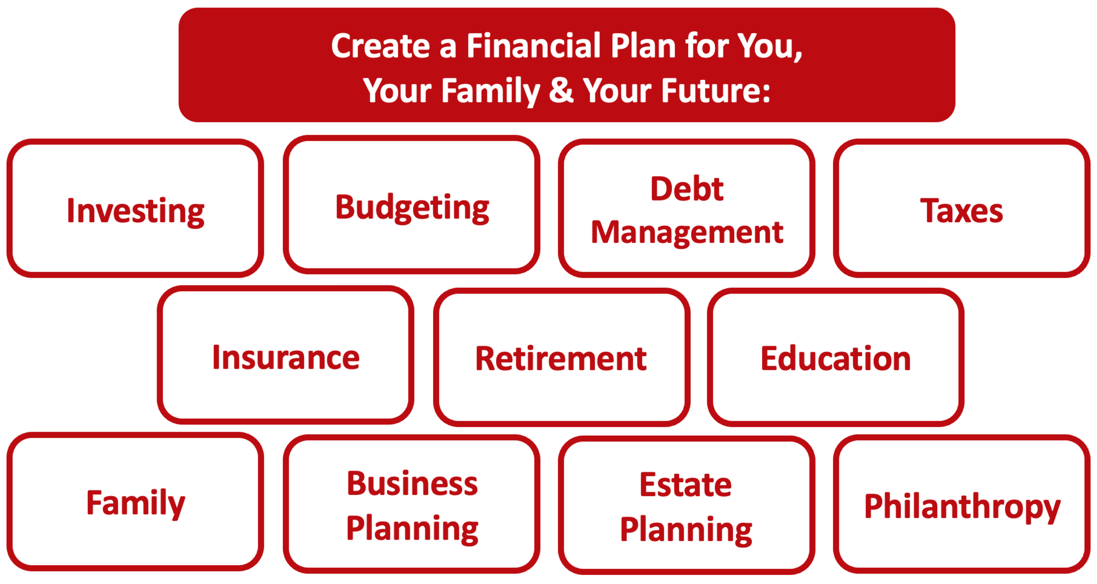

Slide 34
Owning Your Financial Future
YOUR VALUES
YOUR GOALS
Education
Career
Family
FINANCIAL STRATEGIES
Investing
Income & Expense Management
Debt Management
Taxes, Insurance & Other

Slide 35
Owning Your Financial Future
YOUR VALUES
YOUR GOALS
Education
Career
Family
FINANCIAL STRATEGIES
Investing
Income & Expense Management
Debt Management
Taxes, Insurance & Other

Slide 36
Making Financial Planning a Priority
EDUCATION STRATEGIES
GRAD SCHOOL STRATEGIES
Identify Your Resources
Identify Your
Priorities & Goals
Do Your Planning
Monitor & Modify Your Progress & Plan

Slide 37
Making Financial Planning a Priority
FINANCIAL STRATEGIES
EDUCATION STRATEGIES
BUDGETING
STRATEGIES
GRAD SCHOOL STRATEGIES
Identify Your
Income & Expenses
Identify Your Resources
Identify Your
Priorities & Goals
Identify Your
Priorities & Goals
Do Your Planning
Do Your Planning
Monitor & Modify Budgeting Activities
Monitor & Modify Your Progress & Plan

Slide 38
Making Financial Planning a Priority
FINANCIAL STRATEGIES
YOU,
as grad students, are better wired and equipped to make long-term plans – education, career, financial & otherwise – than 99% of humanity.
Be confident.
Be intentional.
Be diligent.
Be awesome.
EDUCATION STRATEGIES
BUDGETING
STRATEGIES
GRAD SCHOOL STRATEGIES
Identify Your
Income & Expenses
Identify Your Resources
Identify Your
Priorities & Goals
Identify Your
Priorities & Goals
Do Your Planning
Do Your Planning
Monitor & Modify Budgeting Activities
Monitor & Modify Your Progress & Plan

Slide 39
TODAY THE NEXT 6 MONTHS THE NEXT 12 MONTHS 2 YEARS AFTER GRADUATION 3 YEARS AFTER GRADUATION
ONCE EVERY SEMESTER:
TRACK EVERY PENNY THAT YOU SPEND & TRACK EVERY PENNY THAT YOU EARN
IN THE NEXT 3 MONTHS:
IDENTIFY WAYS TO DECREASE YOUR DISCRETIONARY SPENDING BY 25%
IN THE NEXT 6 MONTHS:
MAKE A PLAN TO MANAGE – AND PAY OFF – YOUR DEBT
IN THE NEXT 6-12 MONTHS:
OPEN MULTIPLE SAVINGS ACCOUNTS, 1 FOR EACH GOAL
IN THE NEXT 12 MONTHS, OPEN AN IRA OR ROTH IRA
WITHIN 2 YEARS OF GRADUATION:
HAVE AN “EMERGENCY FUND” ACCOUNT, WITH 3-6 MONTHS OF NON-DISCRETIONARY EXPENSES
WITHIN 3 YEARS OF GRADUATION:
ELIMINATE ALL OF YOUR BAD DEBT.

Slide 40
Financial Wellness
If you don’t know where you’ve come from, you can’t know where you’re going.
- Maya Angelou

Slide 41
Your INVESTMENT POLICY STATEMENT
An Investment Policy Statement is your personal investing roadmap and strategy.
It includes a holistic perspective on what your investing goals are and what your investing preferences are.
  It does not include specific details, like your income or stocks you own or want to buy. It’s focused on big-picture strategy, not on execution.
It is about you, your family and your preference.
We want you to be able to use this today and after you graduate and your income (hopefully) increases.
We want you to be able to share this with your family or with a financial advisor who might be able to help you execute your strategy.
Even if you do not have the excess money to invest today, thinking about these issues today can help you be prepared for making such decisions when you are capable.

Slide 42
Your INVESTMENT POLICY STATEMENT
An Investment Policy Statement is your personal investing roadmap and strategy.
It includes the following information:
  Some brief personal information, about you and your situation
  Your risk tolerance
  Your investing goals
  Your tax, liquidity and income preferences
  How you want to handle your investments
  How you want to allocate your investments across different asset classes (stocks vs. bonds)
  Any other personal or situational issues that may impact your ability to invest or your investment strategy

Slide 43
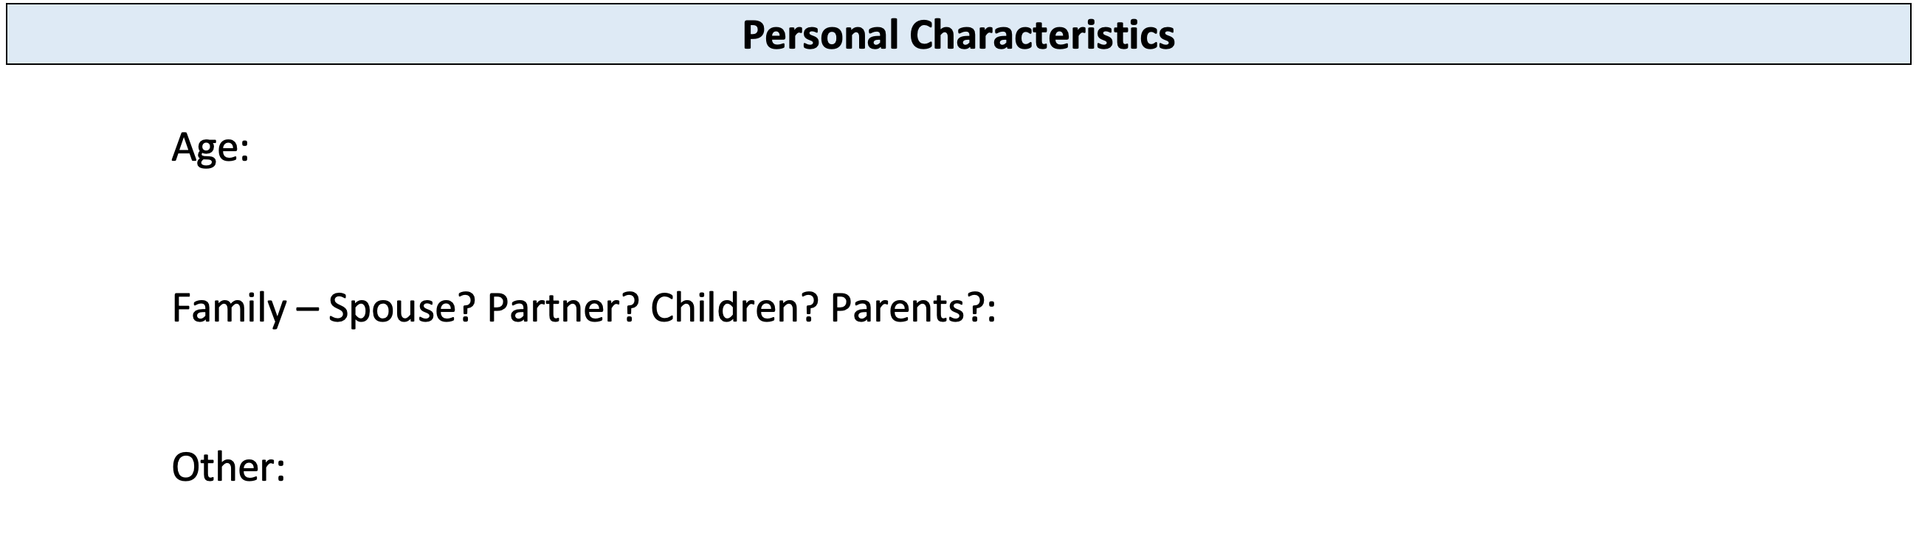
Your INVESTMENT POLICY STATEMENT

Slide 44
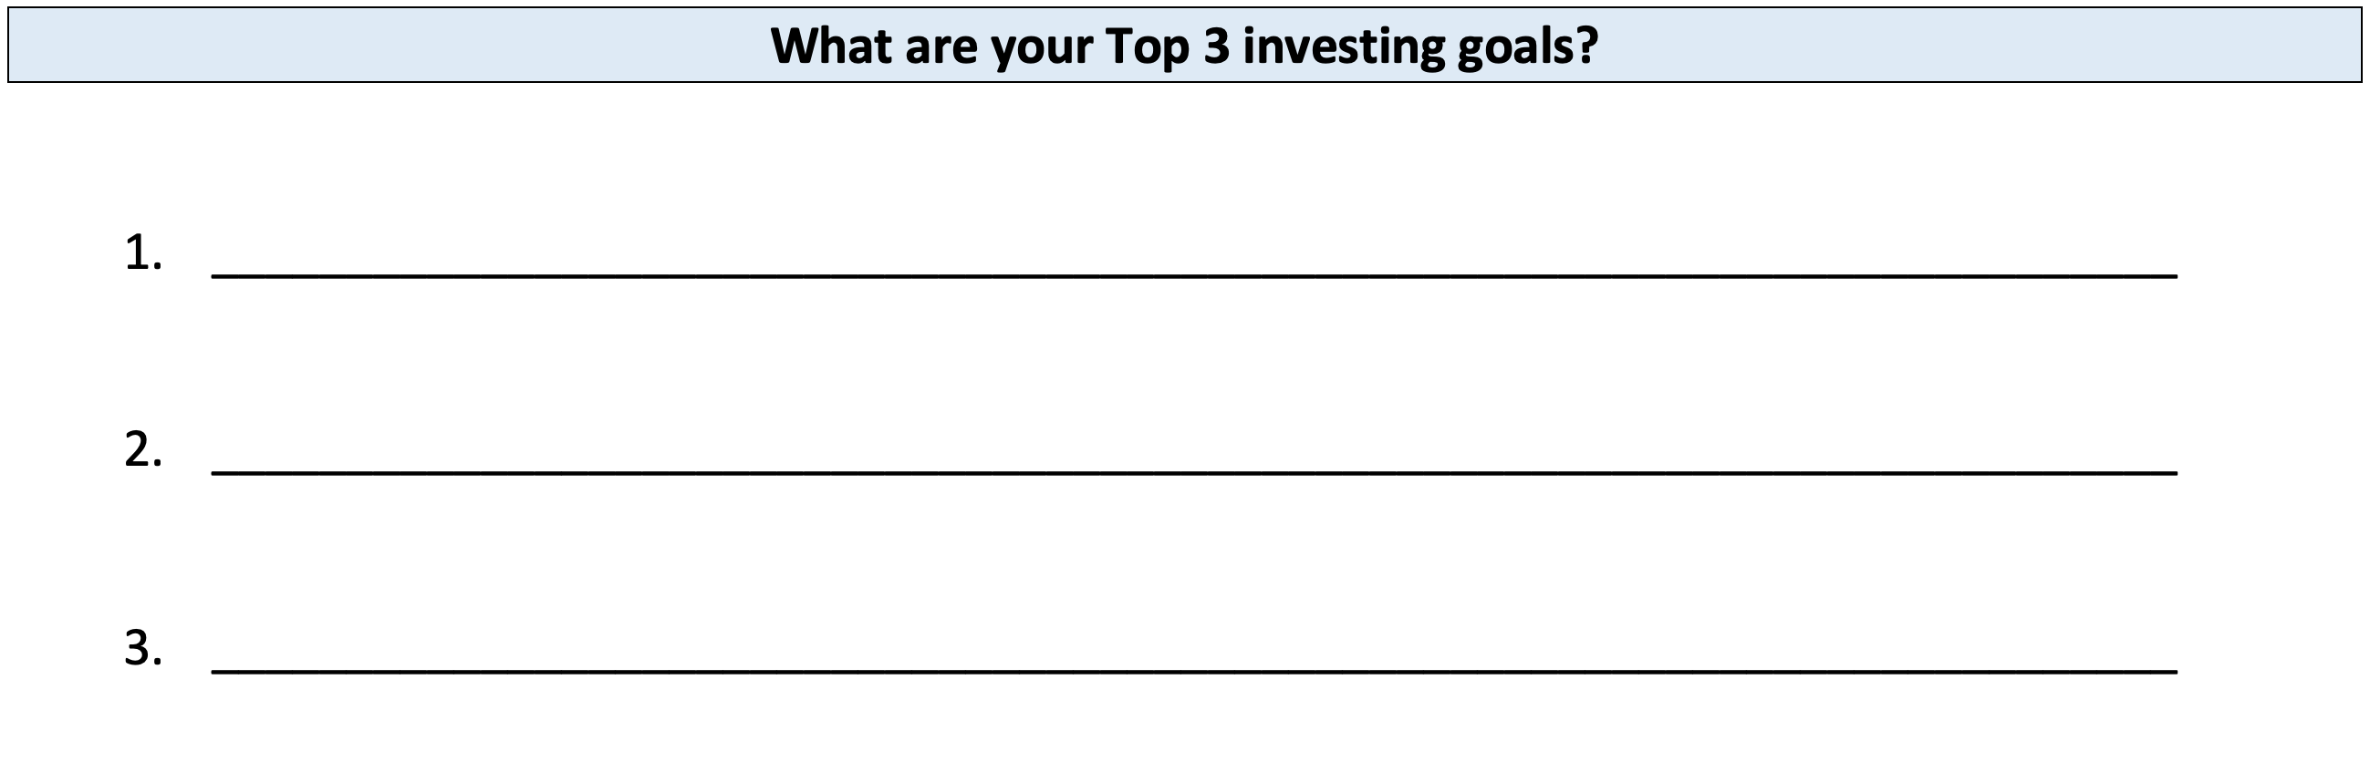
Your INVESTMENT POLICY STATEMENT

Slide 45
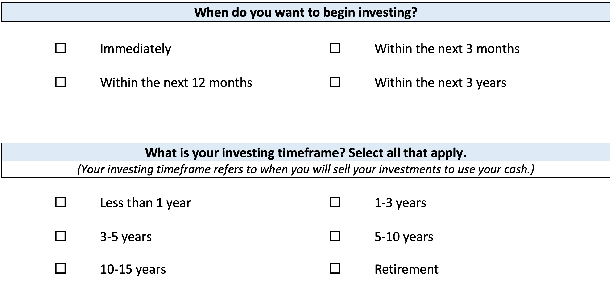
Your INVESTMENT POLICY STATEMENT

Slide 46
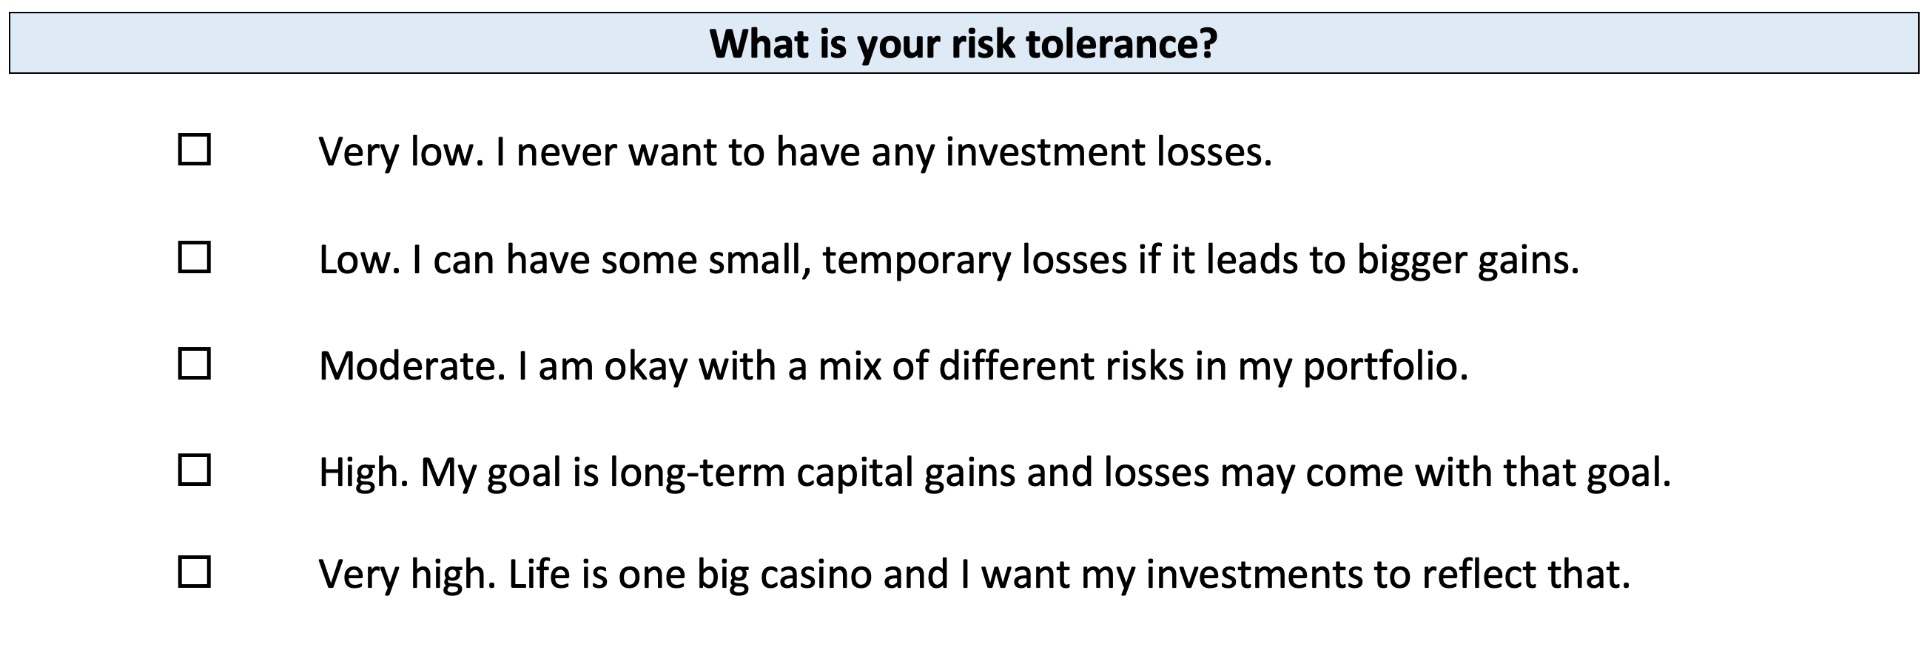
Your INVESTMENT POLICY STATEMENT

Slide 47
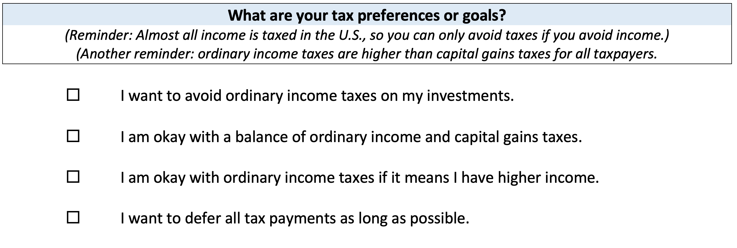
Your INVESTMENT POLICY STATEMENT

Slide 48
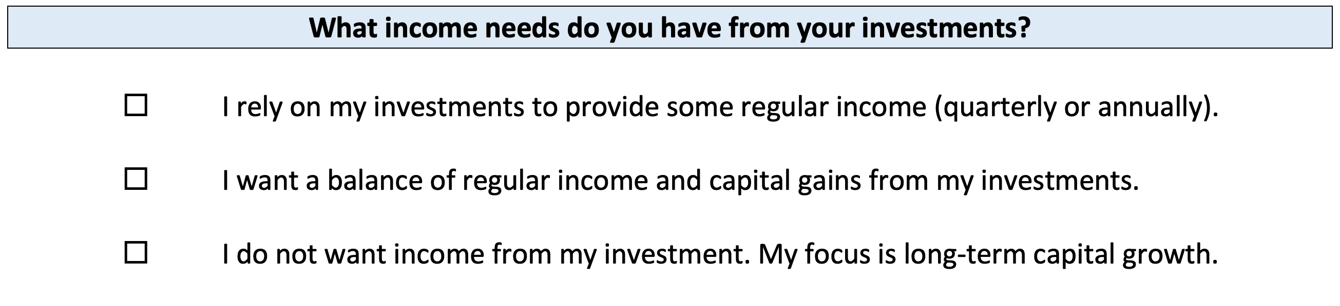
Your INVESTMENT POLICY STATEMENT

Slide 49
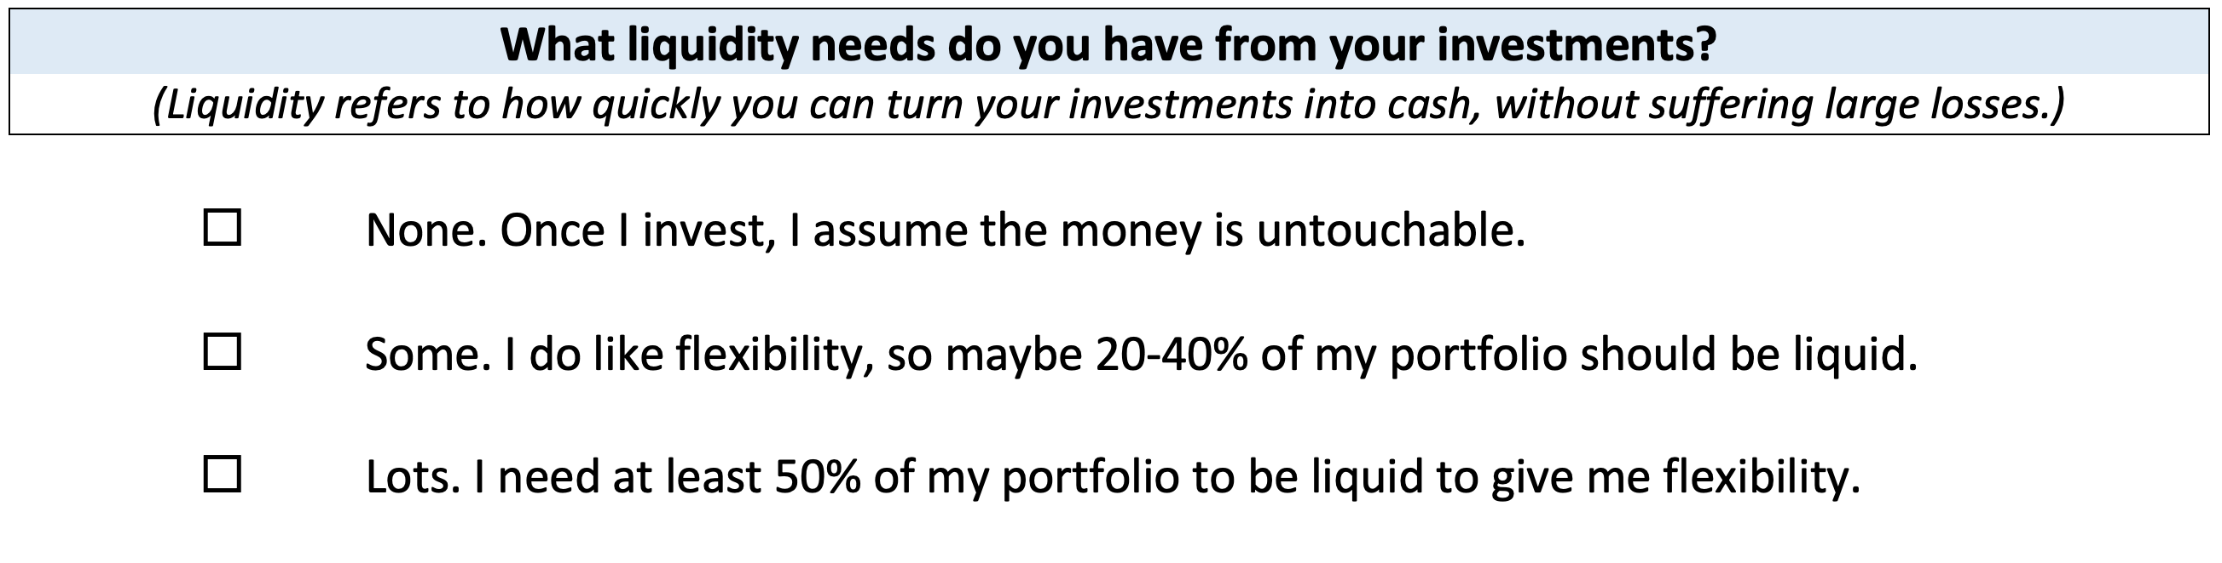
Your INVESTMENT POLICY STATEMENT

Slide 50
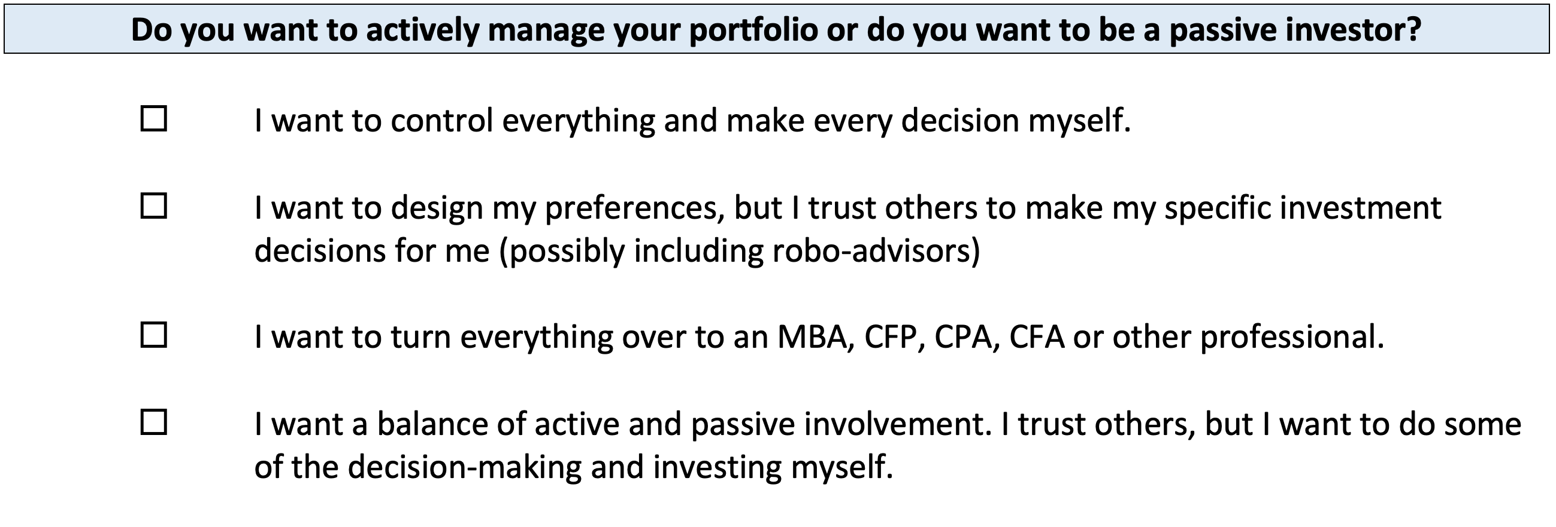
Your INVESTMENT POLICY STATEMENT

Slide 51
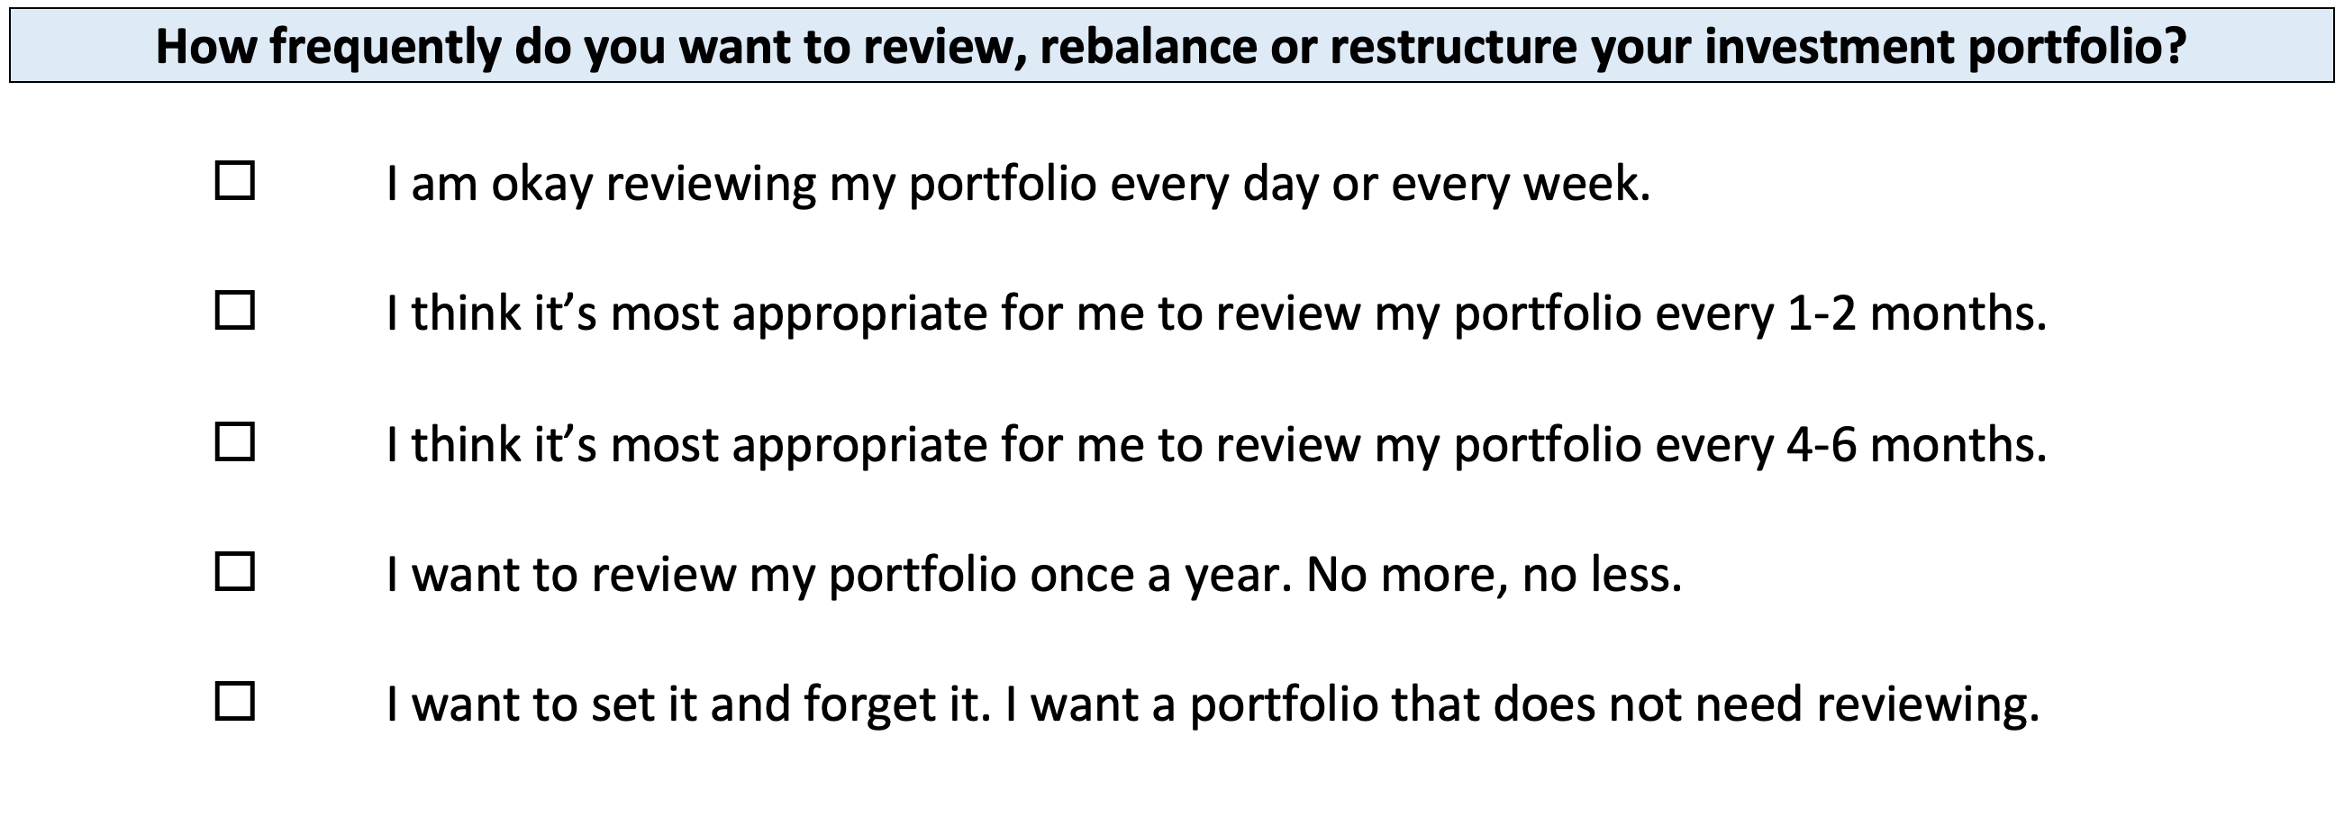
Your INVESTMENT POLICY STATEMENT

Slide 52
Your INVESTMENT POLICY STATEMENT
ASSET ALLOCATION
We know that the asset classes or categories you choose are responsible for 90% of portfolio returns, while specific security selection within classes is responsible for 10% of returns.
This means that how you decide to allocate your investments is the primary driver of your investment returns.
  Think about which geographic regions you want to invest in.
  Think about how to distribute your investment across asset categories.
    Stocks, bonds, currency, real estate, crypto, value stocks, growth stocks,
    large companies, small companies, oil, gold…

Slide 53
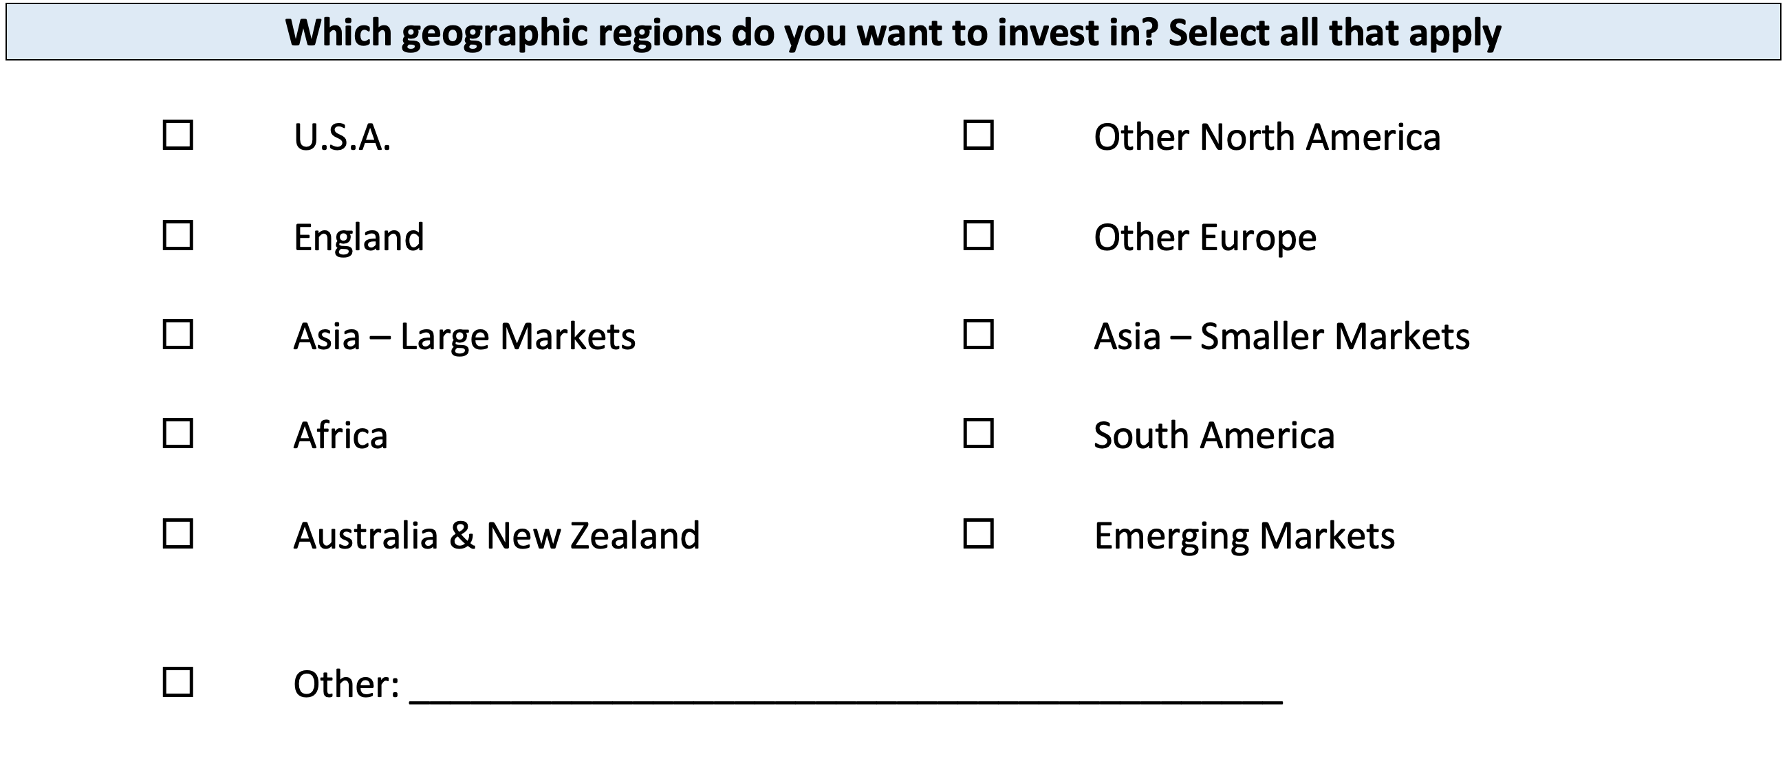
Your INVESTMENT POLICY STATEMENT

Slide 54
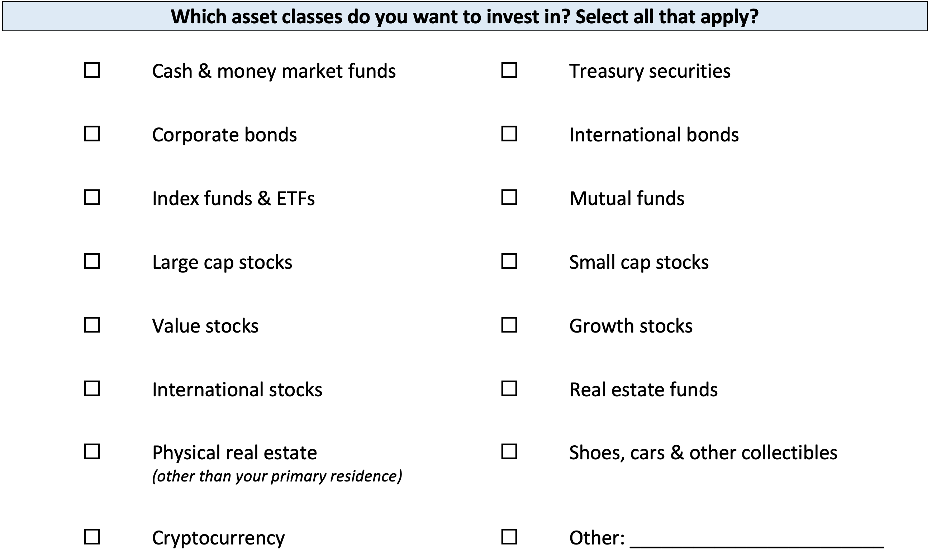
Your INVESTMENT POLICY STATEMENT

Slide 55
Your INVESTMENT POLICY STATEMENT

Slide 56
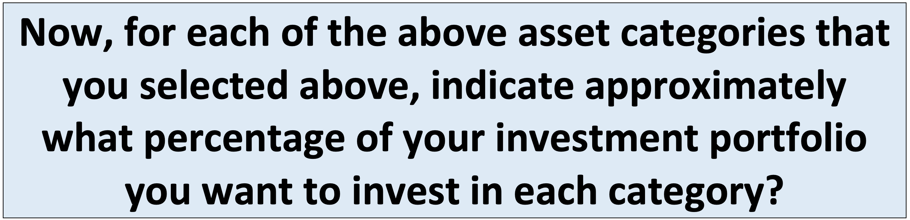
Your INVESTMENT POLICY STATEMENT

Slide 57
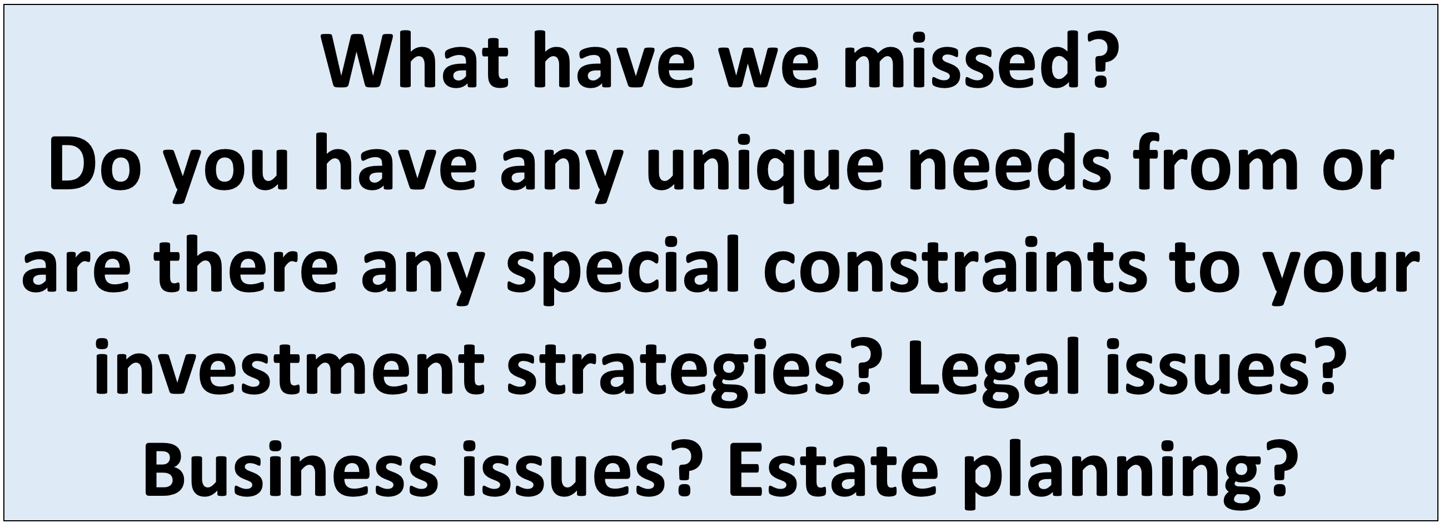
Your INVESTMENT POLICY STATEMENT

Slide 58
Your INVESTMENT POLICY STATEMENT
Complete this worksheet today.
Work on this with your spouse or family.
Revise and update it after you graduate.
Continue refining it throughout your investing life…make it about you and your goals.

Slide 59
I DO NOT GIVE INVESTMENT ADVICE
But here are some investment issues to think about:
Do you want to pick individual stocks (or other securities) and monitor them regularly?
  This can help you feel more control, more connection and more personal interest in your investments.
  Advantages: Potential for big gains, maybe a personal connection to the companies, you feel more engaged with the process.
  Disadvantages: Potential for big losses, requires more time and energy, transaction costs (trading, taxes) can add up, there are 1000s to choose from, potential loss of sleep and hair.

Slide 60
I DO NOT GIVE INVESTMENT ADVICE
But here are some investment issues to think about:
Or, would you be content investing in mutual funds and/or market indexes that pool dozens or hundreds of stocks?
  Advantages: Potential for moderate gains, lower risk (through diversification), lower trading and tax costs, you can narrow down the selection pretty quickly, less loss of sleep and hair
  Disadvantages: Lots of singles and doubles but no home runs, no emotional connection to your investments, susceptible to big market downturns (but not necessarily more than individual stocks)

Slide 61
I DO NOT GIVE INVESTMENT ADVICE
If you want to invest in individual stocks, I cannot help you.
But if you are interested in market indexes, here are some ideas:
  SPY – The S&P 500 index. 500 of the largest U.S. firms, from all industries.
  SPYD – The same as above, with a focus on those companies that pay regular dividends out to investors from their earnings. You will get more income, but possibly lower long-term capital gains.
  IWM – The Russell 2000. 2000 smaller U.S. firms (the 2000 firms after the 1000 largest firms). More volatility, possibly higher returns.
  EFA – Index of non-US firms (Europe, Far East, Australasia). Big firms.
  EEM – Index of non-US, emerging market stocks. Bigger firms in developing countries. More risk than any of the above.
  GBTC – A Bitcoin index. Invest in Bitcoin without mining or owning. Big Risk.

Slide 62
Investing – How Do You Do It?
When you’re just getting started with investing, there are a few approaches you can take:
  Start with a small amount of money – whether that’s $20 or $2,000 – and just go for it. Pick a few investments, track them regularly and be prepared to buy more or sell more should you feel comfortable doing either.

Slide 63
Investing – How Do You Do It?
When you’re just getting started with investing, there are a few approaches you can take:
  Start with a small amount of money – whether that’s $20 or $2,000 – and just go for it. Pick a few investments, track them regularly and be prepared to buy more or sell more should you feel comfortable doing either.
  Determine how much you have to invest.
    Put ½ of that into an index fund or a specific mutual fund. This will provide some security, generally with less or moderate risk.
    Put the other ½ into individual stocks or securities that intrigue you. If you’re interested in the companies, you might be more likely to follow them as investments.
    This half-half approach will help you figure out what kind of investor you are. In 1-2 years, you might gravitate more to either of the approaches that interest you more.

Slide 64
Investing – How Do You Do It?
When you’re just getting started with investing, there are a few approaches you can take:
  Start with a small amount of money – whether that’s $20 or $2,000 – and just go for it. Pick a few investments, track them regularly and be prepared to buy more or sell more should you feel comfortable doing either.
  Determine how much you have to invest.
    Put ½ of that into an index fund or a specific mutual fund. This will provide some security, generally with less or moderate risk.
    Put the other ½ into individual stocks or securities that intrigue you. If you’re interested in the companies, you might be more likely to follow them as investments.
    This half-half approach will help you figure out what kind of investor you are. In 1-2 years, you might gravitate more to either of the approaches that interest you more.
  Talk to a financial advisor. Note that they generally do not (initially) tell you which specific investments to make, but they will work talk through your options with you and help you better understand what you’re getting into.
    They will ask you 2 questions – what are your goals and what is your risk tolerance – and then work with you to find the investments that best align with your answers to these questions.

Slide 65
Long-Term Investment Planning
YOUR VALUES
YOUR GOALS
FINANCIAL STRATEGIES
INVESTMENT STRATEGIES
Identify Your Risk Tolerance
Identify Your Time Horizons
Select Investments
Monitor & Modify Investments

Slide 66
Long-Term Investment Planning
FINANCIAL STRATEGIES
EDUCATION STRATEGIES
INVESTMENT STRATEGIES
GRAD SCHOOL STRATEGIES
Identify Your Risk Tolerance
Identify Your Risk Tolerance
Identify Your Time Horizons
Identify Your Time Horizons
Select Investments
Select Your Field, Program, Specialization, Thesis
Monitor & Modify Investments
Monitor & Modify Your Progress & Plan

Slide 67

Isn’t this a lot like what you do with your education planning?

Slide 68
Question of the Day
Why are you in graduate school?
This is the biggest investment you’ve ever made. You are giving up several years, thousands of dollars and enormous effort & energy.
What return are you getting from this investment?

Slide 69
Financial Wellness
A goal without a plan is just a dream.
Wealth is largely the result of habit.
The most difficult thing is the decision to act; the rest is mere tenacity.
It takes as much energy to plan as it does to wish.
You cannot escape the responsibility of tomorrow by avoiding it today.

Slide 70
Don’t wait around for other people to be happy for you.
Any happiness you get,
You’ve got to make yourself.
~ Alice Walker, poet & novelist
A goal without a plan is just a dream.
Wealth is largely the result of habit.
The most difficult thing is the decision to act; the rest is mere tenacity.
It takes as much energy to plan as it does to wish.
You cannot escape the responsibility of tomorrow by avoiding it today.

Slide 71
Owning Your Financial Future: Spring 2023
FINANCIAL PLANNING FOR INTERNATIONAL STUDENTS
Thursday, January 19
INVESTING, PART 1
TODAY – Wednesday, February 1
TAX PLANNING STRATEGIES
Tuesday, February 28
INVESTING, PART 2
Tuesday, March 21
CAREER PLANNING & FINANCIAL PLANNING
Thursday, April 20

Slide 72

brian.bolton@louisiana.edu http//:business.louisiana.edu/financeispersonal

Slide 73

gradschool@louisiana.edu

