Slide 1
Financial Planning Sudoku!
The tables below are debt payoff schedules. Your job is to find the missing numbers that belong in the shaded ovals. Good luck!

Slide 2


MONEY MATTERS
2022-2023 SESSION #4
October 27, 2022
PRIORITIZING & MANAGING DEBT
Using loans and debt to empower your future, rather than to be an anchor on your future.
Manage Your Money Today
Maximize Your Money in the Future

Slide 3
Happiness
Long-Term Goals
Short-Term Goals
Financial Needs
Family Needs

Slide 4
MONEY MATTERS SERIES: FALL 2022
SEPTEMBER
7
BUDGETING:
GOALS, VALUES & HACKS
OCTOBER
27
DEBT MANGEMENT: PAYING OFF YOUR MOST COSTLY DEBT
NOVEMBER
29
CAREER PLANNING: GETTING YOUR FIRST JOB OFFER
OCTOBER
5
INVESTING:
CREATING YOUR OWN INVESTING ROADMAP
NOVEMBER 10
INVESTING & TAXES:
OPENING YOUR OWN ROTH IRA

Slide 5
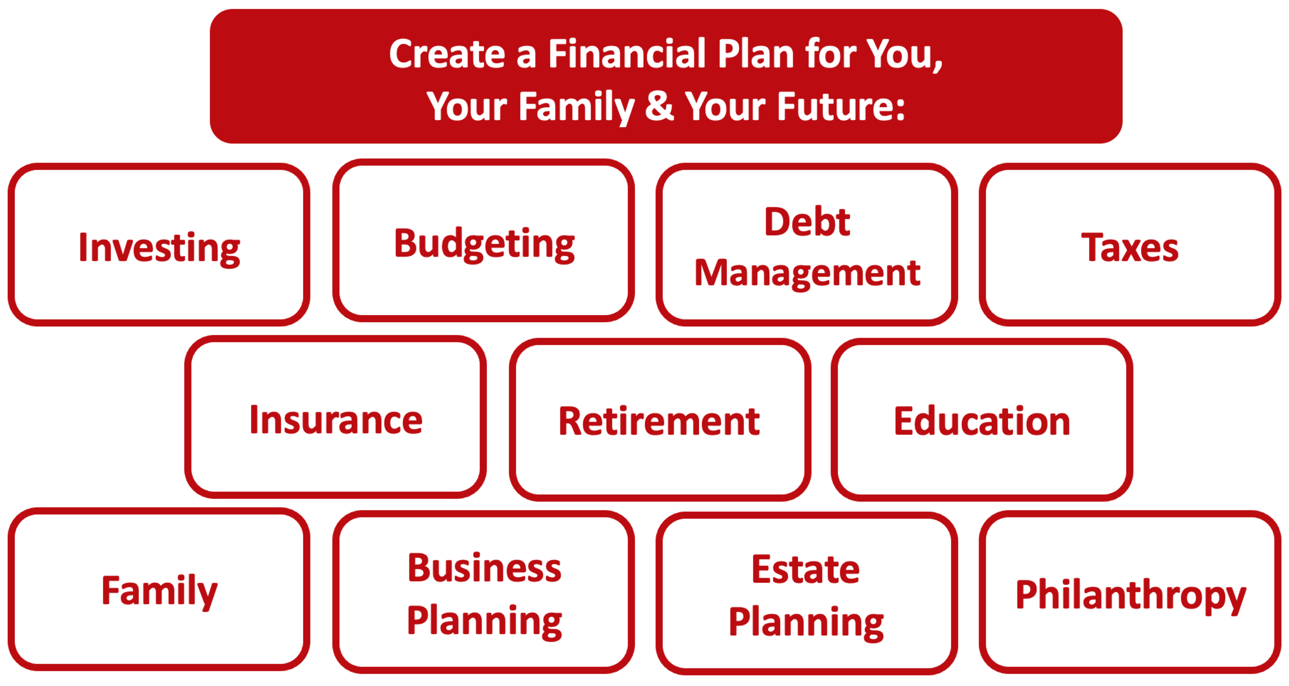

Slide 6
Owning Your Financial Future
YOUR VALUES
YOUR GOALS
Education
Career
Family
FINANCIAL STRATEGIES
Investing
Income & Expense Management
Debt Management
Taxes, Insurance & Other

Slide 7
Owning Your Financial Future
YOUR VALUES
YOUR GOALS
Education
Career
Family
FINANCIAL STRATEGIES
Investing
Income & Expense Management
Debt Management
Taxes, Insurance & Other

Slide 8
Making Financial Planning a Priority
EDUCATION STRATEGIES
GRAD SCHOOL STRATEGIES
Identify Your Resources
Identify Your
Priorities & Goals
Do Your Planning
Monitor & Modify Your Progress & Plan

Slide 9
Making Financial Planning a Priority
FINANCIAL STRATEGIES
EDUCATION STRATEGIES
BUDGETING
STRATEGIES
GRAD SCHOOL STRATEGIES
Identify Your
Income & Expenses
Identify Your Resources
Identify Your
Priorities & Goals
Identify Your
Priorities & Goals
Do Your Planning
Do Your Planning
Monitor & Modify Budgeting Activities
Monitor & Modify Your Progress & Plan

Slide 10
Making Financial Planning a Priority
FINANCIAL STRATEGIES
YOU,
as grad students, are better wired and equipped to make long-term plans – education, career, financial & otherwise – than 99% of humanity.
Be confident.
Be intentional.
Be diligent.
Be awesome.
EDUCATION STRATEGIES
BUDGETING
STRATEGIES
GRAD SCHOOL STRATEGIES
Identify Your
Income & Expenses
Identify Your Resources
Identify Your
Priorities & Goals
Identify Your
Priorities & Goals
Do Your Planning
Do Your Planning
Monitor & Modify Budgeting Activities
Monitor & Modify Your Progress & Plan

Slide 11
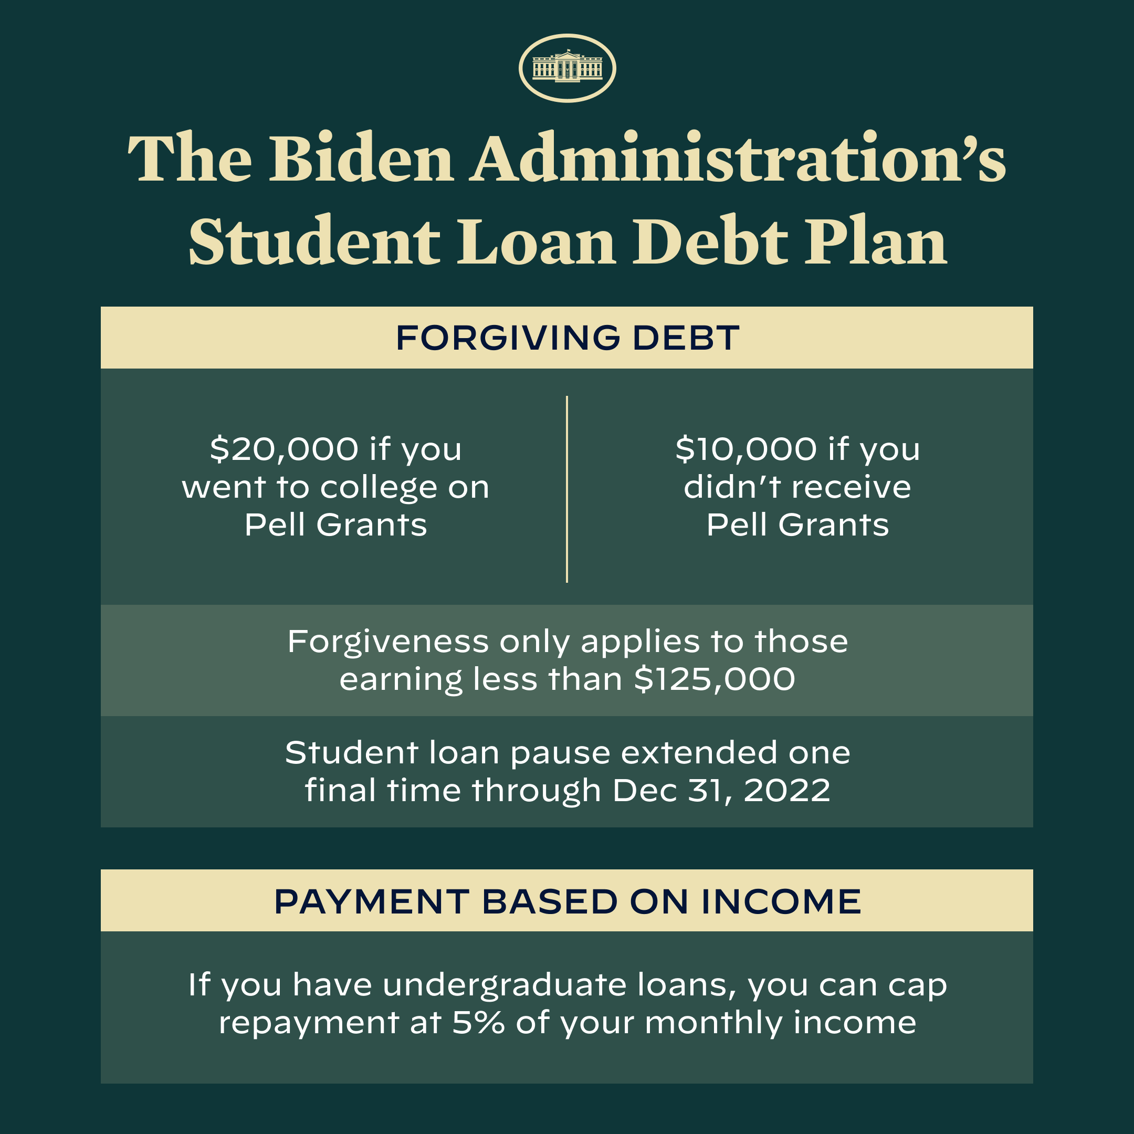

Slide 12
STUDENT LOAN FORGIVENESS UPDATE
Application to apply for loan forgiveness is now open (kind of)
  You can apply, but a court order has paused loan forgiveness
  Application portal to apply for loan forgiveness is expected to close December 31, 2023
Opportunity to enroll in enhanced Public Service Loan Forgiveness program closes October 31, 2022
Student loan interest accrual and payment pause ends December 31, 2022
    And…payments resume in January 2023 for many borrowers
    (But probably not for those of you who are currently full-time students)

Slide 13
STUDENT LOAN FORGIVENESS UPDATE
What you can do now:
  Subscribe to Department of Education updates at www.studentaid.gov
  Check your student loan account at www.studentaid.gov to confirm status, balance, eligibility and servicer
  Contact your servicer to confirm status, eligibility and process
  Get your 2020/2021 income and employment information ready to provide for either PSLF or loan forgiveness
The application should take you 3 minutes. It’s very easy.
  The Department of Education is still processing applications, and expects to continue discharging debt if the court order is lifted.

Slide 14
THE APPLICATION
https://studentaid.gov/debt-relief/application
The application form is now available. It is short and simple.
  Even though debt relief is paused, the system is still processing applications.
The Department of Education has loan balance, Pell grant history and income information for some people….but it does not have income information for everyone.
  These people will receive forgiveness automatically, without filing.
  But most of you do not know if you are one of these people.
  So, complete the application as soon as you can just to be sure.

Slide 15
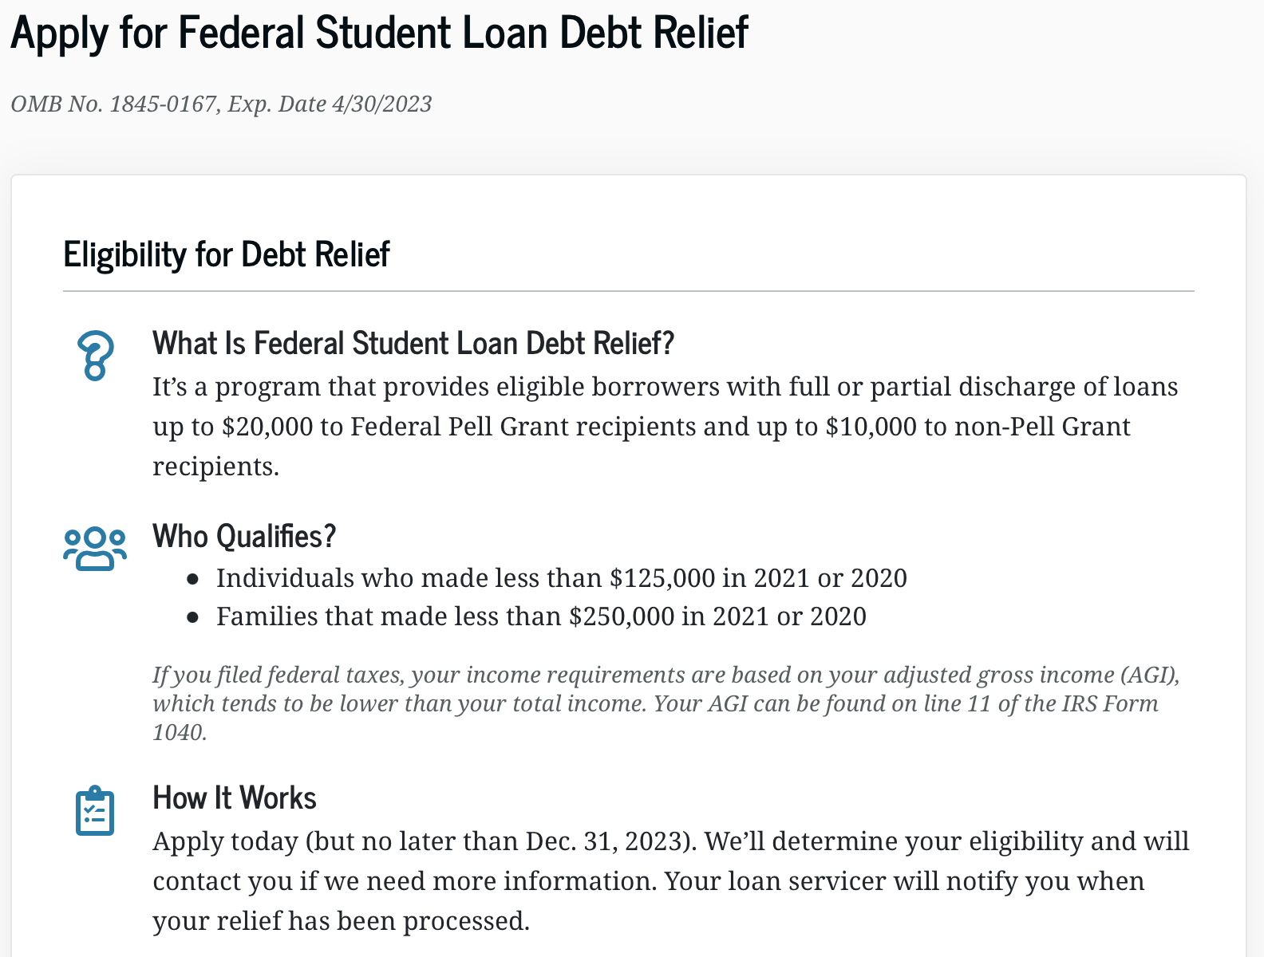
THE APPLICATION

Slide 16
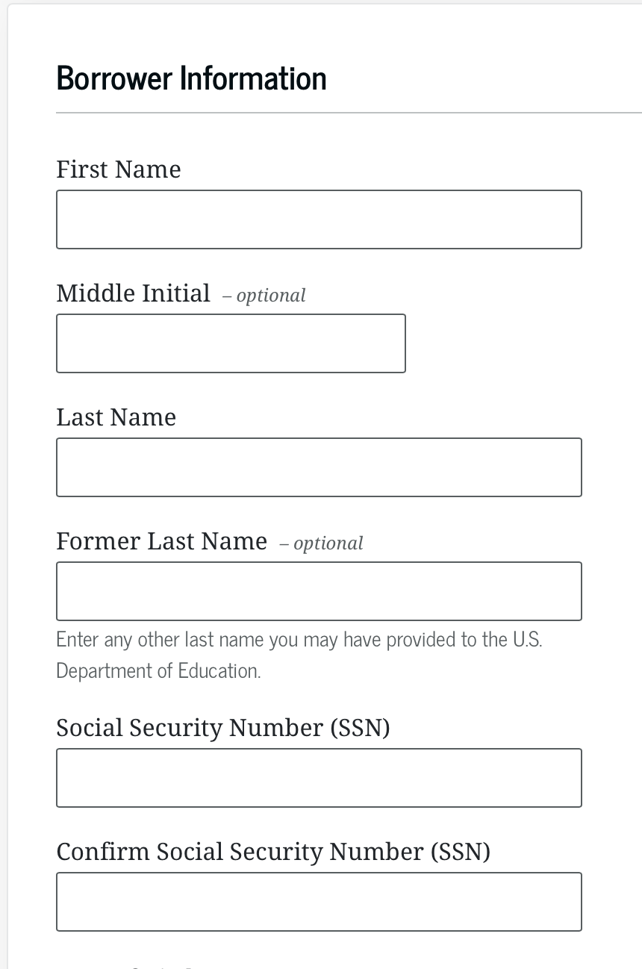
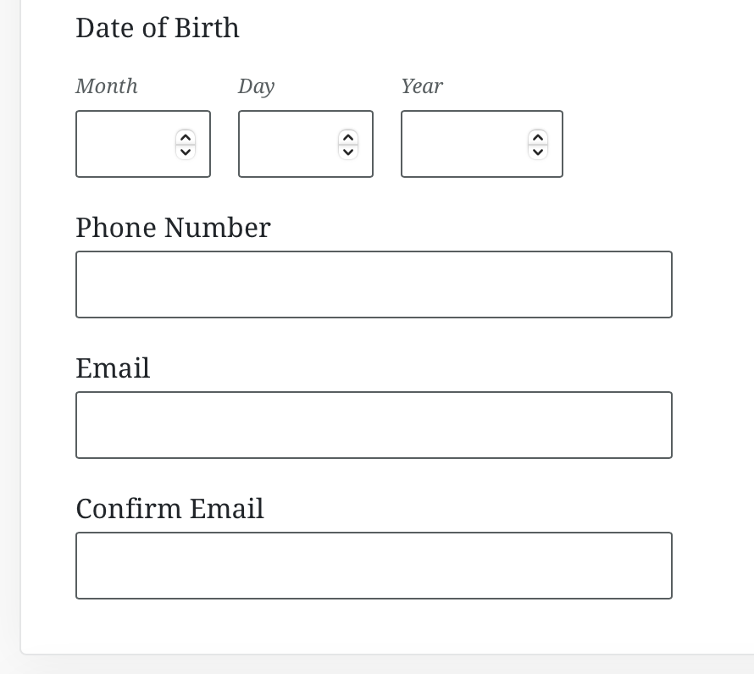
THE APPLICATION

Slide 17
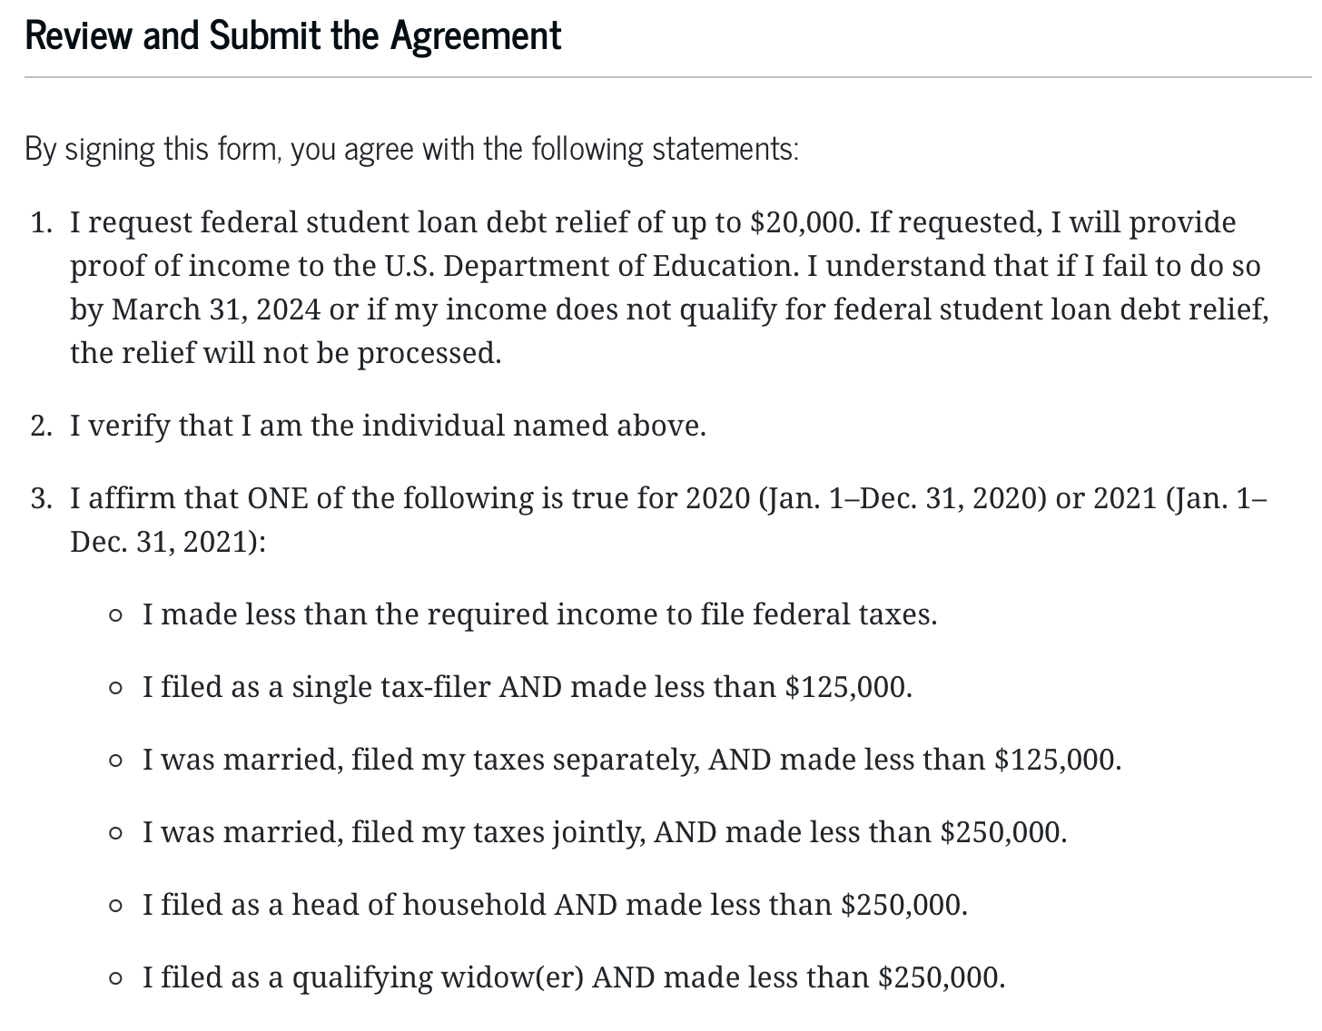
THE APPLICATION

Slide 18
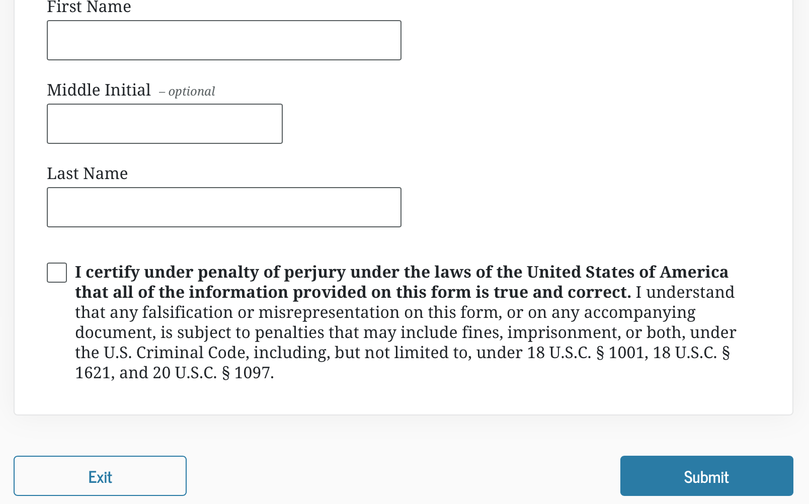
THE APPLICATION

Slide 19
Financial Wellness
If you don’t know where you’ve come from, you can’t know where you’re going.
- Maya Angelou

Slide 20
TODAY THE NEXT 6 MONTHS THE NEXT 12 MONTHS 2 YEARS AFTER GRADUATION 3 YEARS AFTER GRADUATION
ONCE EVERY SEMESTER:
TRACK EVERY PENNY THAT YOU SPEND & TRACK EVERY PENNY THAT YOU EARN
IN THE NEXT 3 MONTHS:
IDENTIFY WAYS TO DECREASE YOUR DISCRETIONARY SPENDING BY 25%
IN THE NEXT 6 MONTHS:
MAKE A PLAN TO MANAGE – AND PAY OFF – YOUR DEBT
IN THE NEXT 6-12 MONTHS:
OPEN MULTIPLE SAVINGS ACCOUNTS, 1 FOR EACH GOAL
IN THE NEXT 12 MONTHS, OPEN AN IRA OR ROTH IRA
WITHIN 2 YEARS OF GRADUATION:
HAVE AN “EMERGENCY FUND” ACCOUNT, WITH 3-6 MONTHS OF NON-DISCRETIONARY EXPENSES
WITHIN 3 YEARS OF GRADUATION:
ELIMINATE ALL OF YOUR BAD DEBT.

Slide 21
TODAY THE NEXT 6 MONTHS THE NEXT 12 MONTHS 2 YEARS AFTER GRADUATION 3 YEARS AFTER GRADUATION
ONCE EVERY SEMESTER:
TRACK EVERY PENNY THAT YOU SPEND & TRACK EVERY PENNY THAT YOU EARN
IN THE NEXT 3 MONTHS:
IDENTIFY WAYS TO DECREASE YOUR DISCRETIONARY SPENDING BY 25%
IN THE NEXT 6 MONTHS:
MAKE A PLAN TO MANAGE – AND PAY OFF – YOUR DEBT
IN THE NEXT 6-12 MONTHS:
OPEN MULTIPLE SAVINGS ACCOUNTS, 1 FOR EACH GOAL
IN THE NEXT 12 MONTHS, OPEN AN IRA OR ROTH IRA
WITHIN 2 YEARS OF GRADUATION:
HAVE AN “EMERGENCY FUND” ACCOUNT, WITH 3-6 MONTHS OF NON-DISCRETIONARY EXPENSES
WITHIN 3 YEARS OF GRADUATION:
ELIMINATE ALL OF YOUR BAD DEBT.

Slide 22
WHAT IS DEBT
Debt is borrowing from YOUR future.
We borrow because we want something today that we cannot afford today.
We make a promise to pay for that something in the future.
The entity we borrow from wants to make money. They are not our friends.
We have to pay them helping us get what we want today.
  At a minimum, we pay them interest on our debt.
  Depending on the type of debt, we may have to pay them much more (fees, collateral, earnings, control, etc.)

Slide 23
WHAT IS DEBT
Debt is borrowing from YOUR future.
If your debt is keeping you up at night…
If your debt is preventing you from achieving your goals…
If your debt is damaging your relationships…
…Then you may have too much debt.
(we will return to this issue later)

Slide 24
One Truism About DEBT
If you borrow $10,000,
You will have to repay $10,000.
Whatever you borrow, you will have to repay – in full, with interest – 99% of the time. Lenders do not exist to give you money.
One good exception: Student loan forgiveness.
Lots of bad exceptions: Default, bankruptcy, short sale…

Slide 25
Financial Planning Sudoku!
The tables below are debt payoff schedules. Your job is to find the missing numbers that belong in the shaded ovals. Good luck!

Slide 26
Financial Planning Sudoku!
The tables below are debt payoff schedules. Your job is to find the missing numbers that belong in the shaded ovals. Good luck!
With the relatively low interest rate and the relatively high annual payments, we are able to fully pay off our $10,000 debt after 10 years.

Slide 27
Financial Planning Sudoku!
The tables below are debt payoff schedules. Your job is to find the missing numbers that belong in the shaded ovals. Good luck!
With the VERY HIGH interest rate and RELATIVELY LOW annual payments, our debt continues to grow and grow. Our $10,000 grows to $76,506, which includes $66,506 of accrued interest. The banks loooove this, so they are going to let this happen. It’s up to you to take control of your debt so this never happens.

Slide 28
PRIORITIZING YOUR DEBT
The first step to taking control of your debt is to identify all of your debt and understand you’re your responsibilities are with respect to each loan or debt.
Today, tomorrow or anytime in the near future, take the time to complete the information below, paying specific attention to the interest rates and any special features related to the debt (e.g. variable rates, prepayment penalties, restructuring fees, ability to negotiate or refinance).
Taking control of your financial situation begins with looking in the mirror and knowing you’re your situation is. This is not always fun, but it is the key to you being in control of your financial situation, instead of your money financial situation being in control of you.

Slide 29
PRIORITIZING YOUR DEBT

Slide 30
PRIORITIZING YOUR DEBT
Which debt is most costly?
  Maybe this is due to the interest rate being very high.
  Maybe this is due to certain restrictions – you cannot prepay or there are fees.
  Or maybe this is due to the repayment term being very long.
Which debt is most flexible?
  Which debt can you prepay anytime?
  Which debt can you renegotiate to different terms without cost?
Which debt helps your credit score?
Which debt hurts your credit score?

Slide 31
PRIORITIZING YOUR DEBT
Which debt is essential to you achieving your goals?
Which debt keeps you up at night?
Can you retire any debt – even if it’s good debt, low interest and flexible – to create a psychological victory to see it gone?
Do you want to keep any debt – even if it’s bad debt – to act as a psychological constraint so you do not build even more debt?
  For example, maybe you keep a $500 balance on a credit card because you are worried that you might use it more if you actually retired the full balance.

Slide 32
PRIORITIZING YOUR DEBT
Making a plan to pay off your debt:
  Which debt can be retired?
  Which debt is most costly?
  Which debt is most flexible?
  What income or savings will you use?
  Make plans for different points in time:
  This year – The Next 2 Years – The Next 5 Years
Paying off all of your bad debt:
  Maybe it takes 5 years, maybe it takes 10 years.
  But begin thinking about how and when you will get rid of the debt that is the biggest burden to you.
IN THE NEXT 6 MONTHS:
MAKE A PLAN TO MANAGE – AND PAY OFF – YOUR DEBT
WITHIN 3 YEARS OF GRADUATION:
ELIMINATE ALL OF YOUR BAD DEBT.

Slide 33
Questions From You #1
Ideally how much of your income should you expect to go into paying off various loans (car, house, school, etc.)?
There are 2 ways to address this:
From a lender’s perspective.
From your own, personal perspective.

Slide 34
Questions From You #1
Ideally how much of your income should you expect to go into paying off various loans (car, house, school, etc.)?
The lender’s perspective:
28% of your gross income should go to housing payments (at most)
(including rent, mortgage, taxes, insurance…but not maintenance or utilities)
36% of your gross income should go to all debt payments (at most)
(including housing, credit cards, student loans, auto loans…)

Slide 35
Questions From You #1
Ideally how much of your income should you expect to go into paying off various loans (car, house, school, etc.)?
28% of your gross income should go to housing payments (at most)
(including rent, mortgage, taxes, insurance…but not maintenance or utilities)
36% of your gross income should go to all debt payments (at most)
(including housing, credit cards, student loans, auto loans…)
Be very careful: These ratios are based on payments, not borrowed amounts or loan balances. Lenders may encourage you to extend your loan repayment term, which may lower your monthly or annual payment….but doing this will usually increase the total amount that you have to repay over the life of the loan.

Slide 36
Questions From You #1
Ideally how much of your income should you expect to go into paying off various loans (car, house, school, etc.)?
These ratios are based on payments, not borrowed amounts or loan balances. Lenders may encourage you to extend your loan repayment term, which may lower your monthly or annual payment….but doing this will usually increase the total amount that you have to repay over the life of the loan.
You generally want to repay your debt as soon as possible.
Longer term = More interest paid = More cash out of your pocket
The biggest exception is student loan debt…where rates are generally the lowest, some interest can be tax deductible, and you have maximum flexibility in repayment plans (and, if you are on track for public service forgiveness, you need to make 10 years of payments).

Slide 37
Questions From You #1
Ideally how much of your income should you expect to go into paying off various loans (car, house, school, etc.)?
From a personal perspective, it will all depend on your other goals and investments and your specific situation.
If you buy a home, you will increase your debt.
If you have children, you may increase your debt as you save for their education or incur other expenses.
You can offset this by having a lower auto loan or reducing your student loans.
Always, always, always pay off your credit card balances as soon as you are able.

Slide 38
Questions From You #1
Ideally how much of your income should you expect to go into paying off various loans (car, house, school, etc.)?
From a personal perspective, it will all depend on your other goals and investments and your specific situation.
If your debt payments are over 40% of your income,
make a plan to change this and to get your payments lower.
This will help your credit score, it will help you access more debt in the future, it will free up income to invest in your other goals…and it will help you sleep at night.

Slide 39
Questions From You #2
How does Income-Driven Repayment of student loans work?
There are several income-based payment plans, so these responses will be generic.
You choose 1 of 4 repayment plans
You make monthly payments based on your discretionary income.
  The payments range from 10-20% of your income.
  The new proposal reduces this to 5% of your income. That’s good.
You have flexibility if you lose your job or move to a lower paying job.
If you make payments for 20-25 years, your loan will be forgiven.
Income-Driven Repayment is generally required if you are going to eventually seek public service loan forgiveness (after 10 years of working in public service and making on-time payments).

Slide 40
Questions From You #2
Income Driven Repayment (IDR) itself is not new.
IDR allows borrowers to repay federal student loan debt based on what their income is, ostensibly to allow students who go into lower-paying careers more flexibility in how they repay their student loans.
  Instead of making monthly payments based on some set formula – like a car loan or a mortgage – the monthly payment amounts are based on borrower annual income.
  You still owe the entire amount, but IDR adjusts both the monthly payments and the loan term, as appropriate.
  Public Service Loan Forgiveness is a special kind of IDR. Many people in academia will be in both programs and take advantage of PSLF if they qualify.
The proposed adjustments to Income-Driven Repayment will substantially reduce future monthly payments for lower- and middle-income borrowers.

Slide 41
Questions From You #2
The proposed adjustments to Income-Driven Repayment will substantially reduce future monthly payments for lower- and middle-income borrowers.
  Require borrowers to pay no more than 5% of their discretionary income monthly on undergraduate loans.
    This is down from the 10% available under the most recent income-driven repayment plan.
  Raise the amount of income that is considered non-discretionary income and therefore is protected from repayment, guaranteeing that no borrower earning under 225% of the federal poverty level will have to make a monthly payment.
  Forgive loan balances after 10 years of payments, instead of 20 years, for borrowers with loan balances of $12,000 or less.
  Cover the borrower's unpaid monthly interest, so that unlike other existing income-driven repayment plans, no borrower's loan balance will grow as long as they make their monthly payments—even when that monthly payment is $0 because their income is low.

Slide 42
Questions From You #2
Why should you consider Income Driven Repayment as an option?
  It does give you some flexibility in how much of your debt you repay each month, affording you the ability to choose careers based on reasons unrelated to how much student loan debt you owe.
  You can still decide to pay more than what is required, thereby reducing your loan balance and potentially retiring your debt sooner.
  If you make on-time payments for 20 years through IDR, your entire remaining balance of UNDERGRADUATE debt may be completely forgiven.
  If you make on-time payments for 25 years through IDR, your entire remaining balance of GRADUATE debt may be completely forgiven.
  (Note: If your loan balance is less than $12,000, the 20 years might be reduced to 10 years.)

Slide 43
Questions From You #2
The proposed adjustments to Income-Driven Repayment will substantially reduce future monthly payments for lower- and middle-income borrowers.
  Require borrowers to pay no more than 5% of their discretionary income monthly on undergraduate loans.
    This is down from the 10% available under the most recent income-driven repayment plan.
  Raise the amount of income that is considered non-discretionary income and therefore is protected from repayment, guaranteeing that no borrower earning under 225% of the federal poverty level will have to make a monthly payment.
  Forgive loan balances after 10 years of payments, instead of 20 years, for borrowers with loan balances of $12,000 or less.
  Cover the borrower's unpaid monthly interest, so that unlike other existing income-driven repayment plans, no borrower's loan balance will grow as long as they make their monthly payments—even when that monthly payment is $0 because their income is low.
These proposed changes to Income-Driven Repayment is different from
the Public Service Loan Forgiveness information on the previous slides.
These proposed changes are only for undergraduate loans
(no changes for graduate loans).
These proposed changes are designed to encourage more borrowers to pursue
Income-Driven Repayment…because more people will benefit from IDR.
You may not need to do anything now…beyond considering whether
you should use IDR when it is time to repay your student loans.

Slide 44
Questions From You #3
Is it smart to pay off student debt as soon as you are able to?
General Answer: No, not for most people.
I have 30k in savings and 16k in student debt, mostly subsidized and low-interest (2-4%). I've been trying to figure out if it would be smarter to pay off my loans entirely before I leave school and start accruing interest or if it'd be better to save/invest my savings and pay off the debt over time.
If I were you, I would not be in a hurry to repay the $16k of student debt.

Slide 45
Questions From You #3
I have 30k in savings and 16k in student debt, mostly subsidized and low-interest (2-4%). I've been trying to figure out if it would be smarter to pay off my loans entirely before I leave school and start accruing interest or if it'd be better to save/invest my savings and pay off the debt over time.
If I were you, I would not be in a hurry to repay the $16k of student debt.
Yes, you could pay off the debt with your savings.
But is there something else you could be using the savings for?
  Buying a new house?
  Building up a retirement account?
  Setting money aside for kids?
  Do you have other debt to repay?
  Does having the debt cause you stress?

Slide 46
Questions From You #3
I have 30k in savings and 16k in student debt, mostly subsidized and low-interest (2-4%). I've been trying to figure out if it would be smarter to pay off my loans entirely before I leave school and start accruing interest or if it'd be better to save/invest my savings and pay off the debt over time.
Do you have any other debt to repay?
As a general rule, student loan debt should be the last debt you pay off.
Your interest rate is very low - lower than you’ll get on just about any other loan.
You generally have the most flexibility with repayment.
  If you quit or lose your job next year, after paying off your student loan debt, that money is gone and you may now have to borrow at a much higher rate.
  But if that $16k is still in savings, you can use it as necessary next year.

Slide 47
Questions From You #3
I have 30k in savings and 16k in student debt, mostly subsidized and low-interest (2-4%). I've been trying to figure out if it would be smarter to pay off my loans entirely before I leave school and start accruing interest or if it'd be better to save/invest my savings and pay off the debt over time.
What else could you be doing with the $16k of savings?
If you are only going to earn 0.25% on your savings, and you don’t have anything else to do with it, maybe pay off the 2-4% student loans at 2-4%.
The S&P 500 Index has averaged 12.1% annual return over the past 100 years. What if you invest $10,000 into an S&P 500 Fund and use the growth in that to pay off your student loan over time?
  Note – This is just an example, not a recommendation. There is no guarantee of getting this return, certainly not every single year. There are other investments you could make that might
  have less risk and uncertainty (or more risk and uncertainty).

Slide 48
Questions From You #3

Slide 49
Questions From You #3

Slide 50
Questions From You #3

Slide 51
Questions From You #3
I have 30k in savings and 16k in student debt, mostly subsidized and low-interest (2-4%). I've been trying to figure out if it would be smarter to pay off my loans entirely before I leave school and start accruing interest or if it'd be better to save/invest my savings and pay off the debt over time.
Only YOU can decide what best aligns with:
Your short-term and long-term goals.
Your mental health. What helps you sleep better at night.
I finished my MBA in a similar situation. I had about the same debt but less in savings. I paid close to the minimum payments for the first 1-2 years after graduation. Then, as my income became more comfortable and my plans become more clear, I was able to make larger one-time payments.
I ended up paying off the debt 4.5 years after graduation. Even then, it wasn’t a financial decision; it was an “I’m ready to get rid of this and stop having to think about this decision.”

Slide 52
Questions From You #4
I don't have any loans personally, but I'm expecting to marry someone who will and I want to be as prepared as possible.
How might their debt affect my credit score, if any, and how much should be allocated to paying off debt? Should it be a top priority to pay off immediately or should it be set as a 5 to 10 year plan sort of thing so that I can use money to also build my present and future in small increments as well.
Initially….there is no affect on your credit score:
Your existing debt and credit score belong to you.
Your spouse’s existing debt and credit score below to them.
Credit rating firms will NOT re-calculate your score based on your partner’s situation.
That’s the good news….

Slide 53
Questions From You #4
How might their debt affect my credit score, if any, and how much should be allocated to paying off debt? Should it be a top priority to pay off immediately or should it be set as a 5 to 10 year plan sort of thing so that I can use money to also build my present and future in small increments as well.
The concern is if you two apply for a loan together – perhaps on a mortgage or car loan or credit card.
Lenders will see both credit scores and will get to decide what rate to charge – or whether to lend to you at all.
Lenders may choose to use a rate based on the worse credit score, causing you both to make higher payments.

Slide 54
Questions From You #4
How might their debt affect my credit score, if any, and how much should be allocated to paying off debt? Should it be a top priority to pay off immediately or should it be set as a 5 to 10 year plan sort of thing so that I can use money to also build my present and future in small increments as well.
The concern is if you two apply for a loan together – perhaps on a mortgage or car loan or credit card.
A strategy might be to co-sign on a loan, possibly getting better terms because of your credit score, and then to use this to improve your spouse’s credit score and situation.
  Of course, you may not get better terms and you may not even get the loan.
Having joint debt will only affect your individual credit score if you miss payments or default (marital status is not a variable in calculating a credit score).

Slide 55
Questions From You #4
How might their debt affect my credit score, if any, and how much should be allocated to paying off debt? Should it be a top priority to pay off immediately or should it be set as a 5 to 10 year plan sort of thing so that I can use money to also build my present and future in small increments as well.
If the spouse-to-be’s debt it at very high interest rates, then being as aggressive as possible in paying it off could be a very good strategy to increase your net cash flow (by decreasing your interest expenses).
And…of course, it should improve your peace of mind and how you think about your financial futures.
My favorite cliché is “own your financial future.” To me, getting rid of high-interest debt can be the most powerful form of taking ownership of your financial future.

Slide 56
Questions From You #4
How might their debt affect my credit score, if any, and how much should be allocated to paying off debt? Should it be a top priority to pay off immediately or should it be set as a 5 to 10 year plan sort of thing so that I can use money to also build my present and future in small increments as well.
I kind of like the 5-to-10 year plan thinking, if you are comfortable with it.
Paying off all of the spouse’s debt immediately WILL NOT immediately correct their credit score. That takes years, regardless.
  And the best way to improve it is to prove that they can repay their debt…and this only happens by having debt and by making all required payments.
Methodically paying off the spouse’s debt, thoughtfully borrowing together (and making required payments) and strategically building up your own portfolio – or your combined portfolio with your assets – may be the most balanced and beneficial plan.

Slide 57
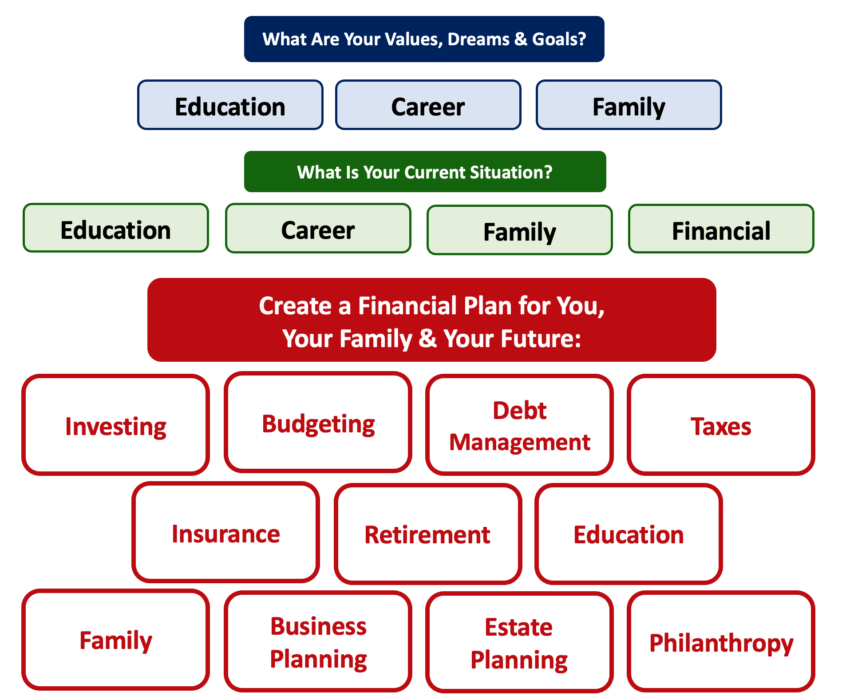

Slide 58
Debt is NOT a bad thing.
Debt can help us achieve our goals, depending on our current situations and what those goals are.
Debt is also called “leverage” – because it gives us the ability do things we might not be able to do otherwise.

Slide 59
Debt is NOT a bad thing.
My one primary piece of advice:
Whenever borrow money – whether it’s $20 for a Friday night pizza on your credit card or a $10,000 student loan – have a plan for paying it back.
Know why you are borrowing and where you will get the money to repay it.

Slide 60
A Little Math: Good Debt vs. Bad Debt

Slide 61
A Little Math: Good Debt vs. Bad Debt
Yes, I’ve simplified this a little. You will be making debt payments on your mortgage over those 3 years, so that would count against your equity growth. But this also means you would repay less in 3 years, which would increase your equity growth. And I have ignored taxes: both the benefits from using a mortgage and any costs due to the gains you may earn on the sale. But the idea here is to show how debt can create – or leverage – opportunities today to create value in the future.

Slide 62
A Little Math: Good Debt vs. Bad Debt
Isn’t this a lot like what you’re doing with your education?
You’re investing today – time, energy, money – in order
to create bigger and better opportunities for your future.
These opportunities may or may not be financial.
These opportunities are what will help you live your values and achieve your goals & dreams.
Yes, you do have to repay the money you borrowed. But if you are borrowing the money to achieve your dreams – dreams that you would not otherwise be able to achieve – then it’s probably a wonderful investment for you.

Slide 63




Good Debt vs. Bad Debt
High cost, both in $$$ and opportunity
Lots of uncertainty
Potential for enormous return
Perfectly aligned with values, goals & dreams
High cost, both in $ and opportunity
Lots of uncertainty
Potential for some return
Usually aligned with values, goals & dreams
Very high cost
Short-term fulfillment
No future return
Unrelated to values, goals & dreams

Slide 64
Good Debt vs. Bad Debt
$100,000 of principal
$45,435 of interest
Repaid over 20 years @ 4% interest

Slide 65
Good Debt vs. Bad Debt
$100,000 of principal
$58,389 of interest
Repaid over 20 years @ 5% interest

Slide 66
Good Debt vs. Bad Debt
$100,000 of principal
$216,030 of interest
Repaid over 20 years @ 15% interest

Slide 67
Good Debt vs. Bad Debt
Is this debt aligned with my values, goals & dreams?
How am I going to repay this debt?

Slide 68
Free Money…for you or for your bank.
Borrowing $100,000
At 15% Interest
Repaying over 20 years.
You Borrow $100,000
You Repay $316,030

Slide 69
Free Money…for you or for your bank.
Borrowing $100,000
At 15% Interest
Repaying over 20 years.
You Borrow $100,000
You Repay $316,030
Investing $50 a month
At 10% interest
For 20 years
You Invest $12,000
You Have $38,285

Slide 70
Good Debt vs. Bad Debt
NOTE:
Using a credit card is not necessarily a bad idea.
Only racking up loads of credit card debt is a bad idea.
I regularly use 3 credit cards.
Here’s how and here’s why…

Slide 71
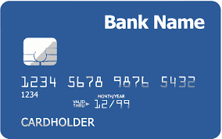
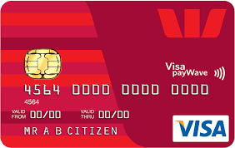
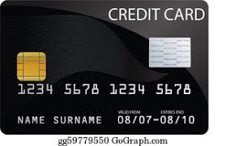
Credits Cards as Tools for Financial Planning
Card #1: Automatic bill payment of recurring monthly expenses (phone, insurance, cable, utilities)
Card #2: Living and discretionary expenses (gas, groceries, coffee, pizza, new shoes)
Card #3: Non-recurring big expenses (vacation, holidays, charity, new refrigerator)
Card #3 frequently has a $0.00 balance

Slide 72
Credits Cards as Tools for Financial Planning
WHY DO I DO THIS?
#1 Mental Budgeting: This helps me mentally be aware of what I’m spending and why I’m spending.
  Instead of just knowing that I’m putting $1,000 on my credit cards in a month, separating the expenses across cards forces me to be aware of what I’m spending money on.
  When I review my statements and budgets at the end of each month, this gives me an easy opportunity to judge myself and to analyze my own behavior.
Card #1: Automatic bill payment of recurring monthly expenses (phone, insurance, cable, utilities)
Card #2: Living and discretionary expenses (gas, groceries, coffee, pizza, new shoes)
Card #3: Non-recurring big expenses (vacation, holidays, charity, new refrigerator)

Slide 73
Credits Cards as Tools for Financial Planning
WHY DO I DO THIS?
#2 FREE MONEY!
  I pay off the full balance of each card each month. If I make a purchase on October 5, the cash does not leave my bank account until December 1.
    It might only be a penny or two, but earning interest during those 57 days feels kind of nice.
  Miles, cash-back and other rewards.
    Choose a card with benefits that you would be paying for anyway. And then cash in the rewards instead of paying cash in the future.
Card #1: Automatic bill payment of recurring monthly expenses (phone, insurance, cable, utilities)
Card #2: Living and discretionary expenses (gas, groceries, coffee, pizza, new shoes)
Card #3: Non-recurring big expenses (vacation, holidays, charity, new refrigerator)

Slide 74
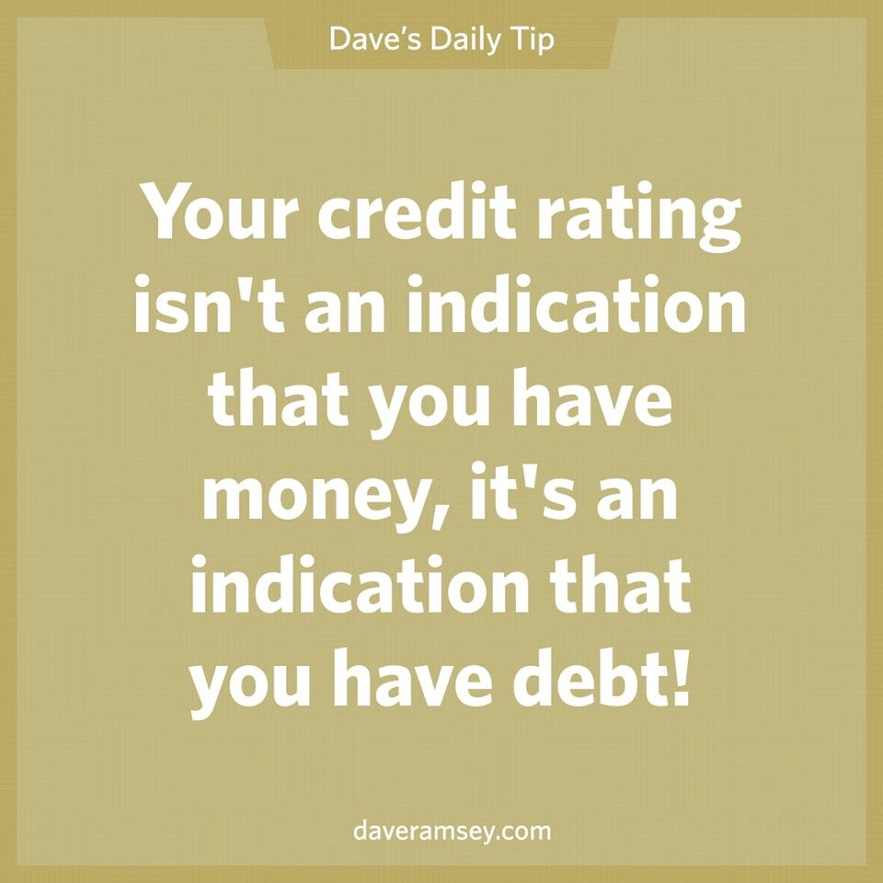
Daily Inspiration

Slide 75
LET’S MAKE THIS PERSONAL…
WHAT IMPACTS YOUR CREDIT RATING AS A CONSUMER?

Slide 76
LET’S MAKE THIS PERSONAL…
WHAT IMPACTS YOUR CREDIT RATING AS A CONSUMER?
35% Payment History – This is perhaps this simplest category, as it looks at how well you repay all borrowed amounts on credit cards, retail accounts, auto loans, utilities and phone bills, other installment loans and other debts. The better you are at repaying, the better your Payment History. Pay your bills on time.

Slide 77
LET’S MAKE THIS PERSONAL…
WHAT IMPACTS YOUR CREDIT RATING AS A CONSUMER?
30% Amounts Owed –The amount you owe is not simply about how much money you owe, but it’s also about how much of your available credit you use. If you have a credit card limit of $5,000 and your balance is $4,000, that’s worse than having a limit of $20,000 and a balance of $10,000. There are many trade-offs within this category and it can be confusing.
Pro-tip if you are using more than 30% of your available balance: Pay it off or down before the end of your reporting cycle and the credit agencies will never know it existed.

Slide 78
LET’S MAKE THIS PERSONAL…
WHAT IMPACTS YOUR CREDIT RATING AS A CONSUMER?
15% Length of Credit History – This is also pretty simple – the longer your history of paying bills and loans, the better off you’ll be. Yes, this does bias against younger borrowers – but if your behavior in the other categories is strong, you should be okay. Be patient – you’ll build your history.

Slide 79
LET’S MAKE THIS PERSONAL…
WHAT IMPACTS YOUR CREDIT RATING AS A CONSUMER?
10% Credit Mix – Perhaps ironically, it can be better to have 5 different accounts that you repay regularly than it is to have just 2 different accounts. The greater the variety of accounts you have, the more opportunity you have to indicate that you are a low credit risk. Of course, if you have 5 accounts and you miss your payments, that will be doubly bad. Pay your bills on time and the Credit Mix will take care of itself.

Slide 80
LET’S MAKE THIS PERSONAL…
WHAT IMPACTS YOUR CREDIT RATING AS A CONSUMER?
10% New Credit – Opening a large number of new accounts in a short period of time may indicate that you are a higher risk. So, is the moral to never open new accounts? No – because then you can never indicate that you are a low risk. Be mindful of opening too many accounts in a short period of time, pay all your bills on time, and the New Credit category will not be a big issue.

Slide 81
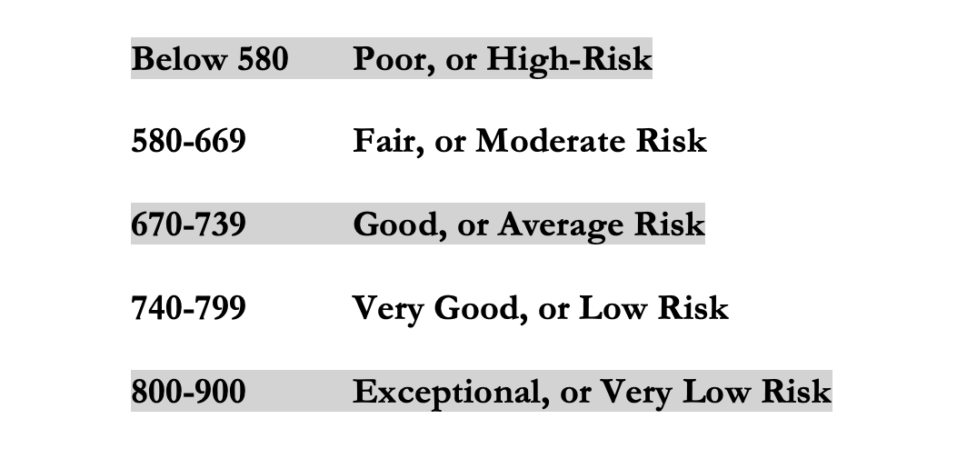
LET’S MAKE THIS PERSONAL…
WHAT IMPACTS YOUR CREDIT RATING AS A CONSUMER?
Your FICO Score will become an actual number: between 250 and 900.
The higher your Score, the lower interest rates you will pay on most loans.
The average FICO Score for Americans is just over 700.
The average in Louisiana is 677, the second lowest in the 50 U.S. states; only Mississippi has a lower average FICO Score.

Slide 82
LET’S MAKE THIS PERSONAL…
WHAT SHOULD YOU BE FOCUSED ON WITH RESPECT TO YOUR CREDIT SCORE?
If your FICO Score is below 600, there are probably 1 or 2 areas where you have significant weaknesses in your history.
Commit to correcting these weaknesses and not creating any new weaknesses.
If your FICO Score is between 600-700, there are probably 1 or 2 areas that can be improved – or where you used to have significant weaknesses.
Keep doing what you’re doing – and commit to not creating any new concerns.
If your FICO Score is over 700, keep doing what you’re doing and time will eventually get you the best score possible.

Slide 83

Isn’t this a lot like what you do with your education planning?

Slide 84
And as you begin to develop your full financial plan – seeing the trade-offs with Budgeting, Investing and Debt Management – you will begin to see how interconnected all of these aspects are.
Finance is just a matter of managing money across time.
And one thing we know about time is that our plans will change – so the better you have control of your initial financial plan, the more you will be able to adjust when life and time give you new goals.
Isn’t this a lot like what you do with your education planning?

Slide 85
Making Debt Management a Part of Your Plan
FINANCIAL STRATEGIES
EDUCATION STRATEGIES
BUDGETING
STRATEGIES
GRAD SCHOOL STRATEGIES
Identify Your
Income & Expenses
Identify Your Resources
Identify Your
Priorities & Goals
Identify Your
Priorities & Goals
Do Your Planning
Do Your Planning
Monitor & Modify Budgeting Activities
Monitor & Modify Your Progress & Plan

Slide 86
Making Debt Management a Part of Your Plan
FINANCIAL STRATEGIES
YOU,
as grad students, are better wired and equipped to make long-term plans – education, career, financial & otherwise – than 99% of humanity.
Be confident.
Be intentional.
Be diligent.
Be awesome.
EDUCATION STRATEGIES
BUDGETING
STRATEGIES
GRAD SCHOOL STRATEGIES
Identify Your
Income & Expenses
Identify Your Resources
Identify Your
Priorities & Goals
Identify Your
Priorities & Goals
Do Your Planning
Do Your Planning
Monitor & Modify Budgeting Activities
Monitor & Modify Your Progress & Plan

Slide 87
Financial Wellness
A goal without a plan is just a dream.
Wealth is largely the result of habit.
The most difficult thing is the decision to act; the rest is mere tenacity.
It takes as much energy to plan as it does to wish.
You cannot escape the responsibility of tomorrow by avoiding it today.

Slide 88
Don’t wait around for other people to be happy for you.
Any happiness you get,
You’ve got to make yourself.
~ Alice Walker, poet & novelist
A goal without a plan is just a dream.
Wealth is largely the result of habit.
The most difficult thing is the decision to act; the rest is mere tenacity.
It takes as much energy to plan as it does to wish.
You cannot escape the responsibility of tomorrow by avoiding it today.

Slide 89
MONEY MATTERS SERIES: FALL 2022
SEPTEMBER
7
BUDGETING:
GOALS, VALUES & HACKS
OCTOBER
27
DEBT MANGEMENT: PAYING OFF YOUR MOST COSTLY DEBT
NOVEMBER
29
CAREER PLANNING: GETTING YOUR FIRST JOB OFFER
OCTOBER
5
INVESTING:
CREATING YOUR OWN INVESTING ROADMAP
NOVEMBER 10
INVESTING & TAXES:
OPENING YOUR OWN ROTH IRA

Slide 90

brian.bolton@louisiana.edu http//:business.louisiana.edu/financeispersonal

Slide 91

gradschool@louisiana.edu

