Slide 2
MONEY MATTERS SERIES: FALL 2022
SEPTEMBER 7
BUDGETING:
GOALS, VALUES & HACKS
OCTOBER 27
DEBT MANGEMENT: PAYING OFF YOUR MOST COSTLY DEBT
NOVEMBER 29
CAREER PLANNING: GETTING YOUR FIRST JOB OFFER
OCTOBER 5
INVESTING:
CREATING YOUR OWN INVESTING ROAD MAP
NOVEMBER 10
INVESTING & TAXES: OPENING YOUR OWN ROTH IRA

Slide 3
MONEY MATTERS SERIES: FALL 2022
Other Topics We Will Have in Spring 2023 or Might Add to Fall 2022:
Financial Planning for International Students
So, You Think You Want To Go To Graduate School?
Investing: Making Your First Investment
Tax Planning for All Students
SEPTEMBER 7
BUDGETING:
GOALS, VALUES & HACKS
OCTOBER 5
INVESTING:
CREATING YOUR OWN INVESTING ROAD MAP
OCTOBER 27
DEBT MANGEMENT: PAYING OFF YOUR MOST COSTLY DEBT
NOVEMBER 10
INVESTING & TAXES: OPENING YOUR OWN ROTH IRA
NOVEMBER 29
CAREER PLANNING: GETTING YOUR FIRST JOB OFFER

Slide 4
WHY WE ARE HERE:
We are NOT here to discuss Student Loan Forgiveness as a policy.

Slide 5
WHY WE ARE HERE:
We are here to discuss how this policy is likely to affect YOU, grad students.

Slide 6
WHY WE ARE HERE:
We are here to help you understand the proposed policy changes and how it might affect your financial planning and your financial wellness during grad school and after grad school.

Slide 7
Let’s assume that the policy proposed on August 24th will become official policy.
The 2003 HEROES Act and the 2021 American Rescue Plan seem to provide precedent.

Slide 8
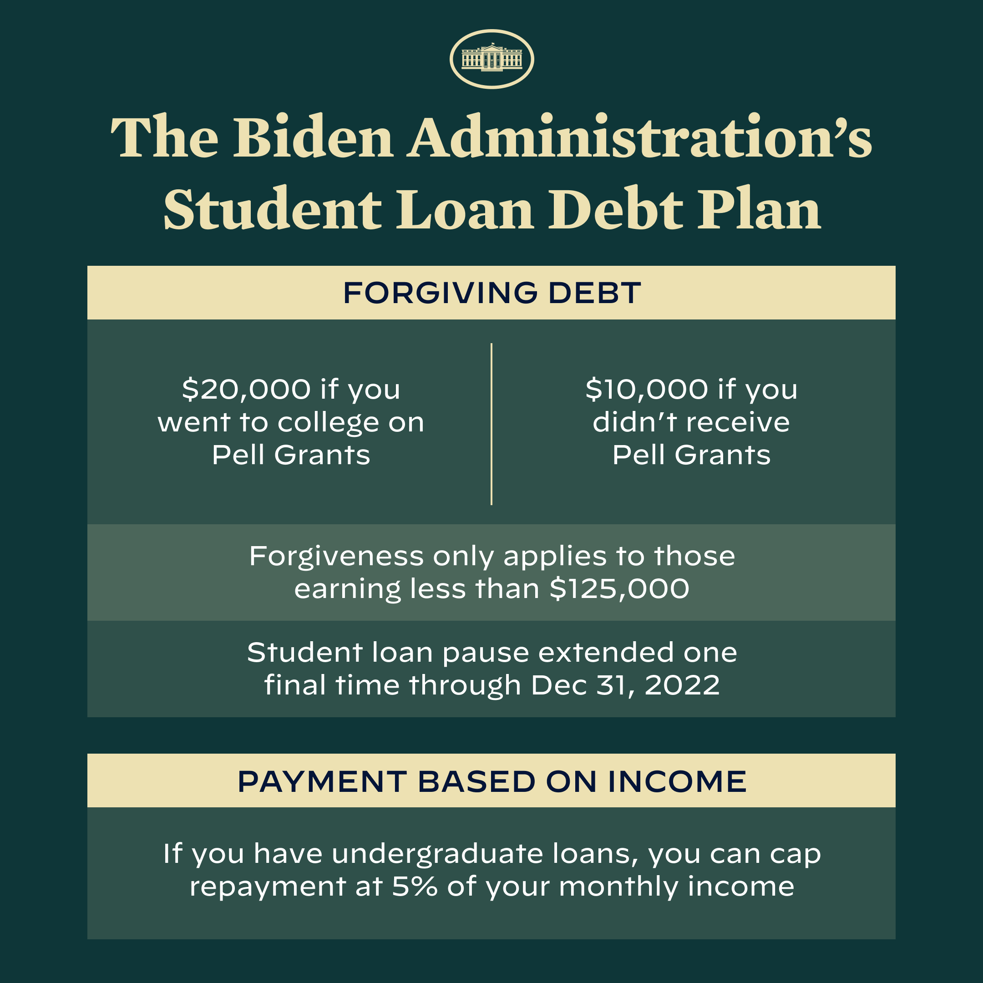

Slide 9
WHO IS ELIGIBLE?
Forgiveness is only available for loans issued by the U.S. Department of Education (Federal Loans, not private loans).
You are probably NOT eligible for student loan forgiveness if…
You obtained your loan from a private lender, not the DoE.
You refinanced your federal loan into a private loan.
You consolidated or combined federal loans and private loans into a single loan repayment package.
A federal loan can be converted into a private loan, but a private loan cannot be converted into a federal loan.

Slide 10
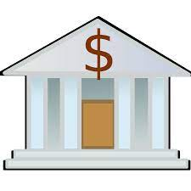
WHO IS ELIGIBLE?
Forgiveness is only available for loans issued by the U.S. Department of Education (Federal Loans, not private loans).
YOU
YOUR COLLEGE
YOUR LOAN SERVICER
MAYBE A BANK
MAYBE SOME INVESTORS
U.S. DEPARTMEMT OF EDUCATION

Slide 11
WHO IS ELIGIBLE?
Forgiveness is only available for loans issued by the U.S. Department of Education (Federal Loans, not private loans).
Forgiveness is only available if annual income is less than $125,000 for individuals or less than $250,000 married couples (filing jointly) or for heads of households.
Not sure if this is based on 2021 or 2020…use whichever is lower.
You should be eligible regardless of when you file the application. The relief window is expected to close on December 31, 2023.
File as soon as possible for several reasons.

Slide 12
DO YOU NEED TO FILE ANYTHING?
YES!
The application form should be available online in early October.
The main piece of information you need to provide is your income.
The Department of Education has loan balance, grant history and income information for some people….but it does not have income information for everyone.
These people will receive forgiveness automatically, without filing.
But most of you do not know if you are one of these people.
So, complete the application as soon as you can just to be sure.

Slide 13
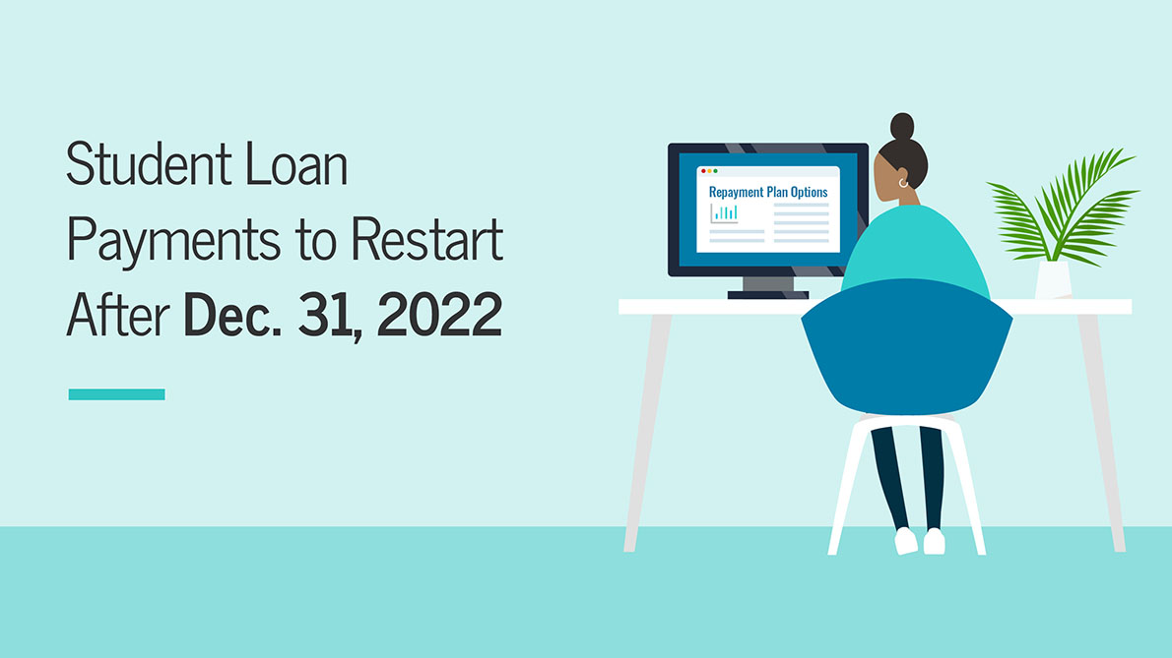
#1: DEFERRAL ENDS DECEMBER 31ST, 2022

Slide 14
#1: DEFERRAL ENDS DECEMBER 31ST, 2022
Since March 2020…
You have not had to make payments on your outstanding debt.
Interest has not been accruing on your outstanding debt.
ALL THAT ENDS ON DECEMBER 31, 2022 * Maybe…depending on your loan and status as a student

Slide 15
#1: DEFERRAL ENDS DECEMBER 31ST, 2022
Since March 2020…
You have not had to make payments on your debt.
Interest has not been accruing on your debt.
ALL THAT ENDS ON DECEMBER 31, 2022
SO, WHAT SHOULD YOU DO:
Check with your servicer to know if you will have payments due in January, 2023
Check with your servicer to know if interest will begin accruing in January, 2023
Make a plan to begin making payments when you have to and when you are able to do so

Slide 16
#1: DEFERRAL ENDS DECEMBER 31ST, 2022
Since March 2020…
You have not had to make payments on your debt.
Interest has not been accruing on your debt.
ALL THAT ENDS ON DECEMBER 31, 2022
SO, WHAT SHOULD YOU DO:
CLAIM YOUR LOAN FORGIVENESS AS SOON AS POSSIBLE SO THAT YOUR OUTSTANDING BALANCE IS $10,000 OR $20,000 LOWER WHEN INTEREST BEGINS ACCRUING AGAIN (You must apply for forgiveness by December 31, 2023)

Slide 17
#1: DEFERRAL ENDS DECEMBER 31ST, 2022
Assume your balance is $30,000 and your interest rate is 6% per year.
You will accrue $1,800 in the first year
You will accrue $1,909 in the second year
Your balance may be as high as $40,202 after 5 years (with no payments made)
Assume your balance is $20,000 and your interest rate is 6% per year.
You will accrue $1,200 in the first year
You will accrue $1,272 in the second year
Your balance may be as high as $26,765 after 5 years (with no payments made)
That’s $3,437 LESS interest accrued over 5 years, simply by claiming the $10,000 forgiveness.

Slide 18
#2: $10k-$20k RELIEF TO ELIGIBLE STUDENTS

Slide 19
#2: $10k-$20k RELIEF TO ELIGIBLE STUDENTS
This is the headline feature of the proposal.
If you do not know if you received a Pell Grant, you should be able to confirm this through your FAFSA account at studentaid.gov or with your servicer.
You should just need to apply through the normal process; the Department of Education knows if you received a Pell, you might like to know just to be sure.
Once you complete the forgiveness application, your outstanding balance should be reduced by $10,000 or $20,000 within 4-6 weeks.
You have until December 31, 2023 to apply.

Slide 20
#2: $10k-$20k RELIEF TO ELIGIBLE STUDENTS
If you have made payments and reduced your outstanding loan balance since the pause began in March 2020, you are eligible to get that money refunded.
Contact your servicer to request your refund.
The refund will effectively increase your loan balance back to where it was in March 2020.
Get your refund before applying for loan forgiveness because your eligible loan forgiveness is limited to the outstanding loan balance, so you want that to be as high as possible.
(Note: studentaid.gov is saying that your payments will be refunded automatically. But, to be safe, it might not hurt if you request it directly.)

Slide 21
#2: $10k-$20k RELIEF TO ELIGIBLE STUDENTS
Note: studentaid.gov is saying that your payments will be refunded automatically. But, to be safe, it might not hurt if you request it directly.
If you have multiple federal loans with outstanding debt, studentaid.gov is saying that the Department of Education will determine which loans receive the forgiveness…with the highest priority to loans that have defaulted and/or have the highest interest rates (to benefit you the most).

Slide 22
#2: $10k-$20k RELIEF TO ELIGIBLE STUDENTS
WHAT ARE THE TAX IMPLICATIONS WHEN YOUR DEBT IS FORGIVEN?
NONE…at the federal level.
This exclusion was part of the 2021 American Rescue Plan (from 2021-2025).
NONE….at the state level (probably)
As of now, Louisiana is not expected to impose state income taxes on forgiven student loan debt.
We think there are 13 states where it will be taxed…but Louisiana is not one of them.
Confirm this before you file your 2022 or 2023 state income taxes.

Slide 23
#3: INCOME DRIVEN REPAYMENT
Public Service Loan Forgiveness
Borrowers who are employed by non-profits, the military, or federal, state, Tribal, or local government may be eligible to have all of their student loans forgiven through the Public Service Loan Forgiveness (PSLF) program.
Temporary changes, ending on October 31, 2022, provide flexibility that makes it easier than ever to receive forgiveness by allowing borrowers to receive credit for past periods of repayment that would otherwise not qualify for PSLF.
Enrollments on or after November 1, 2022 will not be eligible for this treatment.
For more information on eligibility and requirements, go to PSLF.gov.

Slide 24
#3: INCOME DRIVEN REPAYMENT
The proposed an Income-Driven Repayment plan will substantially reduce future monthly payments for lower- and middle-income borrowers.
Require borrowers to pay no more than 5% of their discretionary income monthly on undergraduate loans.
This is down from the 10% available under the most recent income-driven repayment plan.
Raise the amount of income that is considered non-discretionary income and therefore is protected from repayment, guaranteeing that no borrower earning under 225% of the federal poverty level will have to make a monthly payment.
Forgive loan balances after 10 years of payments, instead of 20 years, for borrowers with loan balances of $12,000 or less.
Cover the borrower's unpaid monthly interest, so that unlike other existing income-driven repayment plans, no borrower's loan balance will grow as long as they make their monthly payments—even when that monthly payment is $0 because their income is low.

Slide 25
#3: INCOME DRIVEN REPAYMENT
The proposed an Income-Driven Repayment plan will substantially reduce future monthly payments for lower- and middle-income borrowers.
Require borrowers to pay no more than 5% of their discretionary income monthly on undergraduate loans.
This is down from the 10% available under the most recent income-driven repayment plan.
Raise the amount of income that is considered non-discretionary income and therefore is protected from repayment, guaranteeing that no borrower earning under 225% of the federal poverty level will have to make a monthly payment.
Forgive loan balances after 10 years of payments, instead of 20 years, for borrowers with loan balances of $12,000 or less.
Cover the borrower's unpaid monthly interest, so that unlike other existing income-driven repayment plans, no borrower's loan balance will grow as long as they make their monthly payments—even when that monthly payment is $0 because their income is low.
NOTE:
This proposed Income-Driven Plan is different from the Public Service Loan Forgiveness information on the previous slide.
This proposed Plan is only for undergraduate loans.
These proposed changes are designed to encourage more borrowers to pursue Income-Driven Repayment…because more people will benefit from IDR.
You may not need to do anything now…beyond considering whether you should use IDR when it is time to repay your student loans.

Slide 26
KEY DATES
EARLY OCTOBER – The application for loan forgiveness should become available, presumably at studentaid.gov.
4-6 WEEKS AFTER YOU APPLY – The debt forgiveness should be processed and applied.
Nothing like this has ever been done. And there are many stakeholders involved in the process. Do not be surprised if it takes more than 4-6 weeks.
DECEMBER 31, 2022– The window to apply for forgiveness is expected to close.
DECEMBER 31 – The student loan pause ends.
JANUARY 1 – Any outstanding student loan debt may begin accruing interest…get your forgiveness before the end of 2022.
Apply by November 15 to have your outstanding balance reduced before December 31.

Slide 27
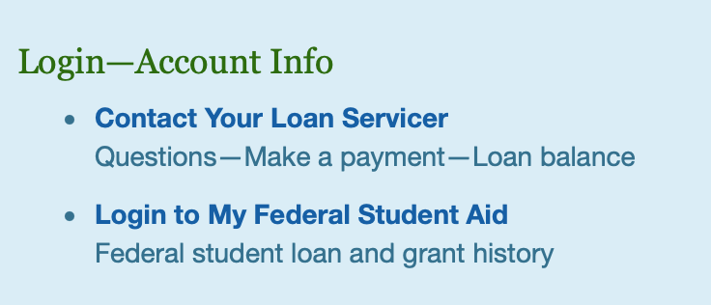
WHAT YOU CAN DO NOW
Sign up for updates with the Department of Education
https://www.ed.gov/subscriptions
Check your FAFSA account to determine your eligibility
https://studentaid.gov/fsa-id/sign-in/landing

Slide 28
WHAT YOU CAN DO NOW
Sign up for updates with the Department of Education
https://www.ed.gov/subscriptions
Check your FAFSA account to determine your eligibility
https://studentaid.gov/fsa-id/sign-in/landing
Collect your 2020 and 2021 Tax Returns to confirm income
Contact your servicer to confirm communication preferences and that you know who is your servicer.
This might be a little bit of a scavenger hunt. Start with your university and with studentaid.gov and go from there.
Begin thinking about what you need to do in January 2023.

Slide 29
WATCH OUT FOR SCAMS
Nobody should call you to gather any personal information
If anyone does, hang up or ignore them and look for necessary information or process on your own.
You should not have to pay any fees for the application or for processing or for collecting.
You might have legitimate outstanding fees related to your debt (e.g. late payments). Verify that they are real. And they should not prevent you from obtaining any loan forgiveness you are eligible for.
Nobody can get you to the front of the line. Be patient.

Slide 30
MONEY MATTERS SERIES: FALL 2022
SEPTEMBER 7
BUDGETING:
GOALS, VALUES & HACKS
OCTOBER 27
DEBT MANGEMENT: PAYING OFF YOUR MOST COSTLY DEBT
NOVEMBER 29
CAREER PLANNING: GETTING YOUR FIRST JOB OFFER
OCTOBER 5
INVESTING:
CREATING YOUR OWN INVESTING ROAD MAP
NOVEMBER 10
INVESTING & TAXES: OPENING YOUR OWN ROTH IRA

Slide 31
brian.bolton@louisiana.edu http//:business.louisiana.edu/financeispersonal

Slide 32
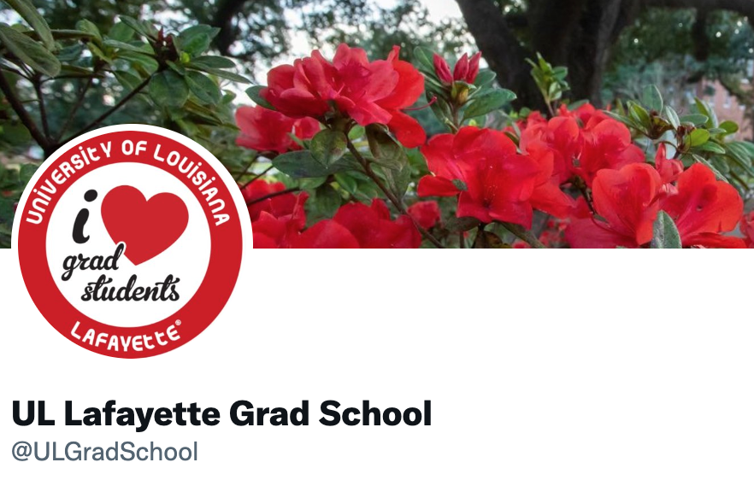
gradschool@louisiana.edu

