Slide 1

MONEY MATTERS
SESSION #1 – INVESTING
Using different investment strategies and tools
to support your personal & professional goals.
Manage Your Money Today
Maximize Your Money in the Future
September 8, 2021

Slide 2
Owning Your Financial Future
YOUR VALUES
YOUR GOALS
Education
Career
Family
FINANCIAL STRATEGIES
Investing
Income & Expense Management
Debt Management
Taxes, Insurance & Other

Slide 3
Owning Your Financial Future
INVESTING STRATEGIES TO SUPPORT YOUR GOALS
Today, September 8
BUDGETING: MANAGING INCOME & EXPENSES
Tuesday, September 28 12:00pm
Wednesday, October 6 6:00pm
DEBT & STUDENT LOAN MANAGEMENT
Wednesday, October 27 6:00pm
CAREER PLANNING & FINANCIAL PLANNING
Wednesday, November 17 6:00pm

Slide 4
Owning Your Financial Future
INVESTING STRATEGIES TO SUPPORT YOUR GOALS
Today, September 8
BUDGETING: MANAGING INCOME & EXPENSES
Tuesday, September 28 12:00pm
Wednesday, October 6 6:00pm
DEBT & STUDENT LOAN MANAGEMENT
Wednesday, October 27 6:00pm
CAREER PLANNING & FINANCIAL PLANNING
Wednesday, November 17 6:00pm

Slide 5
Owning Your Financial Future
INVESTING STRATEGIES TO SUPPORT YOUR GOALS
Today, September 8
BUDGETING: MANAGING INCOME & EXPENSES
Tuesday, September 28 12:00pm
Wednesday, October 6 6:00pm
DEBT & STUDENT LOAN MANAGEMENT
Wednesday, October 27 6:00pm
CAREER PLANNING & FINANCIAL PLANNING
Wednesday, November 17 6:00pm

Slide 6
Owning Your Financial Future
INVESTING STRATEGIES TO SUPPORT YOUR GOALS
Today, September 8
BUDGETING: MANAGING INCOME & EXPENSES
Tuesday, September 28 12:00pm
Wednesday, October 6 6:00pm
DEBT & STUDENT LOAN MANAGEMENT
Wednesday, October 27 6:00pm
CAREER PLANNING & FINANCIAL PLANNING
Wednesday, November 17 6:00pm

Slide 7
Owning Your Financial Future
YOUR VALUES
YOUR GOALS
Education
Career
Family
FINANCIAL STRATEGIES
Investing
Income & Expense Management
Debt Management
Taxes, Insurance & Other

Slide 8
What is INVESTING?
Investing is saving for the future.
We typically think of investing as long-term – anywhere from 1 or 2 years all the way through retirement.
Saving vs. Investing
  Saving can be short-term, Investing is typically long-term.
  Saving is passive, Investing is dedicated…it could be relatively passive or extremely active.
    Passive: Mutual funds. Extremely Active: Owning an apartment complex.
  Saving is typically very low risk, Investing generally has more risk.
  Saving provides low returns on investment (currently about 0.0%)
  Inflation is risky…You can lose 100% or realize huge positive returns.

Slide 9
What is INVESTING?
Investing is saving for the future.
We typically think of investing as long-term – anywhere from 1 or 2 years all the way through retirement.
Saving vs. Investing
  Saving can be short-term, Investing is typically long-term.
  Saving is passive, Investing is dedicated…it could be relatively passive or extremely active.
    Passive: Mutual funds. Extremely Active: Owning an apartment complex.
  Saving is typically very low risk, Investing generally has more risk.
  Saving provides low returns on investment (currently about 0.0%)
  Inflation is risky…You can lose 100% or realize huge positive returns.
OUR FOCUS TODAY:
Medium-to-Long-Term Investing Strategies
With Moderate Risks
That Anyone Can Do – Regardless of Your Goals, Your Income, Your Wealth, Anything.
(If you are curious about other saving-investing issues, just ask)

Slide 10
Why Are You Here?
Take a few seconds to ask yourself:
Why Are You Investing?
What are your investing goals?
To buy a house?
To buy a car?
To pay off debt?
To retire?

Slide 11
Why Are You Here?
My favorite exercise to do in workshops is the following:
Tell the story of your retirement.
When does it happen? How does it happen?
What are you doing? Where are you? Who are you with?
I like this for a couple reasons:
It helps you identify what it important for you.
Starting at the finish line helps us determine what it will take to get there.

Slide 12
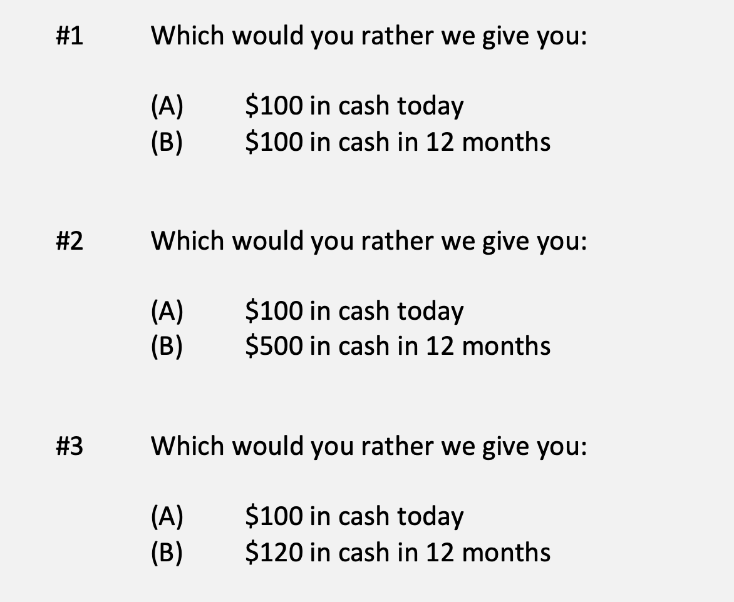
A Few Rules About INVESTING
Investing is about Trade-Offs. Using money today to get (hopefully more) money in the future:

Slide 13
A Few Rules About INVESTING
Risk matters. Know your risk tolerance.
Goals matter. Be intentional about what you are saving for.
  Maybe create 3-5 different investment accounts for different goals.
Transaction costs matter. You can pay a lot of fees for not much benefit or service. Be careful.
Experts rarely have tips or secret. Investing is about predicting the future, and none of us can predict the future (perfectly). Be careful.
  If there really were sure-things or get-rich-quick schemes, the experts would be using them themselves, not sharing them with you.
Communicate with your family. Achieving goals is a family affair.

Slide 14
A Few Rules About INVESTING
Investing lets COMPOUND INTEREST be your friend.
  With compound interest, your interest earns interest.
  Without actively making decisions, your money can grow exponentially.
  Yes, there is risk – the exponential growth rate could be negative.
  Such risk is greatest if you ‘invest’ over very short periods of time.
  Historically, over the past 100+ years, if you invest for 5+ years, you have benefited from positive exponential growth.
  The average return of a common stock over the past 100 years is 10%.
    The word ’average’ is very important here. But, the good news, we can all achieve ‘average’ returns relatively easily (though they may not be 10% in the future)

Slide 15
A Few Rules About INVESTING
Investing lets COMPOUND INTEREST be your friend.
  Invest $100 at 10% interest or growth:
  Year 1: $100 x (1 + 10%) = $110
  Year 2: $110 x (1 + 10%) = $121
  $100 x (1 + 10%)² = $121
  Year 1: $10 of interest
  Year 2: $10 of interest on your original $100 + $1 of interest on year 1 interest

Slide 16
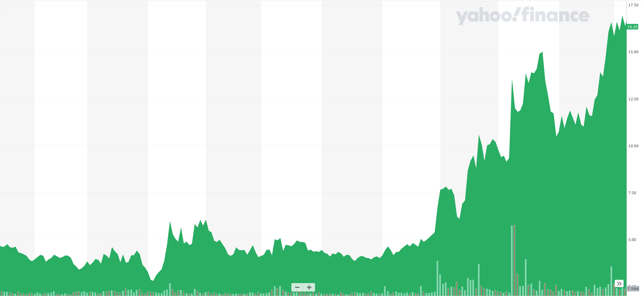
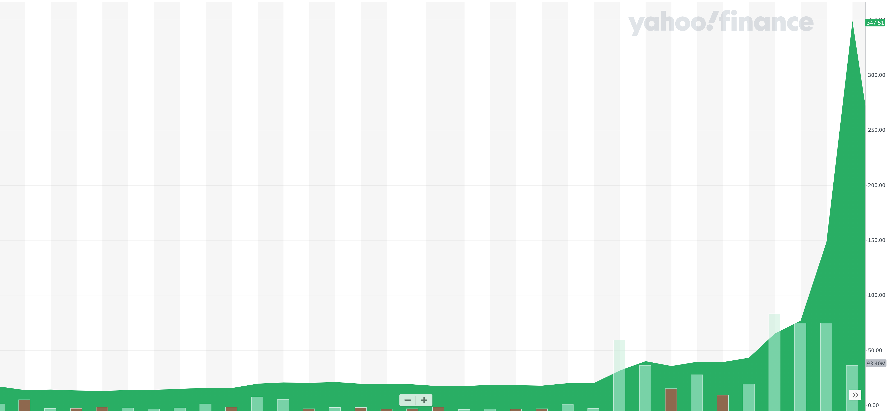
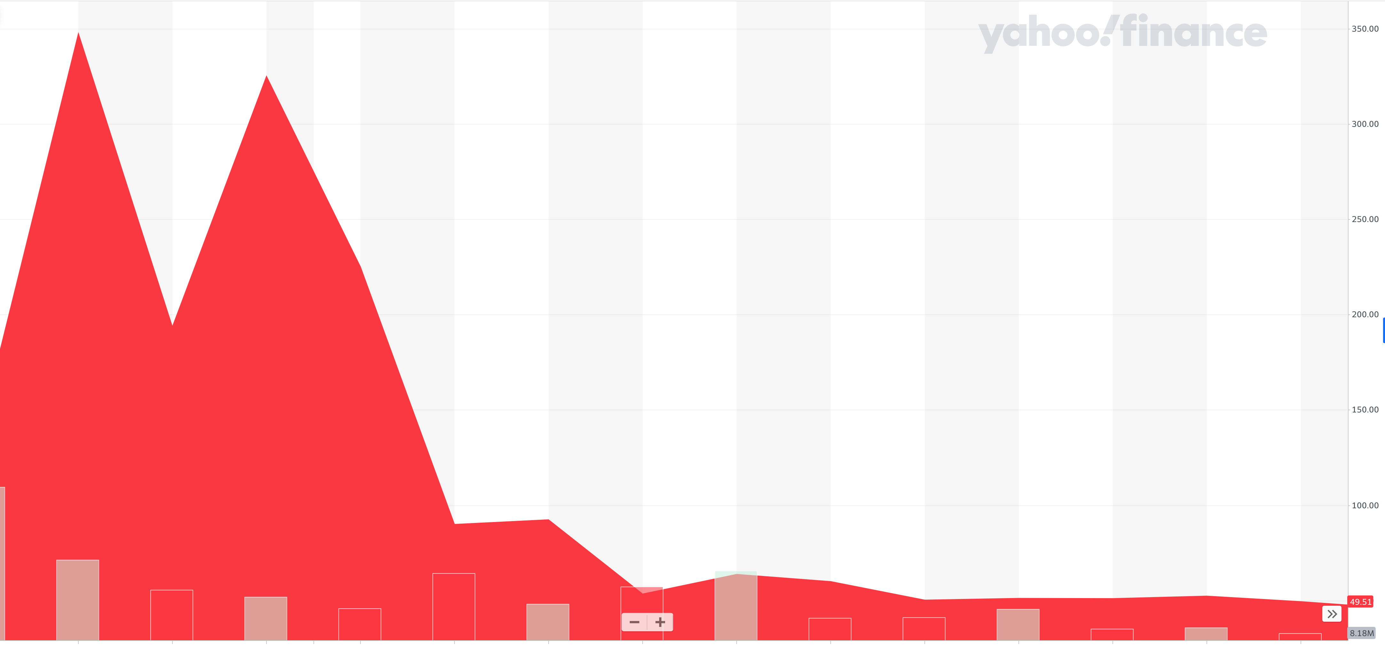
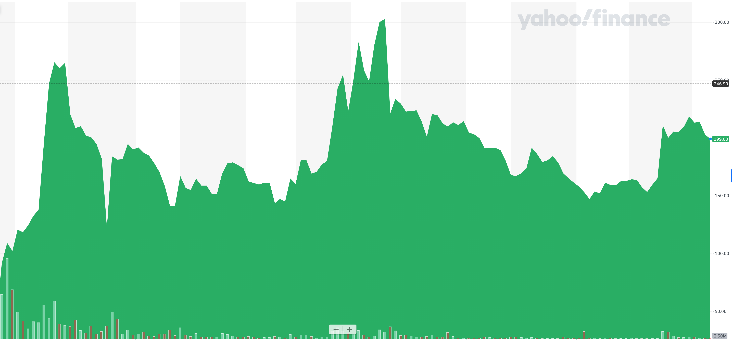
+100%
+3120%
-92%
+300%

Slide 17
All 4 charts are for Gamestop – Just over different periods of time.
First 11 Months in 2020
December 2020 to January 27
January 27 to February 18
February 18 to today

Slide 18
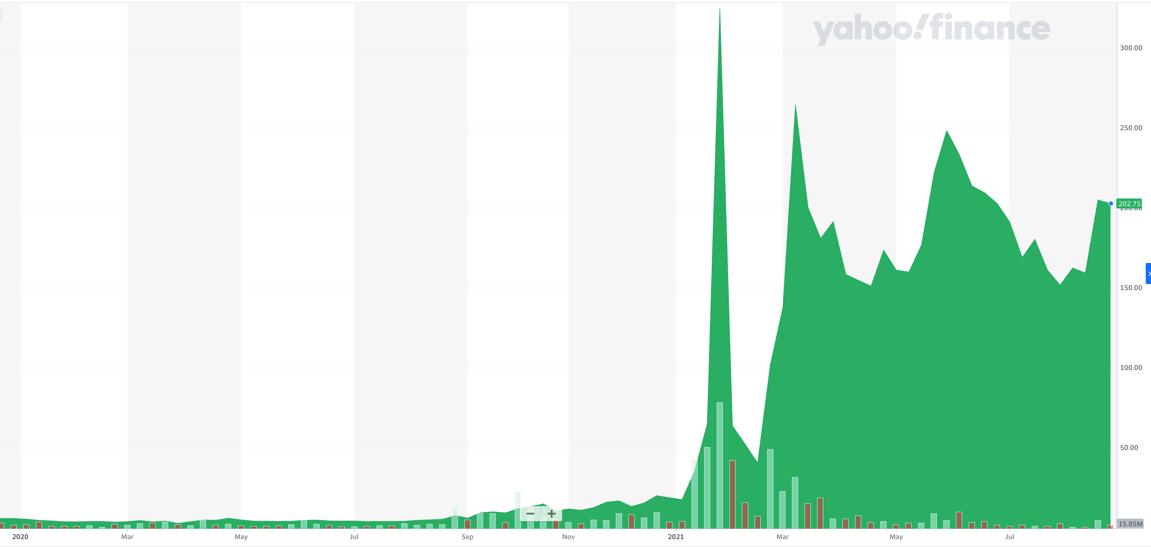
GAMESTOP
From January 2020 to Today
+4000%
If you had invested $100 in Gamestop at the beginning of 2020, that investment would be worth $5000 today.

Slide 19
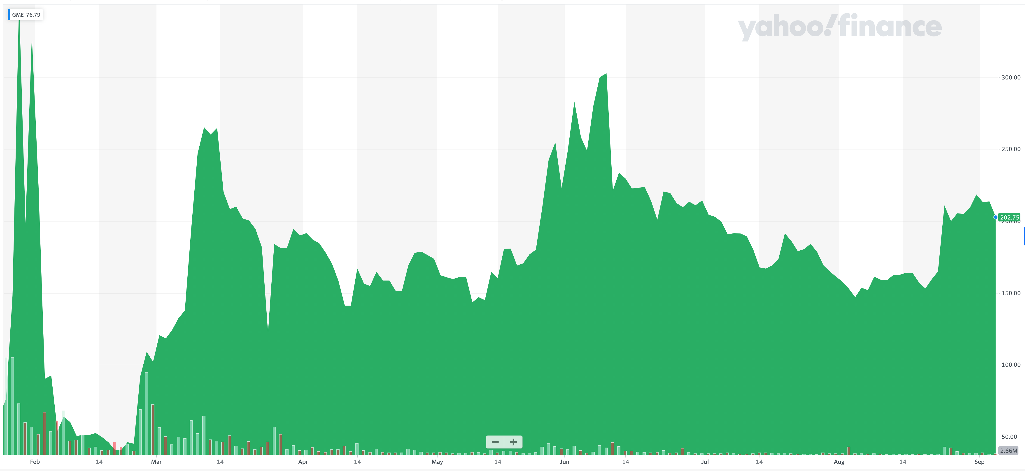
GAMESTOP
If you had invested $100 in Gamestop on January 26, it would have been worth $8 three weeks later.
It would be worth $45 today.

Slide 20
Let’s Revisit Some 7th Grade Math
If an investment gains 50%...and then subsequently loses 50%, you do NOT now have the same amount you started with – you have less.
$100 + 50% = $150
$150 – 50% = $75
Moral: Do NOT get tricked into thinking that returns are summative.
We get the same result if you lose first and then gain.
$100 – 50% = $50 $50 + 50% = $75

Slide 21
Timing Matters
We could tell similar stories about ups-and-downs for Bitcoin, Tesla, Dogecoin, AMC, Viacom and many other investments
It is very, very, very, very, very, very, very, very, very, very, difficult to consistently have perfect timing when making investments
  People who research this phenomenon for a living will tell you it’s impossible
Do you think you’re unique and that you will be able to consistently time the market so you gain from the up moves and never lose from the down moves?

Slide 22
Expertise Matters
Take a minute to think about the following question:
What do YOU do better than 99.9% of humanity?
Think about what you’re studying. Think about what you’ve been working on for years. Think about what you know that I do not know.
I’ve probably only spent 1-2 hours studying what you have dedicated your life to studying and becoming an expert in.
  Could I do your job as well as you do it?

Slide 23
Expertise Matters
Of course, I couldn’t do your job as well as you.
Now connect this logic to investing: there are many professionals who have dedicated their lives to making investments. They are good.
  Yes, there are many amateurs involved in trading stocks – but they (usually) account for a very minor portion of the total money invested.
Remind yourself of this old gambling maxim:
When you are sitting at the poker or gambling table, take a look around and see if you can figure out who the sucker is. If you cannot identify who the sucker is, then the sucker is probably you.

Slide 24
Long-Term Investment Planning
YOUR VALUES
YOUR GOALS
FINANCIAL STRATEGIES
INVESTMENT STRATEGIES
Identify Your Risk Tolerance
Identify Your Time Horizons
Select Investments
Monitor & Modify Investments

Slide 25
Long-Term Investment Planning
FINANCIAL STRATEGIES
INVESTMENT STRATEGIES
Identify Your Risk Tolerance
Identify Your Time Horizons
Select Investments
Monitor & Modify Investments

Slide 26
Long-Term Investment Planning
FINANCIAL STRATEGIES
EDUCATION STRATEGIES
INVESTMENT STRATEGIES
GRAD SCHOOL STRATEGIES
Identify Your Risk Tolerance
Identify Your Risk Tolerance
Identify Your Time Horizons
Identify Your Time Horizons
Select Investments
Select Your Field, Program, Specialization, Thesis
Monitor & Modify Investments
Monitor & Modify Your Progress & Plan

Slide 27
Long-Term Investment Planning
FINANCIAL STRATEGIES
YOU,
as grad students, are better wired and equipped to make long-term plans – education, career, financial & otherwise – than 99% of humanity.
Be confident.
Be intentional.
Be diligent.
Be awesome.
EDUCATION STRATEGIES
INVESTMENT STRATEGIES
GRAD SCHOOL STRATEGIES
Identify Your Risk Tolerance
Identify Your Risk Tolerance
Identify Your Time Horizons
Identify Your Time Horizons
Select Investments
Select Your Field, Program, Specialization, Thesis
Monitor & Modify Investments
Monitor & Modify Your Progress & Plan

Slide 28
I DO NOT GIVE INVESTMENT ADVICE
But here are some investment issues to think about:
Do you want to pick individual stocks (or other securities) and monitor them regularly?
  This would be similar to the Gamestop example presented earlier.
  Advantages: Potential for big gains, maybe a personal connection to the companies, you feel more engaged with the process.
  Disadvantages: Potential for big losses, requires more time and energy, transaction costs (trading, taxes) can add up, there are 1000s to choose from, potential loss of sleep and hair

Slide 29
I DO NOT GIVE INVESTMENT ADVICE
But here are some investment issues to think about:
Or, would you be content investing in mutual funds and/or market indexes that pool dozens or hundreds of stocks?
  Advantages: Potential for moderate gains, lower risk (through diversification), lower trading and tax costs, you can narrow down the selection pretty quickly, less loss of sleep and hair
  Disadvantages: Lots of singles and doubles but no home runs, no emotional connection to your investments, susceptible to big market downturns (but not necessarily more than individual stocks)

Slide 30
I DO NOT GIVE INVESTMENT ADVICE
If you want to invest in individual stocks, I cannot help you.
But if you are interested in market indexes, here are some ideas:
  SPY – The S&P 500 index. 500 of the largest U.S. firms, from all industries.
  SPYD – The same as above, with a focus on those companies that pay regular dividends out to investors from their earnings. You will get more income, but possibly lower long-term capital gains.
  IWM – The Russell 2000. 2000 smaller U.S. firms (the 2000 firms after the 1000 largest firms). More volatility, possibly higher returns.
  EFA – Index of non-US firms (Europe, Far East, Australasia). Big firms.
  EEM – Index of non-US, emerging market stocks. Bigger firms in developing countries. More risk than any of the above.
  GBTC – A Bitcoin index. Invest in Bitcoin without mining or owning. Big Risk.

Slide 31
Owning Your Financial Future
YOUR VALUES
YOUR GOALS
Education
Career
Family
FINANCIAL STRATEGIES
Investing
Income & Expense Management
Debt Management
Taxes, Insurance & Other
YOU, as grad students, are better wired and equipped to make long-term plans – education, career, financial & otherwise – than 99% of humanity.
Be confident. Be intentional. Be diligent. Be awesome.

Slide 32

Isn’t this a lot like what you do with your education planning?

Slide 33
Determining Your Risk Tolerance
High Risk Attitude
I want to summer in Paris and winter in Hawaii
Medium-High Risk Attitude
I will work through normal retirement age, but I want my spouse to retire early - and we want to visit Paris & Hawaii
Medium-Low Risk Attitude
I want my children to have a college education
Low Risk Attitude
I want food on the table and a roof over my head

Slide 34
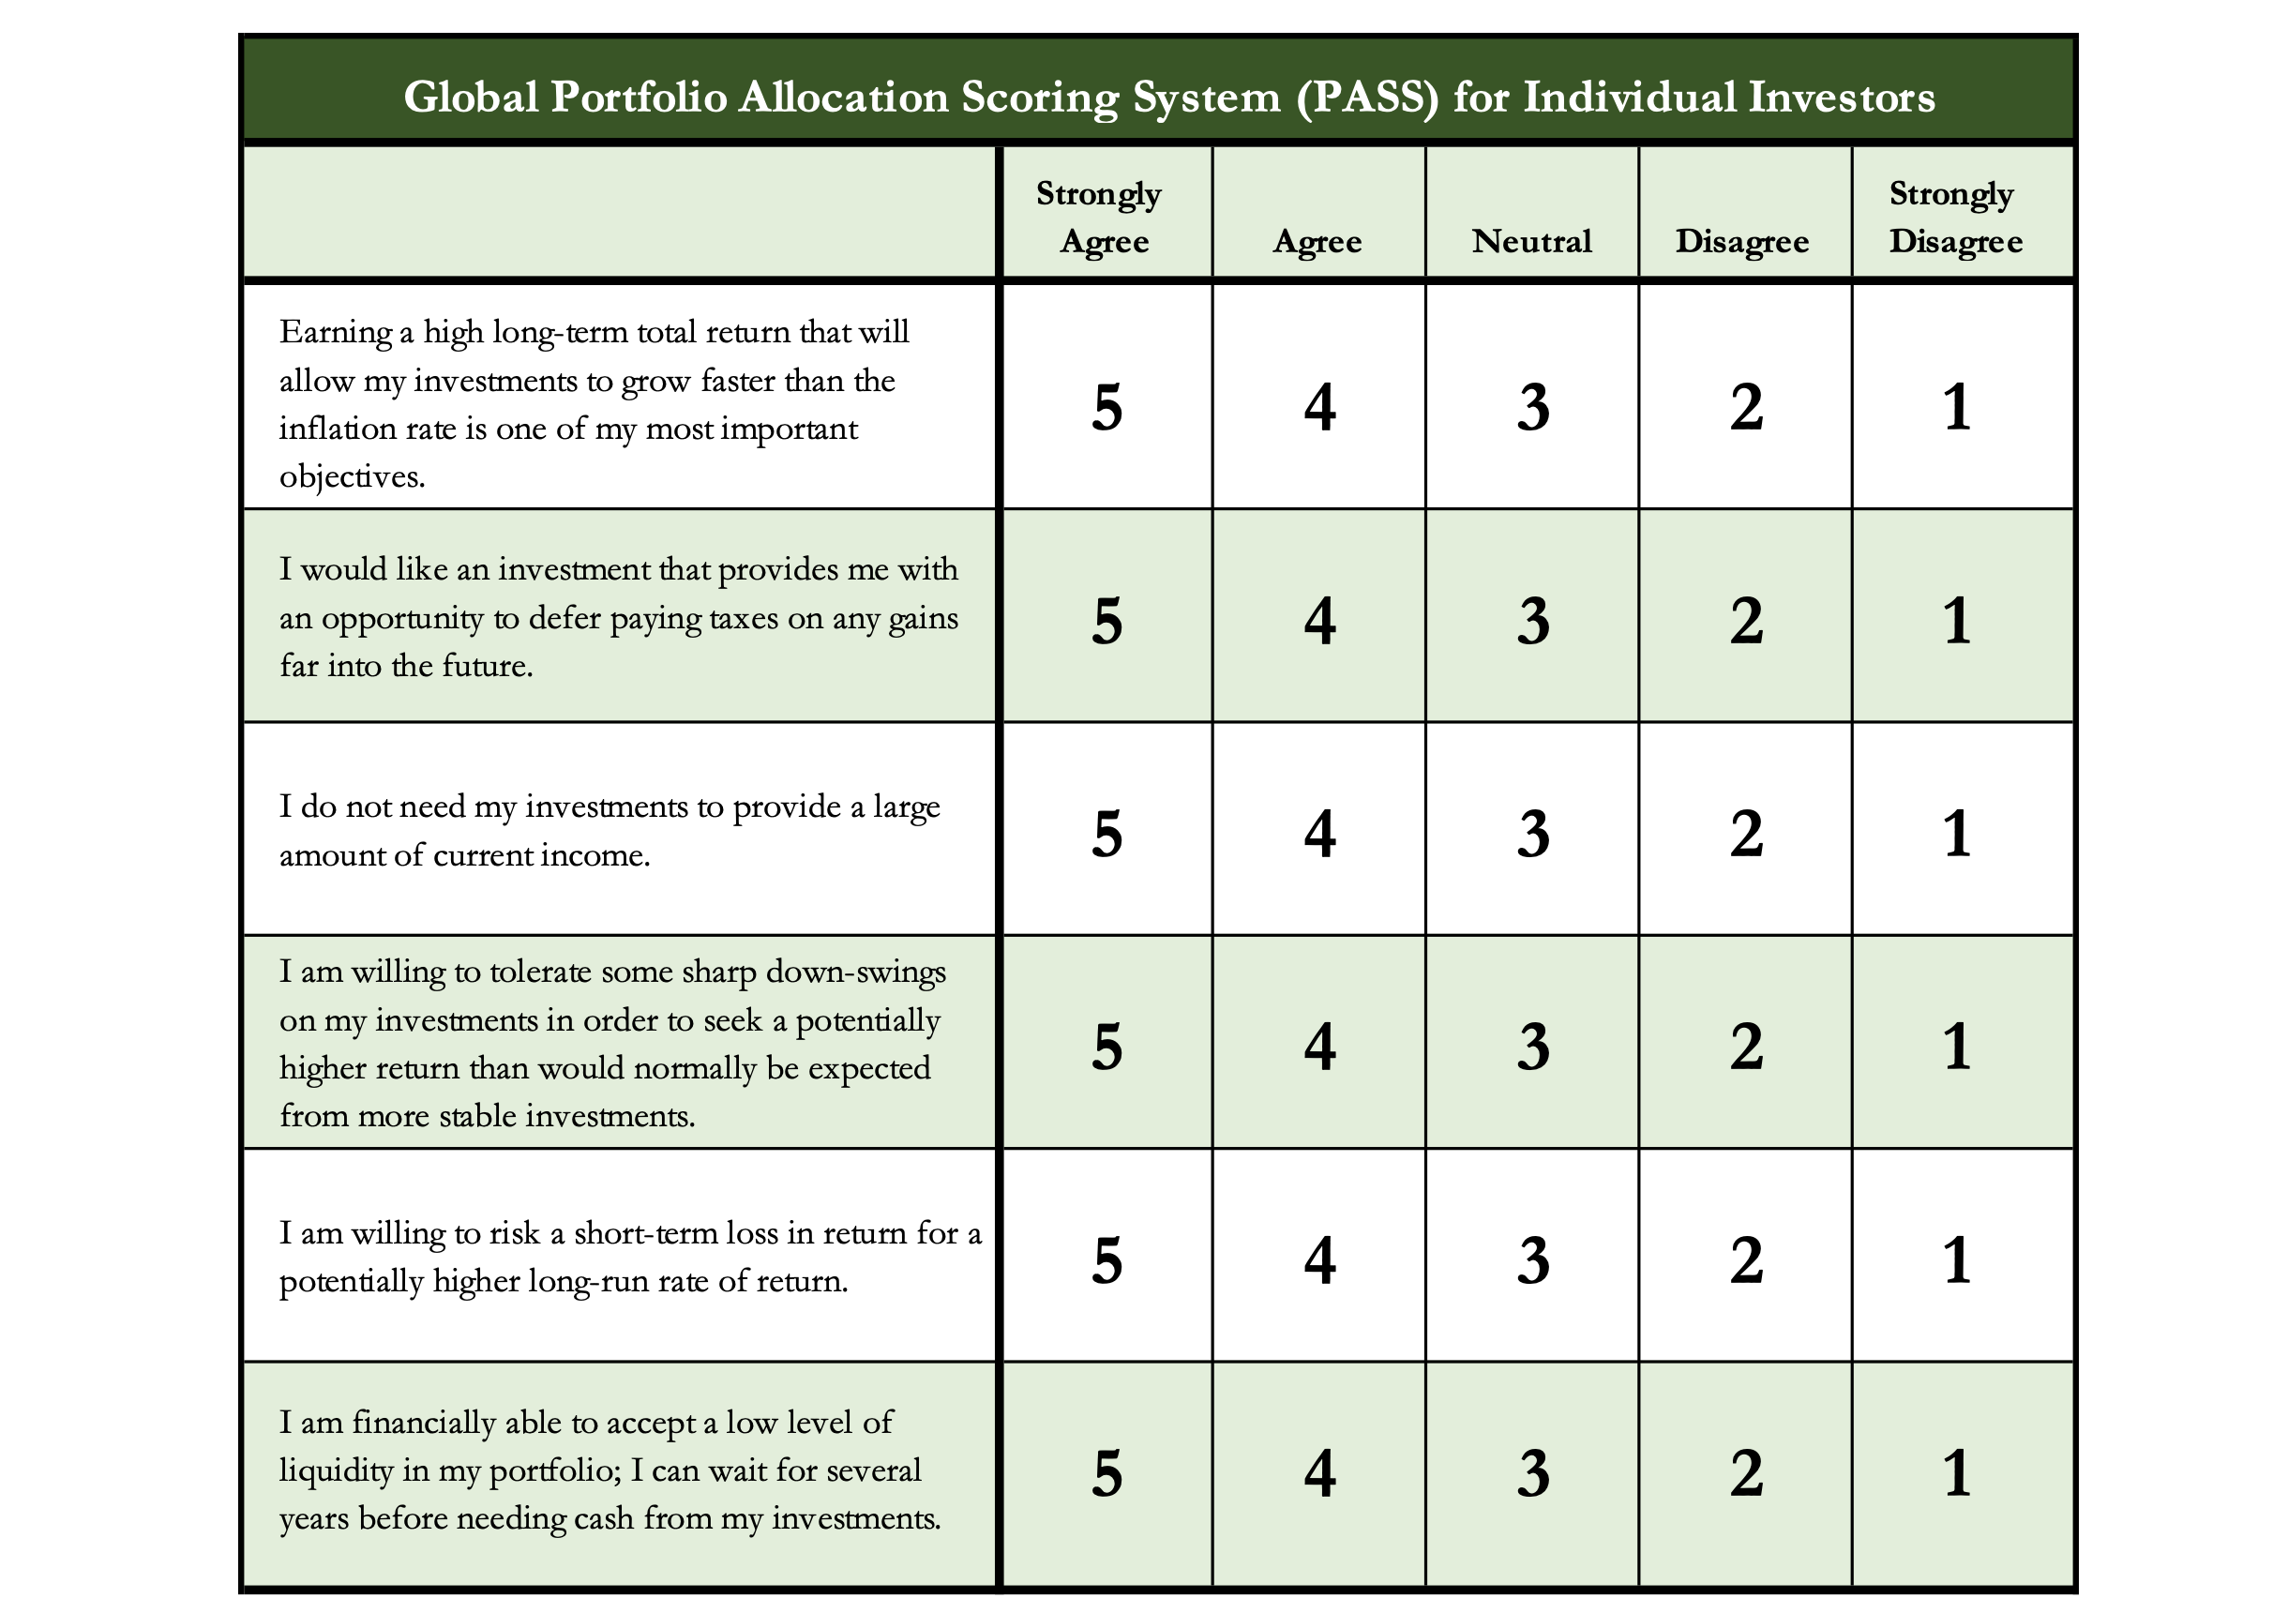
Determining Your Risk Tolerance

Slide 35
Comparing Different Investments

Slide 36
Comparing Different Investments

Slide 37
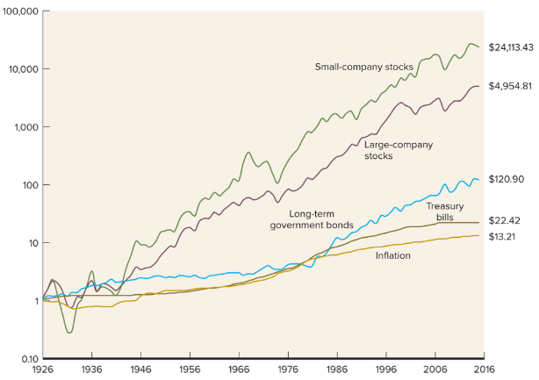
Comparing Different Investments

Slide 38
The Magic of Compound Returns

Slide 39
The Magic of Compound Returns

Slide 40
The Magic of Compound Returns
Quiz Question on Compound Returns:
Under which of the following scenarios will you have more money saved when you turn 65?
Investing $100 per month from age 25-35 (and then nothing from 35-65)
With an 8% return, you will have $185,000 accumulated at 65.
Investing $100 per month from age 35-65 (but nothing from 25-35)
With an 8% return, you will have $150,000 accumulated at 65.
(Note: If the returns on your investments are less than 6%, (B) will lead to greater wealth)

Slide 41
The Magic of Compound Returns
Quiz Question on Compound Returns:
Under which of the following scenarios will you have more money saved when you turn 65?
Investing $100 per month from age 25-35 (and then nothing from 35-65)
With an 8% return, you will have $185,000 accumulated at 65.
Investing $100 per month from age 35-65 (but nothing from 25-35)
With an 8% return, you will have $150,000 accumulated at 65.
(Note: If the returns on your investments are less than 6%, (B) will lead to greater wealth)

Slide 42
Investing – How Do You Do It?
When you’re just getting started with investing, there are a couple approaches you can take:
  Start with a small amount of money – whether that’s $20 or $2,000 – and just go for it. Pick a few investments, track them regularly and be prepared to buy more or sell more should you feel comfortable doing either.
  Talk to a financial advisor. Note that they will not (or should not) tell you which specific investments to make, but they will work talk through your options with you and help you better understand the differences in the above table. This will help you be a little more confident when you’re staring out – but advisors are not free. You will pay them.
    Robinhood, Webull, SoFi, FirstTrade
    Fidelity, Schwab, TD Ameritrade, Edward Jones, Raymond James
    Bank of America, JP Morgan Chase, Goldman Sachs, Wells Fargo

Slide 43
Investing – Some Perspective
I am biased because I am a finance professor. I study investing and I teach investing. My perspective on risk may be meaningless to you.
Do not take my advice on what level of risk you should take. Be thoughtful, be prudent.
Avoid doing things that you know are stupid and that you know will cause you stress.
But don’t be afraid of taking risks just because they scare you. You have already taken many, many risks in your life. Taking informed and measured risks will continue to open many doors and opportunities for you – in both your personal and financial lives.

Slide 44
Investing – Some Parting Words
Nothing in finance is free. Do not think some institution is giving you a super deal just because they like you. There will be costs.
Investment companies work really hard to get your money. They hire psychologists to figure out how to get you addicted to your products. Your money pays for their commercials, buildings, fancy cars and vacation homes.
I check my investment accounts daily. I do not make changes daily (or even monthly). I just don’t want any surprises.

Slide 45
Investing – Some Parting Words
If you ever invest based on personal relationships, be prepared for losses.
Nobody – NOBODY – can predict the future. And investing is all about predicting the future. Be careful about thinking you can predict the future.
Be your own boss. Take control of your investments. Nobody else is going to do it for you. Own your financial future.

Slide 46
brian.bolton@louisiana.edu

