Slide 1

MONEY MATTERS:
UL SYSTEM FINANCIAL WELLNESS SERIES
Session #3
Investing…for Retirement, Education & Special Events
July 13, 2022

Slide 2
Brian Bolton
Professor of Finance brian.bolton@louisiana.edu http://business.louisiana.edu/financeispersonal

Slide 3
Owning Your Financial Future
INVESTING GOALS, HABITS & STRATEGIES
Today, June 22
BUDGETING & DEBT MANAGEMENT
Wednesday, July 6
INVESTING FOR RETIREMENT,
EDUCATION & SPECIAL EVENTS
Wednesday, July 13

Slide 4
Owning Your Financial Future
INVESTING for INTERNATIONAL FACULTY,
STUDENTS & PROFESSIONALS
Wednesday, July 20
TAX PLANNING
(for budgeting, investing & retirement)
Wednesday, July 27
CAREER PLANNING: YOUR MONEY & YOUR FUTURE
Wednesday, August 3

Slide 5
Owning Your Financial Future
Structure of each session:
  Open question & answer session
  Brian presents general update on investing and any relevant current events
  Brian presents specific guidance and ideas for the session’s topic
  Open question & answer session…about any topics you wish to discuss

Slide 6
Happiness
Long-Term Goals
Short-Term Goals
Financial Needs
Family Needs

Slide 7
Financial Wellness
A goal without a plan is just a dream.
Wealth is largely the result of habit.
The most difficult thing is the decision to act; the rest is mere tenacity.
It takes as much energy to plan as it does to wish.
You cannot escape the responsibility of tomorrow by avoiding it today.

Slide 8
This is exactly how most of us think about other priorities in our lives: family, career, education.
Let’s try to have the same thinking for our financial lives.
A goal without a plan is just a dream.
Wealth is largely the result of habit.
The most difficult thing is the decision to act; the rest is mere tenacity.
It takes as much energy to plan as it does to wish.
You cannot escape the responsibility of tomorrow by avoiding it today.

Slide 9
What Are Your Values, Dreams & Goals?
Education
Career
Family
What Is Your Current Situation?
Education
Career
Family
Financial

Slide 10
Create a Personal Financial Plan for You:
Investing
Budgeting
Debt Management
Taxes
Insurance
Retirement
Education
Family
Business Planning
Philanthropy
Estate Planning

Slide 11
A Few Opening Morals
Because personal finance is personal, it is virtually impossible for me to give you any specific advice.
However, there is one word of advice that applies to 99% of people working on their finances:
SAVE

Slide 12
A Few Opening Morals
SAVINGS
INVESTING
OWNERSHIP
WEALTH

Slide 13
A Few Opening Morals
SAVINGS
INVESTING
WEALTH
(and freedom, options & opportunities)

Slide 14
A Few Opening Morals
The most difficult thing is the decision to act; the rest is mere tenacity.

Slide 15
Frequently Asked Question #1
Is it worth working with an investment company if you are new to the stock market and investing? Is this affordable?
The best things that investment companies provide are:
  An investment strategy.
  Peace of mind.
Investment advisors can provide the best guidance when:
  You are just getting started.
  You have specific investment issues - education, retirement, business.
  You are retiring.

Slide 16
Frequently Asked Question #1
Is it worth working with an investment company if you are new to the stock market and investing? Is this affordable?
What about robo-advisors? Are they for real?
Yes, they can be a decent option for some people.
  They can be less expensive than working with a real human.
  And the algorithms they use are designed by real humans, but without the real-time emotion that can complicate planning.
    Of course, during times of turbulence, whether personal or market turbulence, you may want to connect with a real human with real emotions.

Slide 17
Frequently Asked Question #1
Is it worth working with an investment company if you are new to the stock market and investing? Is this affordable?
Is using an investment company affordable?
Yes, probably, for most people.
  Some will charge a fixed fee for their services. This might not be affordable for graduate students and lower incomes.
  Others will charge for a percentage of assets that you have, maybe 1-2%.
  If you use an investment company for specific guidance, your goal should be to rely on them less and do more on your own (and save $$$)

Slide 18
Frequently Asked Question #2
When you have a stock that appreciates in value, do you have to sell
the entire stock to gain the profits?
Answer: Maybe. Or, kind of.
Assume you bought 1 share for $100.
Assume it increased to $120.
You do have to sell entire share to get the $120 cash.
  And you will owe taxes just on the gain of $20.

Slide 19
Frequently Asked Question #2
When you have a stock that appreciates in value, do you have to sell
the entire stock to gain the profits?
Answer: Maybe. Or, kind of.
Assume you bought 5 shares for $20 each for a total investment of $100.
Assume each share increased to $24, making the value of your investment $120.
You can sell 1 share for $24 and leave the other $96 invested.
  And you will owe taxes just on the gain of $4 on the single share.

Slide 20
Frequently Asked Question #2
When you have a stock that appreciates in value, do you have to sell
the entire stock to gain the profits?
Answer: Maybe. Or, kind of.
Assume you bought 5 shares for $20 each for a total investment of $100.
Assume each share increased to $22, making the value of your investment $110.
At the end of the year, the company paid a $2-per-share cash dividend to you. You get this 2 x 5 = $10 cash income without selling anything – and you still have $110 invested in the company.
  And you will owe income taxes just on the $10 in dividends.

Slide 21

Set up separate savings accounts for each goal.
And add to each.
Contribution from ULL
Paycheck
Work Retirement Plan
Bills
Transfer from Savings
Independent Retirement Plan
Short & Medium- Term Goals (0-5 Years)
Long-Term Goals
(5+ Years)

Slide 22
Set up separate savings accounts for each goal.
And add to each.
Paycheck
Paycheck
$200
$100
Bills
$50
Savings Account #3:
NEW HOUSE
Savings Account #2:
NEW CAR
Savings Account #1:
VACATION
Short & Medium- Term Goals (0-5 Years)
Long-Term Goals
(5+ Years)

Slide 23
Set up separate savings accounts for each goal.
And add to each.
Why does this work?
Because it allows me to align different goals with different accounts.
Checking & Transaction Account
No risk,
0.0% return,
all cash
Short-to-Medium Term Goals
Some risk,
0-3% return goals,
cash + savings
Long-Term
Goals
Some Risk,
3-7% return goals,
savings + investments
Retirement
Accounts
Lots of risk,
8-12% return goals,
all investments

Slide 24
Tax Planning: Being Tax Smart With Investments
The IRS likes to incentivize us to make decisions that make the government’s life easier. Many times, these incentives help us increase our cash flow.
Imagine I have $1,000 of excess money from my paycheck at the end of the month.
If I invest this in 10 shares of Amazon through my Robinhood account, what are the tax consequences?
That $1,000 is already after tax, meaning I paid 20-30% of ordinary income tax on it.
If that $1,000 investment loses value, I do not owe any other taxes on it (and can use any losses to offset taxable gains on other investments).

Slide 25
Tax Planning: Being Tax Smart With Investments
The IRS likes to incentivize us to make decisions that make the government’s life easier. Many times, these incentives help us increase our cash flow.
Imagine I have $1,000 of excess money from my paycheck at the end of the month.
If I invest this in 10 shares of Amazon through my Robinhood account, what are the tax consequences?
If Amazon pays me a quarterly dividend on $5, that $5 is taxable, at my ordinary income rate.
  Note – Amazon is only paying me a dividend because it as excess After-Tax income, so this $5 has already been taxed and will be taxed again (and I only got the dividend because I used after-tax income to buy the stock….triple taxation).

Slide 26
Tax Planning: Being Tax Smart With Investments
The IRS likes to incentivize us to make decisions that make the government’s life easier. Many times, these incentives help us increase our cash flow.
Imagine I have $1,000 of excess money from my paycheck at the end of the month.
If I invest this in 10 shares of Amazon through my Robinhood account, what are the tax consequences?
If my investment increases from $1,000 to $1,500 and I sell after 6 months (or anything under a year), I will owe ordinary income taxes on my $500 gain.
If my investment increases from $1,000 to $1,500 and I sell after 5 years (or anything over a year), I will owe capital gain taxes on my $500 gain.

Slide 27
Tax Planning: Being Tax Smart With Investments
The IRS likes to incentivize us to make decisions that make the government’s life easier. Many times, these incentives help us increase our cash flow.
Imagine I have $1,000 of excess money from my paycheck at the end of the month.
If I invest this in 10 shares of Amazon through my Robinhood account, what are the tax consequences?
If my investment increases from $1,000 to $1,500 and I sell after 6 months (or anything under a year), I will owe ordinary income taxes on my $500 gain.
If my investment increases from $1,000 to $1,500 and I sell after 5 years (or anything over a year), I will owe capital gain taxes on my $500 gain.
Unless we are using a dedicated IRS tax-preferred investment plan, we will frequently pay lots of taxes on our investments (potentially both ordinary income & capital gains taxes).
This is not necessarily bad or wrong.
We can think of it as a normal cost of generating income.
But perhaps we can be more strategic and utilize a tax-preferred investment plan and avoid (or at least defer) taxes.

Slide 28
Tax Planning: Being Tax Smart With Investments
The IRS likes to incentivize us to make decisions that make the government’s life easier. Many times, these incentives help us increase our cash flow.
What are these IRS tax-preferred investment vehicles?
A Individual Retirement Account (IRA)
A Roth IRA
A 403(b) or 401(k) retirement account
A 529 College Savings Account

Slide 29
Tax Planning: Being Tax Smart With Investments
The IRS likes to incentivize us to make decisions that make the government’s life easier. Many times, these incentives help us increase our cash flow.
A Individual Retirement Account (IRA)
  You can contribute up to $6,000 per year ($7,000 if you’re 50+)
  You can open this at any brokerage firm or just about any bank or credit union
  You can invest in lots of stocks, bonds, mutual funds and just about any publicly traded security
  You cannot withdraw or access the money until you are 59 ½ (without paying taxes and a 10% penalty)
  You receive a tax deduction today
  You will pay ordinary income taxes when you withdraw the money in retirement
  You will never pay capital gains taxes on your investments in the IRA
  Good for people who expect to be in a lower tax bracket in retirement

Slide 30
Tax Planning: Being Tax Smart With Investments
The IRS likes to incentivize us to make decisions that make the government’s life easier. Many times, these incentives help us increase our cash flow.
A Roth Individual Retirement Account (Roth IRA)
  You can contribute up to $6,000 per year ($7,000 if you’re 50+)
  You can open this at any brokerage firm or just about any bank or credit union
  You can invest in lots of stocks, bonds, mutual funds and just about any publicly traded security
  You cannot withdraw or access the money until you are 59 ½ (without paying taxes and a 10% penalty)
  You DO NOT receive a tax deduction today
  You DO NOT pay ordinary income taxes when you withdraw the money in retirement
  You will never pay capital gains taxes on your investments in the Roth IRA
  Good for people who expect to be in a HIGHER tax bracket in retirement

Slide 31
Tax Planning: Being Tax Smart With Investments
The IRS likes to incentivize us to make decisions that make the government’s life easier. Many times, these incentives help us increase our cash flow.
A 403(b) or 401(k) Retirement Account
  These accounts are functionally the same (403(b) is for non-profits)
  The UL System offers an Optional Retirement Plan
  You can contribute up to $20,500 in 2022
  Your total contribution can be up to $61,000 including employer matching
    “Employer Match” is the most important word here
  This account will be assigned by your employer and it will decide which company holds the assets
  You can invest in select mutual funds sponsored by the chosen brokerage
  You cannot withdraw or access the money until you are 59 ½ (without paying taxes and a 10% penalty)
  You receive a tax deduction today
  You pay ordinary income taxes when you withdraw the money in retirement
  You will never pay capital gains taxes on your investments in the Retirement Plan

Slide 32
Tax Planning: Being Tax Smart With Investments
The IRS likes to incentivize us to make decisions that make the government’s life easier. Many times, these incentives help us increase our cash flow.
A 529 Education Savings Account
  You can contribute as much as you like each year
  You can open this at any brokerage firm or just about any bank or credit union
  You can invest in lots of stocks, bonds, mutual funds and just about any publicly traded security
  The money in the Account can only be used for education purposes…but the term “education purposes” is very flexible. Computers, rent, tuition, private high school…lots of options.
  The money is transferrable to other people.
  You DO NOT receive a tax deduction today
  You DO NOT pay ordinary income taxes when you withdraw the money for education
  You will never pay capital gains taxes on your investments in the 529 Account
  You will pay a 10% penalty if you withdraw the money for non-education purposes

Slide 33
Tax Planning: Being Tax Smart With Investments
The IRS likes to incentivize us to make decisions that make the government’s life easier. Many times, these incentives help us increase our cash flow.
Some concluding thoughts:
  It’s okay to have multiple tax-preferred retirement accounts
    Most of us have no clue what our tax rate will be in retirement. Having multiple accounts, and multiple sources of retirement income, allows you to strategically select income to decrease your overall tax rate as much as possible.
  Pay attention to any company “matching”
  Pay attention to any company “vesting”
  Don’t stress over whether you’re making the ‘right’ decision. Doing something is much better than doing nothing.
  If you are fortunate to be in a position to gift or leave money to your heirs, tax planning with your investments becomes critical: there can be significant costs, but smart strategies can avoid these costs. Plan ahead.

Slide 34
What Can You Do Tomorrow?
You can (and should) assess your risk tolerance
You can (and should) talk to your family about goals and strategies
You can open an IRA or Roth IRA
  Even if you can only contribute $100, opening the account gets you started and gives you future options.
You can open a 529 Education Savings Account
  If you do not have children, open it in your name and then transfer it later
You can open multiple savings-investing accounts for multiple goals
Do not stress over picking the ‘right’ or ‘best’ investment. There is no such thing, at least not in advance. Get started, monitor, adjust.

Slide 35
WE DO NOT GIVE INVESTMENT ADVICE
But here are some investment issues to think about:
Do you want to pick individual stocks (or other securities) and monitor them regularly?
  This can help you feel more control, more connection and more personal interest in your investments.
  Advantages: Potential for big gains, maybe a personal connection to the companies, you feel more engaged with the process.
  Disadvantages: Potential for big losses, requires more time and energy, transaction costs (trading, taxes) can add up, there are 1000s to choose from, potential loss of sleep and hair.

Slide 36
WE DO NOT GIVE INVESTMENT ADVICE
But here are some investment issues to think about:
Or, would you be content investing in mutual funds and/or market indexes that pool dozens or hundreds of stocks?
  Advantages: Potential for moderate gains, lower risk (through diversification), lower trading and tax costs, you can narrow down the selection pretty quickly, less loss of sleep and hair
  Disadvantages: Lots of singles and doubles but no home runs, no emotional connection to your investments, susceptible to big market downturns (but not necessarily more than individual stocks)

Slide 37
WE DO NOT GIVE INVESTMENT ADVICE
If you want to invest in individual stocks, I cannot help you.
But if you are interested in market indexes, here are some ideas:
  SPY – The S&P 500 index. 500 of the largest U.S. firms, from all industries.
  SPYD – The same as above, with a focus on those companies that pay regular dividends out to investors from their earnings. You will get more income, but possibly lower long-term capital gains.
  IWM – The Russell 2000. 2000 smaller U.S. firms (the 2000 firms after the 1000 largest firms). More volatility, possibly higher returns.
  EFA – Index of non-US firms (Europe, Far East, Australasia). Big firms.
  EEM – Index of non-US, emerging market stocks. Bigger firms in developing countries. More risk than any of the above.
  GBTC – A Bitcoin index. Invest in Bitcoin without mining or owning. Big Risk.

Slide 38
Investing – How Do You Do It?
When you’re just getting started with investing, there are a few approaches you can take:
  Start with a small amount of money – whether that’s $20 or $2,000 – and just go for it. Pick a few investments, track them regularly and be prepared to buy more or sell more should you feel comfortable doing either.

Slide 39
Investing – How Do You Do It?
When you’re just getting started with investing, there are a few approaches you can take:
  Start with a small amount of money – whether that’s $20 or $2,000 – and just go for it. Pick a few investments, track them regularly and be prepared to buy more or sell more should you feel comfortable doing either.
  Determine how much you have to invest.
    Put ½ of that into an index fund or a specific mutual fund. This will provide some security, generally with less or moderate risk.
    Put the other ½ into individual stocks or securities that intrigue you. If you’re interested in the companies, you might be more likely to follow them as investments.
    This half-half approach will help you figure out what kind of investor you are. In 1-2 years, you might gravitate more to either of the approaches that interest you more.

Slide 40
Investing – How Do You Do It?
When you’re just getting started with investing, there are a few approaches you can take:
  Start with a small amount of money – whether that’s $20 or $2,000 – and just go for it. Pick a few investments, track them regularly and be prepared to buy more or sell more should you feel comfortable doing either.
  Determine how much you have to invest.
    Put ½ of that into an index fund or a specific mutual fund. This will provide some security, generally with less or moderate risk.
    Put the other ½ into individual stocks or securities that intrigue you. If you’re interested in the companies, you might be more likely to follow them as investments.
    This half-half approach will help you figure out what kind of investor you are. In 1-2 years, you might gravitate more to either of the approaches that interest you more.
  Talk to a financial advisor. Note that they generally do not (initially) tell you which specific investments to make, but they will work talk through your options with you and help you better understand what you’re getting into.
    They will ask you 2 questions – what are your goals and what is your risk tolerance – and then work with you to find the investments that best align with your answers to these questions.

Slide 41
Investing Quiz – Question #1
The U.S. stock markets are having a lousy first half of 2022. If you had invested $1,000 in the S&P 500 at the beginning of 2021 (1 ½ years ago), how much would that $1,000 be worth today?
A. $557
B. $1,002
C. $2,992
D. $5,211

Slide 42
Investing Quiz – Question #1
The U.S. stock markets are having a lousy first half of 2022. If you had invested $1,000 in the S&P 500 at the beginning of 2021 (1 ½ years ago), how much would that $1,000 be worth today?
A. $557
B. $1,002
C. $2,992
D. $5,211

Slide 43
Investing Quiz – Question #2
The U.S. stock markets are having a lousy first half of 2022. If you had invested $1,000 in the S&P 500 at the beginning of 2012 (10 ½ years ago), how much would that $1,000 be worth today?
A. $557
B. $1,002
C. $2,992
D. $5,211

Slide 44
Investing Quiz – Question #2
The U.S. stock markets are having a lousy first half of 2022. If you had invested $1,000 in the S&P 500 at the beginning of 2012 (10 ½ years ago), how much would that $1,000 be worth today?
A. $557
B. $1,002
C. $2,992
That’s an average annual return of 11% over 10.5 years.
D. $5,211

Slide 45
Investing Quiz – Question #3
The U.S. stock markets are having a lousy first half of 2022. If you had invested $1,000 in the S&P 500 at the beginning of 1997 (25 ½ years ago), how much would that $1,000 be worth today?
A. $557
B. $1,002
C. $2,992
D. $5,211

Slide 46
Investing Quiz – Question #3
The U.S. stock markets are having a lousy first half of 2022. If you had invested $1,000 in the S&P 500 at the beginning of 1997 (25 ½ years ago), how much would that $1,000 be worth today?
A. $557
B. $1,002
C. $2,992
D. $5,211
That’s an average annual return of 7% over 25.5 years.

Slide 47
Investing Quiz – Question #3
The U.S. stock markets are having a lousy first half of 2022. If you had invested $1,000 in the S&P 500 at the beginning of 1997 (25 ½ years ago), how much would that $1,000 be worth today?
      +7% per year return over 25.5 years
          With the internet bubble collapsing in 2001 (down 46%)
          With the housing crisis collapsing in 2008 (down 56%)
          With the Covid-19 pandemic in 2020 (down 35%)
          With the inflation-driven turbulence in 2022 (down 20%)
D. $5,211
That’s an average annual return of 7% over 25.5 years.

Slide 48
Investing Quiz – Question #4
If you invest $100 a month every month from ages 25 to 35, earning an 8% annual return, how much will you have accumulated when you retire at 65?
If you invest $100 a month every month from ages 35 to 65, earning an 8% annual return, how much will you have accumulated when you retire at 65?
A. $149,036
C. $149,036
B. $184,092
D. $184,092

Slide 49
Investing Quiz – Question #3
If you invest $100 a month every month from ages 25 to 35, earning an 8% annual return, how much will you have accumulated when you retire at 65?
If you invest $100 a month every month from ages 35 to 65, earning an 8% annual return, how much will you have accumulated when you retire at 65?
A. $149,036
C. $149,036
B. $184,092
D. $184,092
In both cases, this math assumes you make your 1st investment in the first month of your 26th or 36th year and keep all money invested until the end of your 65th year.

Slide 50
Investing Quiz – The Morals
Nothing is free in finance. You have to sacrifice something to receive something good. Every benefit has a cost.
    Risk, uncertainty & volatility are the cost of investing.
Compound interest is your friend – if you are receiving it. Compound interest is your enemy – if you are paying it.
Save and invest as early as you can. Get started today. Small savings today can create enormous opportunities in the future.
Be thoughtful, be strategic, be patient and have a plan.

Slide 51
Investing for Success
If you hire an investment or financial advisor, when you first meet with them they will ask you 2 questions:
  What are your investing goals?
  What is your risk tolerance?

Slide 52
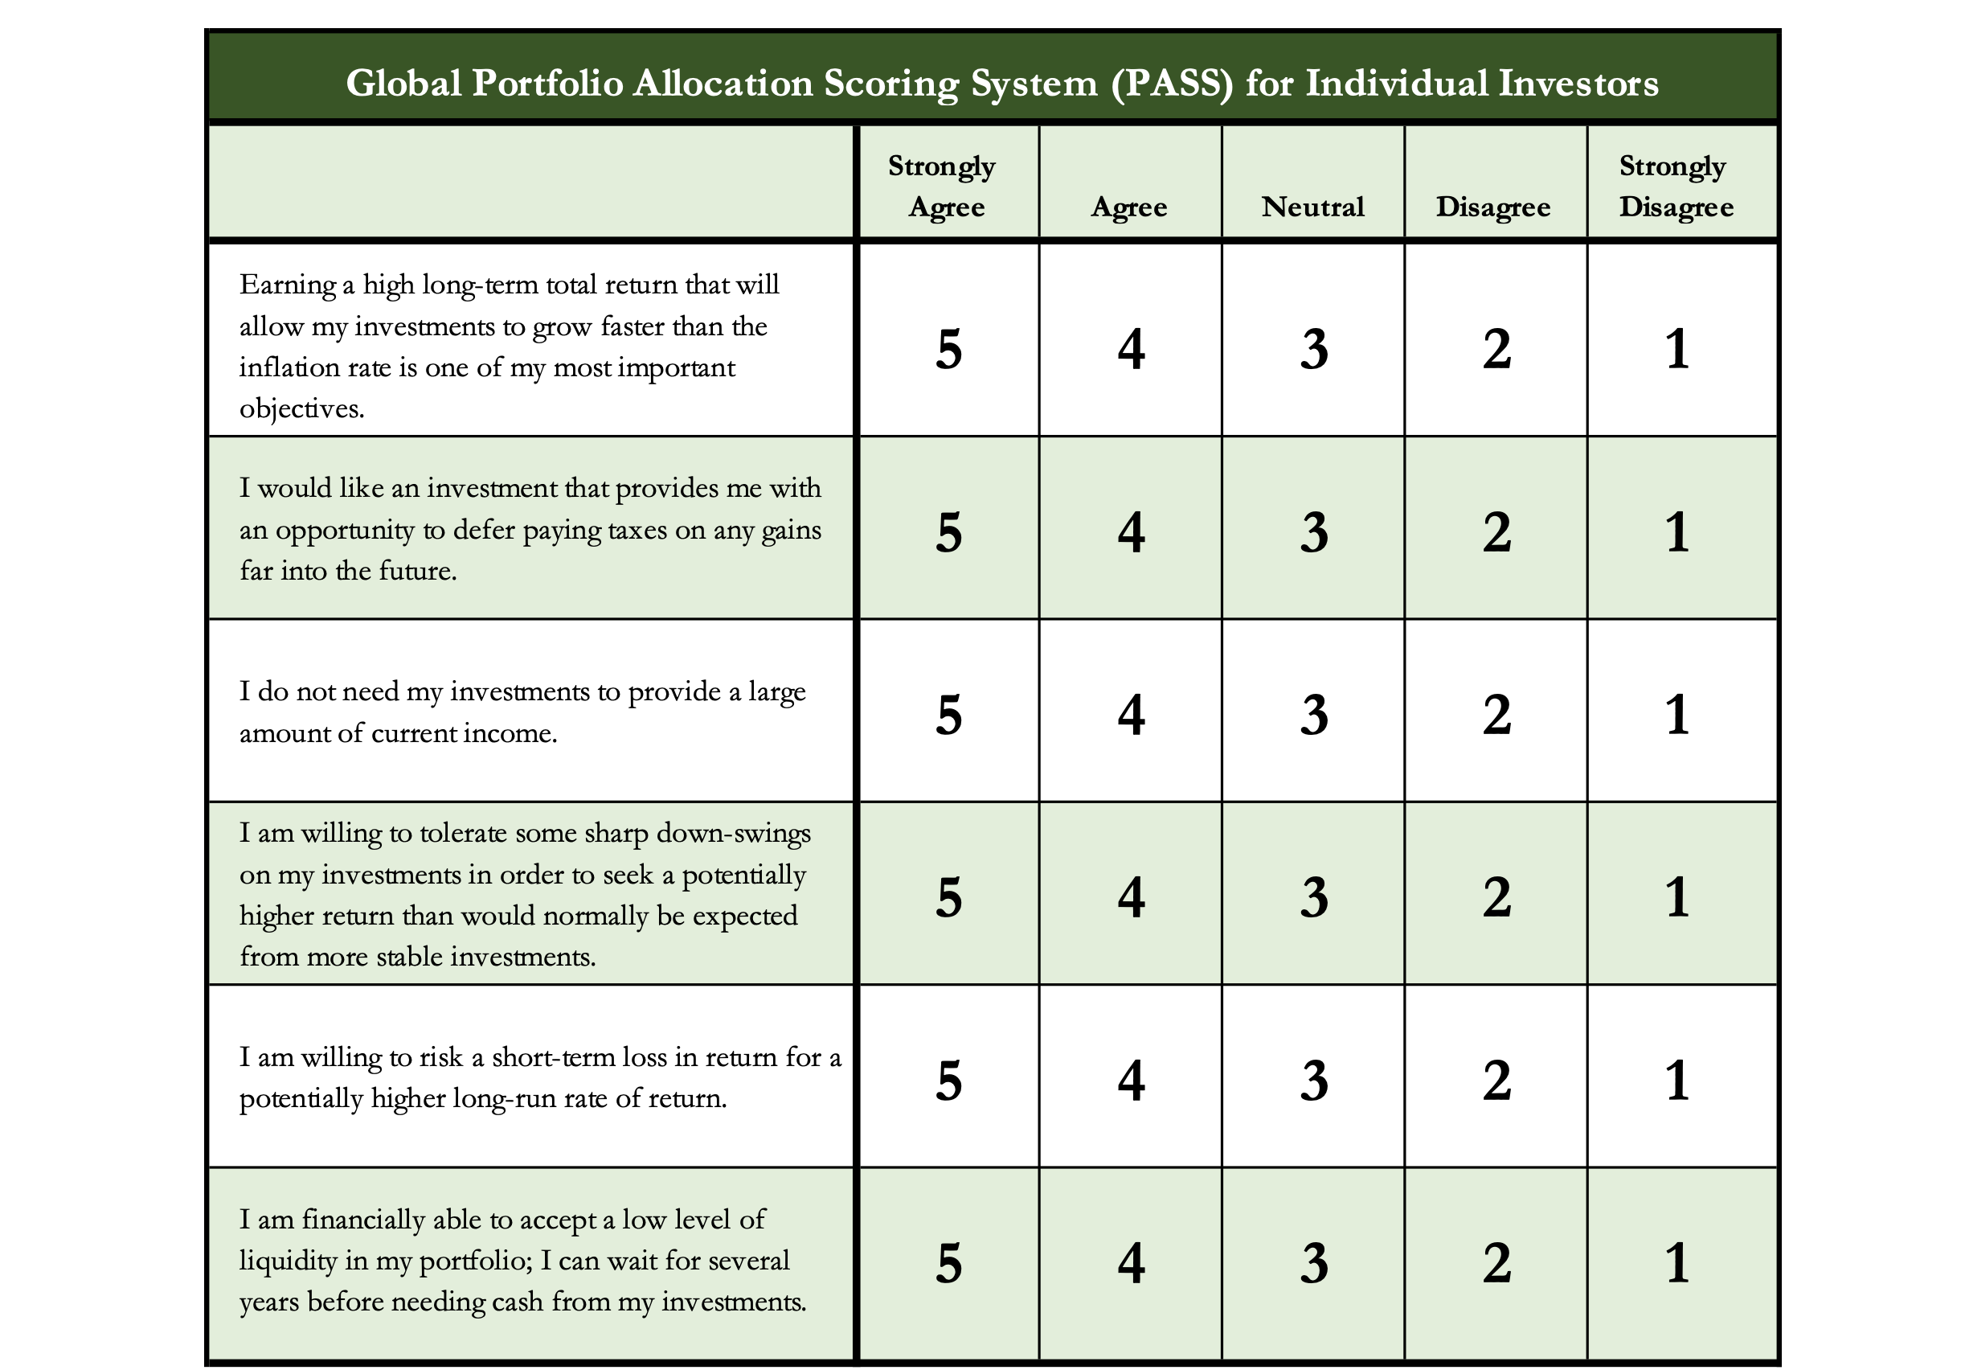
Determining Your Risk Tolerance

Slide 53
Determining Your Risk Tolerance
High Risk Attitude
I want to summer in Paris and winter in Hawaii
Medium-High Risk Attitude
I will work through normal retirement age, but I want my spouse to retire early - and we want to visit Paris & Hawaii
Medium-Low Risk Attitude
I want my children to have a college education
Low Risk Attitude
I want food on the table and a roof over my head

Slide 54
Comparing Different Investments

Slide 55
Comparing Different Investments

Slide 56
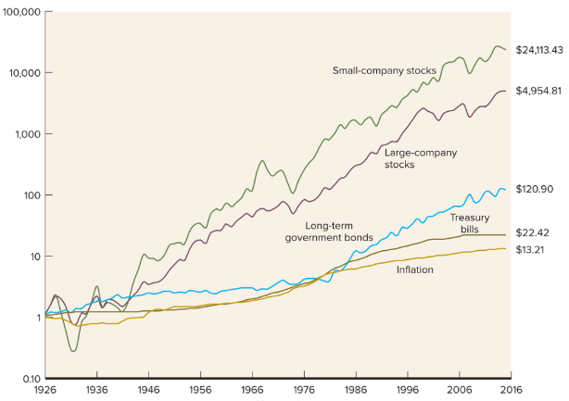
Comparing Different Investments

Slide 57
Comparing Different Investments
Investing $1,000 at different interest rates…
@1% @3% @5% @10%
After 1 year $1,010 $1,030 $1,050 $1,100
After 3 years $1,030 $1,093 $1,158 $1,331
After 5 years $1,051 $1,159 $1,276 $1,611
After 10 years $1,105 $1,344 $1,629 $2,594
After 25 years $1,282 $2,094 $3,386 $10,835

Slide 58
Comparing Different Investments
Investing $1,000 at different interest rates…
@1% @3% @5% @10%
After 1 year $1,010 $1,030 $1,050 $1,100
After 3 years $1,030 $1,093 $1,158 $1,331
After 5 years $1,051 $1,159 $1,276 $1,611
After 10 years $1,105 $1,344 $1,629 $2,594
After 25 years $1,282 $2,094 $3,386 $10,835

Slide 59
Comparing Different Investments
Investing $1,000 at different interest rates…
@1% @3% @5% @10%
After 1 year $1,010 $1,030 $1,050 $1,100
After 3 years $1,030 $1,093 $1,158 $1,331
After 5 years $1,051 $1,159 $1,276 $1,611
After 10 years $1,105 $1,344 $1,629 $2,594
After 25 years $1,282 $2,094 $3,386 $10,835

Slide 60
Comparing Different Investments
Investing $1,000 at different interest rates…
@1% @3% @5% @10%
After 1 year $1,010 $1,030 $1,050 $1,100
After 3 years $1,030 $1,093 $1,158 $1,331
After 5 years $1,051 $1,159 $1,276 $1,611
After 10 years $1,105 $1,344 $1,629 $2,594
After 25 years $1,282 $2,094 $3,386 $10,835

Slide 61
Comparing Different Investments
Investing $1,000 at different interest rates…
@1% @3% @5% @10%
After 1 year $1,010 $1,030 $1,050 $1,100
After 3 years $1,030 $1,093 $1,158 $1,331
After 5 years $1,051 $1,159 $1,276 $1,611
After 10 years $1,105 $1,344 $1,629 $2,594
After 25 years $1,282 $2,094 $3,386 $10,835

Slide 62
Long-Term Investment Planning
YOUR VALUES
YOUR GOALS
FINANCIAL STRATEGIES
INVESTMENT STRATEGIES
Identify Your Risk Tolerance
Identify Your Time Horizons
Select Investments
Monitor & Modify Investments

Slide 63


Slide 64
Don’t wait around for other people to be happy for you.
Any happiness you get,
You’ve got to make yourself.
~ Alice Walker, poet & novelist
A goal without a plan is just a dream.
Wealth is largely the result of habit.
The most difficult thing is the decision to act; the rest is mere tenacity.
It takes as much energy to plan as it does to wish.
You cannot escape the responsibility of tomorrow by avoiding it today.

Slide 65
Owning Your Financial Future
INVESTING GOALS, HABITS & STRATEGIES
Today, June 22
BUDGETING & DEBT MANAGEMENT
Wednesday, July 6
INVESTING FOR RETIREMENT,
EDUCATION & SPECIAL EVENTS
Wednesday, July 13

Slide 66
INVESTING for INTERNATIONAL FACULTY,
STUDENTS & PROFESSIONALS
Wednesday, July 20
TAX PLANNING
(for budgeting, investing & retirement)
Wednesday, July 27
CAREER PLANNING: YOUR MONEY & YOUR FUTURE
Wednesday, August 3

Slide 67
Brian Bolton
Professor of Finance brian.bolton@louisiana.edu http://business.louisiana.edu/financeispersonal

