Slide 1
MONEY MATTERS 2023:
UL SYSTEM FINANCIAL WELLNESS SERIES
Session #6:
Family Financial Planning: Sending Your Loved Ones Off to College
June 27, 2023

Slide 2
Brian Bolton Professor of Finance brian.bolton@louisiana.edu http://business.louisiana.edu/financeispersonal

Slide 3
Owning Your Financial Future
Adults Returning to Finish a Degree: Financial & Other Concerns
June 6, 2023
Financial Planning for Graduate Students
June 7, 2023
Financial & Tax Planning for International Students
June 8, 2023
The Financial Aspects of Your Side- Hustle #1 – Planning, Strategies, Legal, Resources
June 20, 2023
Family Financial Planning: Making Finances Work for the Whole Family
June 23, 2023
Family Financial Planning: Sending Your Loved-Ones Off to College
June 27, 2023
Family Financial Planning: Caring for Adult Dependents
June 28, 2023
Changing Careers: The Financial & Personal Issues
July 13, 2023
Building Savings Accounts & Emergency Funds
July 14, 2023
Financial Planning for Veterans
July 18, 2023 ***
Financial Planning When Retirement is Getting Close (5-7 years out)
July 19, 2023 ***
The Financial Aspects of Your Side- Hustle #2 – Taxes, Profitability, Expansion, Success
July 25, 2023
Financial Planning for the Fun Stuff: Vacations, Home Improvements, New Vehicles
June 26, 2023
Investing 101
August 1, 2023
Navigating the Impacts of Inflation & Turbulent Economic Times
August 2, 2023
Most sessions are from 12:00-1:00pm *** Sessions on July 18, 19 are from 3:00-4:00pm.

Slide 4
Family-Focused Financial Planning
Family Financial Planning: Making Finances Work for the Whole Family
June 23, 2023
Family Financial Planning: Sending Your Loved-Ones Off to College
June 27, 2023
Family Financial Planning: Caring for Adult Dependents
June 28, 2023
Building Savings Accounts & Emergency Funds
July 14, 2023
Financial Planning When Retirement is Getting Close (5-7 years out)
July 19, 2023 ***
Financial Planning for the Fun Stuff: Vacations, Home Improvements, New Vehicles
June 26, 2023
Most sessions are from 12:00-1:00pm *** Sessions on July 18, 19 are from 3:00-4:00pm.

Slide 9
Countdown to College
Kids Are 12 Years Old or Younger
Kids Are 12 to 15 Years Old
Kids Are 15 to 18 Years Old
Kids Are Going Off to College

Slide 10
Countdown to College
Kids Are 12 Years Old or Younger
Open a 529 Education Savings Account….And invest in it.
Current inflation rate 4-5%
Education inflation rate 6-8%
Current savings account rates 2-3% (CDs are earning 4-5%)
Possible investment returns 5-15%
Average over the past 100 years 12%
Return in 2021 +25%
Return in 2022 -20%

Slide 11
Countdown to College
Kids Are 12 Years Old or Younger
Open a 529 Education Savings Account….And invest in it.
Benefits of a 529 Education Savings Account:
All gains earned in the account are tax free…if used for education
Deposit $2,000, it grows to $5,000, the $3,000 gain is tax free…if the $5,000 is used for education
Money in the Account can be transferred to anyone else – which is great if the child does not go to college or does not need all of the money
It is not just for college – can be used for primary and secondary school education expenses
Money in the Account can be invested in just about anything you want
Drawbacks of a 529 Education
If you withdraw the money for non-education expenses, you are subject to a 10% penalty and all applicable taxes (as if you had the money in a taxable brokerage account)

Slide 12
Countdown to College
Kids Are 12 Years Old or Younger
Open a 529 Education Savings Account….And invest in it.
One possible 529 strategy
Put 80-90% of your college fund money into a 529
Invest 60-70% of this money into the S&P 500 Index (symbol SPY)
Invest 15-20% into other select investments, possibly of the child’s choice
Invest 15-20% into CDs, low risk bonds or a money market cash account
The earlier in your child’s life you begin investing, the more risk you can take The closer your child is to college when you invest, the less risk you should take

Slide 13
Countdown to College
Kids Are 12 to 15 Years Old
Begin rotating investments into lower risk assets
If you had 70% in growth stocks at age 12, maybe have 50% by age 15
Make sure the child has their own savings and checking account
Consider opening a credit card in the child’s name (co-signed by you)
Begin researching scholarships, financial aid and the full cost of college
Begin considering other options, such as community college or a gap year
Begin involving the child in conversations about paying for college

Slide 14
Countdown to College
Kids Are 15 to 18 Years Old
Rotate investment assets towards 20-30% are in higher risk stocks
Research scholarships and financial aid
Begin applying for both as soon as you can – for some scholarships, this could be as early as sophomore or junior year
Get familiar with FAFSA, “Free Application for Federal Student Aid”
Make sure each child has their own checking and savings accounts
Make sure each child has a credit card in their name (co-signed by you)

Slide 15
Countdown to College
Kids Are 15 to 18 Years Old
As you narrow down what college your child will be choosing, learn what the true cost of college is:
Tuition might be the most transparent aspect
Room & Board
Will the child live at home: financial benefits vs. social costs
Will the child live on campus: easiest, but maybe less fulfilling
Might be required for many first-year students
Will the child live off-campus: independence vs. all the unknowns
Fees! See if you can figure out all the fees you will be paying
Computers, software, books, other tools and resources
Will the child need a vehicle while at college?
Can the child make money on campus: RA, work study, assistanceships…

Slide 16
Countdown to College
Kids Are 15 to 18 Years Old
As you narrow down what college your child will be choosing, learn what the true cost of college is:
BUDGET!
Make a budget for the next 4-5 years….with estimates for what the true, full cost of college will be, along with any and all income that will be possible or needed.
Involve the child in all of these discussions and processes

Slide 17
Countdown to College
Kids Are Going Off to College: 17-19 Years Old
KEEP EVERY RECEIPT
HAVE CONVERSATIONS ABOUT MONEY WITH YOUR CHILD
MAKE SURE YOUR CHILD HAS APPROPRIATE INSURANCE – HEALTH CARE, LIABILITY, RENTER’S…

Slide 18
Countdown to College
Kids Are Going Off to College: 17-19 Years Old
KEEP EVERY RECEIPT
There are lots of IRS-legit tax credits and deductions that you apply to education expenses
Keeping your receipts is the best way to claim these benefits
American Opportunity Credit – up to $2,500 per student for first 4 years after high school
Lifetime Learning Credit – up to $2,000 per family for all years after high school
Each of the above provides a tax credit of either 25% (AOC) or 20% (LLC) of the first $10,000 in annual qualified education expenses
Qualified education expenses include those required for the education (and unique to the education)
Room, board, transportation and other food ARE NOT qualified education expenses

Slide 19
Countdown to College
Kids Are Going Off to College: 17-19 Years Old
HAVE CONVERSATIONS ABOUT MONEY WITH YOUR CHILD
Help the child become financial responsible and financially independent
Make sure the child knows what you will cover, what they will be responsible for and what will be covered by borrowing
Involve the child in all borrowing decisions
Make sure the child understands the repayment process & obligations
If you do this with the first child you send off to college, any other children will benefit and understand what they are getting into

Slide 20
Countdown to College
Kids Are Going Off to College: 17-19 Years Old
MAKE SURE YOUR CHILD HAS APPROPRIATE INSURANCE – HEALTH CARE, LIABILITY, RENTER’S…
Most undergraduate students will be able to stay on your health care plan (until they are 26), if you wish
This comes as an expensive shock to many graduate students in their mid-20s
If they live on campus, they are probably covered by your homeowners’ liability insurance coverage
But they may want your own renters’ policy, as the terms and deductible may be better
Renters’ vs. Dorm Insurance: dorm insurance just covers the property, not liability, which may be ok
For most students, their laptop is the most valuable and irreplaceable item: make sure it’s protected
Make sure all vehicle coverage is sufficient, especially if the child is going to be driving a lot more, perhaps back-and-forth to home or to work

Slide 21
Your Children Are in College
Continue the budgeting process and conversations
You can get more sophisticated over time…perhaps even shifting the responsibility for income from you to the child
Begin thinking about graduate school
Who pays for it? What will it cost? What are the benefits?
Begin thinking about financial aid repayment
When does it begin? Who is responsible for it?
Begin thinking about financial independence for your child
When will you stop co-signing for their credit card?
When will you stop covering their insurance costs?
Make sure they have an Individual Retirement Account or Roth IRA before they graduate.

Slide 22
Your Empty Nest (or almost empty nest) at Home
If you have other children at home, the nest will not be empty for several years.
But you can begin the same with other children, involving them as much as possible, making the transition easier for them – and you – when they get closer to college
Learn from any mistakes or oversights – you may want to treat all children equally, but you do not want to make the same mistakes equally
Once the nest is empty, shift the focus to YOUR financial plan
For the past 18+ years, your #1 financial goal has probably been “paying for college”
That is no longer your #1 goal.
Review your family financial plan, be honest about your goals, be honest about your assets and situation, and begin thinking about what you and your whole family need going forward
If you have made any financial sacrifices to pay for college – second mortgage, borrowing against a 401(k), personal loans – begin the process of reconciling them…so you can return to making your financial plan your #1 financial priority

Slide 23
A Few Closing Comments
Involve the child as much as possible – financial independence begins with financial engagement
Do not overlook the possibility of a gap year after high school
Different children mature at different times and have different needs & interests
Any initial stigma should be ignored in exchange for what’s best for the child
Never stop looking for scholarships and work-study opportunities
Many colleges have hidden and specialized scholarships…that very few people apply for. Not all scholarships are only for the elite – many are for whomever applies

Slide 24
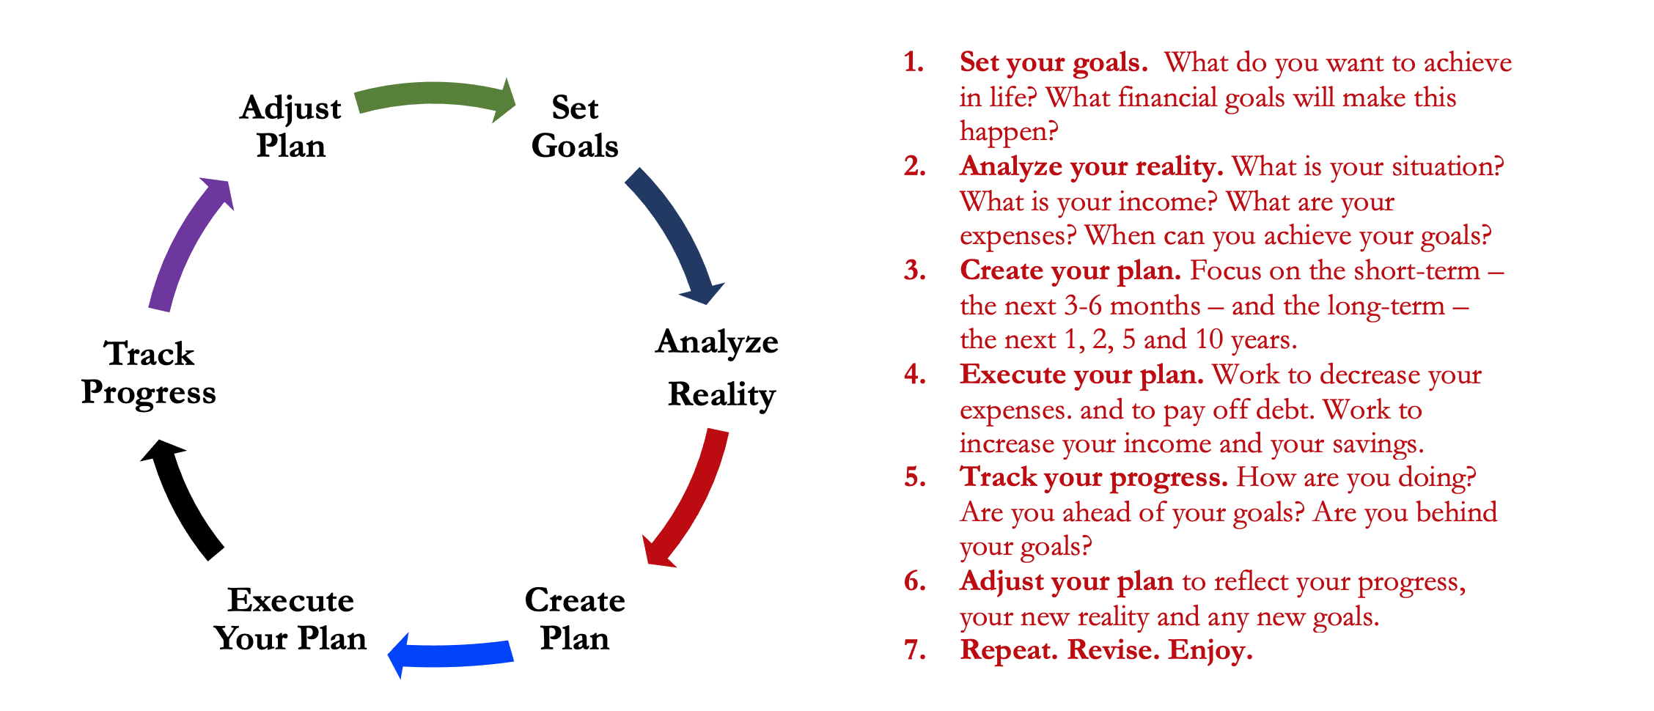
Isn’t this a lot like what you do with your education planning?

Slide 25
Happiness
Long-Term Goals
Short-Term Goals
Financial Needs
Family Needs

Slide 26
Financial Wellness
A goal without a plan is just a dream.
Wealth is largely the result of habit.
The most difficult thing is the decision to act; the rest is mere tenacity.
It takes as much energy to plan as it does to wish.
You cannot escape the responsibility of tomorrow by avoiding it today.

Slide 27
Owning Your Financial Future
Adults Returning to Finish a Degree: Financial & Other Concerns
June 6, 2023 ***
Financial Planning for Graduate Students
June 7, 2023 ***
Financial & Tax Planning for International Students
June 8, 2023 ***
The Financial Aspects of Your Side- Hustle #1 – Planning, Strategies, Legal, Resources
June 20, 2023
Family Financial Planning: Making Finances Work for the Whole Family
June 23, 2023
Family Financial Planning: Sending Your Loved-Ones Off to College
June 27, 2023
Family Financial Planning: Caring for Adult Dependents
June 28, 2023
Changing Careers: The Financial & Personal Issues
July 13, 2023
Building Savings Accounts & Emergency Funds
July 14, 2023
Financial Planning for Veterans
July 18, 2023 ***
Financial Planning When Retirement is Getting Close (5-7 years out)
July 19, 2023 ***
The Financial Aspects of Your Side- Hustle #2 – Taxes, Profitability, Expansion, Success
July 25, 2023
Financial Planning for the Fun Stuff: Vacations, Home Improvements, New Vehicles
June 26, 2023
Investing 101
August 1, 2023
Navigating the Impacts of Inflation & Turbulent Economic Times
August 2, 2023
Most sessions are from 12:00-1:00pm *** Sessions on July 18 & 19 are from 3:00-4:00pm.

Slide 28
Brian Bolton Professor of Finance brian.bolton@louisiana.edu http://business.louisiana.edu/financeispersonal

