Slide 1


MONEY MATTERS 2023:
UL SYSTEM FINANCIAL WELLNESS SERIES
Session #4:
Family Financial Planning:
Making Finances Work for the Whole Family
June 23, 2023

Slide 2
Brian Bolton
Professor of Finance brian.bolton@louisiana.edu http://business.louisiana.edu/financeispersonal

Slide 3
Owning Your Financial Future
Adults Returning to Finish a Degree: Financial & Other Concerns
June 6, 2023
Financial Planning for Graduate Students
June 7, 2023
Financial & Tax Planning for International Students
June 8, 2023
The Financial Aspects of Your Side-
Hustle #1 – Planning, Strategies, Legal, Resources
June 20, 2023
Family Financial Planning: Making Finances Work for the Whole Family
June 23, 2023
Family Financial Planning: Sending Your Loved-Ones Off to College
June 27, 2023
Family Financial Planning: Caring for Adult Dependents
June 28, 2023
Changing Careers: The Financial & Personal Issues
July 13, 2023
Building Savings Accounts & Emergency Funds
July 14, 2023
Financial Planning for Veterans
July 18, 2023 ***
Financial Planning When Retirement is Getting Close
(5-7 years out)
July 19, 2023 ***
The Financial Aspects of Your Side-
Hustle #2 – Taxes, Profitability, Expansion, Success
July 25, 2023
Financial Planning for the Fun Stuff: Vacations, Home Improvements, New Vehicles
June 26, 2023
Investing 101
August 1, 2023
Navigating the Impacts of Inflation & Turbulent Economic Times
August 2, 2023
Most sessions are from 12:00-1:00pm
*** Sessions on June 6, 7, 8 and July 18, 19 are from 3:00-4:00pm.

Slide 4
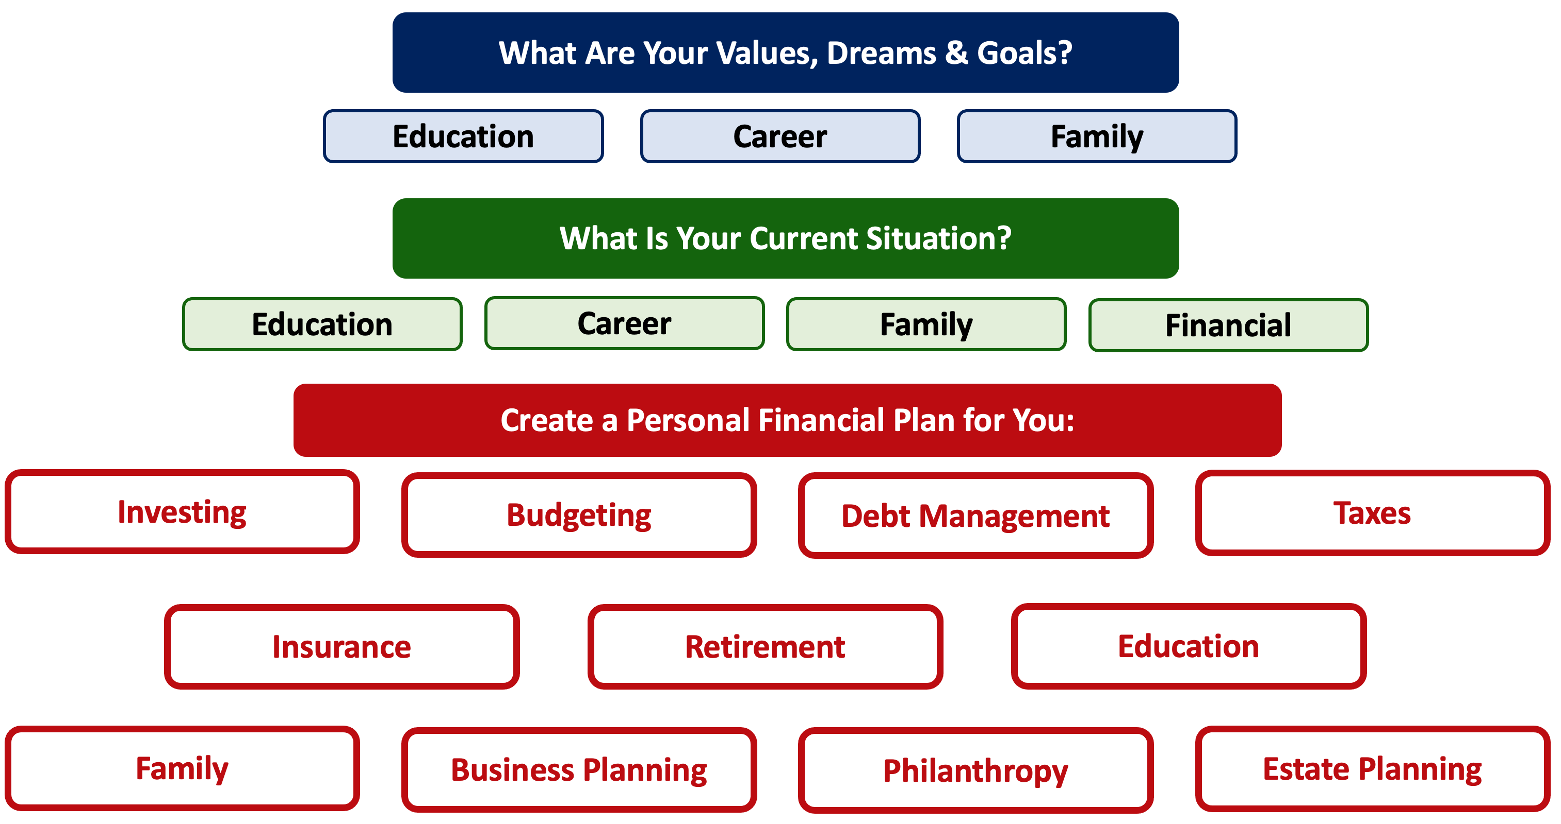

Slide 8
Happiness
Long-Term Goals
Short-Term Goals
Financial Needs
Family Needs

Slide 9
Financial Wellness
A goal without a plan is just a dream.
Wealth is largely the result of habit.
The most difficult thing is the decision to act; the rest is mere tenacity.
It takes as much energy to plan as it does to wish.
You cannot escape the responsibility of tomorrow by avoiding it today.

Slide 10
5 KEY FINANCIAL ISSUES FOR FAMILIES
YOU MAY BE AN ENTREPRENEUR WITHOUT KNOWING IT.
If you make any income through means other than a job with an employer, you need to think, act and report like an entrepreneur.
TAXES!
Being an entrepreneur brings both new opportunities and responsibilities related to taxes. It’s not all bad news – Just do a little homework to make sure you know what you’re doing.
LEGAL & BUSINESS LIABILITY.
Anytime you engage in business activities, you become to new types of liability. Do a lot of homework to make sure you protect yourself.

Slide 11
5 KEY ISSUES FOR ENTREPRENEURS
CAN YOU SEPARATE YOUR BUSINESS & PERSONAL LIVES?
In some ways, you need to keep them separate. In others, you get to choose how much overlap or separation to create.
COMMUNICATE WITH YOUR FAMILY & OTHER LOVED ONES.
As your side-hustle hobby grows into a full business venture, it will require more of your time. And it will become riskier. Communicate with the people in your personal life to makes sure you are all on the same page.

Slide 12
PERSONAL FINANCE for ENTREPRENEURS
PERSONAL FINANCE
Your life as an entrepreneur will regularly overlap with your life as an individual.
Knowing where to take advantage of the overlaps (such as in tax planning) and where to create an intentional divide (such as with relationships) can be critical to both your success in business and your happiness as a human. Be intentional with your choices.

Slide 13
PERSONAL FINANCE for ENTREPRENEURS
PERSONAL FINANCE
Your life as an entrepreneur will regularly overlap with your life as an individual.
Knowing where to take advantage of the overlaps (such as in tax planning) and where to create an intentional divide (such as with relationships) can be critical to both your success in business and your happiness as a human. Be intentional with your choices.

Slide 14
PERSONAL FINANCE for ENTREPRENEURS
FINANCIAL MANAGEMENT
INVESTMENTS
INSURANCE
TAXES
FAMILY
ESTATE PLANNING
IN YOUR PERSONAL LIFE, YOU CONTROL
HOW THESE DIMENSIONS ARE CONNECTED

Slide 15
PERSONAL FINANCE for ENTREPRENEURS
FINANCIAL MANAGEMENT
How much of your savings is necessary to start the business?
Maybe you are using your home as your office.
Maybe you are using your personal computer to run the business.
Maybe your personal car is integral to the business.
INVESTMENTS
INSURANCE
TAXES
FAMILY
ESTATE PLANNING

Slide 16
PERSONAL FINANCE for ENTREPRENEURS
FINANCIAL MANAGEMENT
How are you going to hire employees and grow the business?
Are you able to make any investments outside of the business?
Can you succeed if you don’t commit everything to the business?
Can you have a retirement account?
What physical investments – office, factory, equipment – will you need to make?
INVESTMENTS
INSURANCE
TAXES
FAMILY
ESTATE PLANNING

Slide 17
PERSONAL FINANCE for ENTREPRENEURS
FINANCIAL MANAGEMENT
What insurance do you need for the business?
What insurance do you need for YOU, to ensure that the business can succeed?
What liability do YOU have personally for what the business does?
What legal structure will you choose for the business?
INVESTMENTS
INSURANCE
TAXES
FAMILY
ESTATE PLANNING

Slide 18
PERSONAL FINANCE for ENTREPRENEURS
FINANCIAL MANAGEMENT
What legal structure will you choose for the business?
Will you file taxes as an individual or as a corporation?
What are the tax benefits available to entrepreneurs?
How will the business tax issues impact your family and your long-term personal goals?
INVESTMENTS
INSURANCE
TAXES
FAMILY
ESTATE PLANNING

Slide 19
PERSONAL FINANCE for ENTREPRENEURS
FINANCIAL MANAGEMENT
How will the business tax issues impact your family and your long-term personal goals?
What are the pros and cons of making your venture a family affair?
How do you manage family relationships AND commit yourself to the business?
What happens to the business when you retire?
INVESTMENTS
INSURANCE
TAXES
FAMILY
ESTATE PLANNING

Slide 20
PERSONAL FINANCE for ENTREPRENEURS
FINANCIAL MANAGEMENT
AS AN ENTREPRENEUR,
ALL OF THESE PERSONAL FINANCE DIMENSIONS ARE
GOING TO BE CONNECTED
TO YOUR BUSINESS.
INVESTMENTS
INSURANCE
TAXES
FAMILY
ESTATE PLANNING

Slide 21
5 KEY ISSUES FOR ENTREPRENEURS
YOU MAY BE AN ENTREPRENEUR WITHOUT KNOWING IT.
If you make any income through means other than a job with an employer, you need to think, act and report like an entrepreneur.
  Any money you make that is not from your employer – any income that will not be reported on a W-2 – makes you an entrepreneur.
  Whether you get $50 for mowing lawns or singing in the church choir or building your own business with hundreds of patents and thousands or employees….you are an entrepreneur.
  Once you take your hobby beyond just a fun activity and into a business venture, you probably want to become as professional and strategic as you can….or else your fun activity won’t be so much fun anymore.
  This matters for 2 main reasons: taxes and legal liability.

Slide 22
5 KEY ISSUES FOR ENTREPRENEURS
TAXES!
  Any dollar of income you get, whether it’s from selling cookies or the winning at the casino, is considered (potentially) taxable income by the IRS. You have to report every penny you receive.
    And you should always assume that the person who gave you that cash is reporting it as an expense, so the IRS will know that you received it.
  In general, you can offset any income received from your side-hustle with the expenses associated with creating that income.
    Note that we cannot generally do this for our personal tax returns. The IRS doesn’t care about my car or dinner if they are entirely for personal purposes.
  If you are using a home office, you may be able to consider some of your home expenses legitimate business expenses, thereby reducing your taxable income.
  You may also be able to use business property for personal purposes – like a vehicle or computer – and have the business receive a tax deduction. That’s good.

Slide 23
5 KEY ISSUES FOR ENTREPRENEURS
LEGAL & BUSINESS LIABILITY.
Anytime you engage in business activities, you become to new types of liability. Do a lot of homework to make sure you protect yourself.
  As soon as you engage in business transactions with customers, employees, suppliers and other stakeholders, you become fair game to be sued by those stakeholders.
  You want to think about what you could lose – and how to protect it.
  By default, all entrepreneurs are considered “sole proprietors.”
    As such, you – the individual – are liable for all business issues. That is, if I sue your business, I can come after your personal assets, too.
  To avoid this, you can proactively choose to form an LLC (limited liability company), a corporation or another entity that separates business and personal liability.
    If I sue your LLC, I can take all of the business assets, but I cannot get your house or car or other personal stuff.
    It costs a couple hundred dollars and a few hours of time to set up an LLC….and that’s usually money and time that is very well spent for anyone engaged in formal or informal business activities.

Slide 24
5 KEY ISSUES FOR ENTREPRENEURS
CAN YOU SEPARATE YOUR BUSINESS & PERSONAL LIVES?
  In some ways, you need to keep them separate.
    Creating an LLC or corporation can separate business and personal liability.
    You probably want your business to have its own, completely independent financial life.
      This begins with getting a unique bank account for the business – and includes credit cards, debt, credit scores and anything else the business needs.
      You might also want to build a unique team for the business – including lawyers and accountants.
  In some ways, you can benefit from overlap.
    There can be tax benefits by letting the business pay for assets or expenses that can also be used by you and your family.
    Most entrepreneurs initially work with family members. Sometimes, these partnerships are critical to the operations of the business.

Slide 25
5 KEY ISSUES FOR ENTREPRENEURS
COMMUNICATE WITH YOUR FAMILY & OTHER LOVED ONES.
  Whether your family is actively involved in your business or not, communicate often with them about what the business is doing and where it is headed.
    Financial infidelity is the #1 cause of divorce in the US. Your partner may be your soulmate, but they may have very different attitudes towards taking risk and managing investments than you do. Make sure you’re on the same page.
    Your family members also can be your best advisors. They know you better than anyone. And they aren’t shy to tell you about both your strengths and weaknesses. All business leaders need this feedback. Let them help you be the leader you want to be and create the business you want to create.
  If you family is actively involved in your business, make sure roles, responsibilities and possibilities are clearly defined. Ad hoc expectations rarely work in business…and they never work in personal relationships.
  As your business grows, your entrepreneurial dream will grow into a bigger issue for family members. Communicate early and often.
    Are they okay with you working 100 hours a week? Are they okay with you cashing in your retirement portfolio to fund the business? Should your partner and/or children own any of the business? Do you expect your children to take over the business?

Slide 26
5 THINGS YOU CAN DO TOMORROW
Build your team. Don’t try to do everything on your own.
  You probably want to have an attorney and a tax accountant on your team. You may want to connect with other advisors, but having an attorney and accountant on your team is essential.
Separate your personal and business lives as much as possible.
  Get separate bank accounts for the business.
  Establish a credit history for the business.
Find an accounting system you like. Quicken, Quickbooks, TaxBot, Zero, Sage, FreshBooks are all decent options. Learn it, live it, love it.
Build your business plan. Tell the narrative of your business.
  Banks will want to see this. Investors will want to see this.
  View this as your roadmap or to-do list. Use it to guide both strategy and decision-making.
Prepare a ‘business plan’ or a ‘business model canvas.’ This is step 1 towards designing the mission, strategy, operations & future of your business.

Slide 27
Business Model Canvas

Slide 28
Happiness
Long-Term Goals
Short-Term Goals
Financial Needs
Family Needs

Slide 29

Isn’t this a lot like what you do with your education planning?

Slide 30
Owning Your Financial Future
Adults Returning to Finish a Degree: Financial & Other Concerns
June 6, 2023 ***
Financial Planning for Graduate Students
June 7, 2023 ***
Financial & Tax Planning for International Students
June 8, 2023 ***
The Financial Aspects of Your Side-
Hustle #1 – Planning, Strategies, Legal, Resources
June 20, 2023
Family Financial Planning: Making Finances Work for the Whole Family
June 23, 2023
Family Financial Planning: Sending Your Loved-Ones Off to College
June 27, 2023
Family Financial Planning: Caring for Adult Dependents
June 28, 2023
Changing Careers: The Financial & Personal Issues
July 13, 2023
Building Savings Accounts & Emergency Funds
July 14, 2023
Financial Planning for Veterans
July 18, 2023 ***
Financial Planning When Retirement is Getting Close
(5-7 years out)
July 19, 2023 ***
The Financial Aspects of Your Side-
Hustle #2 – Taxes, Profitability, Expansion, Success
July 25, 2023
Financial Planning for the Fun Stuff: Vacations, Home Improvements, New Vehicles
June 26, 2023
Investing 101
August 1, 2023
Navigating the Impacts of Inflation & Turbulent Economic Times
August 2, 2023
Most sessions are from 12:00-1:00pm
*** Sessions on June 6, 7, 8 and July 18, 19 are from 3:00-4:00pm.

Slide 31
Brian Bolton
Professor of Finance brian.bolton@louisiana.edu http://business.louisiana.edu/financeispersonal

