Slide 1
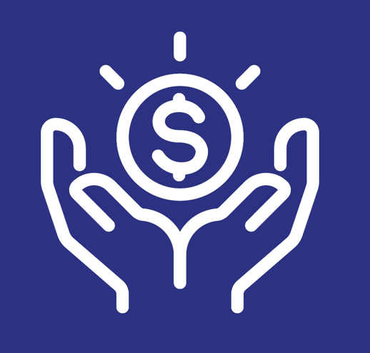
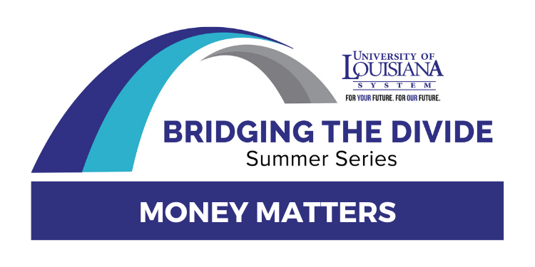
MONEY MATTERS 2023:
UL SYSTEM FINANCIAL WELLNESS SERIES
Session #14:
Investing 101
August 1, 2023

Slide 2
Brian Bolton
Professor of Finance brian.bolton@louisiana.edu http://business.louisiana.edu/financeispersonal

Slide 3
Opening Quiz Question
If you invest $100 a month every month from ages 25 to 35, earning an 8% annual return, how much will you have accumulated when you retire at 65?
If you invest $100 a month every month from ages 35 to 65, earning an 8% annual return, how much will you have accumulated when you retire at 65?
A. $149,036
C. $149,036
B. $184,092
D. $184,092

Slide 4
Opening Quiz Question
If you invest $100 a month every month from ages 25 to 35, earning an 8% annual return, how much will you have accumulated when you retire at 65?
If you invest $100 a month every month from ages 35 to 65, earning an 8% annual return, how much will you have accumulated when you retire at 65?
A. $149,036
C. $149,036
B. $184,092
D. $184,092
In both cases, this math assumes you make your 1st investment in the first month of your 26th or 36th year and keep all money invested until the end of your 65th year.

Slide 5
Owning Your Financial Future
Adults Returning to Finish a Degree: Financial & Other Concerns
June 6, 2023
Financial Planning for Graduate Students
June 7, 2023
Financial & Tax Planning for International Students
June 8, 2023
The Financial Aspects of Your Side-
Hustle #1 – Planning, Strategies, Legal, Resources
June 20, 2023
Family Financial Planning: Making Finances Work for the Whole Family
June 23, 2023
Family Financial Planning: Sending Your Loved-Ones Off to College
June 27, 2023
Family Financial Planning: Caring for Adult Dependents
June 28, 2023
Changing Careers: The Financial & Personal Issues
July 13, 2023
Building Savings Accounts & Emergency Funds
July 14, 2023
Financial Planning for Veterans
July 18, 2023
Financial Planning When Retirement is Getting Close
(5-7 years out)
July 19, 2023
The Financial Aspects of Your Side-
Hustle #2 – Taxes, Profitability, Expansion, Success
July 25, 2023
Financial Planning for the Fun Stuff: Vacations, Home Improvements, New Vehicles
June 26, 2023
Investing 101
August 1, 2023
Navigating the Impacts of Inflation & Turbulent Economic Times
August 2, 2023

Slide 6
Happiness
Long-Term Goals
Short-Term Goals
Financial Needs
Family Needs

Slide 7
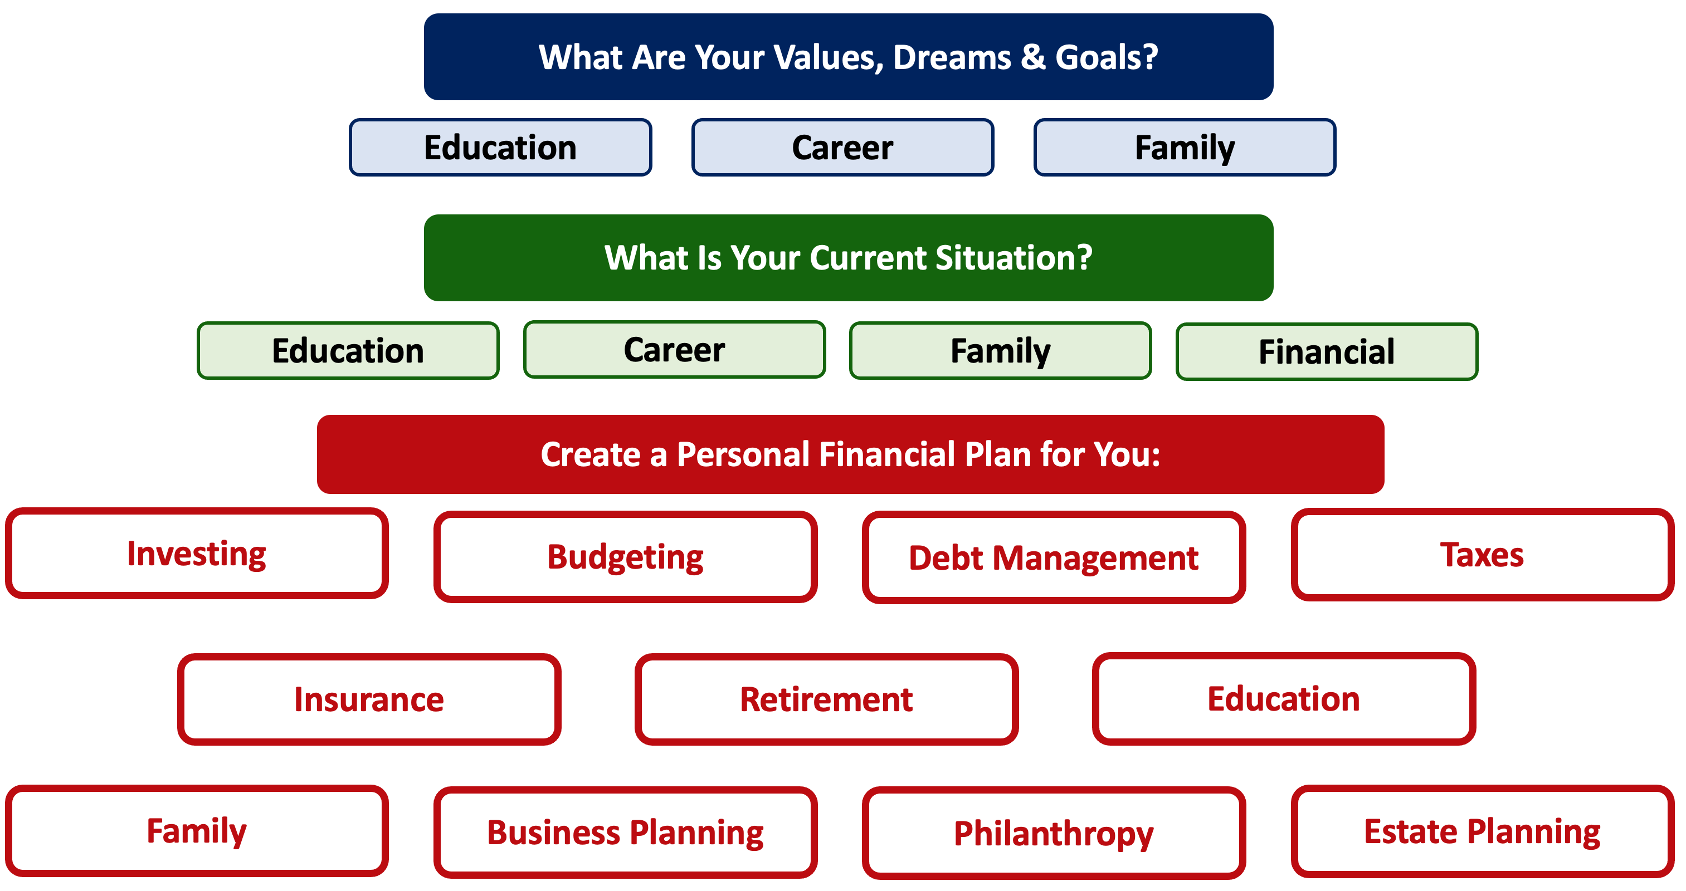

Slide 8
SAVINGS
INVESTING
OWNERSHIP
WEALTH

Slide 9
3 Opening Morals #1
Personal Finance is…personal.
It’s about you and not about anyone else.
You have to make it about you and your goals.

Slide 10
3 Opening Morals #2
Because personal finance is personal, it is virtually impossible for me to give you any specific advice.
However, there is one word of advice that applies to 99% of people working on their finances:
SAVE

Slide 11
SAVINGS
INVESTING
OWNERSHIP
WEALTH

Slide 12
3 Opening Morals #3
When it comes to investing
– or saving or eating or going to the amusement park –
RISK and RETURN always work in tandem.
Higher returns are associated with higher risk.
But…higher risk does not automatically lead to higher return.

Slide 13
3 Opening Morals #3
Average Stock Returns, 2021-2023:
2021 +25%
2022 - 22%
2023 +20%

Slide 14
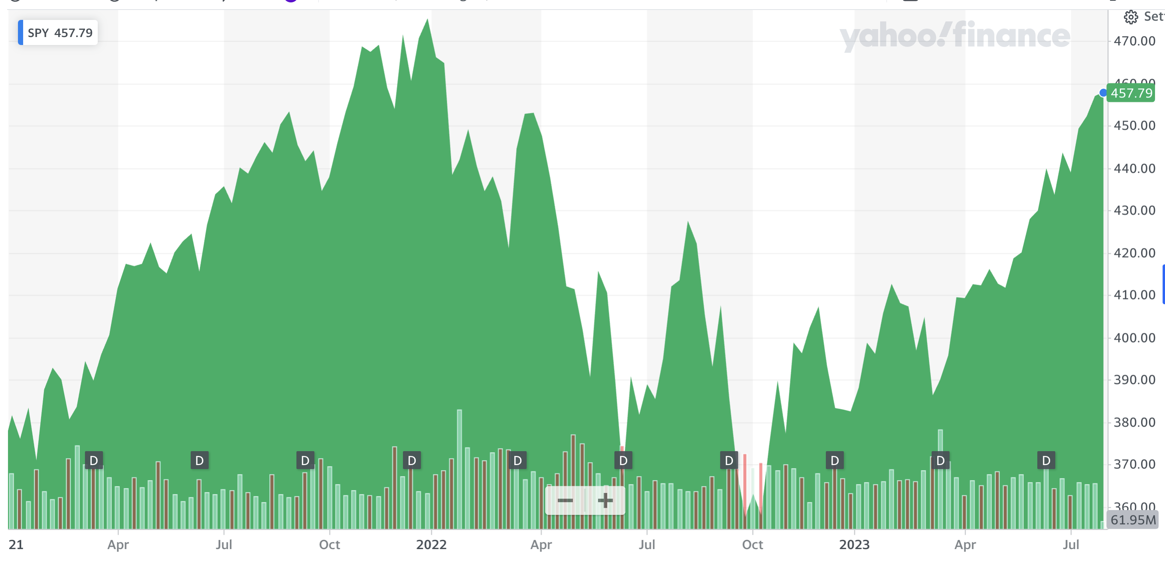
3 Opening Morals #3
Average Stock Returns, 2021-2023:
2021 +25%
2022 - 22%
2023 +20%

Slide 15
Question I Was Asked Last Week
I’m about to receive $50,000 from a family member.
What should I do with it?

Slide 16
Question I Was Asked Last Week
I’m about to receive $50,000 from a family member.
What should I do with it?
Personal Finance is PERSONAL. Investing is PERSONAL.
If you ever meet with a financial advisor, they will ask you 2 questions:
What are your goals?
What is your risk tolerance?

Slide 17
Question I Was Asked Last Week
I’m about to receive $50,000 from a family member.
What should I do with it?
Today’s Focus:
Investing in financial markets and financial securities (stocks, bonds, CDs)
Investing in real estate, cryptocurrency, classic cars, Beanie Babies, sneakers…
That’s all real investing, but I’m not talking about that today.

Slide 18
Question I Was Asked Last Week
I’m about to receive $50,000 from a family member.
What should I do with it?
Let’s assume you are 25 years old:
Pay bills, pay off bad debt.
$10,000 in cash / savings
$10,000 in a 6 or 12 month certificate of deposit, earning a certain 5% per year.
$10,000 to $15,000 in the S&P 500 Index, a broad basket of 500 of the largest companies in the U.S. Average return over the past 100 years = 12.1%
$10,000 to $15,000 in 5-10 companies / stocks that interest you. Don’t stress or overanalyze. Don’t sell within 1 year. Just pick, watch, and wait patiently.

Slide 19
Question I Was Asked Last Week
I’m about to receive $50,000 from a family member.
What should I do with it?
Let’s assume you are 55 years old:
Pay bills, pay off bad debt.
$10,000 to $15,000 in cash / savings
$20,000 in a 6, 12 or 18 month CD, earning a guaranteed 5% per year.
$10,000 in the S&P 500 Index, a broad basket of 500 of the largest companies in the U.S. Average return over the past 100 years = 12.1%
$10,000 to $15,000 in 5-10 companies / stocks that interest you. Don’t stress or overanalyze. Just pick, watch, and wait very patiently.

Slide 20
Investment Tools We All Can Use
Investing is not just for super-rich Wall Street types.
We all have opportunities to invest in financial securities through our other goals.
401(k) or 403(b) – probably able to invest in a selection of 10-15 mutual funds.
Individual Retirement Account or Roth IRA – able to invest in most financial securities
529 college savings plan – able to invest in most financial securities.
Taxable brokerage account – able to invest in any financial security, with as little as $1.00
  Robinhood and the democratization of finance has made it (a) super-easy, and
  (b) super-cheap for anyone to invest just like they are a super-rich Wall Street type.

Slide 21
Opening an IRA or Roth IRA – Why Do It?
An IRA is an Individual Retirement Account
A Roth IRA is a special kind of IRA.
Either an IRA or a Roth IRA has special tax benefits…the difference between the two is when you get those benefits.
  With a Traditional IRA, you get the benefits (or tax deduction) today, when you make the investment…which means it’s good for people in high tax brackets today.
  With a Roth IRA, you get the benefits (or tax deduction) when you withdraw cash in retirement…which means it’s good for people in low tax brackets today.
  With either type, there are 2 tax benefits:
    As shown above, the ability to choose WHEN you pay ordinary income taxes on the income.
    You never pay capital gains taxes on investment growth within the IRA.

Slide 22
Opening an IRA or Roth IRA – Why Do It?
Conceptually, the earlier we begin saving for retirement, the more we will benefit from compound interest when we get to retirement age.
  If you invest $6,500 per year from age 25 to age 60, you would have $1,400,000 in your account at age 60 (assuming a 9% annual return).
  If you wait 10 years and invest $6,000 per year from age 35 to age 60, you would have $550,000 in your account at age 60 (assuming a 9% annual return).

Slide 23
Opening an IRA or Roth IRA – Why Do It?
But what is an IRA? Why the Roth IRA?
  An IRA is an Individual Retirement Account.
  You are allowed to contribute $6,500 per year
  The key decision is based on whether you think your tax rate will be higher today or in the future.
  The bad news is that the money you put into an IRA cannot be withdrawn, unless you pay a 10% penalty, until you turn 59 ½ years old
  There is some fine print that we are skipping over here and some minor exceptions to this overview, but this should cover most of you and most situations.

Slide 24
Opening an IRA or Roth IRA – A Checklist
  Research – and pick – a brokerage or financial institution to use.
      Functionally, as far as managing your account and investments, they are going to be similar.
      However, the user interfaces will be different…including how you use the account and resources available.
      And, some brokerages may not offer certain types of accounts.
      Fidelity, Charles Schwab, JP Morgan Chase, Bank of America, TD Ameritrade and many others are all good. Robinhood can be good (but different…and maybe a wee bit dangerous).
  Establish and open your IRA or Roth IRA account.
      This will require your Social Security number and other personal information, but not too much. It should take 5-10 minutes.

Slide 25
Opening an IRA or Roth IRA – A Checklist
  Fund your IRA or Roth IRA account.
      Link a bank account to your IRA or Roth IRA to allow online transfers. It may take 1-2 weeks initially to get the money transferred as the Roth IRA account verifies your bank accounts.
      You may be able to upload an electronic copy of a personal check to deposit funds into your Roth IRA account.
      You may be able to go old school and visit a branch of your brokerage to do everything in person.
  Begin investing and saving for your retirement.

Slide 26
Opening an IRA or Roth IRA – A Checklist
  Research – and pick – a brokerage or financial institution to use.
  Establish and open your Roth IRA account.
  Fund your Roth IRA account.
  Begin investing and saving for your retirement.
  This all begins with understanding who you are and what your investment goals are.
  And this all begins with your Investment Policy Statement, your personal investing roadmap.

Slide 27
Your INVESTMENT POLICY STATEMENT
An Investment Policy Statement is your personal investing roadmap and strategy.
It includes the following information:
  Some brief personal information, about you and your situation
  Your risk tolerance
  Your investing goals
  Your tax, liquidity and income preferences
  How you want to handle your investments
  How you want to allocate your investments across different asset classes (stocks vs. bonds)
  Any other personal or situational issues that may impact your ability to invest or your investment strategy

Slide 28
Your INVESTMENT POLICY STATEMENT
ASSET ALLOCATION
We know that the asset classes or categories you choose are responsible for 90% of portfolio returns, while specific security selection within classes is responsible for 10% of returns.
This means that how you decide to allocate your investments is the primary driver of your investment returns.
  Think about which geographic regions you want to invest in.
  Think about how to distribute your investment across asset categories.
    Stocks, bonds, currency, real estate, crypto, value stocks, growth stocks, large companies, small companies, oil, gold, sneakers, Beanie Babies…

Slide 30
Investing – How Do You Do It?
When you’re just getting started with investing, here are a few approaches you can take:
  Start with a small amount of money – whether that’s $20 or $2,000 – and just go for it. Pick a few investments, track them regularly and be prepared to buy more or sell more should you feel comfortable doing either.

Slide 31
Investing – How Do You Do It?
When you’re just getting started with investing, here are a few approaches you can take:
  Start with a small amount of money – whether that’s $20 or $2,000 – and just go for it. Pick a few investments, track them regularly and be prepared to buy more or sell more should you feel comfortable doing either.
  Determine how much you have to invest.
    Maybe put ½ of that into an index fund or a specific mutual fund. This will provide some security, generally with less or moderate risk.
    Maybe put the other ½ into individual stocks or securities that intrigue you. If you’re interested in the companies, you might be more likely to follow them as investments.
    This half-half approach will help you figure out what kind of investor you are. In 1-2 years, you might gravitate more to either of the approaches that interest you more.

Slide 32
Investing – How Do You Do It?
When you’re just getting started with investing, here are a few approaches you can take:
  Start with a small amount of money – whether that’s $20 or $2,000 – and just go for it. Pick a few investments, track them regularly and be prepared to buy more or sell more should you feel comfortable doing either.
  Determine how much you have to invest.
    Put ½ of that into an index fund or a specific mutual fund. This will provide some security, generally with less or moderate risk.
    Put the other ½ into individual stocks or securities that intrigue you. If you’re interested in the companies, you might be more likely to follow them as investments.
    This half-half approach will help you figure out what kind of investor you are. In 1-2 years, you might gravitate more to either of the approaches that interest you more.
  Talk to a financial advisor. Note that they generally do not (initially) tell you which specific investments to make, but they will work talk through your options with you and help you better understand what you’re getting into.
    They will ask you 2 questions – what are your goals and what is your risk tolerance – and then work with you to find the investments that best align with your answers to these questions.
    But they do not work for free…and most adults can manage their investments on their own with minimal effort and stress.

Slide 33
I DO NOT GIVE INVESTMENT ADVICE
But here are some investment issues to think about:
Do you want to pick individual stocks (or other securities) and monitor them regularly?
  This can help you feel more control, more connection and more personal interest in your investments.
  Advantages: Potential for big gains, maybe a personal connection to the companies, you feel more engaged with the process.
  Disadvantages: Potential for big losses, requires more time and energy, transaction costs (trading, taxes) can add up, there are 1000s to choose from, potential loss of sleep and hair.

Slide 34
I DO NOT GIVE INVESTMENT ADVICE
Or, would you be content investing in mutual funds and/or market indexes that pool dozens or hundreds of stocks?
  Advantages: Potential for moderate gains, lower risk (through diversification), lower trading and tax costs, you can narrow down the selection pretty quickly, less loss of sleep and hair
  Disadvantages: Lots of singles and doubles but no home runs, no emotional connection to your investments, susceptible to big market downturns (but not necessarily more than individual stocks)

Slide 35
I DO NOT GIVE INVESTMENT ADVICE
If you want to invest in individual stocks, I cannot help you.
But if you are interested in market indexes, here are some ideas:
  SPY – The S&P 500 index. 500 of the largest U.S. firms, from all industries.
  SPYD – The same as above, with a focus on those companies that pay regular dividends out to investors from their earnings. You will get more income, but possibly lower long-term capital gains.
  IWM – The Russell 2000. 2000 smaller U.S. firms (the 2000 firms after the 1000 largest firms). More volatility, possibly higher returns.
  EFA – Index of non-US firms (Europe, Far East, Australasia). Big firms.
  EEM – Index of non-US, emerging market stocks. Bigger firms in developing countries. More risk than any of the above.
  GBTC – A Bitcoin index. Invest in Bitcoin without mining or owning. Big Risk.

Slide 36
ENJOY THE EXPERIENCE
If you invest in stocks or bonds, yes, there is risk…there is a chance that you will lose some of your money.
But it is really difficult to lose all of your money. It is even difficult to lose a lot of your money.
  2022…we lost 22% in the stock market. That stinks.
  But 2022 was one of the 10 worst years since 1900. The Depression was worse. So was 2008. But losing 22% in a single year is historically unusual.
  My retirement account is up 20% since January 1, 2021. That’s pretty cool.
In investing, TIME is your best friend. Take some risks, be patient, enjoy the experience.

Slide 37

Isn’t this a lot like what you do with your education planning?

Slide 38
Financial Wellness
A goal without a plan is just a dream.
Wealth is largely the result of habit.
The most difficult thing is the decision to act; the rest is mere tenacity.
It takes as much energy to plan as it does to wish.
You cannot escape the responsibility of tomorrow by avoiding it today.

Slide 39
Don’t wait around for other people to be happy for you.
Any happiness you get,
You’ve got to make yourself.
~ Alice Walker, poet & novelist
A goal without a plan is just a dream.
Wealth is largely the result of habit.
The most difficult thing is the decision to act; the rest is mere tenacity.
It takes as much energy to plan as it does to wish.
You cannot escape the responsibility of tomorrow by avoiding it today.

Slide 40
Owning Your Financial Future
Adults Returning to Finish a Degree: Financial & Other Concerns
June 6, 2023
Financial Planning for Graduate Students
June 7, 2023
Financial & Tax Planning for International Students
June 8, 2023
The Financial Aspects of Your Side-
Hustle #1 – Planning, Strategies, Legal, Resources
June 20, 2023
Family Financial Planning: Making Finances Work for the Whole Family
June 23, 2023
Family Financial Planning: Sending Your Loved-Ones Off to College
June 27, 2023
Family Financial Planning: Caring for Adult Dependents
June 28, 2023
Changing Careers: The Financial & Personal Issues
July 13, 2023
Building Savings Accounts & Emergency Funds
July 14, 2023
Financial Planning for Veterans
July 18, 2023
3:00pm ***
Financial Planning When Retirement is Getting Close
(5-7 years out)
July 19, 2023
3:00pm ***
The Financial Aspects of Your Side-
Hustle #2 – Taxes, Profitability, Expansion, Success
July 25, 2023
Financial Planning for the Fun Stuff: Vacations, Home Improvements, New Vehicles
June 26, 2023
Investing 101
August 1, 2023
Navigating the Impacts of Inflation & Turbulent Economic Times
August 2, 2023

Slide 41
Brian Bolton
Professor of Finance brian.bolton@louisiana.edu http://business.louisiana.edu/financeispersonal

