Slide 1


MONEY MATTERS 2023:
UL SYSTEM FINANCIAL WELLNESS SERIES
Session #12:
The Financial Aspects of Your Side-Hustle #2: Taxes, Profitability, Expansion, Success
July 25, 2023

Slide 2
Brian Bolton
Professor of Finance brian.bolton@louisiana.edu http://business.louisiana.edu/financeispersonal

Slide 3
Owning Your Financial Future
Adults Returning to Finish a Degree: Financial & Other Concerns
June 6, 2023
Financial Planning for Graduate Students
June 7, 2023
Financial & Tax Planning for International Students
June 8, 2023
The Financial Aspects of Your Side-
Hustle #1 – Planning, Strategies, Legal, Resources
June 20, 2023
Family Financial Planning: Making Finances Work for the Whole Family
June 23, 2023
Family Financial Planning: Sending Your Loved-Ones Off to College
June 27, 2023
Family Financial Planning: Caring for Adult Dependents
June 28, 2023
Changing Careers: The Financial & Personal Issues
July 13, 2023
Building Savings Accounts & Emergency Funds
July 14, 2023
Financial Planning for Veterans
July 18, 2023
Financial Planning When Retirement is Getting Close
(5-7 years out)
July 19, 2023
The Financial Aspects of Your Side-
Hustle #2 – Taxes, Profitability, Expansion, Success
July 25, 2023
Financial Planning for the Fun Stuff: Vacations, Home Improvements, New Vehicles
June 26, 2023
Investing 101
August 1, 2023
Navigating the Impacts of Inflation & Turbulent Economic Times
August 2, 2023
All future sessions are from 12:00-1:00pm

Slide 4
Happiness
Long-Term Goals
Short-Term Goals
Financial Needs
Family Needs

Slide 5
Financial Wellness
A goal without a plan is just a dream.
Wealth is largely the result of habit.
The most difficult thing is the decision to act; the rest is mere tenacity.
It takes as much energy to plan as it does to wish.
You cannot escape the responsibility of tomorrow by avoiding it today.

Slide 6
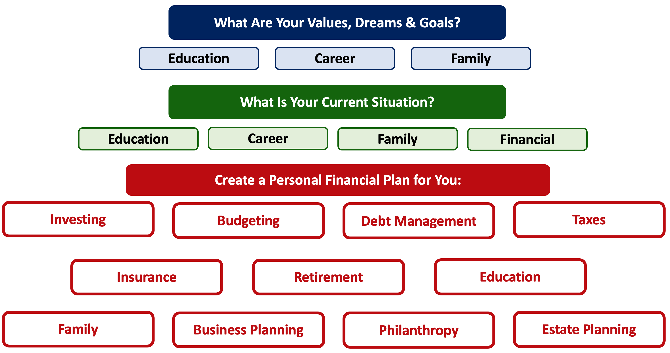

Slide 8
The Financial Aspects of Your Side-Hustle #1
YOU MAY BE AN ENTREPRENEUR WITHOUT KNOWING IT.
TAXES!
LEGAL & BUSINESS LIABILITY.
CAN YOU SEPARATE YOUR BUSINESS & PERSONAL LIVES?
COMMUNICATE WITH YOUR FAMILY & OTHER LOVED ONES.

Slide 9
The Financial Aspects of Your Side-Hustle #2
TAXES…YES, MORE TAXES.
PROFITABILITY…HOW TO MEASURE IT AND HOW TO PLAN FOR IT.
EXPANSION…DO YOU WANT TO EXPAND? SHOULD YOU EXPAND?
SUCCESS…WHAT DO DO WHEN YOU ACHIEVE IT?

Slide 10
Entrepreneurs, Stakeholders & Making Money
Revenues
– Cost of Goods Sold
= Gross Margin
– Operating Expenses
= Operating Income
– Other Expenses
= Taxable Income
– Income Taxes
= Net Income

Slide 11
Entrepreneurs, Stakeholders & Making Money
Revenues:
Customers give us money to make their lives better. Every dollar of Revenue any business has ever received has come from Customers.
Revenues
– Cost of Goods Sold
= Gross Margin
– Operating Expenses
= Operating Income
– Other Expenses
= Taxable Income
– Income Taxes
= Net Income

Slide 12
Entrepreneurs, Stakeholders & Making Money
Revenues
– Cost of Goods Sold
= Gross Margin
– Operating Expenses
= Operating Income
– Other Expenses
= Taxable Income
– Income Taxes
= Net Income
Cost of Goods Sold:
We give cash to employees and suppliers to create the goods and services we provide to customers

Slide 13
Entrepreneurs, Stakeholders & Making Money
Revenues
– Cost of Goods Sold
= Gross Margin
– Operating Expenses
= Operating Income
– Other Expenses
= Taxable Income
– Income Taxes
= Net Income
Operating Expenses:
We give cash to employees, the landlord, the advertising agency, the utilities company and others in exchange for giving us the infrastructure to run our business

Slide 14
Entrepreneurs, Stakeholders & Making Money
Revenues
– Cost of Goods Sold
= Gross Margin
– Operating Expenses
= Operating Income
– Other Expenses
= Taxable Income
– Income Taxes
= Net Income
Other Expenses:
We give cash to the bank and other non-recurring, non-operating sources in exchange for certain benefits.

Slide 15
Entrepreneurs, Stakeholders & Making Money
Revenues
– Cost of Goods Sold
= Gross Margin
– Operating Expenses
= Operating Income
– Other Expenses
= Taxable Income
– Income Taxes
= Net Income
Income Taxes:
We give cash to governments because they give us the social infrastructure for our business to succeed (in theory, at least, if not always in practice)

Slide 16
Entrepreneurs, Stakeholders & Making Money
Net Income:
After we make our customers happy and we pay all other stakeholders who made our business possible, whatever cash is leftover is ours to keep, to give to our family, to re-invest in the business, to buy a boat, to return to outside investors.
Revenues
– Cost of Goods Sold
= Gross Margin
– Operating Expenses
= Operating Income
– Other Expenses
= Taxable Income
– Income Taxes
= Net Income

Slide 17
Taxes…Yes, More Taxes
1. TAXES!
  Any dollar of income you get, whether it’s from selling cookies or the winning at the casino, is considered (potentially) taxable income by the IRS. You have to report every penny you receive.
  In general, you can offset any income received from your side-hustle with the expenses associated with creating that income.
  You may also be able to use business property for personal purposes – like a home office, vehicle or computer – and have the business receive a tax deduction. That’s good.

Slide 18
Taxes…Yes, More Taxes
1. TAXES!
  In general, if your business earns a profit in 3 out of 5 years, your business is a business and you can use these business deductions and carry losses forward into future years. That’s good.
  If not, your business is a side-hustle or hobby, and you cannot only apply hobby expenses to hobby income – and you cannot carry losses forward to future years. That’s not so good.
  The trade-off is all the work you have to do to achieve a profit.
  The IRS wants to reward serious businesses, but does not want to give benefits for just hobbies…where do you draw the line? Exercising? Video games? Books?

Slide 19
Taxes…Yes, More Taxes
1. TAXES!
  Unless you structure your business as a corporation, you will report all business operations and file your business taxes on Schedule C of the 1040.
    Here you will effectively complete the income statement for the business, showing all business (or hobby) revenue and expenses.
    This applies for all LLCs, partnerships, sole proprietorships and other non-corporations.
    If you structure as a corporation, the corporation will file its own tax return, independent (and in addition to your personal 1040).
    If you structure your business as a non-profit…
      You have to register as a corporation with the state (to get your EIN)
      You have to obtain tax exempt status through the IRS
      And the business has to file its own tax return, either confirming it did not make any money (for small non-profits) or providing the income statement for the business.

Slide 20
Taxes…Yes, More Taxes
1. TAXES!
  Example: The difference between hobby & business tax reporting:
    Imagine your day job salary is $100,000.
      Your hobby or business of selling cookies brought in $15,000 of revenue and had $10,000 of expenses. Your total personal income for the year will be $100,000 + $5,000 = $105,000.
      Your hobby of selling cookies brought in $15,000 of revenue and had $20,000 of expenses. Your total personal income for the year will be $100,000. The $5,000 hobby loss does not help you.
      Your business of selling cookies brought $15,000 of revenue and had $20,000 of expenses. Your total personal income for the year will be $100,000.
        However, you can apply the $5,000 loss to future year’s business operations…and if you earn a profit in the future, you can reduce this taxable profit by this year’s loss to lower your tax burden. That’s good.

Slide 21
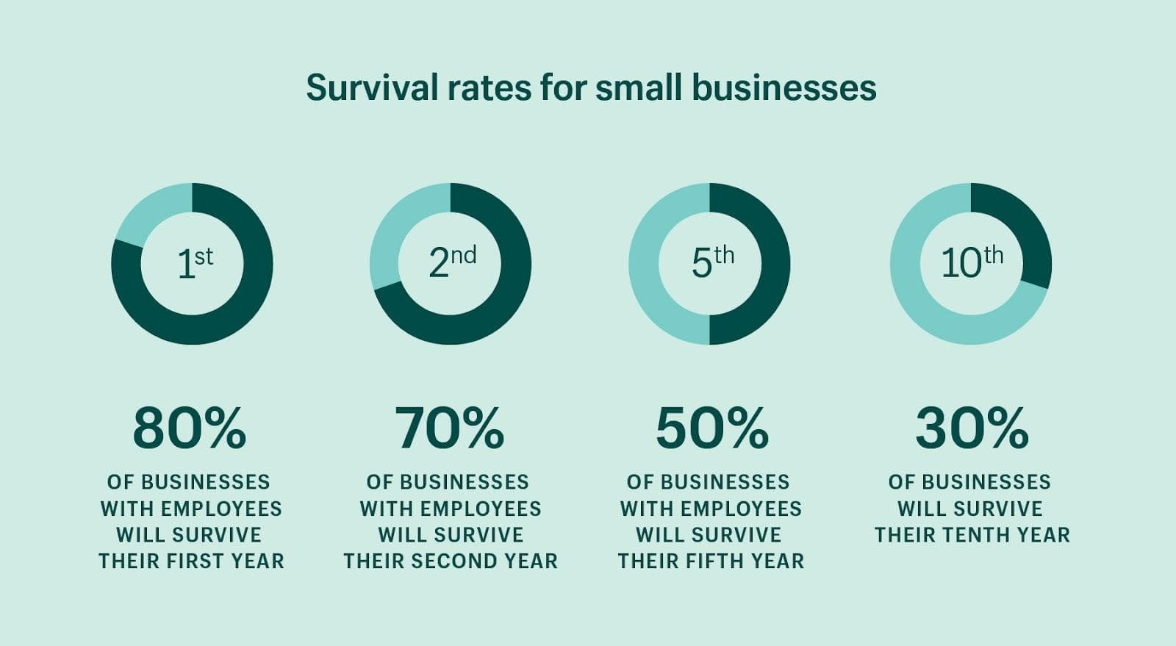
Profitability…How to Measure it
2. Profitability (and financial success)

Slide 22
Profitability…How to Measure it
Profitability (and financial success)
  In short, profitability – or financial success - is measured as Net Income or Net Profit
  Different entrepreneurs will measure success differently
  If you have unlimited resources to throw at the business or hobby, your business can succeed forever
  But most of us do not have that luxury.
  Most of need to earn a profit – eventually – or at least breakeven to keep the business going.
  So let’s talk about ‘breakeven analysis’
Revenues
– Cost of Goods Sold
= Gross Margin
– Operating Expenses
= Operating Income
– Other Expenses
= Taxable Income
– Income Taxes
= Net Income

Slide 23
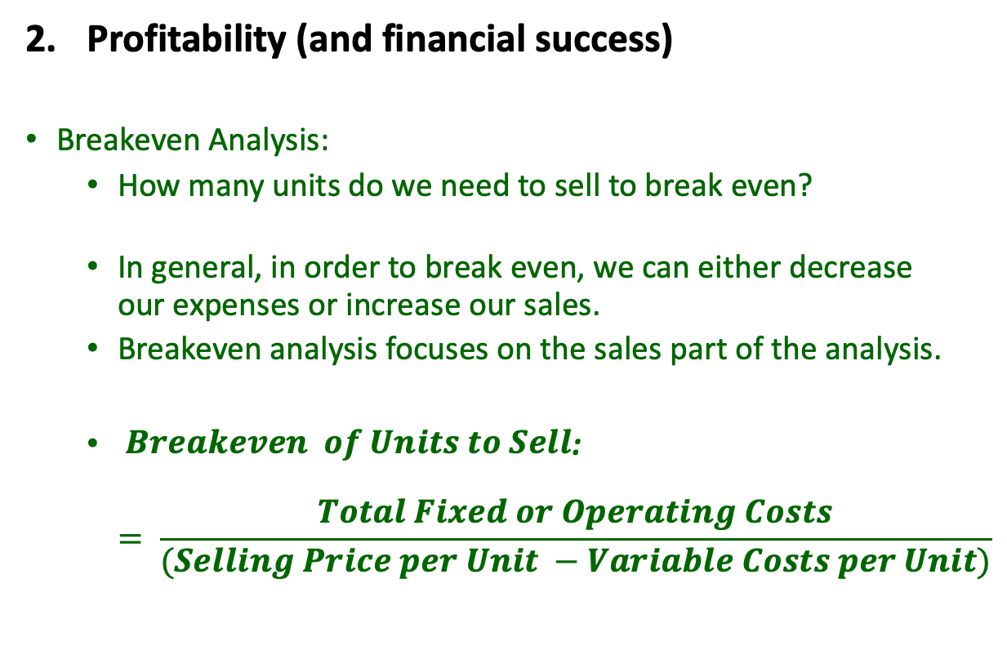
Profitability…How to Measure it
Profitability (and financial success)
Breakeven Analysis:
  How many units do we need to sell to break even?
  In general, in order to break even, we can either decrease our expenses or increase our sales.
  Breakeven analysis focuses on the sales part of the analysis.
  $\begin{aligned} Breakeven \# of Units to Sell\end{aligned}$:
  $= \frac{Total Fixed or Operating Costs}{(Selling Price per Unit −Variable Costs per Unit)}$
Revenues
– Cost of Goods Sold
= Gross Margin
– Operating Expenses
= Operating Income
– Other Expenses
= Taxable Income
– Income Taxes
= Net Income

Slide 24
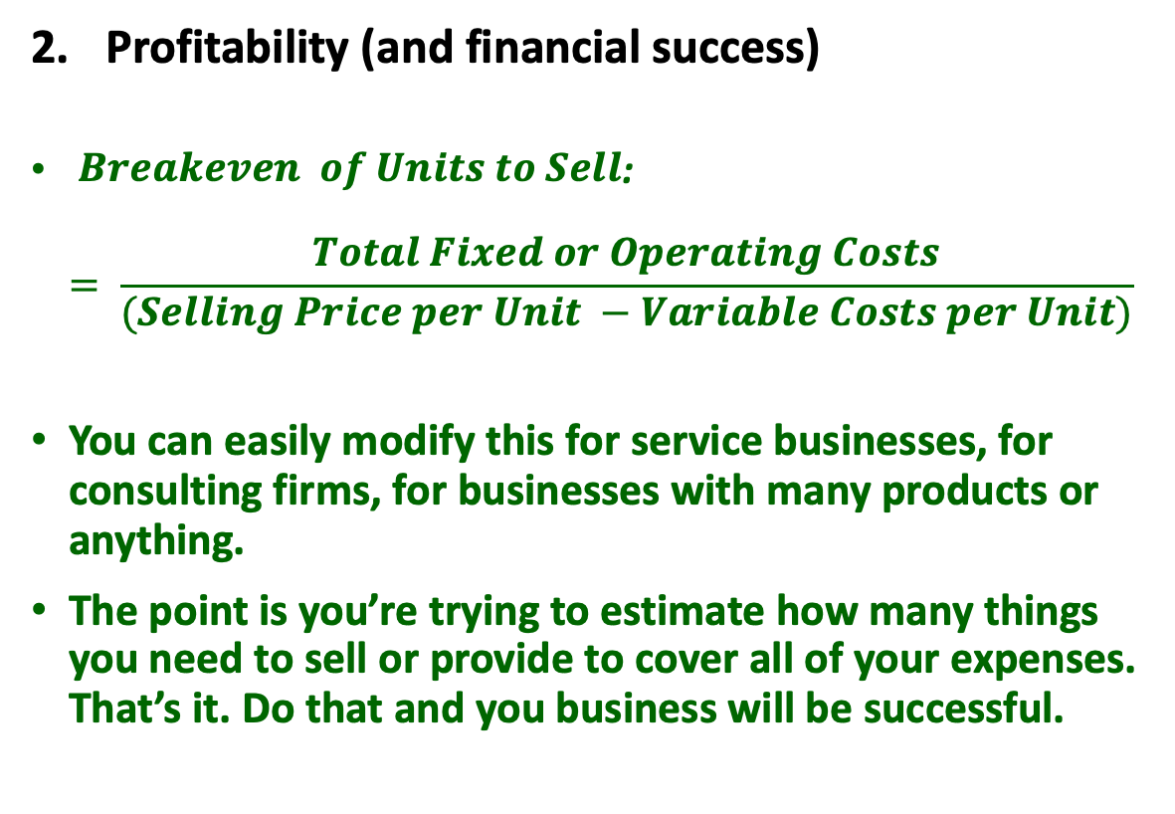
Profitability…How to Measure it
Profitability (and financial success)
$\begin{aligned} Breakeven \# of Units to Sell\end{aligned}$:
$= \frac{Total Fixed or Operating Costs}{(Selling Price per Unit −Variable Costs per Unit)}$
You can easily modify this for service businesses, for consulting firms, for businesses with many products or anything.
The point is you’re trying to estimate how many things you need to sell or provide to cover all of your expenses. That’s it. Do that and you business will be successful.
Revenues
– Cost of Goods Sold
= Gross Margin
– Operating Expenses
= Operating Income
– Other Expenses
= Taxable Income
– Income Taxes
= Net Income

Slide 25
Expansion…How to Grow your Business?
3. EXPANDING YOUR BUSINESS
Many successful businesses have to grow & expand in order to succeed (Walmart, Amazon, most grocery stores).
  If you margins per sale are small, you need to make lots of sales to breakeven.
But expansion makes your business exponentially more complicated.
So, you first need to ask: Do you NEED to expand? Do you WANT to expand?

Slide 26
Expansion…How to Grow your Business?
3. EXPANDING YOUR BUSINESS
Can you expand with existing financial resources?
Or do you need to acquire external financing?
  Friends & family and credit cards might not be an option anymore.
  Bank loans, partnerships and external investors might be your best options.
Be sure to invest in infrastructure, people and support.
And be sure to keep focused on your breakeven points, to make sure you have a plan for generating income to support ever-increasing expenses.

Slide 27
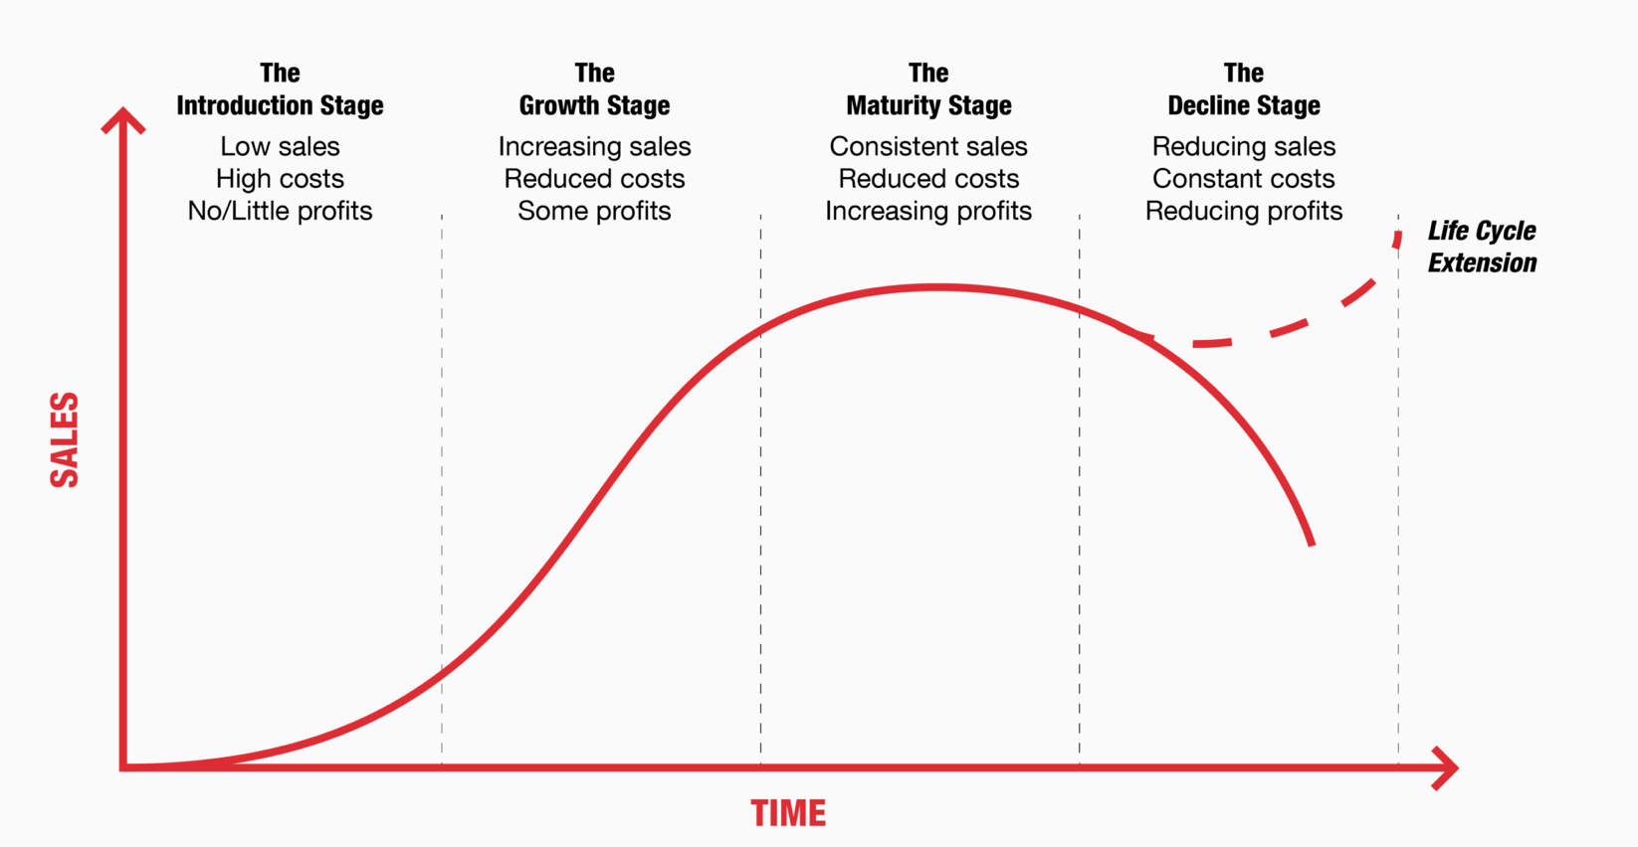
Expansion…How to Grow your Business?
3. EXPANDING YOUR BUSINESS

Slide 28
Success…What To Do When You Achieve It?
Success…Things to think about as your business grows & succeeds:
You can now afford to pay yourself – and your most important contributors – a real salary. How much do you pay yourself?
Who owns the business?
  Can you sell/give ownership to family, friends or business partners?
  Yes, legally you can (within limits), and you may want to in order to share your success.
What do you do with profits that have accumulated in the business – and that the business does not need anymore?
  If you pay yourself and/or other business partners a dividend, that’s fine. You will each pay ordinary income taxes on the money you pay yourself.
  If you keep the money in the business, you do not pay taxes…but maybe the money is not being utilized efficiently.
  If you choose to have the business invest in other business…well, now you’re a magnate!

Slide 29
5 THINGS YOU CAN DO TOMORROW
Build your team. Don’t try to do everything on your own.
  You probably want to have an attorney and a tax accountant on your team. You may want to connect with other advisors, but having an attorney and accountant on your team is essential.
Separate your personal and business lives as much as possible.
  Get separate bank accounts for the business.
  Establish a credit history for the business.
Find an accounting system you like. Quicken, Quickbooks, TaxBot, Zero, Sage, FreshBooks are all decent options. Learn it, live it, love it.
Register your business with the state. This will take a couple hundred dollars and a couple hours…but it’s the first step to securing your business name, to building your brand and to protecting your business from liability
Build your business plan. Tell the narrative of your business. View this as your roadmap or to-do list. Use it to guide both strategy and decision-making.
  Banks will want to see this. Investors will want to see this. Investors will want to see this.
  In addition to a full business plan, prepare a ‘business model canvas.’ This is step 1 towards designing the mission, strategy, operations & future of your business.

Slide 30
Business Model Canvas

Slide 31
Happiness
Long-Term Goals
Short-Term Goals
Financial Needs
Family Needs

Slide 32

Isn’t this a lot like what you do with your education planning?

Slide 33
Owning Your Financial Future
Adults Returning to Finish a Degree: Financial & Other Concerns
June 6, 2023
Financial Planning for Graduate Students
June 7, 2023
Financial & Tax Planning for International Students
June 8, 2023
The Financial Aspects of Your Side-
Hustle #1 – Planning, Strategies, Legal, Resources
June 20, 2023
Family Financial Planning: Making Finances Work for the Whole Family
June 23, 2023
Family Financial Planning: Sending Your Loved-Ones Off to College
June 27, 2023
Family Financial Planning: Caring for Adult Dependents
June 28, 2023
Changing Careers: The Financial & Personal Issues
July 13, 2023
Building Savings Accounts & Emergency Funds
July 14, 2023
Financial Planning for Veterans
July 18, 2023
Financial Planning When Retirement is Getting Close
(5-7 years out)
July 19, 2023
The Financial Aspects of Your Side-
Hustle #2 – Taxes, Profitability, Expansion, Success
July 25, 2023
Financial Planning for the Fun Stuff: Vacations, Home Improvements, New Vehicles
June 26, 2023
Investing 101
August 1, 2023
Navigating the Impacts of Inflation & Turbulent Economic Times
August 2, 2023
All future sessions are from 12:00-1:00pm

Slide 34
Brian Bolton
Professor of Finance brian.bolton@louisiana.edu http://business.louisiana.edu/financeispersonal

