Slide 1


MONEY MATTERS 2023:
UL SYSTEM FINANCIAL WELLNESS SERIES
Session #11:
Financial Planning When Retirement
is Close…within 5-7 Years
July 19, 2023

Slide 2
Brian Bolton
Professor of Finance brian.bolton@louisiana.edu http://business.louisiana.edu/financeispersonal

Slide 3
Owning Your Financial Future
Adults Returning to Finish a Degree: Financial & Other Concerns
June 6, 2023
Financial Planning for Graduate Students
June 7, 2023
Financial & Tax Planning for International Students
June 8, 2023
The Financial Aspects of Your Side-
Hustle #1 – Planning, Strategies, Legal, Resources
June 20, 2023
Family Financial Planning: Making Finances Work for the Whole Family
June 23, 2023
Family Financial Planning: Sending Your Loved-Ones Off to College
June 27, 2023
Family Financial Planning: Caring for Adult Dependents
June 28, 2023
Changing Careers: The Financial & Personal Issues
July 13, 2023
Building Savings Accounts & Emergency Funds
July 14, 2023
Financial Planning for Veterans
July 18, 2023 ***
Financial Planning When Retirement is Getting Close
(5-7 years out)
July 19, 2023 ***
The Financial Aspects of Your Side-
Hustle #2 – Taxes, Profitability, Expansion, Success
July 25, 2023
Financial Planning for the Fun Stuff: Vacations, Home Improvements, New Vehicles
June 26, 2023
Investing 101
August 1, 2023
Navigating the Impacts of Inflation & Turbulent Economic Times
August 2, 2023
Most sessions are from 12:00-1:00pm
*** Sessions on July 18, 19 are from 3:00-4:00pm.

Slide 4
Happiness
Long-Term Goals
Short-Term Goals
Financial Needs
Family Needs

Slide 5
Personal Finance is…personal.
It’s about you and not about anyone else.
You have to make it about you and your goals.

Slide 6
Because personal finance is personal, it is virtually impossible for me to give you any specific advice.
However, there is one word of advice that applies to 99% of people working on their finances:
SAVE

Slide 7
SAVINGS
INVESTING
OWNERSHIP
WEALTH

Slide 8
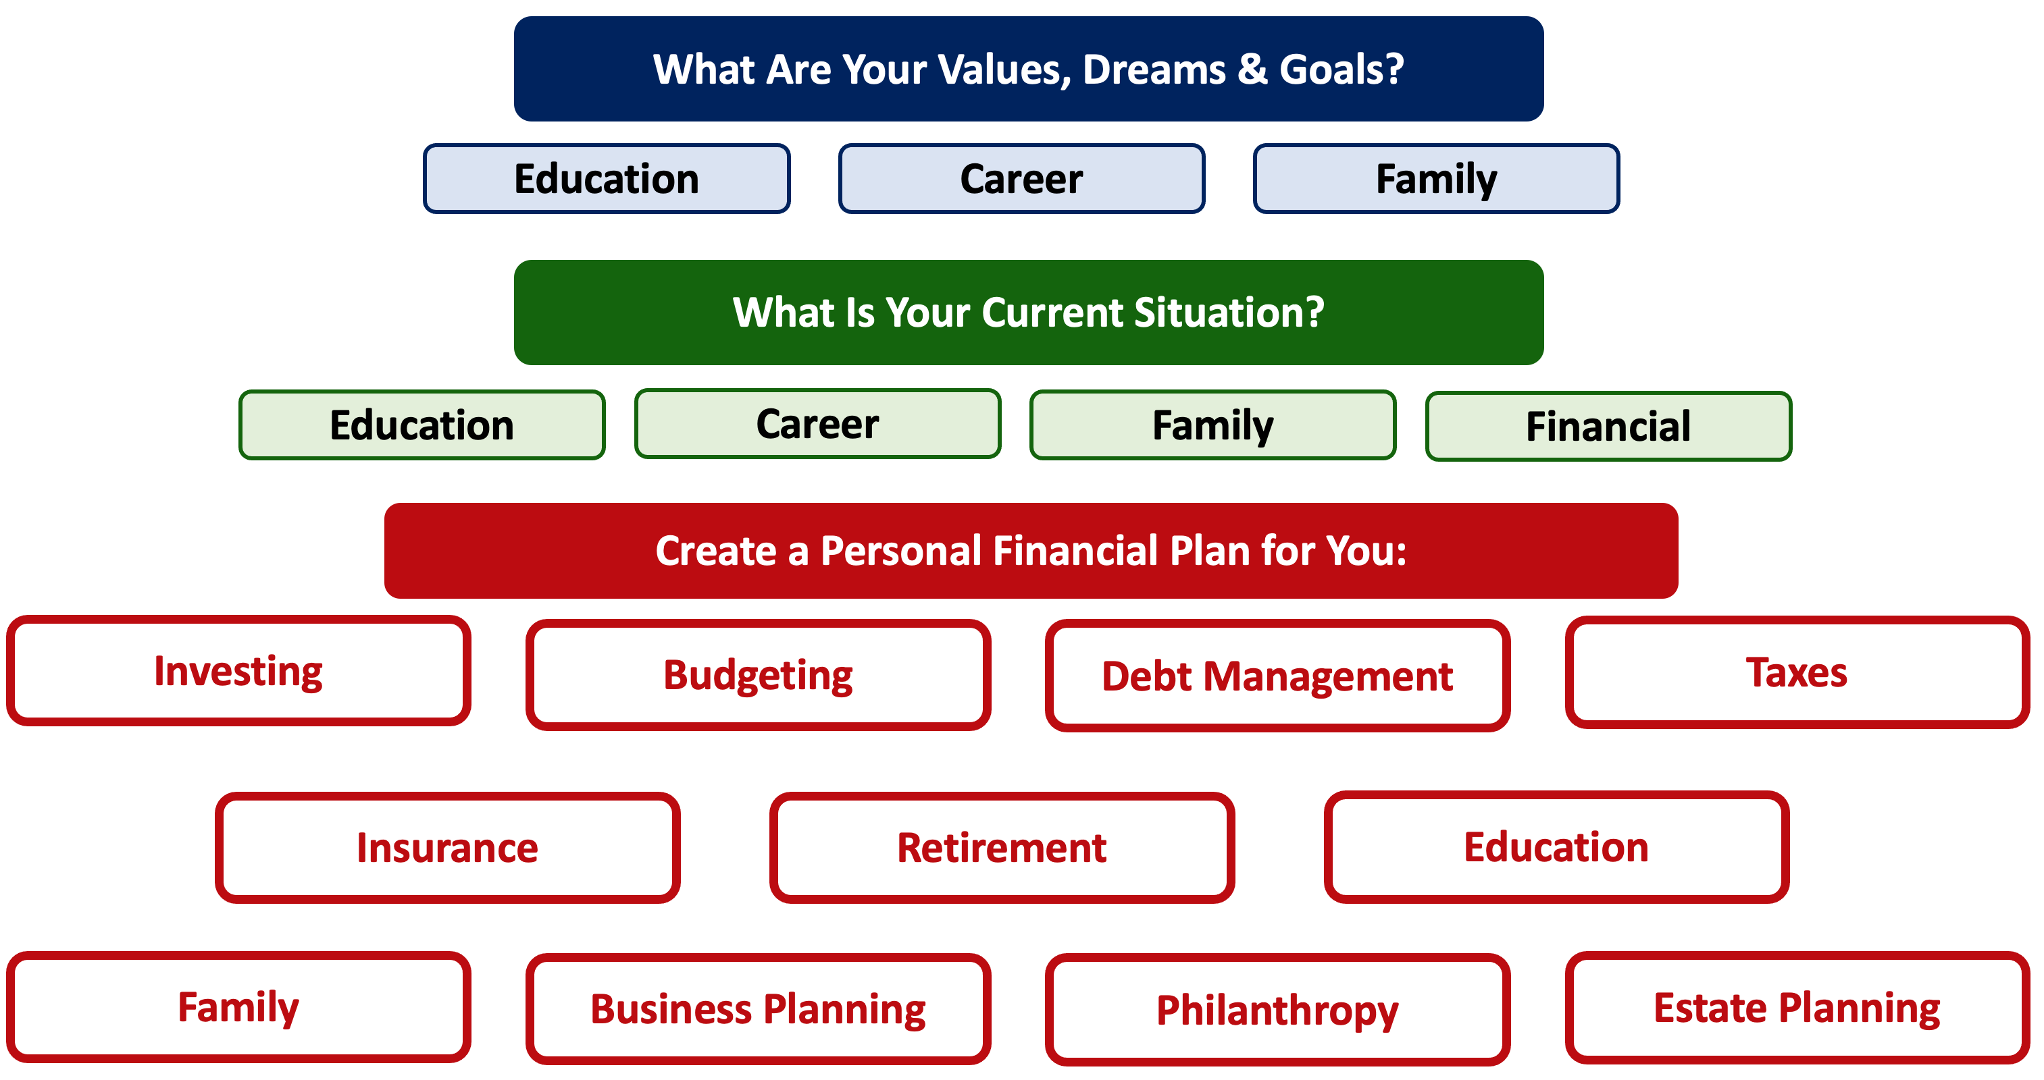

Slide 10
TODAY THE NEXT 6 MONTHS THE NEXT 12 MONTHS 2 YEARS AFTER GRADUATION 3 YEARS AFTER GRADUATION
ONCE EVERY SEMESTER:
TRACK EVERY PENNY THAT YOU SPEND & TRACK EVERY PENNY THAT YOU EARN
IN THE NEXT 3 MONTHS:
IDENTIFY WAYS TO DECREASE YOUR DISCRETIONARY SPENDING BY 25%
IN THE NEXT 6 MONTHS:
MAKE A PLAN TO MANAGE – AND PAY OFF – YOUR DEBT
IN THE NEXT 6-12 MONTHS:
OPEN MULTIPLE SAVINGS ACCOUNTS, 1 FOR EACH GOAL
IN THE NEXT 12 MONTHS, OPEN AN IRA OR ROTH IRA
WITHIN 2 YEARS OF GRADUATION:
HAVE AN “EMERGENCY FUND” ACCOUNT, WITH 3-6 MONTHS OF NON-DISCRETIONARY EXPENSES
WITHIN 3 YEARS OF GRADUATION:
ELIMINATE ALL OF YOUR BAD DEBT.

Slide 11
THE 3 FINANCIAL PLANNING PRIORITIES

Slide 12
THE 3 FINANCIAL PLANNING PRIORITIES

Slide 13
Savings Goals
Spend an afternoon going through your budget. Pick a month. Identify every penny that you spent. Track and know everything.
Categorize each expense as either “Non-Discretionary” (essential) or “Discretionary” (less essential).
For next month, add an ‘expense’ line for Savings. And pay yourself first – move some money, however much you can live without, from your checking or operating account to 1 or more savings accounts on the first day of the month.

Slide 14
Savings Goals

Slide 15
Savings Goals

Slide 16
Savings Goals

Slide 17
Savings Goals

Slide 18
Savings Goals
IN THE NEXT 3 MONTHS:
IDENTIFY WAYS TO DECREASE YOUR DISCRETIONARY SPENDING BY 25%
How can you decrease your discretionary spending by 25% over time?
Cut subscriptions?
Cut impulse purchases?
Coffee? Fast food? Entertainment?

Slide 19
Savings Goals
Can you decrease your non-discretionary, essential spending by 10% over time?
Change insurance or phone carriers? Buy groceries in bulk? Empty your freezer and pantry?

Slide 20
Building An Emergency Fund
What happens if your AC dies?
What happens if your car dies?
What happens if you lose your job?
Ideally, your EMERGENCY FUND would be a savings account with 3-6 months of non-discretionary expenses saved up to cover emergencies.
$1,050 x 3 = $3,150
$1,050 x 6 = $6,300

Slide 21
Frequently Asked Question
Ideally how much of your income should you expect to go into paying off various loans (car, house, school, etc.)?
There are 2 ways to address this:
From a lender’s perspective.
From your own, personal perspective.

Slide 22
Frequently Asked Question
Ideally how much of your income should you expect to go into paying off various loans (car, house, school, etc.)?
The lender’s perspective:
28% of your gross income should go to housing payments (at most)
(including rent, mortgage, taxes, insurance…but not maintenance or utilities)
36% of your gross income should go to all debt payments (at most)
(including housing, credit cards, student loans, auto loans…)

Slide 23
Frequently Asked Question
Ideally how much of your income should you expect to go into paying off various loans (car, house, school, etc.)?
28% of your gross income should go to housing payments (at most)
(including rent, mortgage, taxes, insurance…but not maintenance or utilities)
36% of your gross income should go to all debt payments (at most)
(including housing, credit cards, student loans, auto loans…)
Be very careful: These ratios are based on payments, not borrowed amounts or loan balances. Lenders may encourage you to extend your loan repayment term, which may lower your monthly or annual payment….but doing this will usually increase the total amount that you have to repay over the life of the loan.

Slide 24
Frequently Asked Question
Ideally how much of your income should you expect to go into paying off various loans (car, house, school, etc.)?
From a personal perspective, it will all depend on your other goals and investments and your specific situation.
If you buy a home, you will increase your debt.
If you have children, you may increase your debt as you save for their education or incur other expenses.
You can offset this by having a lower auto loan or reducing your student loans.
Always, always, always pay off your credit card balances as soon as you are able.

Slide 25
GOAL: Set up separate savings accounts for each savings goal. And add to each.
Our minds are wacky.
We engage in a behavior economists call “mental budgeting.”
Having $10,000 in one account feels different than having $2,000 in five different accounts.
  If each account has a purpose or goal, there’s a little governor in our brain that regulates our desire to use money from an account for anything but its intended purpose.
  Some banks will let you do this automatically. If not, do this for yourself, by actually opening up 3-5 different savings accounts.

Slide 26

Mental Budgeting & Savings Accounts
Contribution from ULL
Paycheck
Work Retirement Plan
Bills
Transfer from Savings
Independent Retirement Plan
Short & Medium- Term Goals (0-5 Years)
Long-Term Goals
(5+ Years)

Slide 27
Mental Budgeting & Savings Accounts
Paycheck
Paycheck
$200
$100
Bills
$50
Savings Account #3:
NEW HOUSE
Savings Account #2:
NEW CAR
Savings Account #1:
VACATION
Short & Medium- Term Goals (0-5 Years)
Long-Term Goals
(5+ Years)

Slide 28
Mental Budgeting & Savings Accounts
I utilize 4-5 different accounts on a regular basis, as defined below. This allows me to mentally align my finances with my goals, kind of like how I use 3 credit cards with 3 different purposes each.
Checking & Transaction Account
No risk,
0.0% return,
all cash
Short-to-Medium Term Goals
Some risk,
0-3% return goals,
cash + savings
Long-Term
Goals
Some Risk,
3-7% return goals,
savings + investments
Retirement
Accounts
Lots of risk,
8-12% return goals,
all investments

Slide 29
Mental Budgeting & Savings Accounts
Maybe the money for these goals sits in a savings account, earning 0.25% interest. Maybe I buy a Certificate of Deposit and lock up this money for 3 months to 2 years, earning 0.50% to 2.00%. Maybe I invest in a government, municipal or corporate bond and earn a little bit more (and take on a little bit more risk).
The key is liquidity. I have to be able to comfortably and confidently convert these investments to cash when it’s time to enjoy my goals.
Short-to-Medium Term Goals
Some risk,
0-3% return goals,
cash + savings

Slide 30
Mental Budgeting & Savings Accounts
Maybe I want to buy a new house in 10 years and need to save $50,000. I really want the house, but the timing and amount are flexible.
Maybe I just had my first child and want to start a 529 Savings Plan for their college in 18 years.
Liquidity is less of the priority with these goals. I can take more risk, which should lead to higher returns over the longer-term. Now maybe I choose index funds or mutual funds. Maybe I choose individual stocks. Maybe the real estate is the risk. Patience is the key.
Long-Term
Goals
Some Risk,
3-7% return goals,
savings + investments

Slide 31
Mental Budgeting & Savings Accounts
A company-sponsored 403(b) or 401(k) will give me the structure to invest for my retirement.
It will limit my investment options, but I should have plenty of index fund and mutual fund options.
These are tax-preferred accounts, so the IRS doesn’t want me using this money for a new house or my kids’ college. If I withdraw the money before I turn 59 ½, I pay all taxes and a 10% penalty.
Retirement
Accounts
Lots of risk,
8-12% return goals,
all investments

Slide 32
Mental Budgeting & Savings Accounts
Liquidity is not the issue, again.
I care about:
Capital appreciation
Minimizing taxes (both today and in the future)
Getting the maximum company match.
Meeting any vesting period requirements.
Retirement
Accounts
Lots of risk,
8-12% return goals,
all investments

Slide 33
A Few Opening Morals
SAVINGS
INVESTING
OWNERSHIP
WEALTH

Slide 34


Slide 35
Financial Wellness
A goal without a plan is just a dream.
Wealth is largely the result of habit.
The most difficult thing is the decision to act; the rest is mere tenacity.
It takes as much energy to plan as it does to wish.
You cannot escape the responsibility of tomorrow by avoiding it today.

Slide 36
Financial Wellness
A goal without a plan is just a dream.
Wealth is largely the result of habit.
The most difficult thing is the decision to act; the rest is mere tenacity.
It takes as much energy to plan as it does to wish.
You cannot escape the responsibility of tomorrow by avoiding it today.

Slide 37
Owning Your Financial Future
Adults Returning to Finish a Degree: Financial & Other Concerns
June 6, 2023
Financial Planning for Graduate Students
June 7, 2023
Financial & Tax Planning for International Students
June 8, 2023
The Financial Aspects of Your Side-
Hustle #1 – Planning, Strategies, Legal, Resources
June 20, 2023
Family Financial Planning: Making Finances Work for the Whole Family
June 23, 2023
Family Financial Planning: Sending Your Loved-Ones Off to College
June 27, 2023
Family Financial Planning: Caring for Adult Dependents
June 28, 2023
Changing Careers: The Financial & Personal Issues
July 13, 2023
Building Savings Accounts & Emergency Funds
July 14, 2023
Financial Planning for Veterans
July 18, 2023
Financial Planning When Retirement is Getting Close
(5-7 years out)
July 19, 2023
The Financial Aspects of Your Side-
Hustle #2 – Taxes, Profitability, Expansion, Success
July 25, 2023
Financial Planning for the Fun Stuff: Vacations, Home Improvements, New Vehicles
June 26, 2023
Investing 101
August 1, 2023
Navigating the Impacts of Inflation & Turbulent Economic Times
August 2, 2023
Most sessions are from 12:00-1:00pm
*** Sessions on July 18 & 19 are from 3:00-4:00pm.

Slide 38
Brian Bolton
Professor of Finance brian.bolton@louisiana.edu http://business.louisiana.edu/financeispersonal

