Slide 1
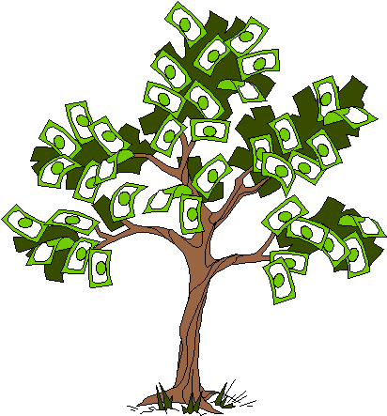

MCOBA Student Investment Fund
Meeting #1: Introduction to the Student Investment Fund
January 21, 2026
January 23, 2026

Slide 2
Brian Bolton Professor of Finance brian.bolton@louisiana.edu https://business.louisiana.edu/financeispersonal

Slide 3
Mission of the Student Investment Fund
The MCOBA Student Investment Fund exists to help students in all business majors learn about investment strategies and philosophies, to gain practical investing experience and to empower students to take greater control of their own financial futures.

Slide 4
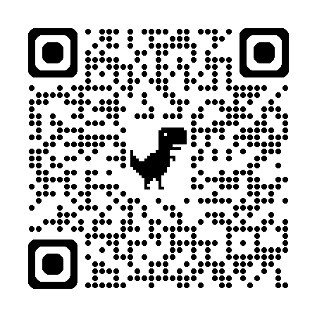
Schedule of Meetings
January 21, Wednesday 5:00-6:30pm (Intro Meeting)
January 23, Friday 11:30am-1:00pm (Intro Meeting)
January 28, Wednesday 5:00-6:30pm
February 19, Thursday 5:00-6:30pm
March 6, Friday 11:30am-1:00pm
March 23, Monday 5:00-6:30pm
April 1, Wednesday 11:30am-1:00pm
April 24, Friday 11:30am-1:00pm

Slide 5
The Magic of Investing & Compound Returns
Quiz Question on Compound Returns:
Under which of the following scenarios will you have more money saved when you turn 65?
Investing $100 per month from age 25-35 (and then nothing from 35-65) With an 8% return, you will have $185,000 accumulated at 65.
Investing $100 per month from age 35-65 (but nothing from 25-35) With an 8% return, you will have $150,000 accumulated at 65. Note: If the returns on your investments are less than 6%, (B) will lead to greater wealth. There’s a similar but different problem on page 37 of your handbook.

Slide 6
The Magic of Investing & Compound Returns
Quiz Question on Compound Returns:
Under which of the following scenarios will you have more money saved when you turn 65?
Investing $100 per month from age 25-35 (and then nothing from 35-65) With an 8% return, you will have $185,000 accumulated at 65.
Investing $100 per month from age 35-65 (but nothing from 25-35) With an 8% return, you will have $150,000 accumulated at 65. Note: If the returns on your investments are less than 6%, (B) will lead to greater wealth.

Slide 7
A Few Opening Morals
Personal Finance is…personal.
It’s about you and not about anyone else.
You have to make it about you and your goals.

Slide 8
A Few Opening Morals
There is no judgment in personal finance.
There is no ego in personal finance.
There is no shame in personal finance.
It’s about you and not about anyone else.

Slide 9
A Few Opening Morals
Because personal finance is personal, it is virtually impossible for me to give you any specific advice.
However, there is one word of advice that applies to 99% of people working on their finances:
SAVE

Slide 10
A Few Opening Morals
SAVINGS
INVESTING
OWNERSHIP
WEALTH

Slide 11
Financial Wellness
A goal without a plan
Is just a dream.
~ Antoine de Saint-Exupéry

Slide 12
The Policies & Strategies
We have $100,000 to invest.
You will invest that into the U.S. stock markets…there are about 10,000 publicly traded U.S. companies you can invest in.
We will NOT invest in cryptocurrency, NFTs, real estate, your student loan, debt…just US stocks.
No single investment can be less than 3% of our fund.
But no single investment can make up more than 10% of our fund.

Slide 13
The Policies & Strategies
We must hold each investment for at least 2 months.
This is NOT a day-trading fund, it’s an investment fund.
No single sectors will comprise more than 40% of the total portfolio value.
The 11 sectors of the S&P 500 are: Information Technology, Health Care, Financials, Consumer Discretionary, Communication Services, Industrials, Consumer Staples, Energy, Utilities, Real Estate, Materials.
YOU will make the investment decisions.
I have veto power…but in 3 years of doing this with other funds on campus, I have never vetoed any student recommendations.

Slide 14
The Policies & Strategies
Our meetings can be conversational and exploratory, with lots of brainstorming about potential investment picks.
BUT…to make an investment, one student must make a pitch. Ideally, this will come with a (brief) analysis, either written or verbal.
Same holds if there is a motion to sell an existing investment.
Decisions will be made based on 2/3 of the students in attendance voting for the decision.

Slide 15
The Cool Part
All PROFITS will be returned to students in the form of scholarships.
Any losses will be absorbed by the fund sponsors.
This math and portfolio rebalancing will be done on a calendar basis (Jan-Dec).

Slide 16
The Cool Part
Example:
We start 2026 with $100,000
We end 2026 with $90,000
We end 2027 with $95,000
At the end of 2026, no scholarship money will be awarded.
At the end of 2027, $5,000 of scholarship money will be awarded.
If we end 2026 with $110,000, then $10,000 of scholarship money will be awarded in early 2027.

Slide 17
Investing – How Do You Do It?
When you’re just getting started with investing, there are a few approaches you can take:
Start with a small amount of money – whether that’s $20 or $2,000 – and just go for it. Pick a few investments, track them regularly and be prepared to buy more or sell more should you feel comfortable doing either.

Slide 18
Investing – How Do You Do It?
When you’re just getting started with investing, there are a few approaches you can take:
Start with a small amount of money – whether that’s $20 or $2,000 – and just go for it. Pick a few investments, track them regularly and be prepared to buy more or sell more should you feel comfortable doing either.
Determine how much you have to invest.
Put ½ of that into an index fund or a specific mutual fund. This will provide some security, generally with less or moderate risk.
Put the other ½ into individual stocks or securities that intrigue you. If you’re interested in the companies, you might be more likely to follow them as investments.
This half-half approach will help you figure out what kind of investor you are. In 1-2 years, you might gravitate more to either of the approaches that interest you more.

Slide 19
Investing – How Do You Do It?
When you’re just getting started with investing, there are a few approaches you can take:
Start with a small amount of money – whether that’s $20 or $2,000 – and just go for it. Pick a few investments, track them regularly and be prepared to buy more or sell more should you feel comfortable doing either.
Determine how much you have to invest.
Put ½ of that into an index fund or a specific mutual fund. This will provide some security, generally with less or moderate risk.
Put the other ½ into individual stocks or securities that intrigue you. If you’re interested in the companies, you might be more likely to follow them as investments.
This half-half approach will help you figure out what kind of investor you are. In 1-2 years, you might gravitate more to either of the approaches that interest you more.
Talk to a financial advisor. Note that they generally do not (initially) tell you which specific investments to make, but they will work talk through your options with you and help you better understand what you’re getting into.
They will ask you 2 questions – what are your goals and what is your risk tolerance – and then work with you to find the investments that best align with your answers to these questions.

Slide 20
If you save or invest $5,000 per year….
With a 1% investment return, you will have a total of $325,539 after 50 years.
This includes $75,539 of passive income.

Slide 21
If you save or invest $5,000 per year….
With a 4% investment return, you will have a total of $793,869 after 50 years.
This includes $543,869 of passive income.

Slide 22
If you save or invest $5,000 per year….
With a 7% investment return, you will have a total of $2,174,930 after 50 years.
This includes $1,924,930 of passive income.

Slide 23
If you save or invest $5,000 per year….
With an 11% investment return, you will have a total of $9,261,680 after 50 years.
This includes $9,011,680 of passive income.
If you save or invest $5,000 per year….
With a 11% investment return, you will have a total of $9,261,680 after 50 years.
This includes $9,011,680 of passive income.

Slide 24
If we invest for 20 years instead of 50 years:
At 1%: $100,000 ➔ $111,196
At 4%: $100,000 ➔ $154,846
At 7%: $100,000 ➔ $219,326
At 11%: $100,000 ➔ $356,326

Slide 25
YES, There is Risk
Have you heard of…
Bed, Bath & Beyond?
Peloton?
Waitr?
Lululemon?
Deckers Outdoor?

Slide 26
YES, There is Risk
Have you heard of…
Bed, Bath & Beyond? Bankrupt!
Peloton? Down 97% since 2021
Waitr? Down 99% since 2021
Lululemon? Down 50% in 2025
Deckers Outdoor? Down 60% in 2025

Slide 27
2020 – A Uniquely Unique Year
-34%
February 19
to March 23
+43%
March 23
to June 10
+19%
June 10
to December 31

Slide 28
2020 – Another Uniquely Unique Year
-34%
February 19
to March 23
+43%
March 23
to June 10
+19%
June 10
to December 31
+18.33%
January 1 to December 31

Slide 29
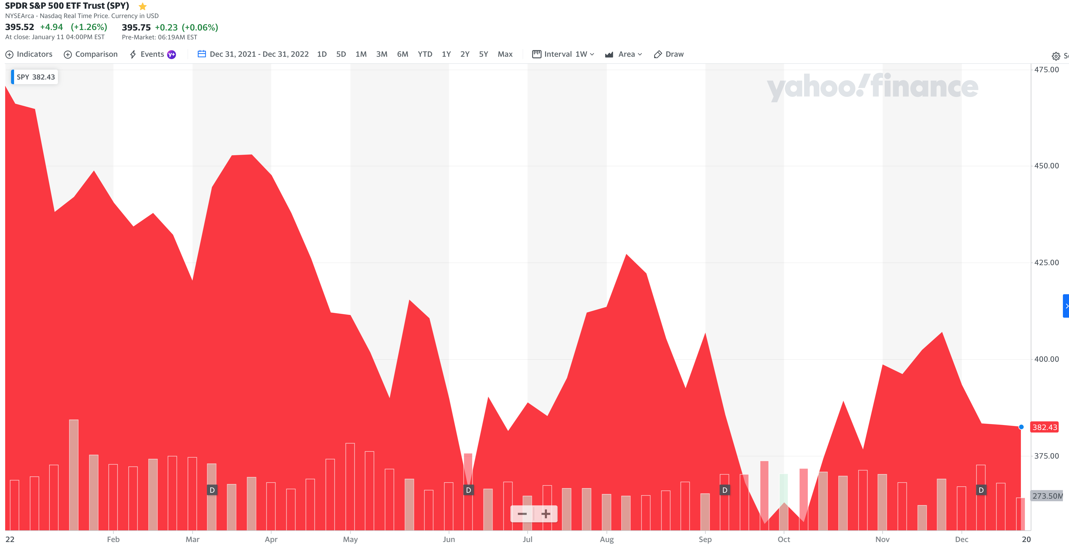
2022 – A Very Tough Year
-20.00%
January 1 to December 31

Slide 30
2022 – A Very Tough Year
-20.00%
January 1 to December 31
Only 7 of the past 100 years have been worse.

Slide 31
YES, There is Risk
BUT….
If we stick to the policies,
If we stick to our strategies,
If we invest in 10-30 different companies…
Have you heard of…
Bed, Bath & Beyond? Bankrupt!
Peloton? Down 97% since 2021
Waitr? Down 99% since 2021
Lululemon? Down 50% in 2025
Deckers Outdoor? Down 60% in 2025

Slide 32
YES, There is Risk
It will be very difficult for the portfolio to lose a lot of money.
(The caveat is that if the overall stock market crashes or really struggles, our portfolio will probably really struggle, no matter how brilliant your picks are. The overall stock market lost 20% in 2022; only 7 years since 1925 have been worse.)
Have you heard of…
Bed, Bath & Beyond? Bankrupt!
Peloton? Down 97% since 2021
Waitr? Down 99% since 2021
Lululemon? Down 50% in 2025
Deckers Outdoor? Down 60% in 2025

Slide 33
YES, There is Risk
Just as it is difficult to regularly and easily identify winners, it is just as difficult to regularly and easily pick losers.
Have you heard of…
Bed, Bath & Beyond? Bankrupt!
Peloton? Down 97% since 2021
Waitr? Down 99% since 2021
Lululemon? Down 50% in 2025
Deckers Outdoor? Down 60% in 2025

Slide 34
A Few Rules About INVESTING
Risk matters. Know your risk tolerance.
Goals matter. Be intentional about what you are saving for.
Maybe create 3-5 different investment accounts for different goals.
This is what I do – I’ll show you why in a bit.
Transaction costs matter. You can pay a lot of fees for not much benefit or service. Be careful.
Experts rarely have tips or secrets. Investing is about predicting the future, and none of us can predict the future (perfectly). Be careful.
If there really were sure-things or get-rich-quick schemes, the experts would be using them themselves, not sharing them with you.
Communicate with your family. Achieving goals is a family affair.

Slide 35
A Few Rules About INVESTING
Investing lets COMPOUND INTEREST be your friend.
With compound interest, your interest earns interest.
Without actively making decisions, your money can grow exponentially.
Yes, there is risk – the exponential growth rate could be negative.
Such risk is greatest if you ‘invest’ over very short periods of time.
Historically, over the past 100+ years, if you invest for 5+ years, you have benefited from positive exponential growth.
The average return of a common stock over the past 100 years is 10%.
The word ’average’ is very important here. But, the good news, we can all achieve ‘average’ returns relatively easily (though they may not be 10% in the future)

Slide 36
A Few Rules About INVESTING
Investing lets COMPOUND INTEREST be your friend.
With compound interest, your interest earns interest.
Without actively making decisions, your money can grow exponentially.
Yes, there is risk – the exponential growth rate could be negative.
Such risk is greatest if you ‘invest’ over very short periods of time.
Historically, over the past 100+ years, if you invest for 5+ years, you have benefited from positive exponential growth.
The average return of a common stock over the past 100 years is 10%.
The word ’average’ is very important here. But, the good news, we can all achieve ‘average’ returns relatively easily (though they may not be 10% in the future)
Not to be too esoteric or philosophical…
But compound interest doesn’t just apply to investing.
Compound interest applies to all aspects of college life:
Your New Year’s resolutions
Mental Health
Health Management
Writing Skills
Relationships
And…Of course, Money Management

Slide 37
Determining Your Risk Tolerance
High Risk Attitude I want to summer in Paris and winter in Hawaii
Medium-High Risk Attitude I will work through normal retirement age, but I want my spouse to retire early - and we want to visit Paris & Hawaii
Medium-Low Risk Attitude I want my children to have a college education
Low Risk Attitude I want food on the table and a roof over my head

Slide 38
Comparing Different Investments

Slide 39
Comparing Different Investments

Slide 40
TODAY THE NEXT 6 MONTHS THE NEXT 12 MONTHS 2 YEARS AFTER GRADUATION 3 YEARS AFTER GRADUATION
ONCE EVERY SEMESTER:
TRACK EVERY PENNY THAT YOU SPEND & TRACK EVERY PENNY THAT YOU EARN
IN THE NEXT 3 MONTHS:
IDENTIFY WAYS TO DECREASE YOUR DISCRETIONARY SPENDING BY 25%
IN THE NEXT 6 MONTHS:
MAKE A PLAN TO MANAGE – AND PAY OFF – YOUR DEBT
IN THE NEXT 6-12 MONTHS:
OPEN MULTIPLE SAVINGS ACCOUNTS, 1 FOR EACH GOAL
IN THE NEXT 12 MONTHS, OPEN AN IRA OR ROTH IRA
WITHIN 2 YEARS OF GRADUATION:
HAVE AN “EMERGENCY FUND” ACCOUNT, WITH 3-6 MONTHS OF NON-DISCRETIONARY EXPENSES
WITHIN 3 YEARS OF GRADUATION:
ELIMINATE ALL OF YOUR BAD DEBT.
SEVEN FINANCIAL PLANNING GOALS FOR ALL COLLEGE STUDENTS

Slide 41
Some Parting Words
Nothing in finance is free. Do not think some institution is giving you a super deal just because they like you. There will be costs.
You have to know your goals, know your timeline and know your risk.
I check my bank, savings & investment accounts daily. I do not make changes daily (or even monthly). I just don’t want any surprises.
There are two ways to accumulate crazy wealth – Try to do both.
Sign a big contract and/or get a huge salary.
Manage and invest your money intentionally for the long term.

Slide 42
Some Parting Words
If you ever invest based on personal relationships, be prepared for losses.
Nobody – NOBODY – can predict the future. And investing is all about predicting the future. Be careful about thinking you can predict the future. Make sure your investments align with your goals.
Be your own boss. Take control of your money and your investments. Nobody else is going to do it for you. Own your financial future.

Slide 43
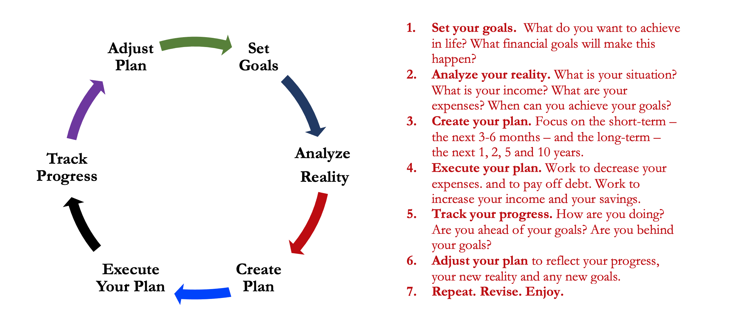
Isn’t this a lot like what you do with your education planning?

Slide 44
You’ve been doing this with your education for years.
You’re about to begin doing this with your career…and you will continue working through this process for the next 30 or 40 years.
Whether it’s education planning or career planning, by now we know that all of our personal decisions with have financial implications.
The more we plan ahead and integrate our decision-making process, the more control we will have over our futures…and the less money will be a source of stress and the more money will be a source of empowerment.
Isn’t this a lot like what you do with your education planning?

Slide 45
Financial Wellness
Don’t wait around for other people to be happy for you.
Any happiness you get, You’ve got to make yourself.
~ Alice Walker American novelist, poet, activist

Slide 46

brian.bolton@louisiana.edu http//:business.louisiana.edu/financeispersonal

