Slide 1


Money Mindsets:
How Beliefs Shape Financial Habits
Living your values, Financial Planning & Owning Your Financial Future
October 2, 2025
Brian Bolton
Professor & Endowed Chair of Finance
Interim Dean – College of Business
University of Louisiana at Lafayette

Slide 2
Brian Bolton
Professor of Finance brian.bolton@louisiana.edu http://business.louisiana.edu/financeispersonal

Slide 3
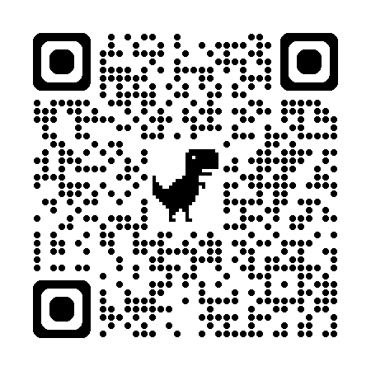

Slide 4
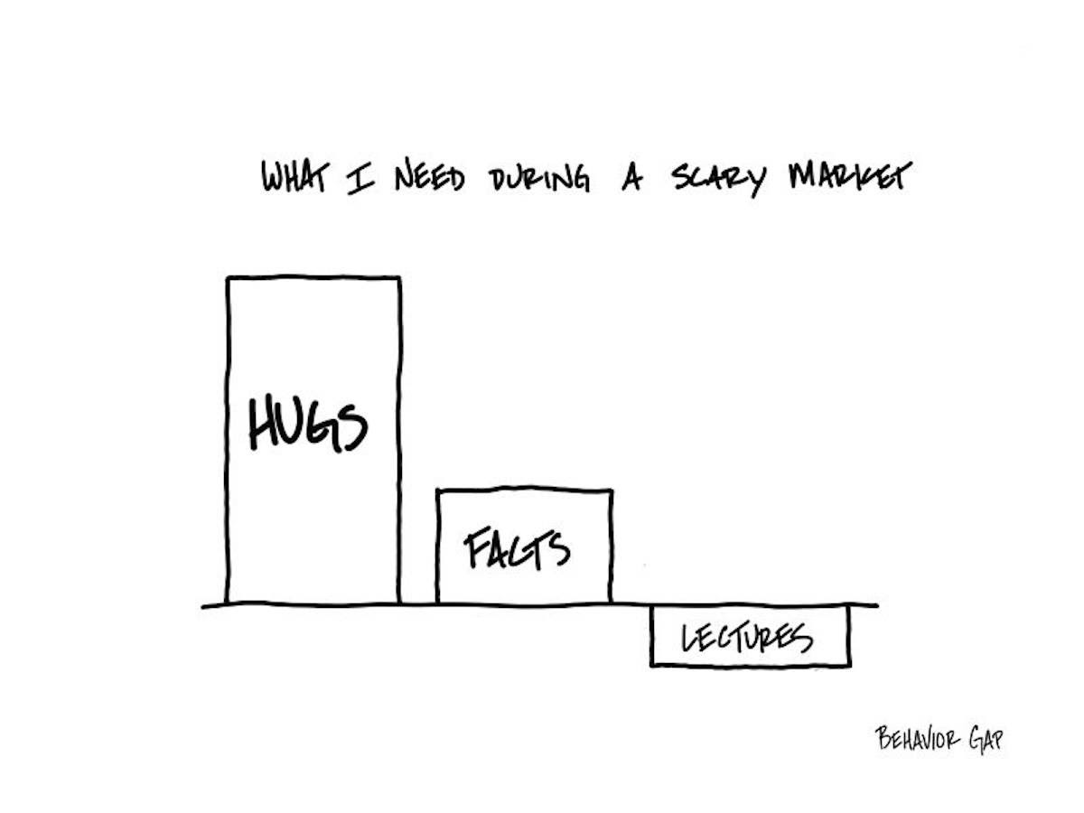

Slide 5
Let’s Take a Quick Quiz
Please define the following word:
VALUES
Now define this word:
VALUE
THESE ARE THE SAME WORDS!

Slide 6
A Few Opening Morals
Personal Finance is…personal.
It’s about you and not about anyone else.
You have to make it about you and your goals.

Slide 7
A Few Opening Morals
There is no judgment in personal finance.
There is no ego in personal finance.
There is no shame in personal finance.
It’s about you and not about anyone else.

Slide 8
A Few Opening Morals
Because personal finance is personal, it is virtually impossible for me to give you any specific advice.
However, there is one word of advice that applies to 99% of people working on their finances:
SAVE

Slide 9
A Few Opening Morals
SAVINGS
INVESTING
OWNERSHIP
WEALTH

Slide 10
Financial Wellness
Becoming an owner allows you to be the architect of your own future.
- Leigha Porter
Entrepreneur, Dancer, Choreographer, Founder of the Creole Nutcracker, PARC Village
and FIRE Expressions Conservatory, UL Lafayette grad, Northside High School grad

Slide 11
Financial Wellness
A goal without a plan
Is just a dream.
~ Antoine de Saint-Exupéry

Slide 12
Happiness
Long-Term Goals
Short-Term Goals
Financial Needs
Family Needs

Slide 13
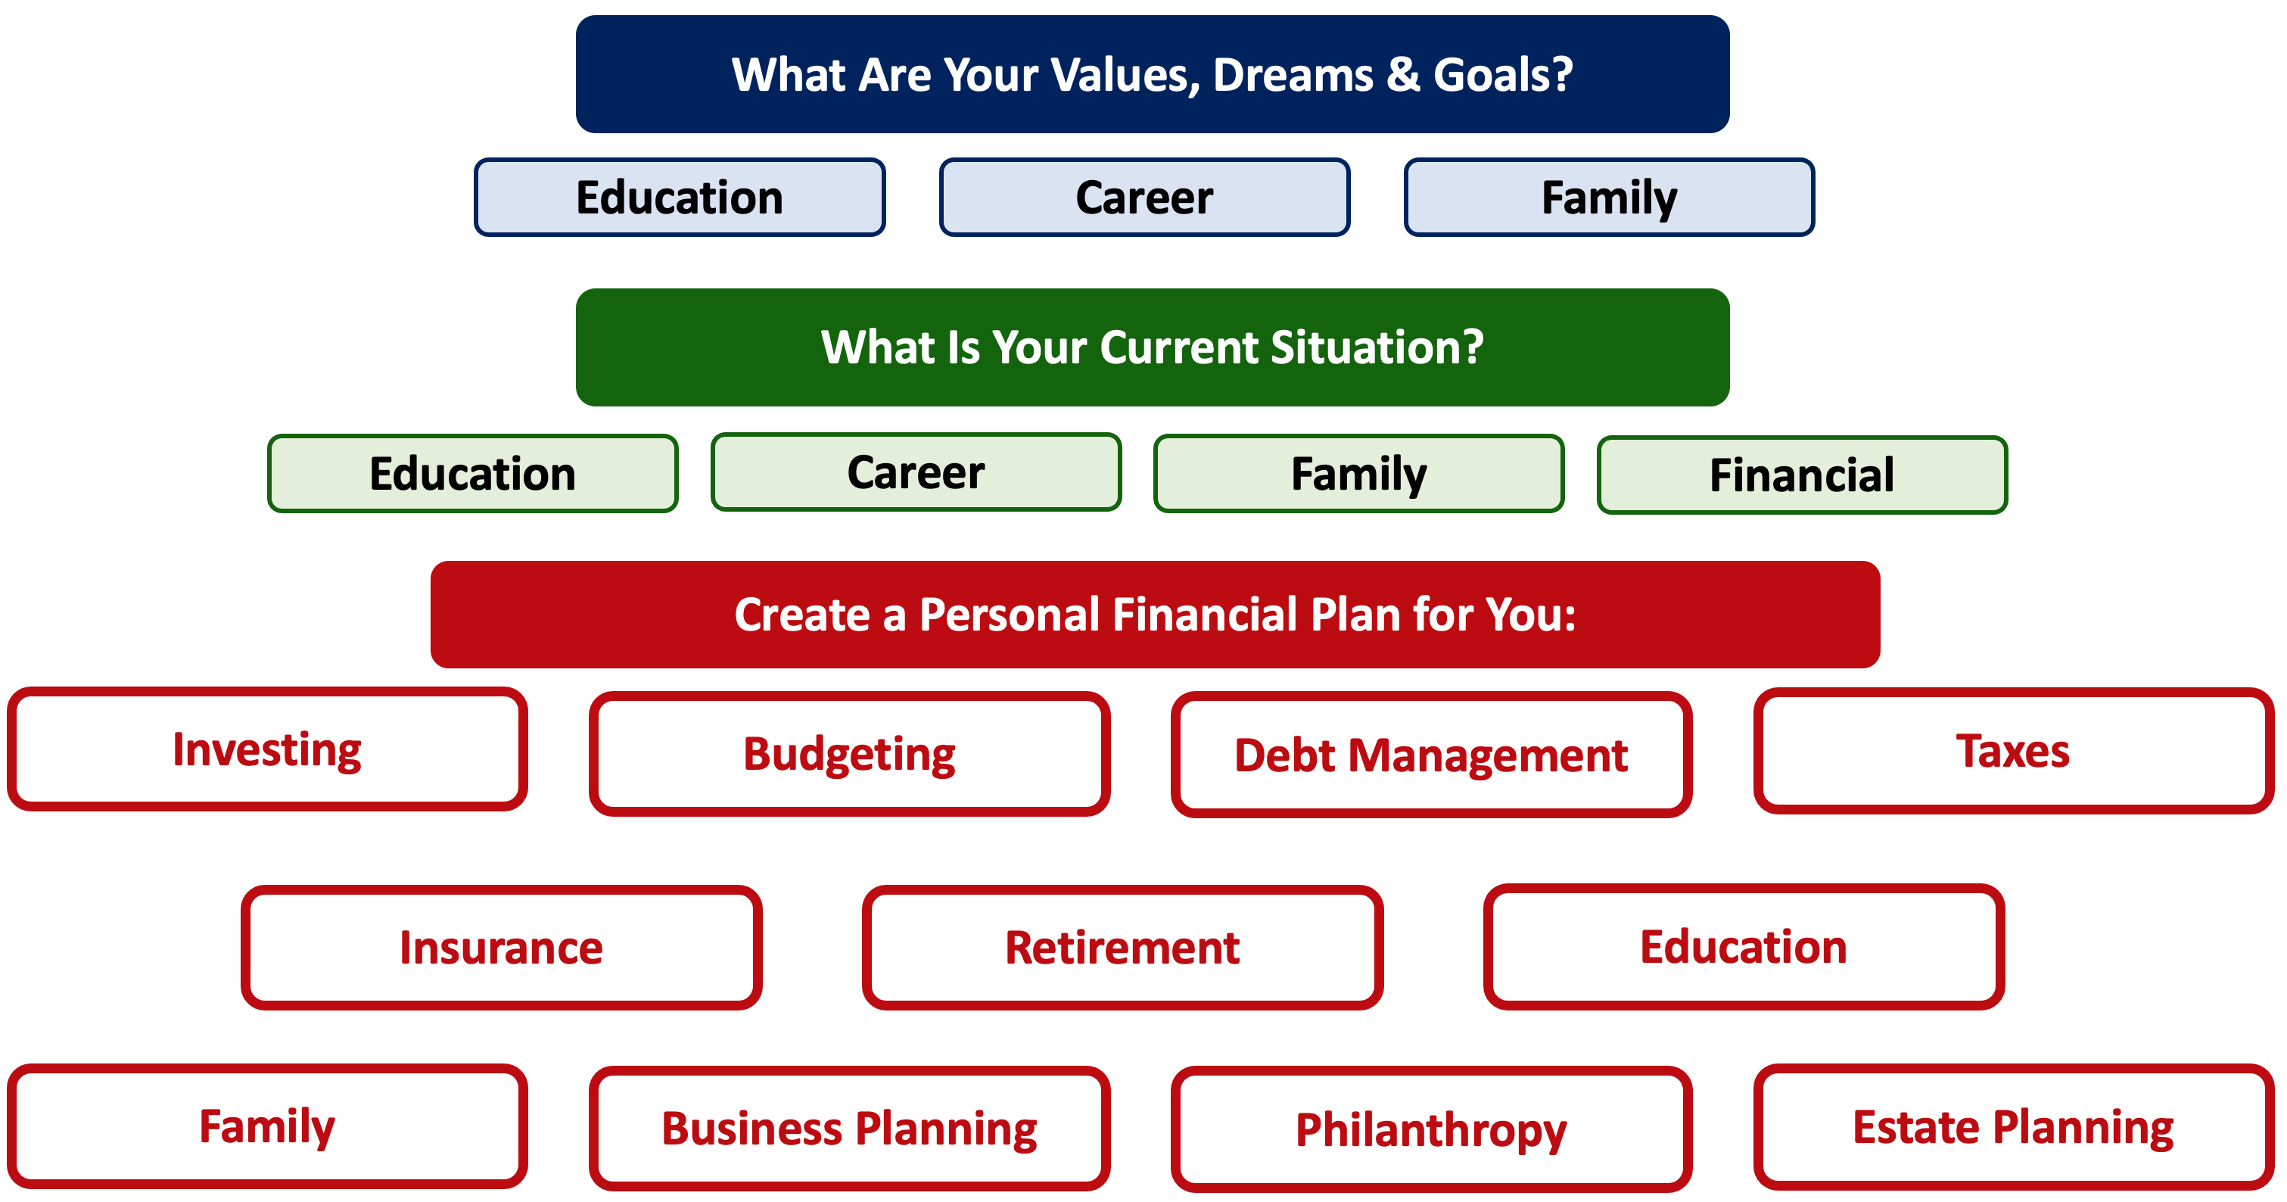

Slide 14
Owning Your Financial Future
YOUR VALUES
YOUR GOALS
Education
Career
Family
FINANCIAL STRATEGIES
Investing
Income & Expense Management
Debt Management
Taxes, Insurance & Other

Slide 15
Owning Your Financial Future
YOUR VALUES
YOUR GOALS
Education
Career
Family
FINANCIAL STRATEGIES
Investing
Income & Expense Management
Debt Management
Taxes, Insurance & Other

Slide 16
Owning Your Financial Future
YOUR VALUES
YOUR GOALS
Education
Career
Family
FINANCIAL STRATEGIES
Investing
Income & Expense Management
Debt Management
Taxes, Insurance & Other

Slide 17
Financial Wellness
Don’t tell me where your priorities are. Show me where you spend your money and I’ll tell you what your values are.
~ James Frick

Slide 18
Financial Wellness
Don’t tell me where your priorities are. Show me where you spend your money and I’ll tell you what your values are.
~ James Frick

Slide 19
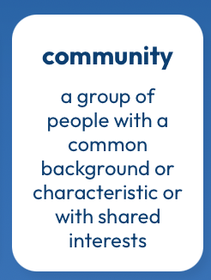
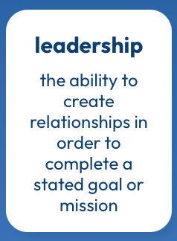
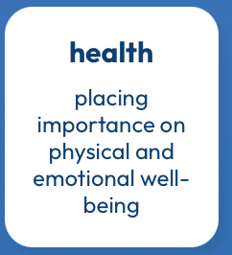

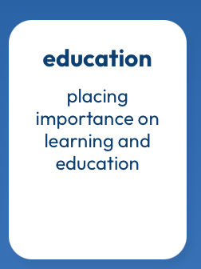
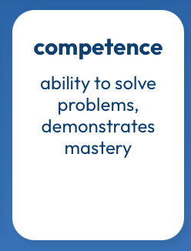
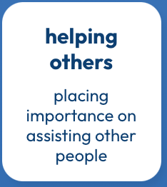
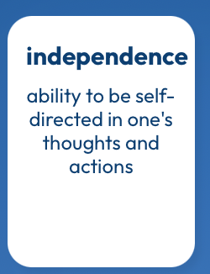
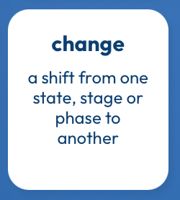

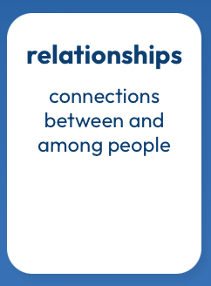
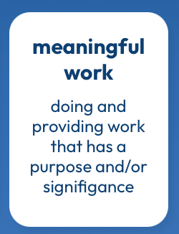

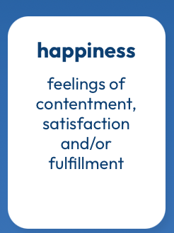
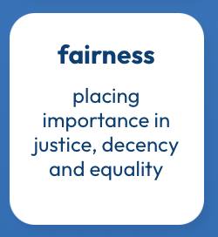
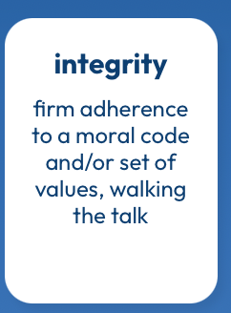
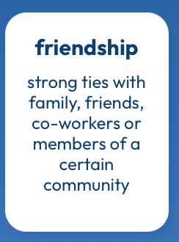
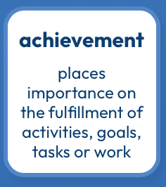
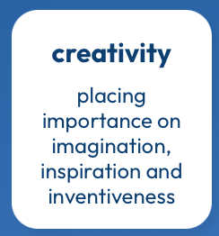
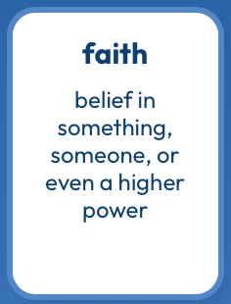

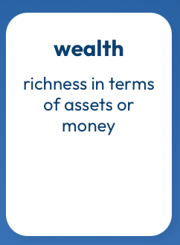
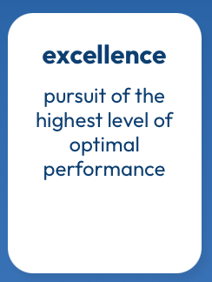
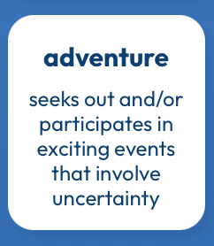
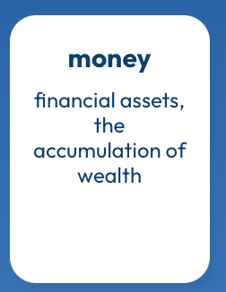
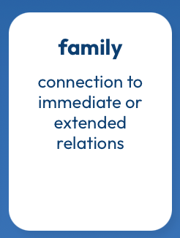
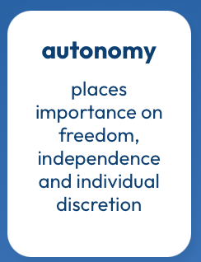
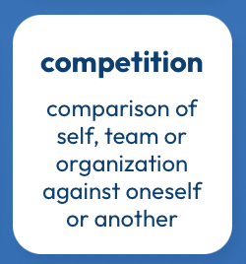
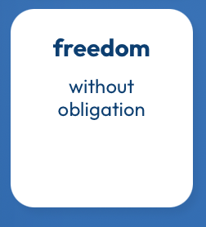
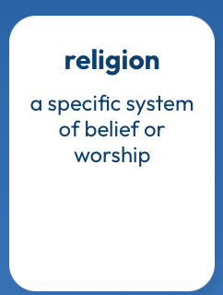
What Are Your Values?
https://www.think2perform.com/values#start

Slide 20
What Are MY Values?
What values are part of my DNA?
What Am I Looking For in MY LIFE?
What Am I Looking For in A JOB?
https://www.think2perform.com/values#start

Slide 21
What Are MY Values?
What values are part of my DNA?
https://www.think2perform.com/values#start

Slide 22
What Are MY Values?
What Am I Looking For in MY LIFE?
https://www.think2perform.com/values#start

Slide 23
What Are MY Values?
What Am I Looking For in A JOB?
https://www.think2perform.com/values#start

Slide 24
What Am I Looking For in A JOB?
These are the values that give my work energy and purpose.
I need to find a job, a career, projects, programs, activities or hobbies that give me the opportunity to embrace with and connect with these values.
https://www.think2perform.com/values#start

Slide 25
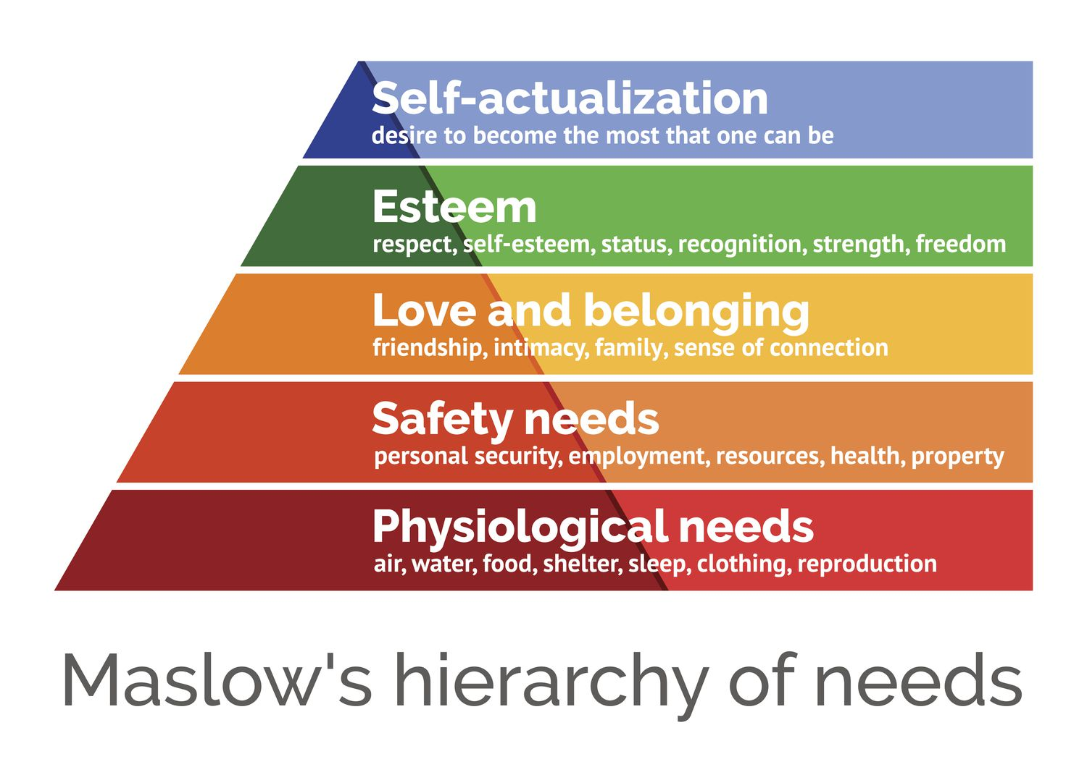
https://www.think2perform.com/values#start

Slide 26
Some Homework for You
Make a list of the 5-10 most important criteria you are looking for in a job or career.
Rank these criteria.
Connect these criteria to your long-term and
short-term goals. Connect these criteria to your values.

Slide 27
More Homework for You
Once a week: Make a list of the money you are
going to spend this week.
Once a month: Make a list of how your job serves
your values – or how school serves
your values over the long-term.
Once a year: Revisit your values and identify
your short- and long-term goals.

Slide 28
Values, Financial Wellness & Resilience
Budgeting & Debt Management
Resetting your financial plan
Tax planning
Summer Work, Holiday spending & New Year’s Resolutions
Revisiting your family, personal & career goals

Slide 29
Budgeting & Debt Management
Budgeting – The one truth is that you can only spend money that you have or earn…unless you borrow.
  Find a budget approach that works for you.
  Don’t outsource all of your budgeting to apps, websites or your bank. Do it yourself. Internalize the numbers.
  Set boundaries and rules – make willpower natural.
  Set goals and challenges – make saving a game.
  Align your spending with your values and what you care about most.

Slide 30
Budgeting & Debt Management
Debt Management – When you borrow, you are saying that your present needs are so great that you are willing to endure some pain or sacrifice in the future to satisfy those needs (and almost all students do this).
  Whenever you borrow – whether it’s student loans or credit card debt – make a plan for how you’re going to repay that debt.
  Interest: the premium you pay to use someone else’s money.
    Find loans with low rates, no fees or penalties & a short repayment term.
  Once a year, talk to a bank or lender about consolidating your debt.
  Live a life that is not controlled by debt. This starts with your values, your behavior & your budgeting. Always have a plan to get rid of your debt.

Slide 31
Financial Wellness & Resilience
Resetting your financial plan
  Revisit your values and identify your short- and long-term goals
  Analyze your insurance, phone, subscription and other expenses
  Should you look for a new job?
  Start a money journal – note your behaviors, feelings and emotions related to how you spend money
  Share your financial goals with your family

Slide 32
TODAY THE NEXT 6 MONTHS THE NEXT 12 MONTHS 2 YEARS AFTER GRADUATION 3 YEARS AFTER GRADUATION
ONCE EVERY SEMESTER:
TRACK EVERY PENNY THAT YOU SPEND & TRACK EVERY PENNY THAT YOU EARN
IN THE NEXT 3 MONTHS:
IDENTIFY WAYS TO DECREASE YOUR DISCRETIONARY SPENDING BY 25%
IN THE NEXT 6 MONTHS:
MAKE A PLAN TO MANAGE – AND PAY OFF – YOUR DEBT
IN THE NEXT 6-12 MONTHS:
OPEN MULTIPLE SAVINGS ACCOUNTS, 1 FOR EACH GOAL
IN THE NEXT 12 MONTHS, OPEN AN IRA OR ROTH IRA
WITHIN 2 YEARS OF GRADUATION:
HAVE AN “EMERGENCY FUND” ACCOUNT, WITH 3-6 MONTHS OF NON-DISCRETIONARY EXPENSES
WITHIN 3 YEARS OF GRADUATION:
ELIMINATE ALL OF YOUR BAD DEBT.

Slide 33
Financial Wellness & Resilience
Tax planning
  Do you want to make any charitable donations before year-end (or wait until January)?
  Should you recognize any investment gains or losses before year-end?
  Do you know all of the deductions and credits that you are eligible for?
  Did you receive a tax refund this year? Do you really want a tax refund each year?

Slide 34
Financial Wellness & Resilience
Summer, Holiday & Side Hustle Work
  If you’re earning money this summer, make a plan for how that money is going to help you achieve your future goals.
    Yes, it’s okay to enjoy some of that money during this summer…but maybe don’t enjoy ALL of it.
  If you’re not earning money this summer, this is a great time to develop budgeting habits that will serve you in the long-term.
  When do you transition from a job that pays well (but doesn’t align with your career goals) (like bartending) to an internship or lower-paying job (that does align with your career goals)?
    Only you can decide that…but you probably will have to decide at some point.

Slide 35
Financial Wellness & Resilience
Holiday spending
  Set a budget & make lots of lists
  Make a list of what you are going to buy
  Make a list of what you are NOT going to buy
  Have open conversations about money with your family
New Year’s Resolutions
  Create specific financial goals (For example…Eliminate 3 subscriptions this year)
  Create generic financial goals (For example…Improve my credit score)
  Think about how financial resolutions relate to other resolutions
    If you want to exercise, travel or read more, what will it cost?

Slide 36
Financial Wellness & Resilience
Revisiting your family, personal & career goals
  What do you want to achieve over the next 1-2 years?
  What do you want to achieve over the next 3-5 years?
  What do you want to achieve over the next 10 years?
  As you revisit your goals, be sure to communicate with your family and anyone else affected by your goals.

Slide 37
TODAY THE NEXT 6 MONTHS THE NEXT12 MONTHS 2 YEARS AFTER GRADUATION 3 YEARS AFTER GRADUATION
ONCE EVERY SEMESTER:
TRACK EVERY PENNY THAT YOU SPEND & TRACK EVERY PENNY THAT YOU EARN
IN THE NEXT 3 MONTHS:
IDENTIFY WAYS TO DECREASE YOUR DISCRETIONARY SPENDING BY 25%
IN THE NEXT 6 MONTHS:
MAKE A PLAN TO MANAGE – AND PAY OFF – YOUR DEBT
IN THE NEXT 6-12 MONTHS:
OPEN MULTIPLE SAVINGS ACCOUNTS, 1 FOR EACH GOAL
IN THE NEXT 12 MONTHS, OPEN AN IRA OR ROTH IRA
WITHIN 2 YEARS OF GRADUATION:
HAVE AN “EMERGENCY FUND” ACCOUNT, WITH 3-6 MONTHS OF NON-DISCRETIONARY EXPENSES
WITHIN 3 YEARS OF GRADUATION:
ELIMINATE ALL OF YOUR BAD DEBT.

Slide 38
Owning Your Financial Future
YOUR VALUES
YOUR GOALS
Education
Career
Family
FINANCIAL STRATEGIES
Investing
Income & Expense Management
Debt Management
Taxes, Insurance & Other
Every bit of savings is like taking a point in the future that would
have been owned by someone else and giving it back to yourself.

Slide 39
Financial Wellness
We have been living
in the context of abundance.
~ Dr. Jaimie Hebert
September 25, 2025

Slide 40
When people pile up debts they will find difficult and perhaps impossible to repay, they are saying several things at once.
They are obviously saying that they want more than they can immediately afford.

Slide 41
They are saying, less obviously, that their present wants are so important that, to satisfy them, it is worth some future difficulty.
But in making that bargain they are
implying that when the future difficulty arrives, they’ll figure it out. They don’t always do that.
- Michael Lewis in Boomerang

Slide 42
WHAT IS DEBT
Debt is borrowing from YOUR future.
We borrow because we want something today that we cannot afford today.
We make a promise to pay for that something in the future.
The entity we borrow from wants to make money. They are not our friends.
We have to pay them helping us get what we want today.
  At a minimum, we pay them interest on our debt.
  Depending on the type of debt, we may have to pay them much more (fees, collateral, earnings, control, etc.)

Slide 43
WHAT IS DEBT
Debt is borrowing from YOUR future.
If your debt is keeping you up at night…
If your debt is preventing you from achieving your goals…
If your debt is damaging your relationships…
…Then you may have too much debt.

Slide 44
One Truism About DEBT
If you borrow $10,000,
You will have to repay $10,000.
Whatever you borrow, you will have to repay – in full, with interest – 99% of the time. Lenders do not exist to give you money.
One good exception: Student loan forgiveness.
Lots of bad exceptions: Default, bankruptcy, short sale…

Slide 45
TODAY THE NEXT 6 MONTHS THE NEXT12 MONTHS 2 YEARS AFTER GRADUATION 3 YEARS AFTER GRADUATION
ONCE EVERY SEMESTER:
TRACK EVERY PENNY THAT YOU SPEND & TRACK EVERY PENNY THAT YOU EARN
IN THE NEXT 3 MONTHS:
IDENTIFY WAYS TO DECREASE YOUR DISCRETIONARY SPENDING BY 25%
IN THE NEXT 6 MONTHS:
MAKE A PLAN TO MANAGE – AND PAY OFF – YOUR DEBT
IN THE NEXT 6-12 MONTHS:
OPEN MULTIPLE SAVINGS ACCOUNTS, 1 FOR EACH GOAL
IN THE NEXT 12 MONTHS, OPEN AN IRA OR ROTH IRA
WITHIN 2 YEARS OF GRADUATION:
HAVE AN “EMERGENCY FUND” ACCOUNT, WITH 3-6 MONTHS OF NON-DISCRETIONARY EXPENSES
WITHIN 3 YEARS OF GRADUATION:
ELIMINATE ALL OF YOUR BAD DEBT.

Slide 46
TODAY THE NEXT 6 MONTHS THE NEXT12 MONTHS 2 YEARS AFTER GRADUATION 3 YEARS AFTER GRADUATION
ONCE EVERY SEMESTER:
TRACK EVERY PENNY THAT YOU SPEND & TRACK EVERY PENNY THAT YOU EARN
IN THE NEXT 3 MONTHS:
IDENTIFY WAYS TO DECREASE YOUR DISCRETIONARY SPENDING BY 25%
IN THE NEXT 6 MONTHS:
MAKE A PLAN TO MANAGE – AND PAY OFF – YOUR DEBT
IN THE NEXT 6-12 MONTHS:
OPEN A SAVINGS ACCOUNT, ONE FOR EACH OF YOUR GOALS
IN THE NEXT 12 MONTHS:
OPEN AN IRA OR A ROTH IRA (INDIVIDUAL RETIREMENT ACCOUNT)
You can contribute $7,000 per year and invest in a wide variety of options.
You get to avoid capital gains taxes and possibly defer income taxes.
You get to benefit from compound investment returns over the long-term..and that’s one of the key hacks to building wealth.
Open a Roth IRA if your income is very low today – the tax benefits are huge.

Slide 47
Why Should YOU Begin Saving for Retirement?
SAVINGS
INVESTING
OWNERSHIP
WEALTH

Slide 48
If you save or invest $5,000 per year….
With a 1% investment return, you will have a total of $325,539 after 50 years.
This includes $75,539 of passive income.

Slide 49
If you save or invest $5,000 per year….
With a 4% investment return, you will have a total of $793,869 after 50 years.
This includes $543,869 of passive income.

Slide 50
If you save or invest $5,000 per year….
With a 7% investment return, you will have a total of $2,174,930 after 50 years.
This includes $1,924,930 of passive income.

Slide 51
If you save or invest $5,000 per year….
With an 11% investment return, you will have a total of $9,261,680 after 50 years.
This includes $9,011,680 of passive income.
If you save or invest $5,000 per year….
With a 11% investment return, you will have a total of $9,261,680 after 50 years.
This includes $9,011,680 of passive income.

Slide 52
If we invest for 20 years instead of 50 years:
At 1%: $100,000 ➔ $111,196
At 4%: $100,000 ➔ $154,846
At 7%: $100,000 ➔ $219,326
At 11%: $100,000 ➔ $356,326

Slide 53
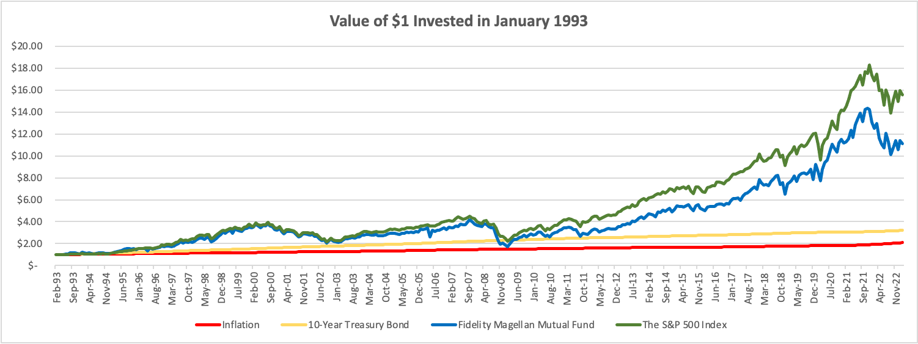
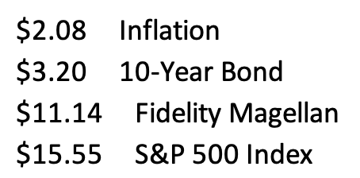

Slide 54
INVESTING
Investing lets COMPOUND INTEREST be your friend.
  With compound interest, your interest earns interest.
  Without actively making decisions, your money can grow exponentially.
  Yes, there is risk – the exponential growth rate could be negative.
  Such risk is greatest if you ‘invest’ over very short periods of time.
  Historically, over the past 100+ years, if you invest for 5+ years, you have benefited from positive exponential growth.
  The average return of a common stock over the past 100 years is 10%.
    The word ’average’ is very important here. But, the good news, we can all achieve ‘average’ returns relatively easily (though they may not be 10% in the future)

Slide 55
INVESTING
Investing lets COMPOUND INTEREST be your friend.
  With compound interest, your interest earns interest.
  Without actively making decisions, your money can grow exponentially.
  Yes, there is risk – the exponential growth rate could be negative.
  Such risk is greatest if you ‘invest’ over very short periods of time.
  Historically, over the past 100+ years, if you invest for 5+ years, you have benefited from positive exponential growth.
  The average return of a common stock over the past 100 years is 10%.
    The word ’average’ is very important here. But, the good news, we can all achieve ‘average’ returns relatively easily (though they may not be 10% in the future)
Not to be too esoteric or philosophical…
But compound interest doesn’t just apply to investing.
Compound interest applies to all aspects of grad school life:
Time Management
Mental Health
Health Management
Writing Skills
Relationships
And…Of course, Money Management

Slide 56
INVESTING
Investing lets COMPOUND INTEREST be your friend.
  With compound interest, your interest earns interest.
  Without actively making decisions, your money can grow exponentially.
  Yes, there is risk – the exponential growth rate could be negative.
  Such risk is greatest if you ‘invest’ over very short periods of time.
  Historically, over the past 100+ years, if you invest for 5+ years, you have benefited from positive exponential growth.
  The average return of a common stock over the past 100 years is 10%.
    The word ’average’ is very important here. But, the good news, we can all achieve ‘average’ returns relatively easily (though they may not be 10% in the future)
And…if we connect this to Debt Management:
Owing Compound Interest can be your biggest financial foe.
Owing interest on interest on interest can be an anchor on your future and can compromise all of your dreams and goals.

Slide 57
Happiness
Long-Term Goals
Short-Term Goals
Financial Needs
Family Needs

Slide 58
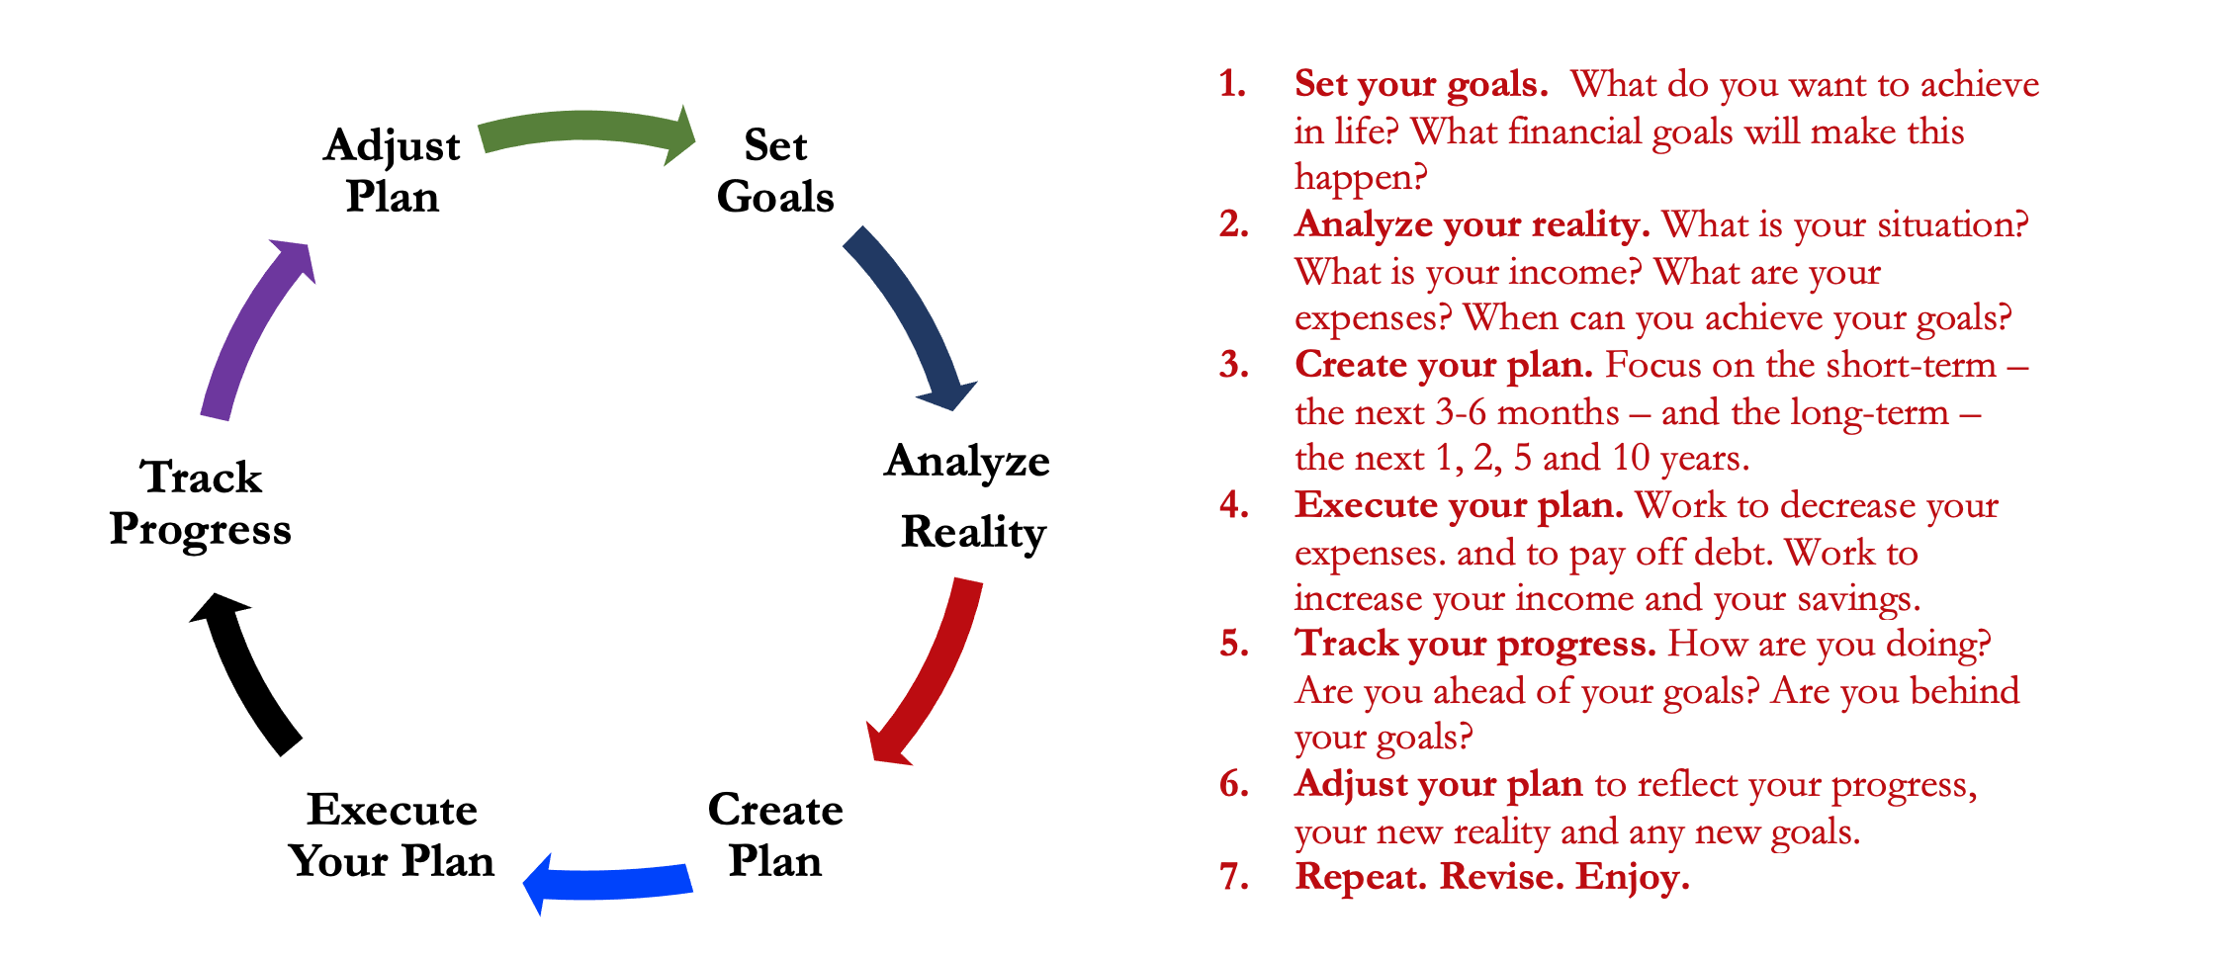
Isn’t this a lot like what you do with your education planning?

Slide 59
Financial Wellness
& Your Values
A goal without a plan is just a dream.
Wealth is largely the result of habit.
The most difficult thing is the decision to act; the rest is mere tenacity.
It takes as much energy to plan as it does to wish.
You cannot escape the responsibility of tomorrow by avoiding it today.

Slide 60
Don’t wait around for other people to be happy for you.
Any happiness you get,
You’ve got to make yourself.
~ Alice Walker, poet & novelist
A goal without a plan is just a dream.
Wealth is largely the result of habit.
The most difficult thing is the decision to act; the rest is mere tenacity.
It takes as much energy to plan as it does to wish.
You cannot escape the responsibility of tomorrow by avoiding it today.

Slide 62
brian.bolton@louisiana.edu http//:business.louisiana.edu/financeispersonal

