Slide 1
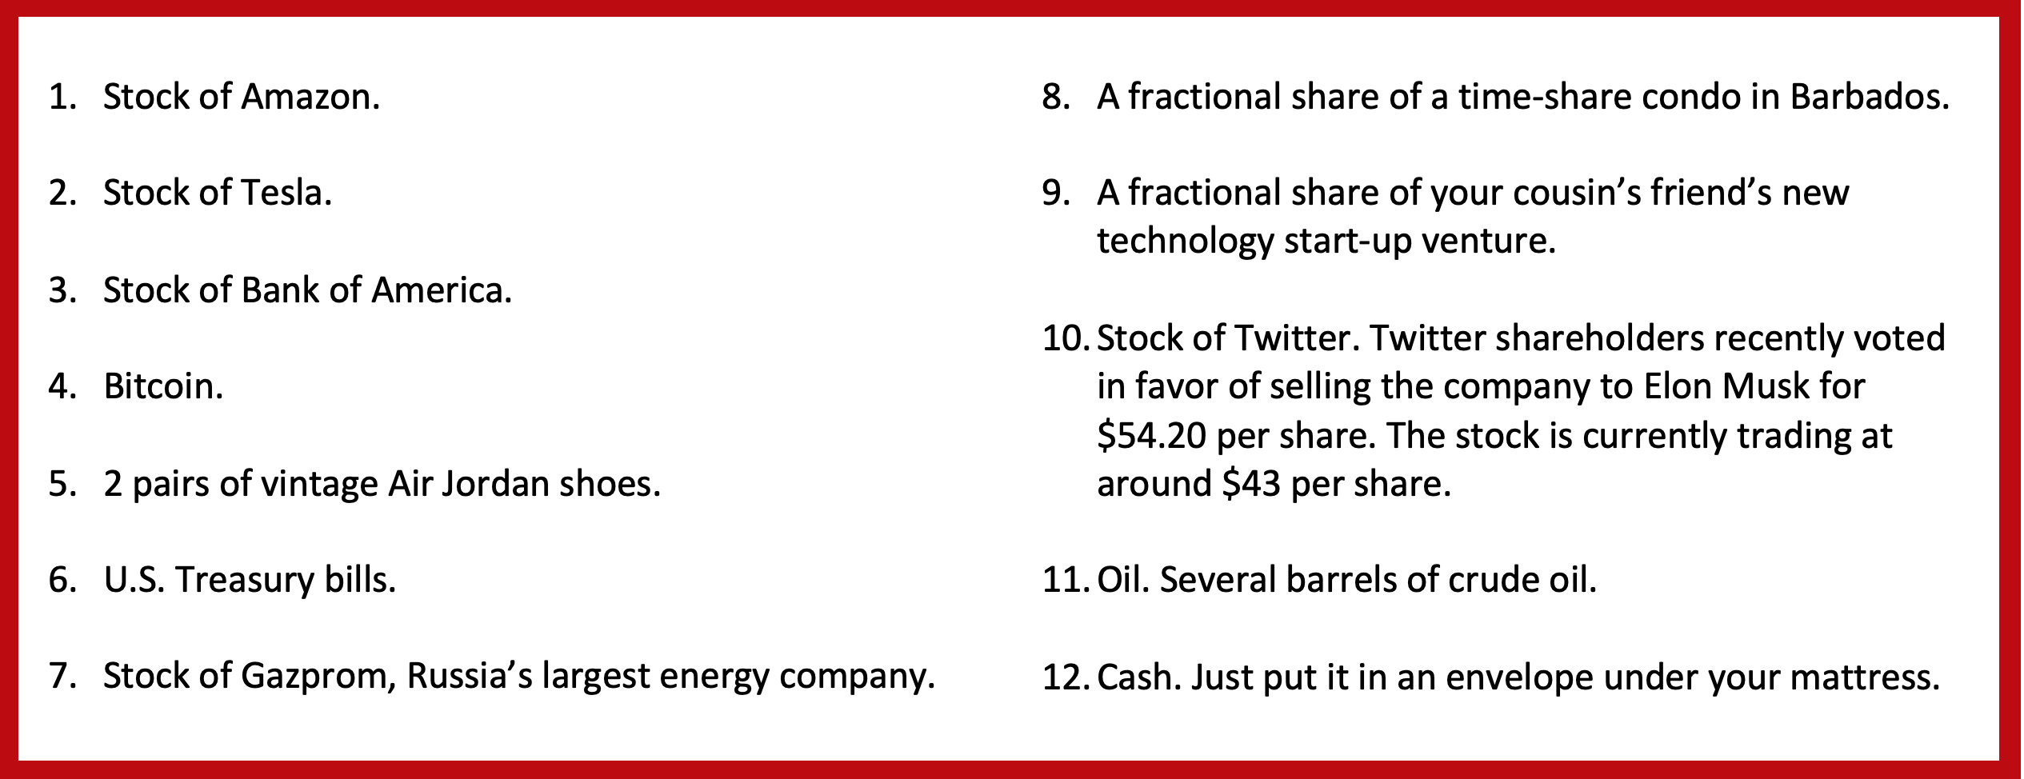
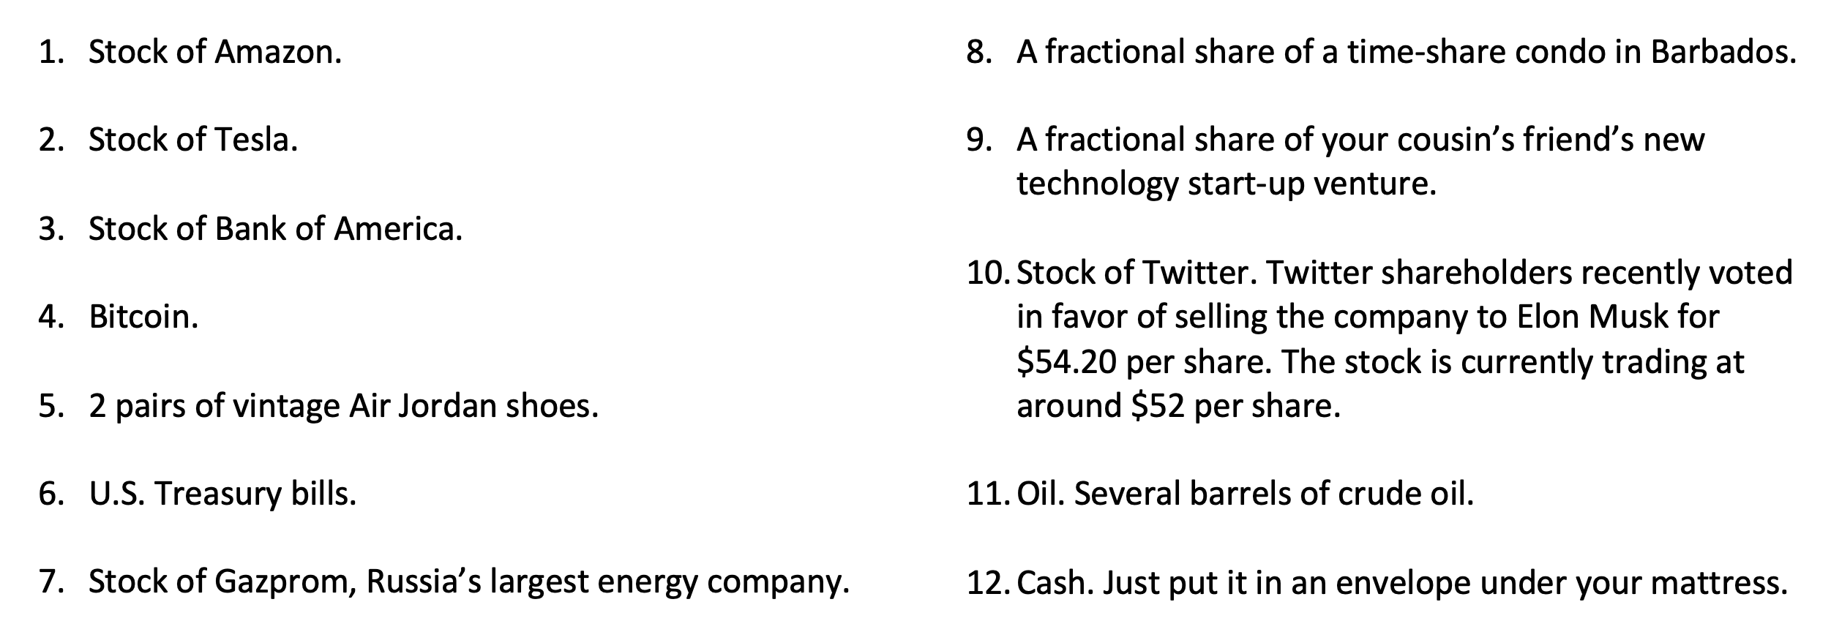
Imagine that you won $1,000 playing a scratch-off lottery ticket. Congratulations!
And now you want to invest this $1,000 to work towards achieving your personal goals.
Which of the following are you going to invest in?
Please select up to 3 of these options and discuss your selection with a neighbor.

Slide 2


MONEY MATTERS
2022-2023 SESSION #3
October 5, 2022
DESIGNING AN INVESTING ROADMAP
Let’s create your own personal Investment Policy Statement for your goals.
Manage Your Money Today
Maximize Your Money in the Future

Slide 3
Happiness
Long-Term Goals
Short-Term Goals
Financial Needs
Family Needs

Slide 4
MONEY MATTERS SERIES: FALL 2022
SEPTEMBER
7
BUDGETING:
GOALS, VALUES & HACKS
OCTOBER
27
DEBT MANGEMENT: PAYING OFF YOUR MOST COSTLY DEBT
NOVEMBER
29
CAREER PLANNING: GETTING YOUR FIRST JOB OFFER
OCTOBER
5
INVESTING:
CREATING YOUR OWN INVESTING ROADMAP
NOVEMBER 10
INVESTING & TAXES:
OPENING YOUR OWN ROTH IRA

Slide 5
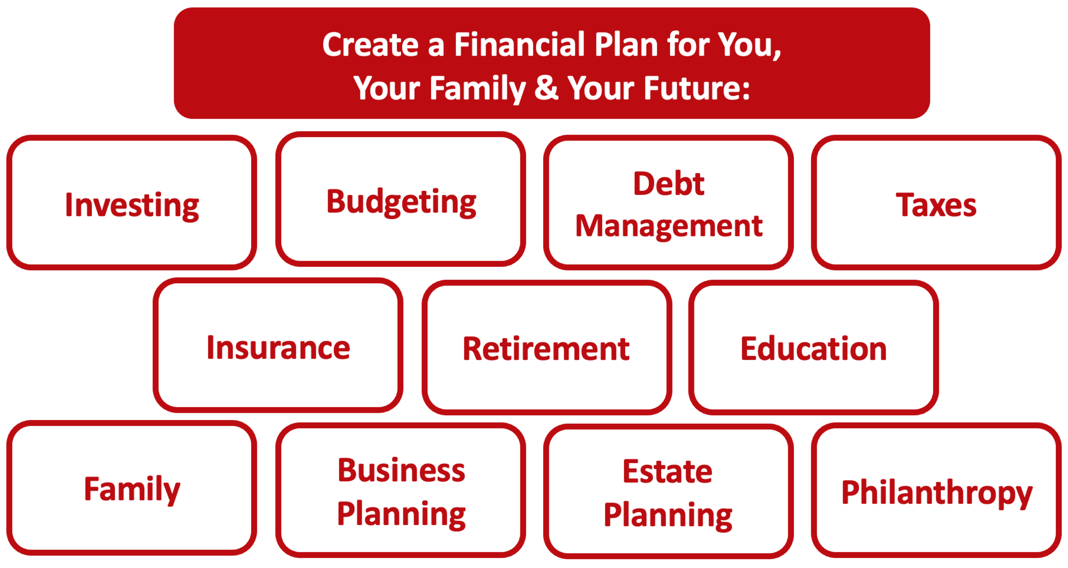

Slide 6
Owning Your Financial Future
YOUR VALUES
YOUR GOALS
Education
Career
Family
FINANCIAL STRATEGIES
Investing
Income & Expense Management
Debt Management
Taxes, Insurance & Other

Slide 7
Owning Your Financial Future
YOUR VALUES
YOUR GOALS
Education
Career
Family
FINANCIAL STRATEGIES
Investing
Income & Expense Management
Debt Management
Taxes, Insurance & Other

Slide 8
Making Financial Planning a Priority
EDUCATION STRATEGIES
GRAD SCHOOL STRATEGIES
Identify Your Resources
Identify Your
Priorities & Goals
Do Your Planning
Monitor & Modify Your Progress & Plan

Slide 9
Making Financial Planning a Priority
FINANCIAL STRATEGIES
EDUCATION STRATEGIES
BUDGETING
STRATEGIES
GRAD SCHOOL STRATEGIES
Identify Your
Income & Expenses
Identify Your Resources
Identify Your
Priorities & Goals
Identify Your
Priorities & Goals
Do Your Planning
Do Your Planning
Monitor & Modify Budgeting Activities
Monitor & Modify Your Progress & Plan

Slide 10
Making Financial Planning a Priority
FINANCIAL STRATEGIES
YOU,
as grad students, are better wired and equipped to make long-term plans – education, career, financial & otherwise – than 99% of humanity.
Be confident.
Be intentional.
Be diligent.
Be awesome.
EDUCATION STRATEGIES
BUDGETING
STRATEGIES
GRAD SCHOOL STRATEGIES
Identify Your
Income & Expenses
Identify Your Resources
Identify Your
Priorities & Goals
Identify Your
Priorities & Goals
Do Your Planning
Do Your Planning
Monitor & Modify Budgeting Activities
Monitor & Modify Your Progress & Plan

Slide 11
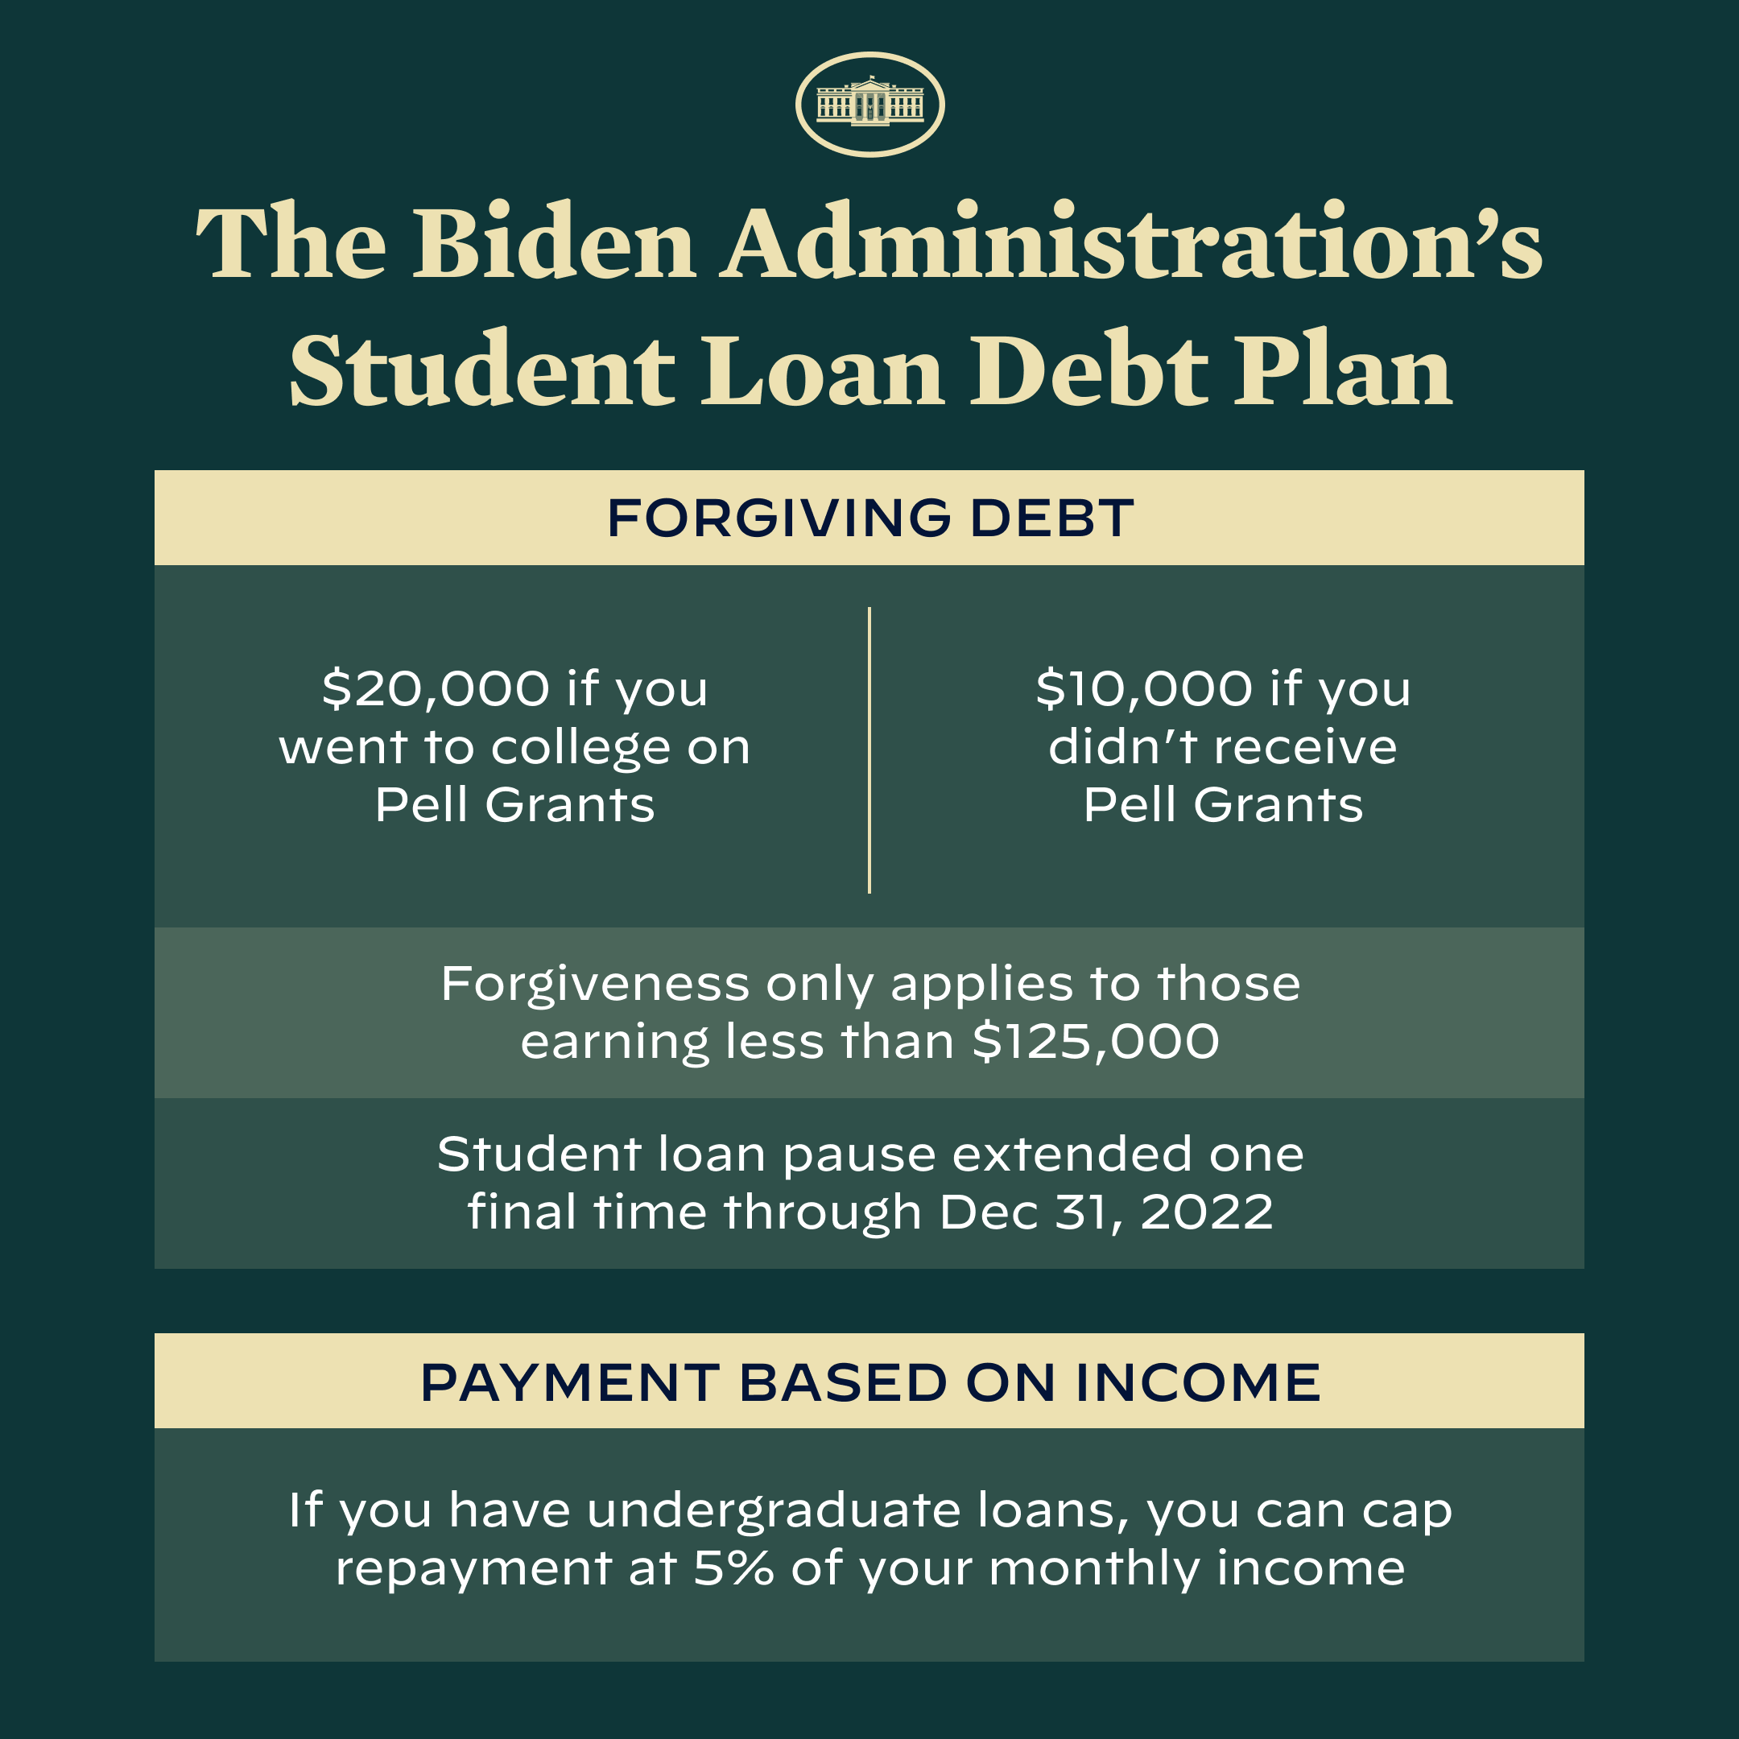

Slide 12
STUDENT LOAN FORGIVENESS UPDATE
No structural updates since program announced in August
Key Dates:
  Application portal to apply for loan forgiveness should open anytime
    Application portal to apply for loan forgiveness is expected to close December 31, 2022
  Opportunity to enroll in enhanced Public Service Loan Forgiveness program closes October 31, 2022
  Student loan interest accrual and payment pause ends December 31, 2022
    And…payments resume in January 2023 for many borrowers (but probably not for those of you who are currently full-time students)

Slide 13
STUDENT LOAN FORGIVENESS UPDATE
No structural updates since program announced in August
What you can do now:
  Subscribe to Department of Education updates at www.studentaid.gov
  Check your student loan account at www.studentaid.gov to confirm status, balance, eligibility and servicer
  Contact your servicer to confirm status, eligibility and process
  Get your 2020/2021 income and employment information ready to provide for either PSLF or loan forgiveness
Once the loan forgiveness window opens, it should be a quick-and-easy process to complete your application. But you certainly do not want to let this opportunity lapse.

Slide 14
TODAY THE NEXT 6 MONTHS THE NEXT 12 MONTHS 2 YEARS AFTER GRADUATION 3 YEARS AFTER GRADUATION
ONCE EVERY SEMESTER:
TRACK EVERY PENNY THAT YOU SPEND & TRACK EVERY PENNY THAT YOU EARN
IN THE NEXT 3 MONTHS:
IDENTIFY WAYS TO DECREASE YOUR DISCRETIONARY SPENDING BY 25%
IN THE NEXT 6 MONTHS:
MAKE A PLAN TO MANAGE – AND PAY OFF – YOUR DEBT
IN THE NEXT 6-12 MONTHS:
OPEN MULTIPLE SAVINGS ACCOUNTS, 1 FOR EACH GOAL
IN THE NEXT 12 MONTHS, OPEN AN IRA OR ROTH IRA
WITHIN 2 YEARS OF GRADUATION:
HAVE AN “EMERGENCY FUND” ACCOUNT, WITH 3-6 MONTHS OF NON-DISCRETIONARY EXPENSES
WITHIN 3 YEARS OF GRADUATION:
ELIMINATE ALL OF YOUR BAD DEBT.

Slide 15
Financial Wellness
If you don’t know where you’ve come from, you can’t know where you’re going.
- Maya Angelou

Slide 16
Your INVESTMENT POLICY STATEMENT
An Investment Policy Statement is your personal investing roadmap and strategy.
It includes a holistic perspective on what your investing goals are and what your investing preferences are.
  It does not include specific details, like your income or stocks you own or want to buy. It’s focused on big-picture strategy, not on execution.
It is about you, your family and your preference.
We want you to be able to use this today and after you graduate and your income (hopefully) increases.
We want you to be able to share this with your family or with a financial advisor who might be able to help you execute your strategy.
Even if you do not have the excess money to invest today, thinking about these issues today can help you be prepared for making such decisions when you are capable.

Slide 17
Your INVESTMENT POLICY STATEMENT
An Investment Policy Statement is your personal investing roadmap and strategy.
It includes the following information:
  Some brief personal information, about you and your situation
  Your risk tolerance
  Your investing goals
  Your tax, liquidity and income preferences
  How you want to handle your investments
  How you want to allocate your investments across different asset classes (stocks vs. bonds)
  Any other personal or situational issues that may impact your ability to invest or your investment strategy

Slide 18
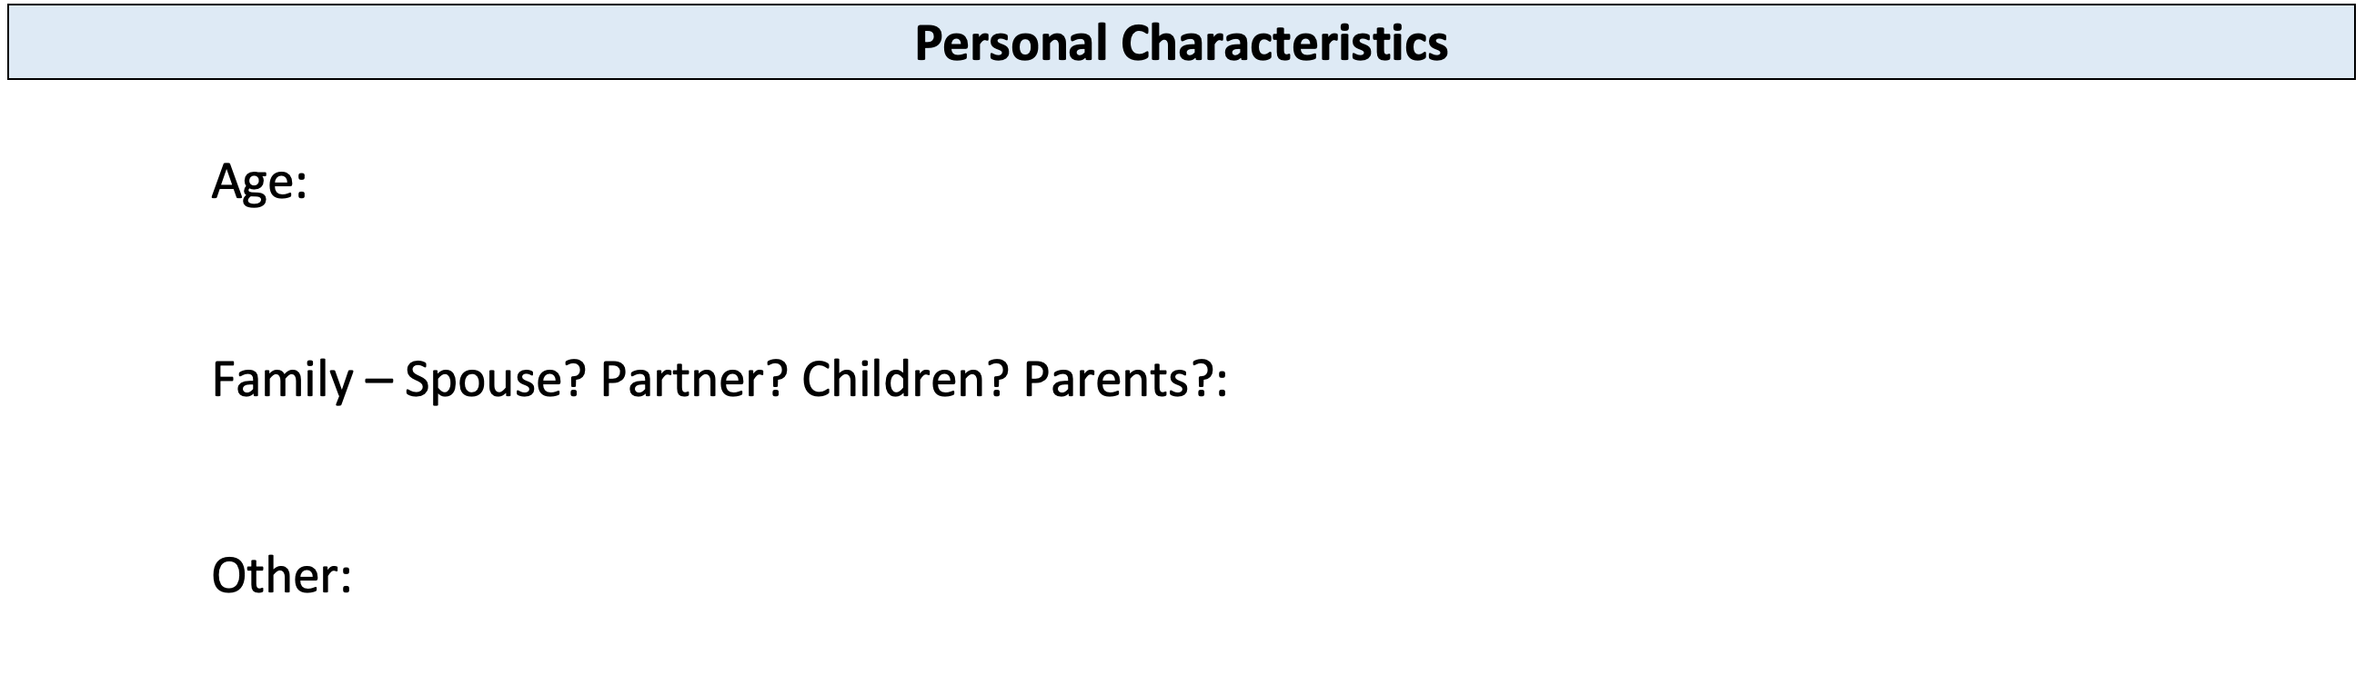
Your INVESTMENT POLICY STATEMENT

Slide 19
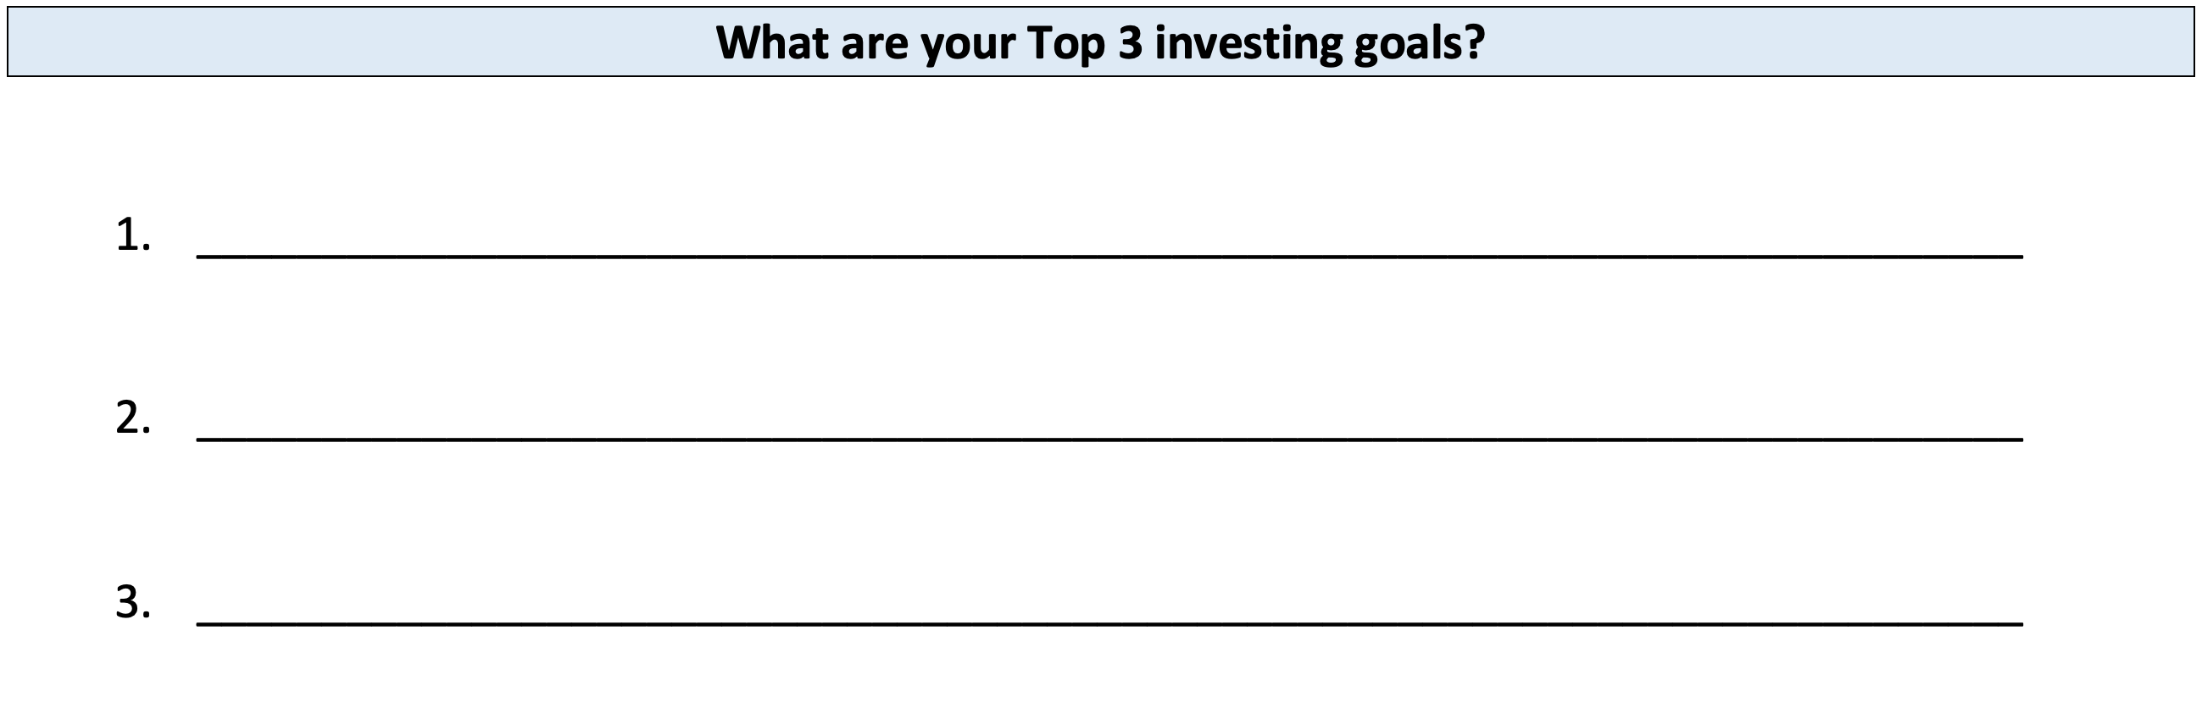
Your INVESTMENT POLICY STATEMENT

Slide 20
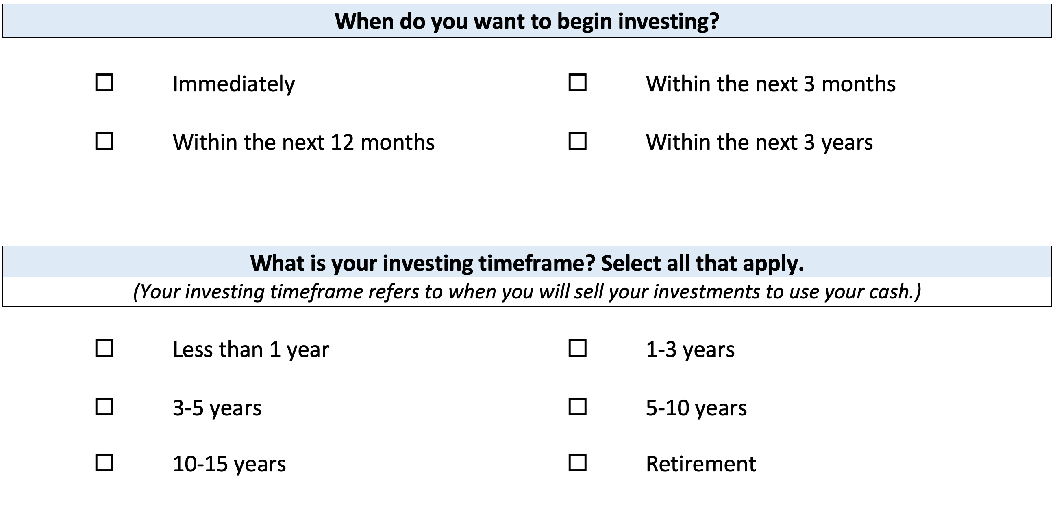
Your INVESTMENT POLICY STATEMENT

Slide 21
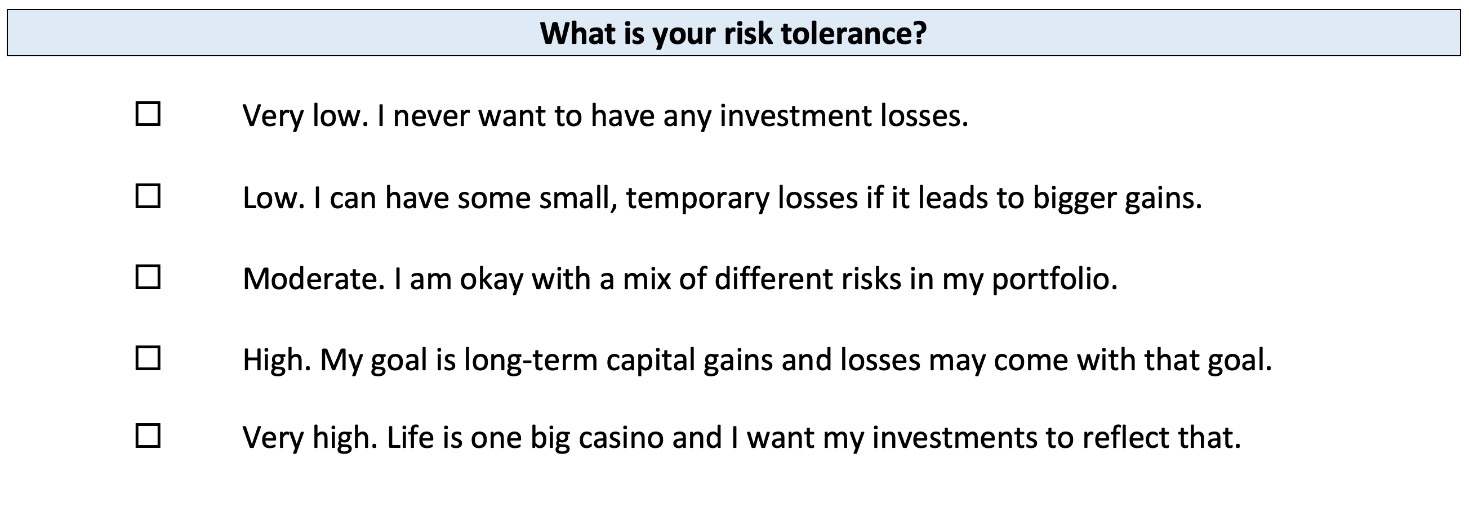
Your INVESTMENT POLICY STATEMENT

Slide 22
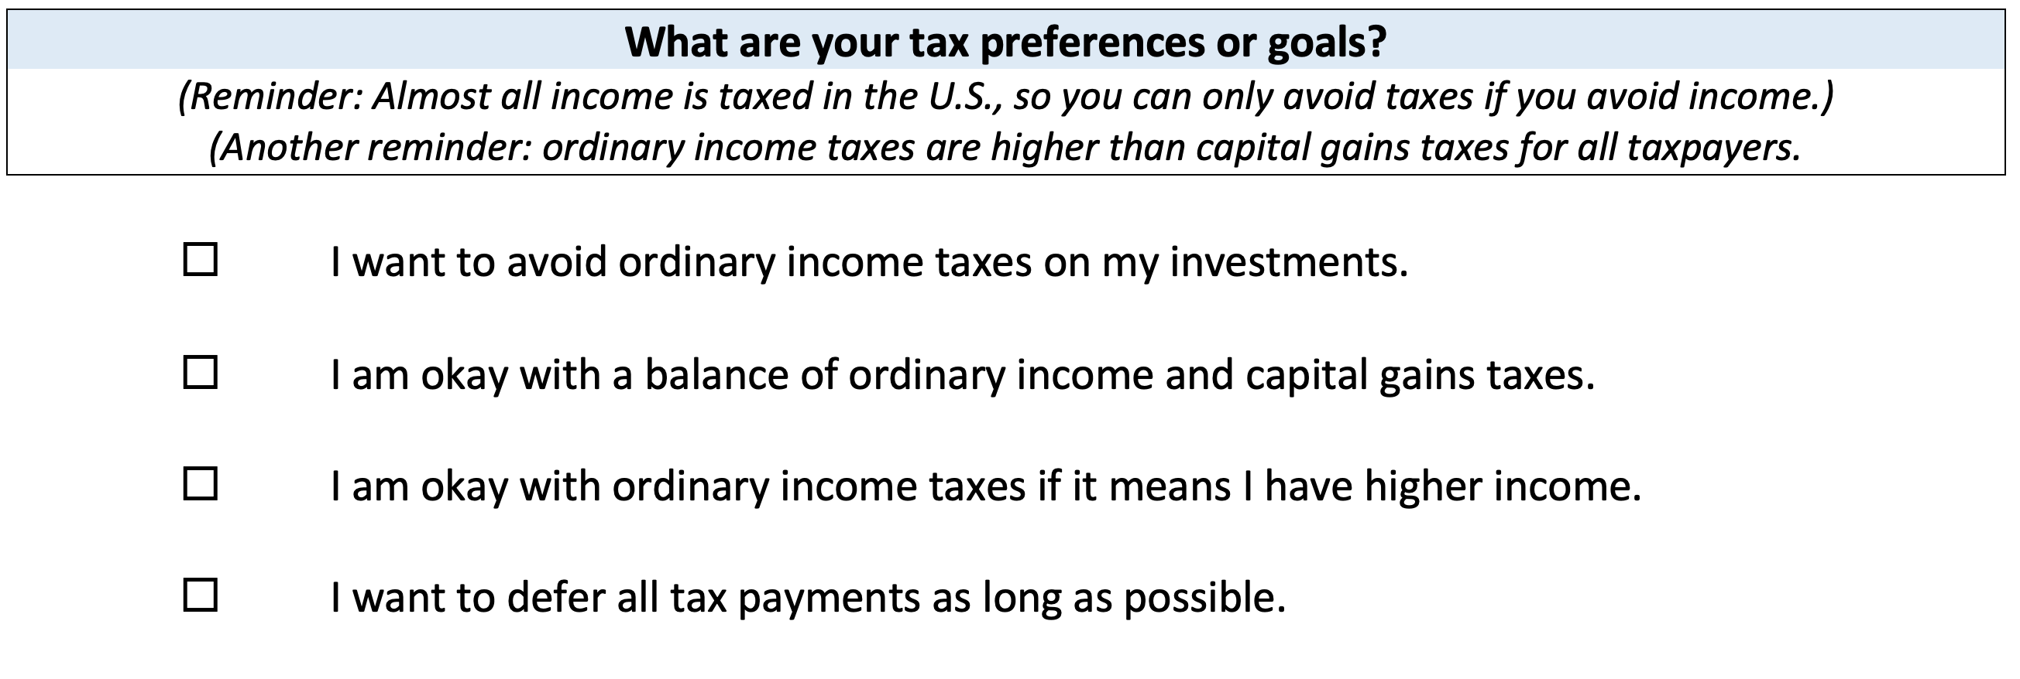
Your INVESTMENT POLICY STATEMENT

Slide 23
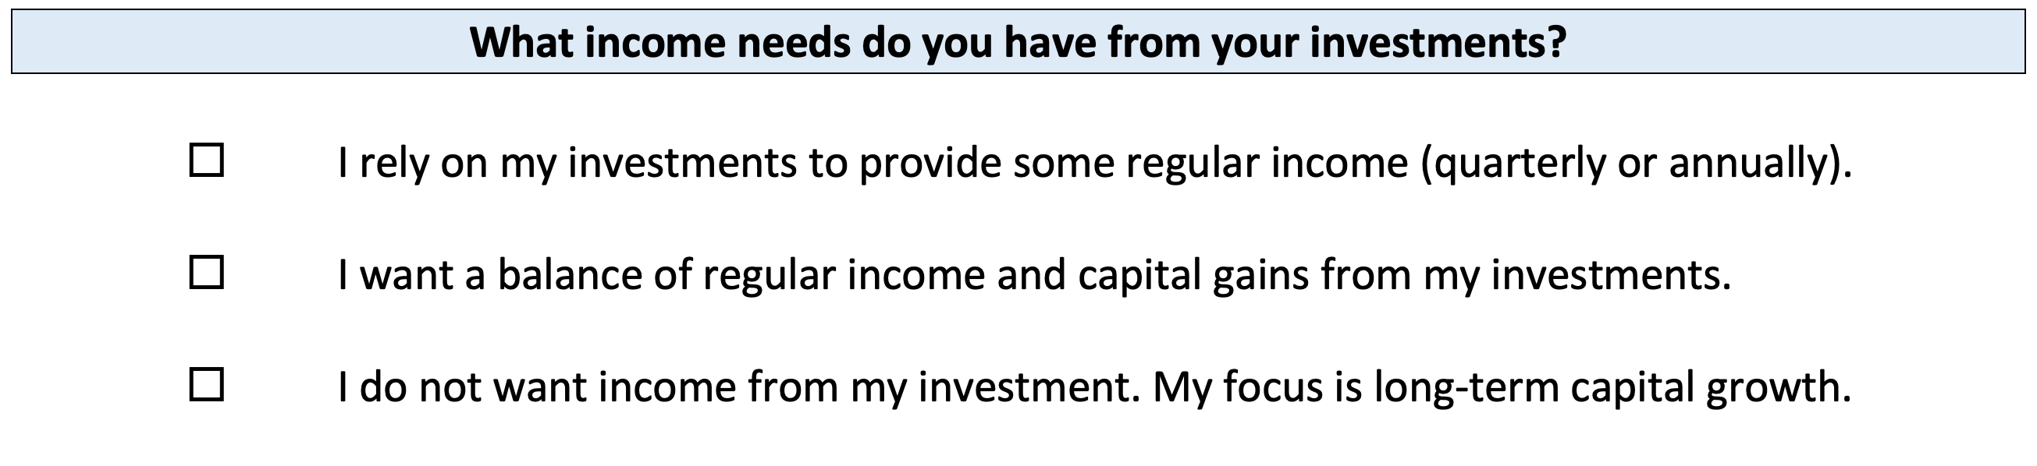
Your INVESTMENT POLICY STATEMENT

Slide 24
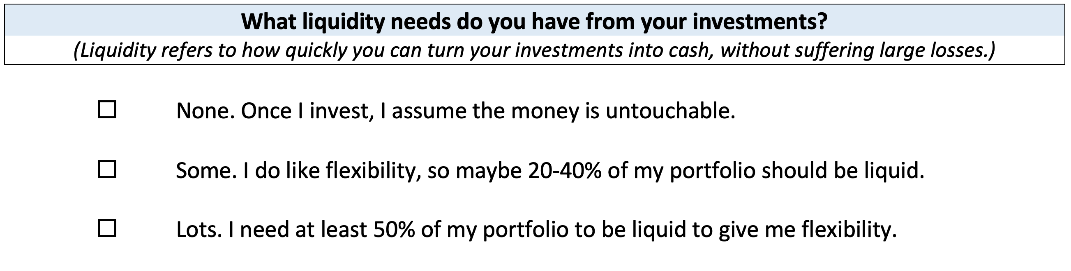
Your INVESTMENT POLICY STATEMENT

Slide 25
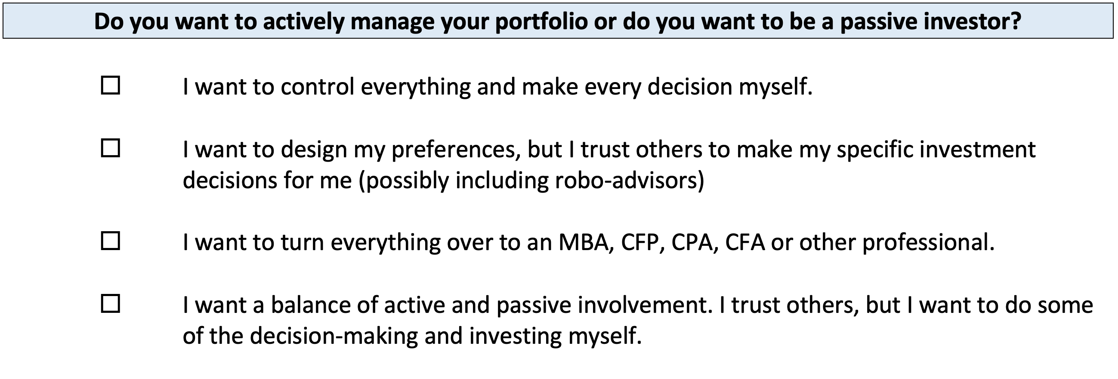
Your INVESTMENT POLICY STATEMENT

Slide 26
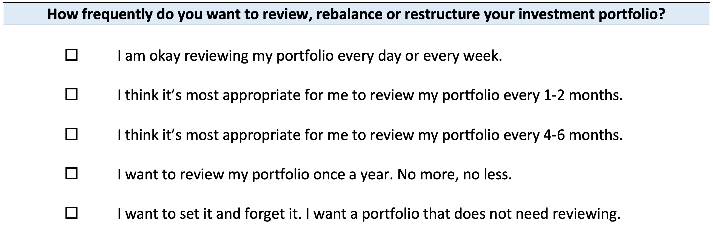
Your INVESTMENT POLICY STATEMENT

Slide 27
Your INVESTMENT POLICY STATEMENT
ASSET ALLOCATION
We know that the asset classes or categories you choose are responsible for 90% of portfolio returns, while specific security selection within classes is responsible for 10% of returns.
This means that how you decide to allocate your investments is the primary driver of your investment returns.
  Think about which geographic regions you want to invest in.
  Think about how to distribute your investment across asset categories.
    Stocks, bonds, currency, real estate, crypto, value stocks, growth stocks,
    large companies, small companies, oil, gold…

Slide 28
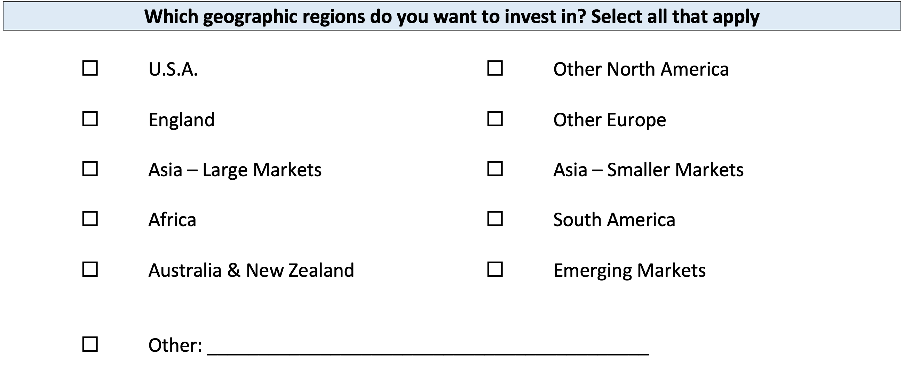
Your INVESTMENT POLICY STATEMENT

Slide 29
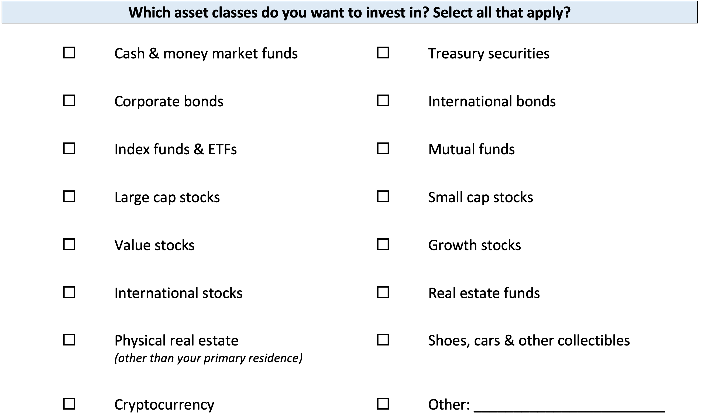
Your INVESTMENT POLICY STATEMENT

Slide 30
Your INVESTMENT POLICY STATEMENT

Slide 31
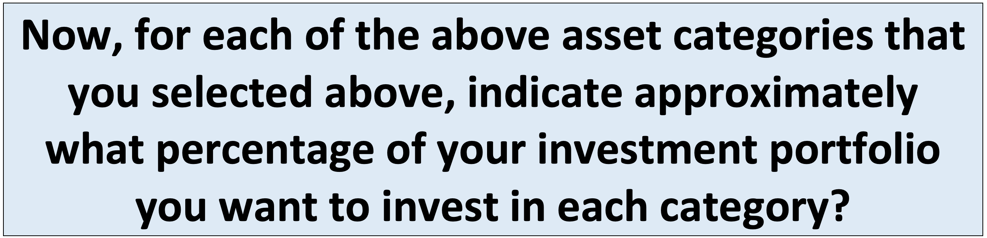
Your INVESTMENT POLICY STATEMENT

Slide 32
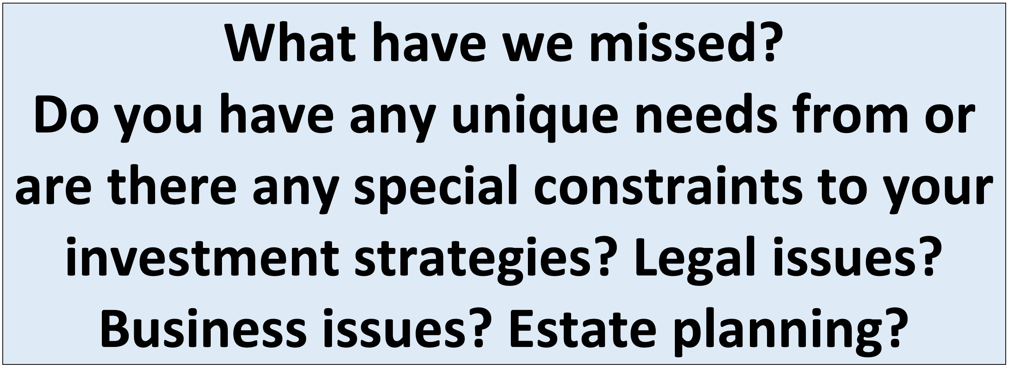
Your INVESTMENT POLICY STATEMENT

Slide 33
Your INVESTMENT POLICY STATEMENT
Complete this worksheet today.
Work on this with your spouse or family.
Revise and update it after you graduate.
Continue refining it throughout your investing life…make it about you and your goals.

Slide 34
I DO NOT GIVE INVESTMENT ADVICE
But here are some investment issues to think about:
Do you want to pick individual stocks (or other securities) and monitor them regularly?
  This can help you feel more control, more connection and more personal interest in your investments.
  Advantages: Potential for big gains, maybe a personal connection to the companies, you feel more engaged with the process.
  Disadvantages: Potential for big losses, requires more time and energy, transaction costs (trading, taxes) can add up, there are 1000s to choose from, potential loss of sleep and hair.

Slide 35
I DO NOT GIVE INVESTMENT ADVICE
But here are some investment issues to think about:
Or, would you be content investing in mutual funds and/or market indexes that pool dozens or hundreds of stocks?
  Advantages: Potential for moderate gains, lower risk (through diversification), lower trading and tax costs, you can narrow down the selection pretty quickly, less loss of sleep and hair
  Disadvantages: Lots of singles and doubles but no home runs, no emotional connection to your investments, susceptible to big market downturns (but not necessarily more than individual stocks)

Slide 36
I DO NOT GIVE INVESTMENT ADVICE
If you want to invest in individual stocks, I cannot help you.
But if you are interested in market indexes, here are some ideas:
  SPY – The S&P 500 index. 500 of the largest U.S. firms, from all industries.
  SPYD – The same as above, with a focus on those companies that pay regular dividends out to investors from their earnings. You will get more income, but possibly lower long-term capital gains.
  IWM – The Russell 2000. 2000 smaller U.S. firms (the 2000 firms after the 1000 largest firms). More volatility, possibly higher returns.
  EFA – Index of non-US firms (Europe, Far East, Australasia). Big firms.
  EEM – Index of non-US, emerging market stocks. Bigger firms in developing countries. More risk than any of the above.
  GBTC – A Bitcoin index. Invest in Bitcoin without mining or owning. Big Risk.

Slide 37
Investing – How Do You Do It?
When you’re just getting started with investing, there are a few approaches you can take:
  Start with a small amount of money – whether that’s $20 or $2,000 – and just go for it. Pick a few investments, track them regularly and be prepared to buy more or sell more should you feel comfortable doing either.

Slide 38
Investing – How Do You Do It?
When you’re just getting started with investing, there are a few approaches you can take:
  Start with a small amount of money – whether that’s $20 or $2,000 – and just go for it. Pick a few investments, track them regularly and be prepared to buy more or sell more should you feel comfortable doing either.
  Determine how much you have to invest.
    Put ½ of that into an index fund or a specific mutual fund. This will provide some security, generally with less or moderate risk.
    Put the other ½ into individual stocks or securities that intrigue you. If you’re interested in the companies, you might be more likely to follow them as investments.
    This half-half approach will help you figure out what kind of investor you are. In 1-2 years, you might gravitate more to either of the approaches that interest you more.

Slide 39
Investing – How Do You Do It?
When you’re just getting started with investing, there are a few approaches you can take:
  Start with a small amount of money – whether that’s $20 or $2,000 – and just go for it. Pick a few investments, track them regularly and be prepared to buy more or sell more should you feel comfortable doing either.
  Determine how much you have to invest.
    Put ½ of that into an index fund or a specific mutual fund. This will provide some security, generally with less or moderate risk.
    Put the other ½ into individual stocks or securities that intrigue you. If you’re interested in the companies, you might be more likely to follow them as investments.
    This half-half approach will help you figure out what kind of investor you are. In 1-2 years, you might gravitate more to either of the approaches that interest you more.
  Talk to a financial advisor. Note that they generally do not (initially) tell you which specific investments to make, but they will work talk through your options with you and help you better understand what you’re getting into.
    They will ask you 2 questions – what are your goals and what is your risk tolerance – and then work with you to find the investments that best align with your answers to these questions.

Slide 40
Long-Term Investment Planning
YOUR VALUES
YOUR GOALS
FINANCIAL STRATEGIES
INVESTMENT STRATEGIES
Identify Your Risk Tolerance
Identify Your Time Horizons
Select Investments
Monitor & Modify Investments

Slide 41
Long-Term Investment Planning
FINANCIAL STRATEGIES
EDUCATION STRATEGIES
INVESTMENT STRATEGIES
GRAD SCHOOL STRATEGIES
Identify Your Risk Tolerance
Identify Your Risk Tolerance
Identify Your Time Horizons
Identify Your Time Horizons
Select Investments
Select Your Field, Program, Specialization, Thesis
Monitor & Modify Investments
Monitor & Modify Your Progress & Plan

Slide 42

Isn’t this a lot like what you do with your education planning?

Slide 43
Question of the Day
Why are you in graduate school?
This is the biggest investment you’ve ever made. You are giving up several years, thousands of dollars and enormous effort & energy.
What return are you getting from this investment?

Slide 44
Financial Wellness
A goal without a plan is just a dream.
Wealth is largely the result of habit.
The most difficult thing is the decision to act; the rest is mere tenacity.
It takes as much energy to plan as it does to wish.
You cannot escape the responsibility of tomorrow by avoiding it today.

Slide 45
Don’t wait around for other people to be happy for you.
Any happiness you get,
You’ve got to make yourself.
~ Alice Walker, poet & novelist
A goal without a plan is just a dream.
Wealth is largely the result of habit.
The most difficult thing is the decision to act; the rest is mere tenacity.
It takes as much energy to plan as it does to wish.
You cannot escape the responsibility of tomorrow by avoiding it today.

Slide 46
MONEY MATTERS SERIES: FALL 2022
SEPTEMBER
7
BUDGETING:
GOALS, VALUES & HACKS
OCTOBER
27
DEBT MANGEMENT: PAYING OFF YOUR MOST COSTLY DEBT
NOVEMBER
29
CAREER PLANNING: GETTING YOUR FIRST JOB OFFER
OCTOBER
5
INVESTING:
CREATING YOUR OWN INVESTING ROADMAP
NOVEMBER 10
INVESTING & TAXES:
OPENING YOUR OWN ROTH IRA

Slide 47

brian.bolton@louisiana.edu http//:business.louisiana.edu/financeispersonal

Slide 48

gradschool@louisiana.edu

