Slide 1
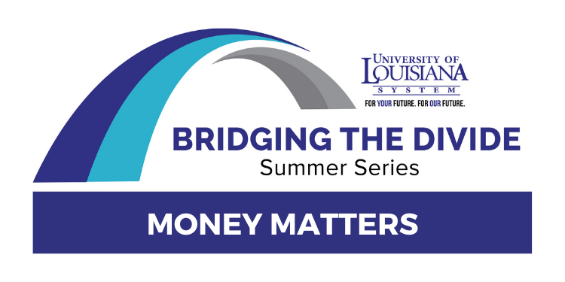
MONEY MATTERS:
UL SYSTEM FINANCIAL WELLNESS SERIES
Federal Student Loan Forgiveness Information Session for UL System Employees
October 24, 2022

Slide 2
Brian Bolton Professor of Finance brian.bolton@louisiana.edu http://business.louisiana.edu/financeispersonal

Slide 3
Happiness
Long-Term Goals
Short-Term Goals
Financial Needs
Family Needs

Slide 4
Financial Wellness
A goal without a plan is just a dream.
Wealth is largely the result of habit.
The most difficult thing is the decision to act; the rest is mere tenacity.
It takes as much energy to plan as it does to wish.
You cannot escape the responsibility of tomorrow by avoiding it today.

Slide 7
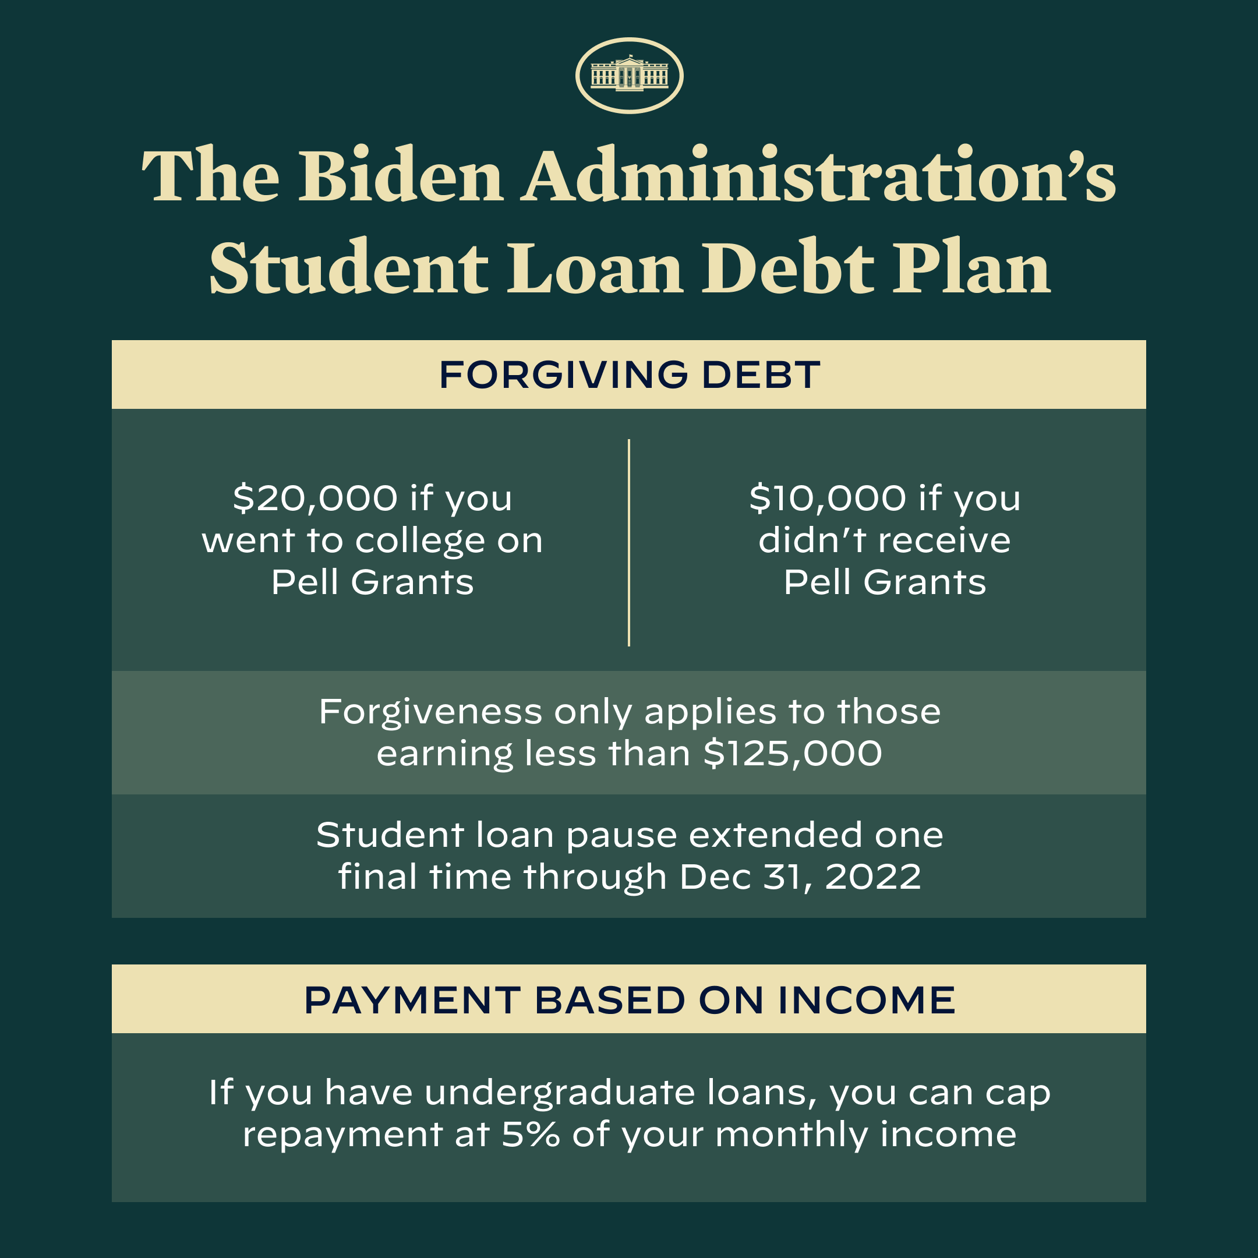

Slide 8
WHY WE ARE HERE:
We are NOT here to discuss Student Loan Forgiveness as a policy.

Slide 9
WHY WE ARE HERE:
We are here to discuss how this policy is likely to affect YOU, as UL System employees, students, former students, advisors, parents, faculty…

Slide 10
WHY WE ARE HERE:
We are here to help you understand the proposed policy changes and how it might affect your financial planning and your financial wellness in both the short-term and possibly over the long-term.

Slide 11
Let’s assume that the policy proposed on August 24th will become official policy….but…

Slide 12
“Application is open, but debt discharge is paused.
As a result of a court order, we are temporarily blocked from processing debt discharges. We encourage you to apply if you are eligible. We will continue to review applications. We will quickly process discharges when we are able to do so and you will not need to reapply.”
Notice on Federal Student Aid website, October 22, 2022

Slide 13
The original proposal really contains 4 components:
Debt Relief
Payment Pause Ending
Public Service Loan Forgiveness (PSLF) One-Time Opportunity for Enhanced Enrollment
Income Driven Repayment (IDR) Enhanced Structure

Slide 14
The original proposal really contains 4 components:
Debt Relief
Payment Pause Ending
Public Service Loan Forgiveness (PSLF) One-Time Opportunity for Enhanced Enrollment
Income Driven Repayment (IDR) Enhanced Structure
The current court order only puts a pause on debt relief. All other components remain in effect as announced.

Slide 15
#1 $10k-$20k of DEBT RELIEF

Slide 16
#1 $10k-$20k of DEBT RELIEF
This is the headline feature of the proposal.
If you do not know if you received a Pell Grant, you should be able to confirm this through your FAFSA account at studentaid.gov or with your servicer.
The Department of Education knows if you received a Pell, you might like to know just to be sure.
Once you complete the forgiveness application, your outstanding balance should be reduced by $10,000 or $20,000 within 4-6 weeks.
You will NOT receive cash or a check. You will only see the change effected on your loan balance online.
You have until December 31, 2023 to apply.

Slide 17
#1 $10k-$20k of DEBT RELIEF
If you have made payments and reduced your outstanding loan balance since the pause began in March 2020, you are eligible to get that money refunded.
Contact your servicer to request your refund.
The refund will effectively increase your loan balance back to where it was in March 2020.
Get your refund before applying for loan forgiveness because your eligible loan forgiveness is limited to the outstanding loan balance, so you want that to be as high as possible. (Note: studentaid.gov is saying that your payments will be refunded automatically. But, to be safe, it might not hurt if you request it directly.)

Slide 18
#1 $10k-$20k of DEBT RELIEF
If you have multiple federal loans with outstanding debt, studentaid.gov is saying that the Department of Education will determine which loans receive the forgiveness
The highest priority will go to loans that have defaulted and/or have the highest interest rates (to benefit you the most).
Neither you nor your service have the ability to request a different priority or order of relief, so hopefully the DoE does right by you.

Slide 19
#1 $10k-$20k of DEBT RELIEF
WHAT ARE THE TAX IMPLICATIONS WHEN YOUR DEBT IS FORGIVEN?
NONE…at the federal level.
This exclusion was part of the 2021 American Rescue Plan (from 2021-2025).
NONE….at the state level (probably)
As of now, Louisiana is not expected to impose state income taxes on forgiven student loan debt.
We think there are 13 states where it will be taxed…but Louisiana is not one of them.
Confirm this before you file your 2022 or 2023 state income taxes.

Slide 20
#1 DEBT RELIEF: WHO IS ELIGIBLE?
Forgiveness is only available for loans held by the U.S. Department of Education (Federal Loans, not private loans).
You are probably NOT eligible for student loan forgiveness if…
You obtained your loan from a private lender, not the DoE.
You refinanced your federal loan into a private loan.
You consolidated or combined federal loans and private loans into a single loan repayment package.
You have a FFEL or Perkins loan that was moved from federal to private
A federal loan can be converted into a private loan, but a private loan cannot be converted into a federal loan.

Slide 21
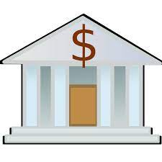
#1 DEBT RELIEF: WHO IS ELIGIBLE?
Forgiveness is only available for loans held by the U.S. Department of Education (Federal Loans, not private loans).
YOU
YOUR COLLEGE
YOUR LOAN SERVICER
MAYBE A BANK
MAYBE SOME INVESTORS
U.S. DEPARTMEMT OF EDUCATION

Slide 22
#1 DEBT RELIEF: WHO IS ELIGIBLE?
Forgiveness is only available for loans held by the U.S. Department of Education (Federal Loans, not private loans).
Forgiveness is only available if annual income is less than $125,000 for individuals or less than $250,000 married couples (filing jointly) or for heads of households in either 2020 or 2021.
You do not need to provide income information, you just need to confirm that your income was below the limit levels in 2020 or 2021.
You should be eligible regardless of when you file the application. The relief window is expected to close on December 31, 2023.

Slide 23
#1 DO YOU NEED TO FILE ANYTHING?
https://studentaid.gov/debt-relief/application
The application form is now available. It is short and simple.
Even though debt relief is paused, the system is still processing applications.
The Department of Education has loan balance, Pell grant history and income information for some people….but it does not have income information for everyone.
These people will receive forgiveness automatically, without filing.
But most of you do not know if you are one of these people.
So, complete the application as soon as you can just to be sure.

Slide 24
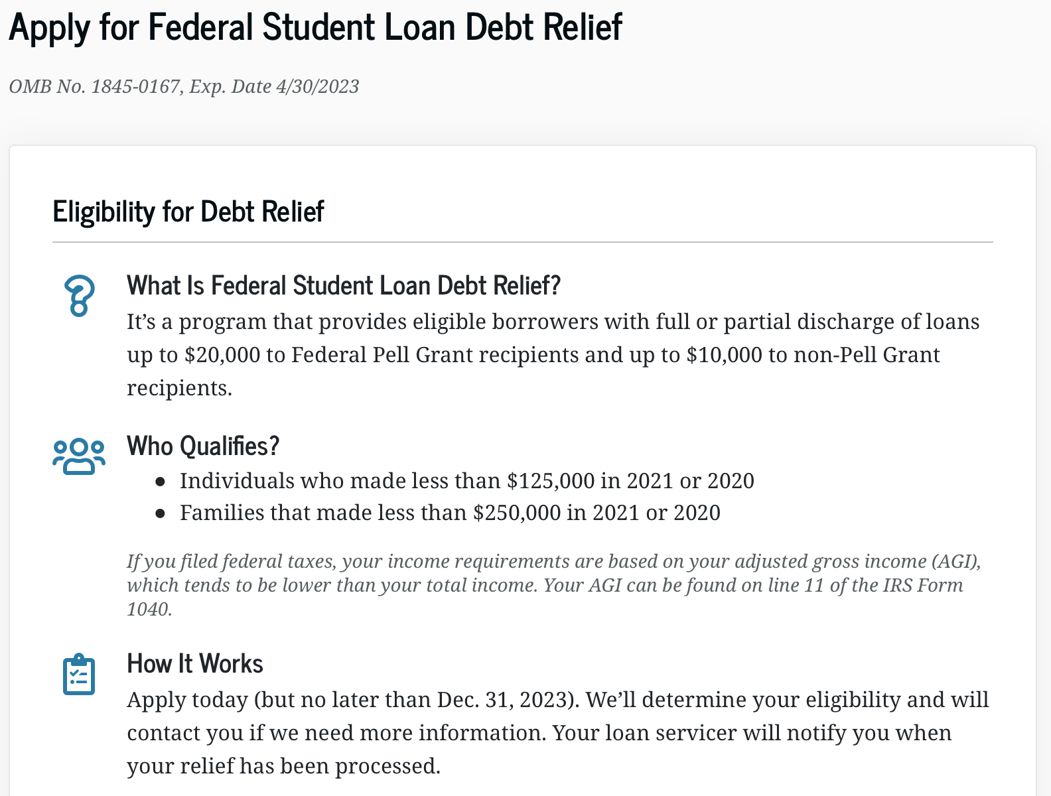
#1 DO YOU NEED TO FILE ANYTHING?

Slide 25
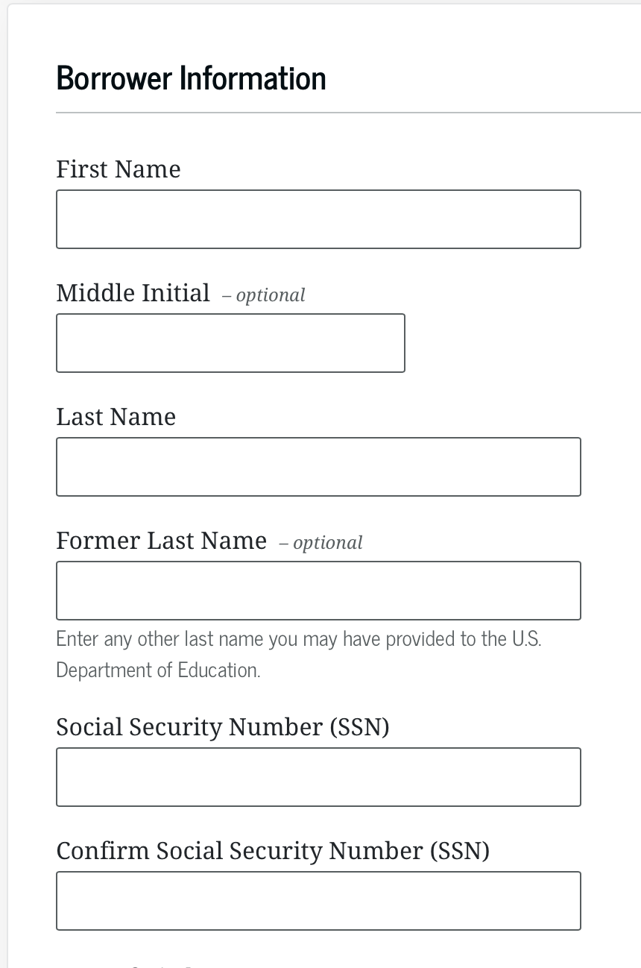
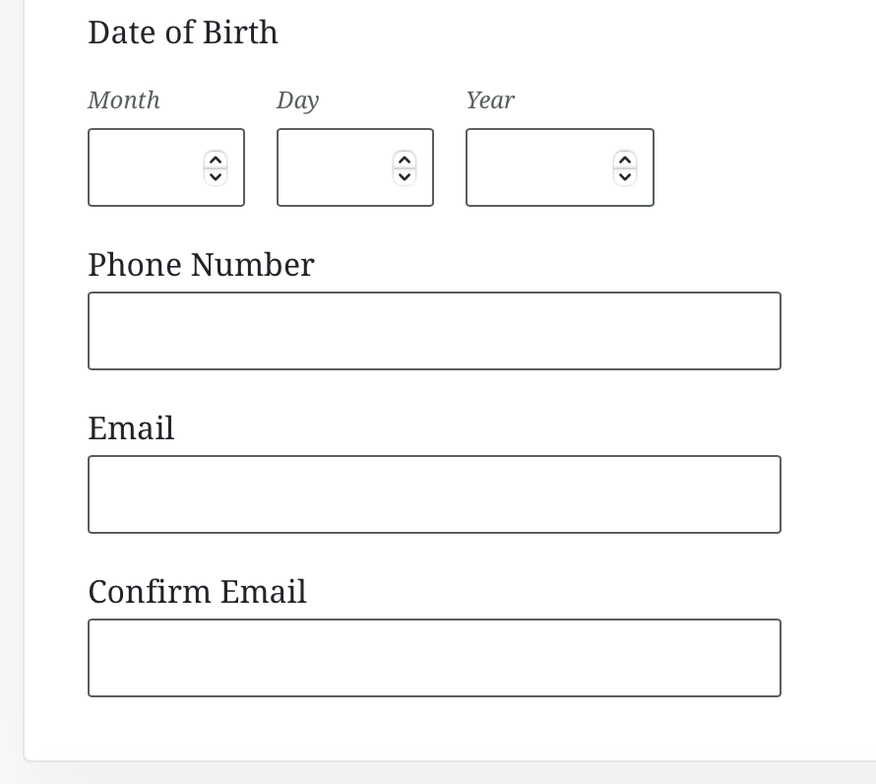
#1 DO YOU NEED TO FILE ANYTHING?

Slide 26
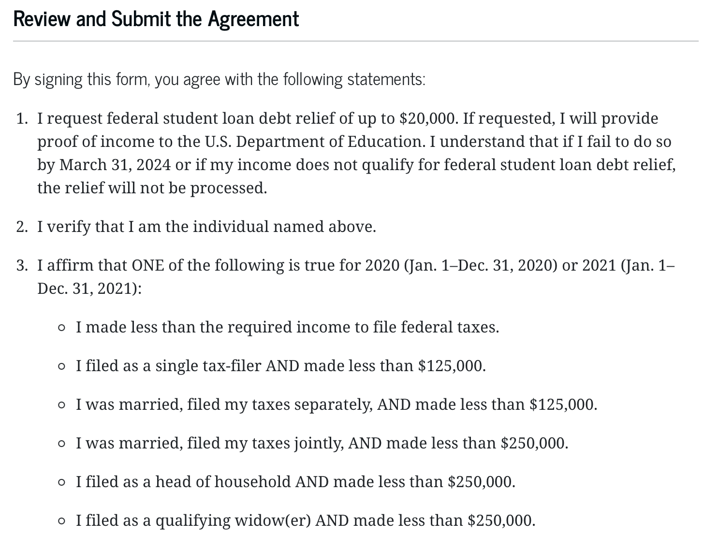
#1 DO YOU NEED TO FILE ANYTHING?

Slide 27
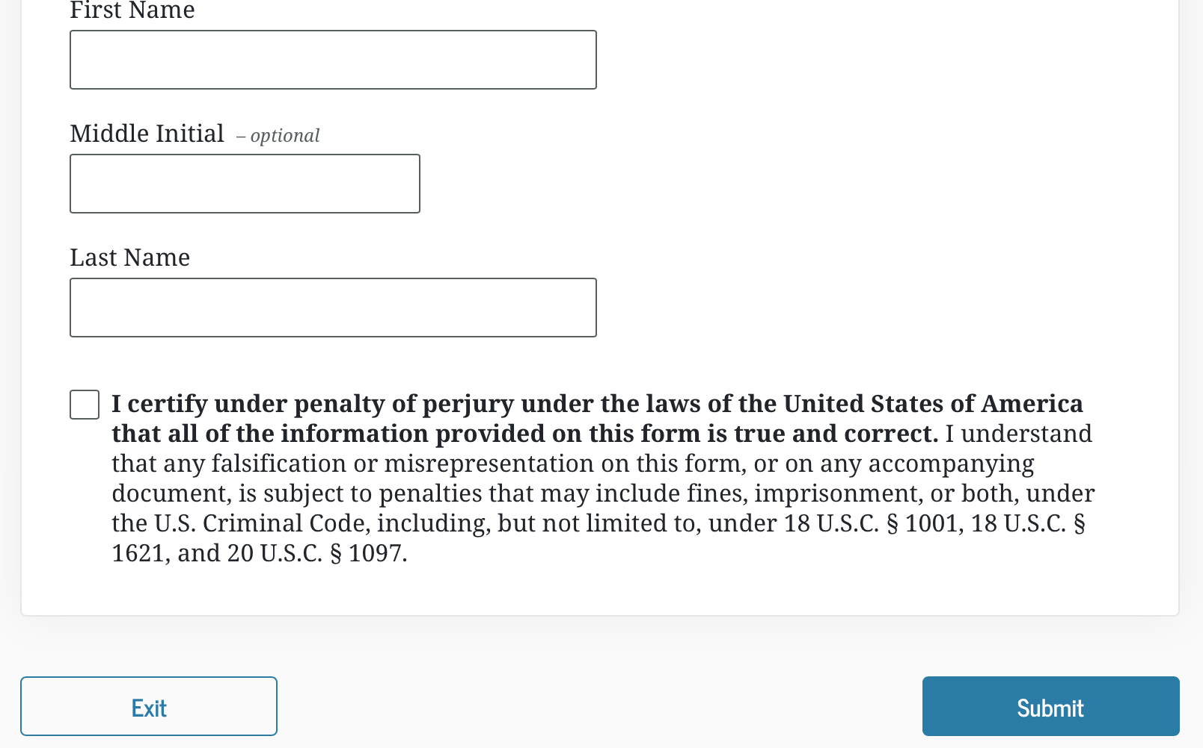
#1 DO YOU NEED TO FILE ANYTHING?

Slide 28
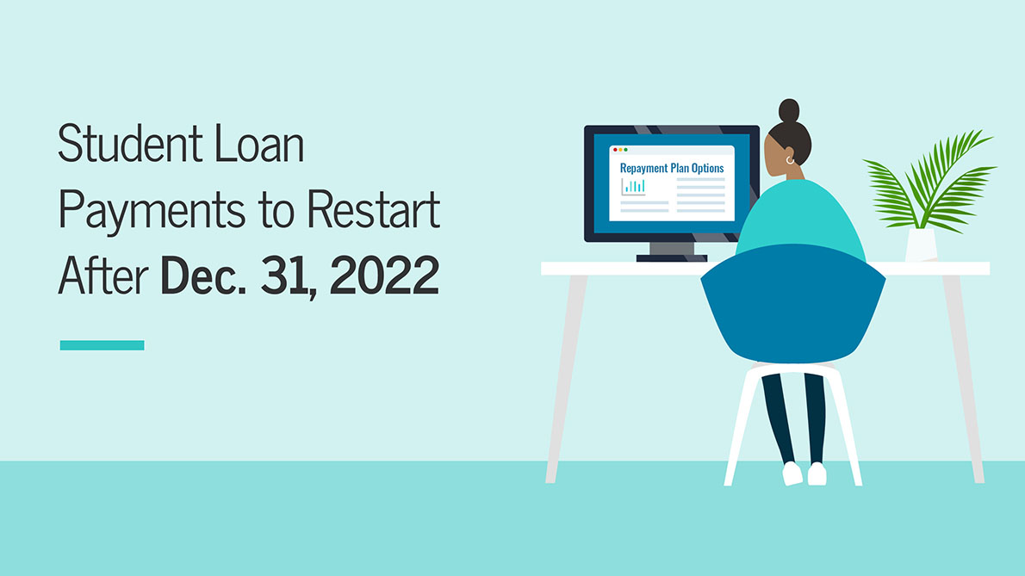
#2 DEFERRAL ENDS DECEMBER 31ST, 2022

Slide 29
#2 DEFERRAL ENDS DECEMBER 31ST, 2022
Since March 2020…
You have not had to make payments on your federal outstanding debt.
Interest has not been accruing on your outstanding federal debt.
ALL THAT ENDS ON DECEMBER 31, 2022* * Maybe…depending on your loan and status as a student. * If your status normally affords you interest and payment deferral, then nothing changes – you are still eligible for deferral.

Slide 30
#2 DEFERRAL ENDS DECEMBER 31ST, 2022
Since March 2020…
You have not had to make payments on your debt.
Interest has not been accruing on your debt.
ALL THAT ENDS ON DECEMBER 31, 2022
SO, WHAT SHOULD YOU DO:
Check with your servicer to know if you will have payments due in January, 2023
Check with your servicer to know if interest will begin accruing in January, 2023
Make a plan to begin making payments when you have to and when you are able to do so

Slide 31
#2 DEFERRAL ENDS DECEMBER 31ST, 2022
Since March 2020…
You have not had to make payments on your debt.
Interest has not been accruing on your debt.
ALL THAT ENDS ON DECEMBER 31, 2022
SO, WHAT SHOULD YOU DO:
CLAIM YOUR LOAN FORGIVENESS AS SOON AS POSSIBLE SO THAT YOUR OUTSTANDING BALANCE IS $10,000 OR $20,000 LOWER WHEN INTEREST BEGINS ACCRUING AGAIN
Try to obtain your loan forgiveness by December 31, 2022 to give yourself the maximum benefit.

Slide 32
#2 DEFERRAL ENDS DECEMBER 31ST, 2022
Assume your balance is $30,000 and your interest rate is 6% per year.
You will accrue $1,800 in the first year
You will accrue $1,909 in the second year
Your balance may be as high as $40,202 after 5 years (with no payments made)
Assume your balance is $20,000 and your interest rate is 6% per year.
You will accrue $1,200 in the first year
You will accrue $1,272 in the second year
Your balance may be as high as $26,765 after 5 years (with no payments made)
That’s $3,437 LESS interest accrued over 5 years, simply by claiming the $10,000 forgiveness.

Slide 33
#3 PUBLIC SERVICE LOAN FORGIVENESS
Borrowers who are employed by non-profits, the military, or federal, state, Tribal, or local government may be eligible to have all of their student loans forgiven through the Public Service Loan Forgiveness (PSLF) program.
If you work in public service for 10 years and make payments for 10 years, you are eligible to have your loan balance completely forgiven after 10 years.
As this is the most generous repayment plan the Department of Education offers, it has had very strict requirements regarding loan payments and employment.
YOU MAY HAVE THE OPPORTUNITY TO EARN BACK-CREDIT AND GET IN PSFL.

Slide 34
#3 PUBLIC SERVICE LOAN FORGIVENESS
Borrowers who are employed by non-profits, the military, or federal, state, Tribal, or local government may be eligible to have all of their student loans forgiven through the Public Service Loan Forgiveness (PSLF) program.
For the past year, the DoE has offered some temporary changes that provide greater provide flexibility – to confirm your employment or to receive credit for past periods of repayment that would otherwise not qualify for PSLF.
These temporary changes expire October 31, 2022.
Enrollments on or after November 1, 2022 will not be eligible for this treatment.
Contact previous employers and get your paperwork completed immediately.
For more information on eligibility and requirements, go to PSLF.gov.

Slide 35
#4 INCOME DRIVEN REPAYMENT
Income Driven Repayment (IDR) itself is not new.
IDR allows borrowers to repay federal student loan debt based on what their income is, ostensibly to allow students who go into lower-paying careers more flexibility in how they repay their student loans.
Instead of making monthly payments based on some set formula – like a car loan or a mortgage – the monthly payment amounts are based on borrower annual income.
You still owe the entire amount, but IDR adjusts both the monthly payments and the loan term, as appropriate.
Public Service Loan Forgiveness is a special kind of IDR. Many people in academia will be in both programs and take advantage of PSLF if they qualify.
The proposed adjustments to Income-Driven Repayment will substantially reduce future monthly payments for lower- and middle-income borrowers.

Slide 36
#4 INCOME DRIVEN REPAYMENT
The proposed adjustments to Income-Driven Repayment will substantially reduce future monthly payments for lower- and middle-income borrowers.
Require borrowers to pay no more than 5% of their discretionary income monthly on undergraduate loans.
This is down from the 10% available under the most recent income-driven repayment plan.
Raise the amount of income that is considered non-discretionary income and therefore is protected from repayment, guaranteeing that no borrower earning under 225% of the federal poverty level will have to make a monthly payment.
Forgive loan balances after 10 years of payments, instead of 20 years, for borrowers with loan balances of $12,000 or less.
Cover the borrower's unpaid monthly interest, so that unlike other existing income-driven repayment plans, no borrower's loan balance will grow as long as they make their monthly payments—even when that monthly payment is $0 because their income is low.

Slide 37
#4 INCOME DRIVEN REPAYMENT
Why should you consider Income Driven Repayment as an option?
It does give you some flexibility in how much of your debt you repay each month, affording you the ability to choose careers based on reasons unrelated to how much student loan debt you owe.
You can still decide to pay more than what is required, thereby reducing your loan balance and potentially retiring your debt sooner.
If you make on-time payments for 20 years through IDR, your entire remaining balance of UNDERGRADUATE debt may be completely forgiven. If you make on-time payments for 25 years through IDR, your entire remaining balance of GRADUATE debt may be completely forgiven. (Note: If your loan balance is less than $12,000, the 20 years might be reduced to 10 years.)

Slide 38
#4 INCOME DRIVEN REPAYMENT
The proposed adjustments to Income-Driven Repayment will substantially reduce future monthly payments for lower- and middle-income borrowers.
Require borrowers to pay no more than 5% of their discretionary income monthly on undergraduate loans.
This is down from the 10% available under the most recent income-driven repayment plan.
Raise the amount of income that is considered non-discretionary income and therefore is protected from repayment, guaranteeing that no borrower earning under 225% of the federal poverty level will have to make a monthly payment.
Forgive loan balances after 10 years of payments, instead of 20 years, for borrowers with loan balances of $12,000 or less.
Cover the borrower's unpaid monthly interest, so that unlike other existing income-driven repayment plans, no borrower's loan balance will grow as long as they make their monthly payments—even when that monthly payment is $0 because their income is low.
These proposed changes to Income-Driven Repayment is different from the Public Service Loan Forgiveness information on the previous slides.
These proposed changes are only for undergraduate loans (no changes for graduate loans).
These proposed changes are designed to encourage more borrowers to pursue Income-Driven Repayment…because more people will benefit from IDR.
You may not need to do anything now…beyond considering whether you should use IDR when it is time to repay your student loans.

Slide 39
KEY DATES for LOAN FORGIVENESS
The application for loan forgiveness is now available at studentaid.gov
4-6 WEEKS AFTER YOU APPLY – The debt forgiveness should be processed and applied (subject to court orders and other potential challenges)
Nothing like this has ever been done. And there are many stakeholders involved in the process. Do not be surprised if it takes more than 4-6 weeks.
DECEMBER 31, 2023 – The window to apply for forgiveness is expected to close.
Apply for your loan forgiveness as soon as possible so that you are in the queue – and hope that it will be processed in due time.
Some people have already received their loan forgiveness, prior to the court order. We do not know what will happen to these amounts…but the DoE wants to give as much relief to as many people as soon as possible. Do what you can to become one of these people.

Slide 40
KEY DATES for OTHER CHANGES
OCTOBER 31, 2022 – PUBLIC SERVICE LOAN FORGIVENESS The window for enhanced enrollment or re-enrollment into PSLF closes.
DECEMBER 31, 2022 – The student loan pause ends.
JANUARY 1, 2023 – Any outstanding student loan debt may begin accruing interest…get your forgiveness before the end of 2022.
Apply by November 15 to have your outstanding balance reduced before December 31.
Continue checking studentaid.gov and the Department of Education (education.gov) in case there are additional challenges, pauses or modifications to the information presented here.

Slide 41
WHAT YOU CAN DO NOW
Apply for loan forgiveness: https://studentaid.gov/debt-relief/application
Sign up for updates with the Department of Education:
https://www.ed.gov/subscriptions
Check your FAFSA account to determine your eligibility & loan status
https://studentaid.gov/fsa-id/sign-in/landing
Collect your 2020 and 2021 Tax Returns to confirm income
Contact your servicer to confirm communication preferences and that you know who is your servicer.
This might be a little bit of a scavenger hunt. Start with your university and with studentaid.gov and go from there.
Begin thinking about what you need to do in January 2023.

Slide 42
WATCH OUT FOR SCAMS
Nobody should call you to gather any personal information
If anyone does, hang up or ignore them and look for necessary information or process on your own.
You should not have to pay any fees for the application or for processing or for collecting.
You might have legitimate outstanding fees related to your debt (e.g. late payments). Verify that they are real. And they should not prevent you from obtaining any loan forgiveness you are eligible for.
Nobody can get you to the front of the line. Be patient.

Slide 43
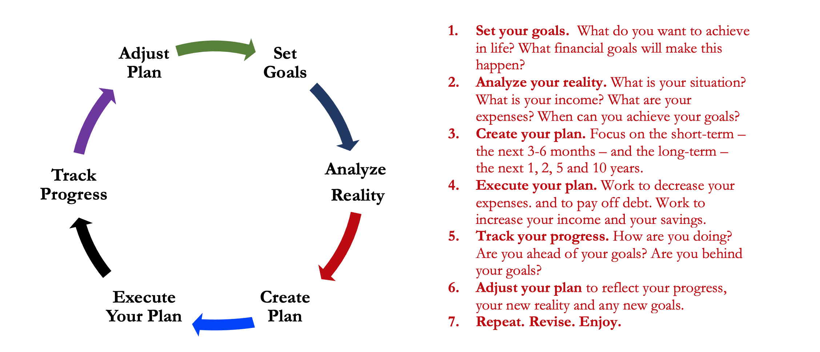
Financial Planning should be a lot like Education Planning…
Use this opportunity for debt forgiveness or restructuring to better let your financial situation work for your future rather than work against your future.

Slide 44
Happiness
Long-Term Goals
Short-Term Goals
Financial Needs
Family Needs

Slide 45
Don’t wait around for other people to be happy for you.
Any happiness you get,
You’ve got to make yourself.
~ Alice Walker, poet & novelist
A goal without a plan is just a dream.
Wealth is largely the result of habit.
The most difficult thing is the decision to act; the rest is mere tenacity.
It takes as much energy to plan as it does to wish.
You cannot escape the responsibility of tomorrow by avoiding it today.

Slide 46
Brian Bolton Professor of Finance brian.bolton@louisiana.edu http://business.louisiana.edu/financeispersonal

